Slide 1
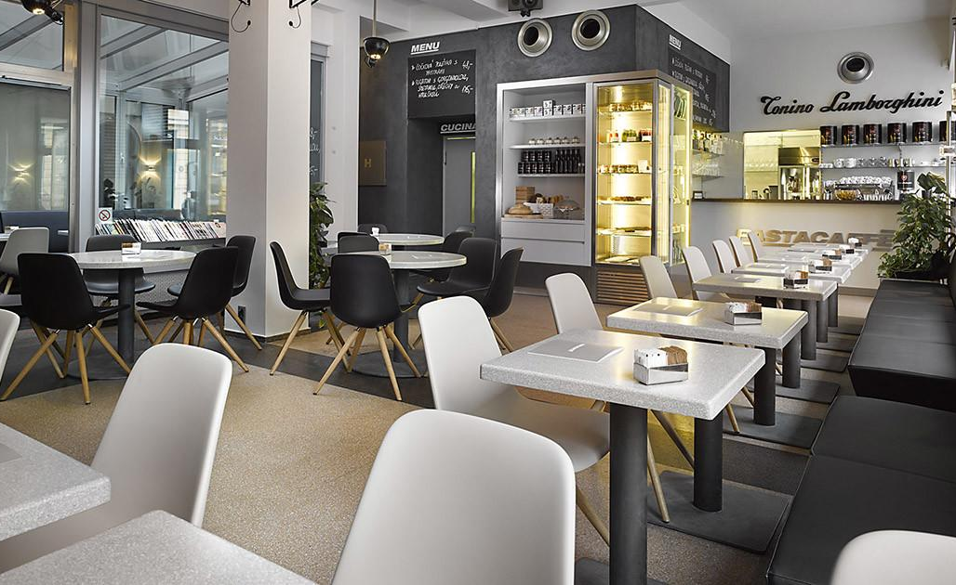
Effective Cleaning by
DESIGN

Slide 2
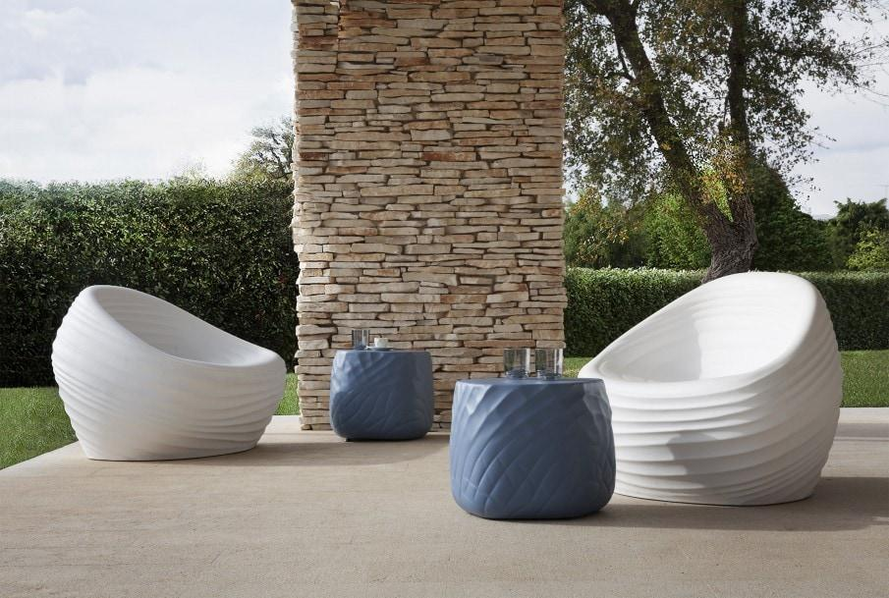
During these challenging times, cleaning and hygiene have become of paramount importance. With this in mind, we are listing here those products from our collections that can be cleaned with most effective disinfectant cleaning solutions like Virex and diluted bleach without the risk of causing damage or deterioration to the furniture.

Slide 3
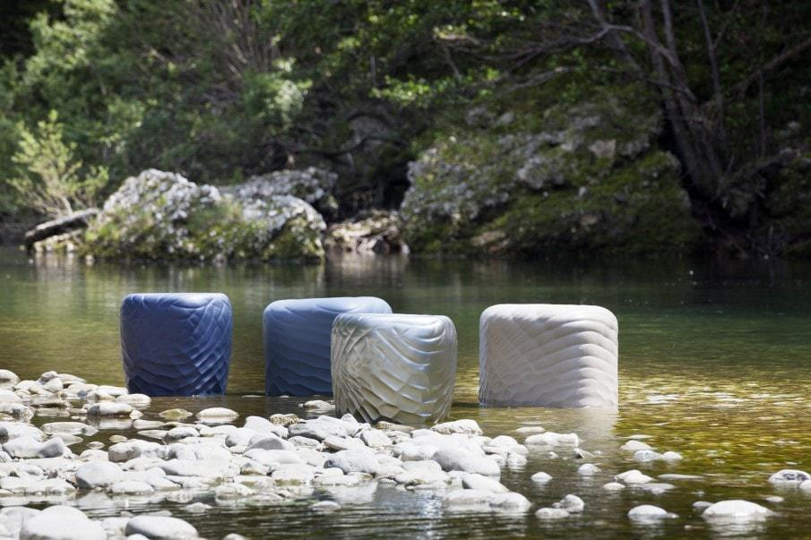
Tonon Soft Touch Collection
Soft Touch is tough, cleanable urethane injected over a steel frame. The integral foam is waterproof, hygienic, PVC free and soft to the touch. The tear-resistant surface is characterized by a high abrasion resistance, an extremely pleasant feel, high elasticity, low thermal conductivity and maximum comfort. Another strength of integral foam is its easy maintenance: the product can be simply cleaned with warm water and mild soap or alternatively with a wide range of disinfectants, the material is CFC free.

Slide 4
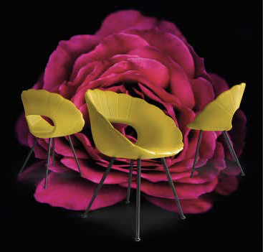
Flower

Slide 5
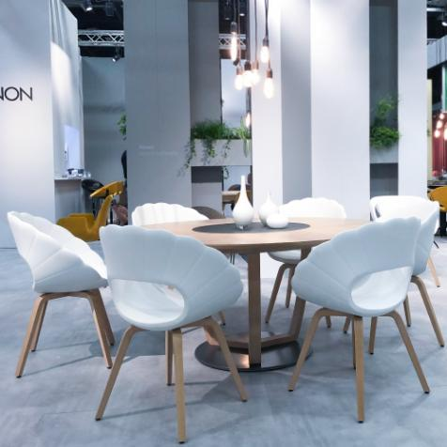
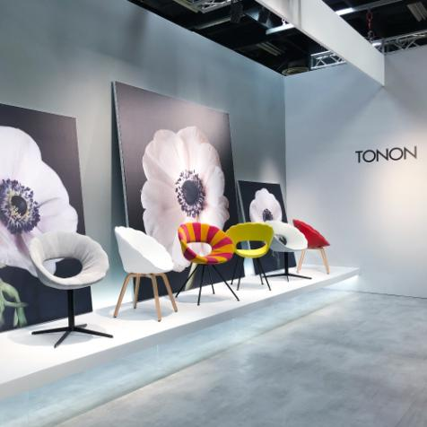

Slide 6
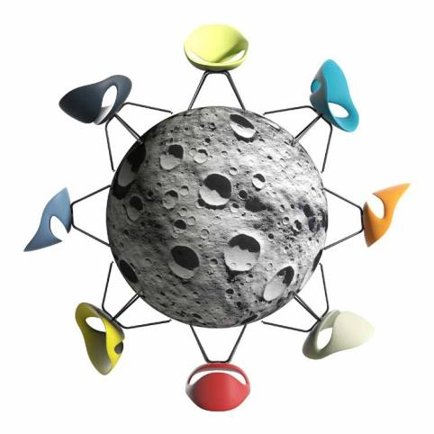
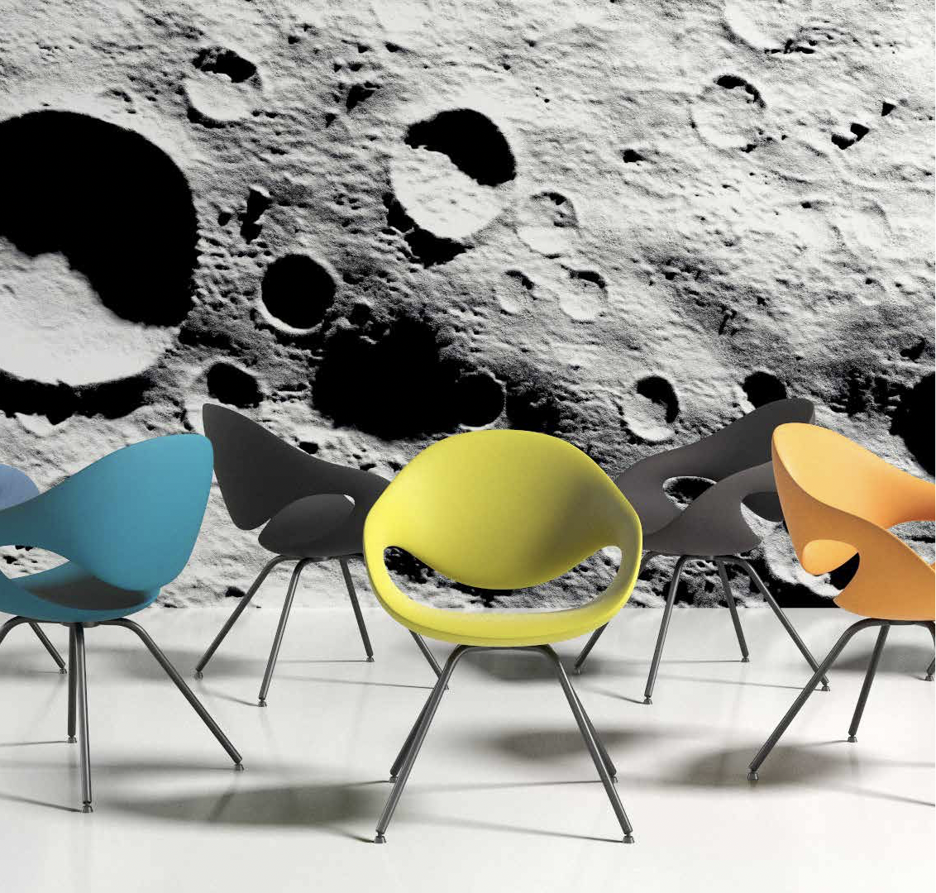
Moon

Slide 7
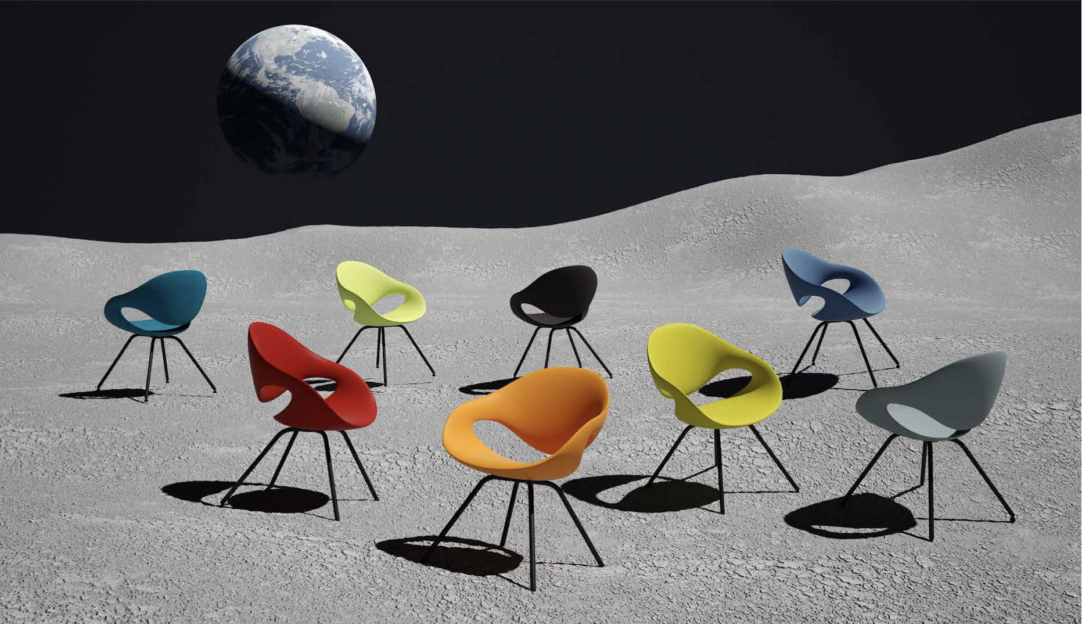

Slide 8
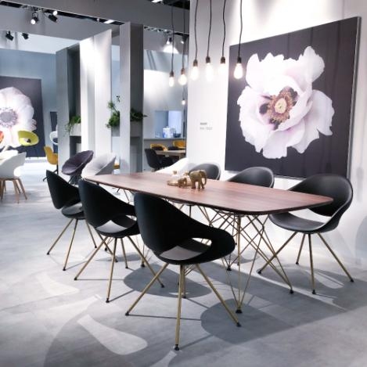
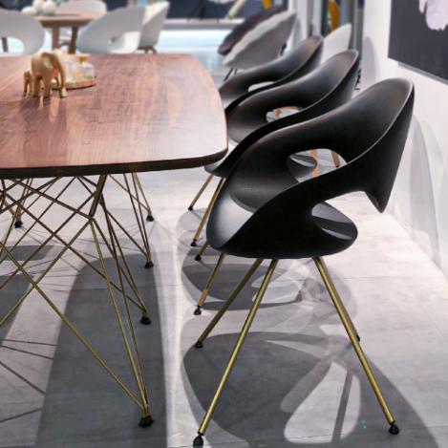

Slide 9
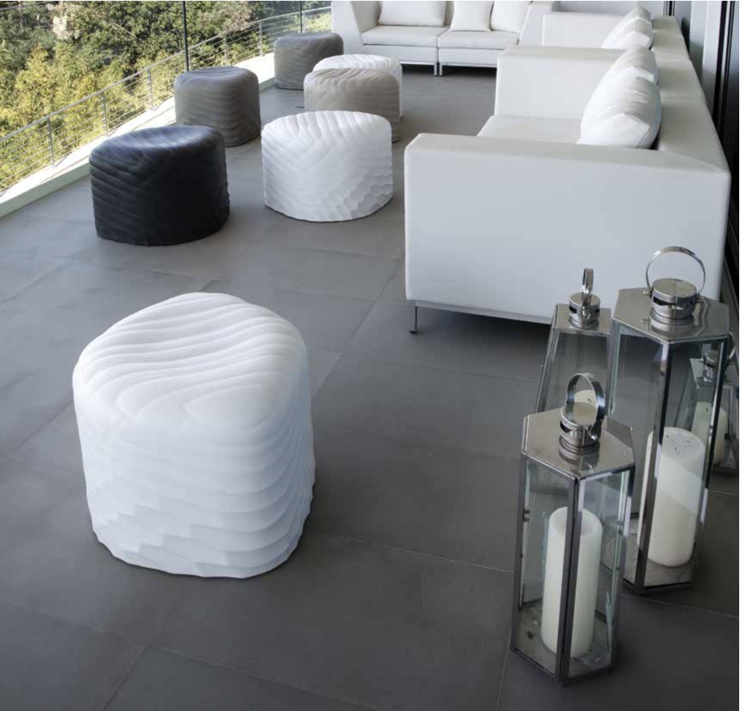
River Stone

Slide 10
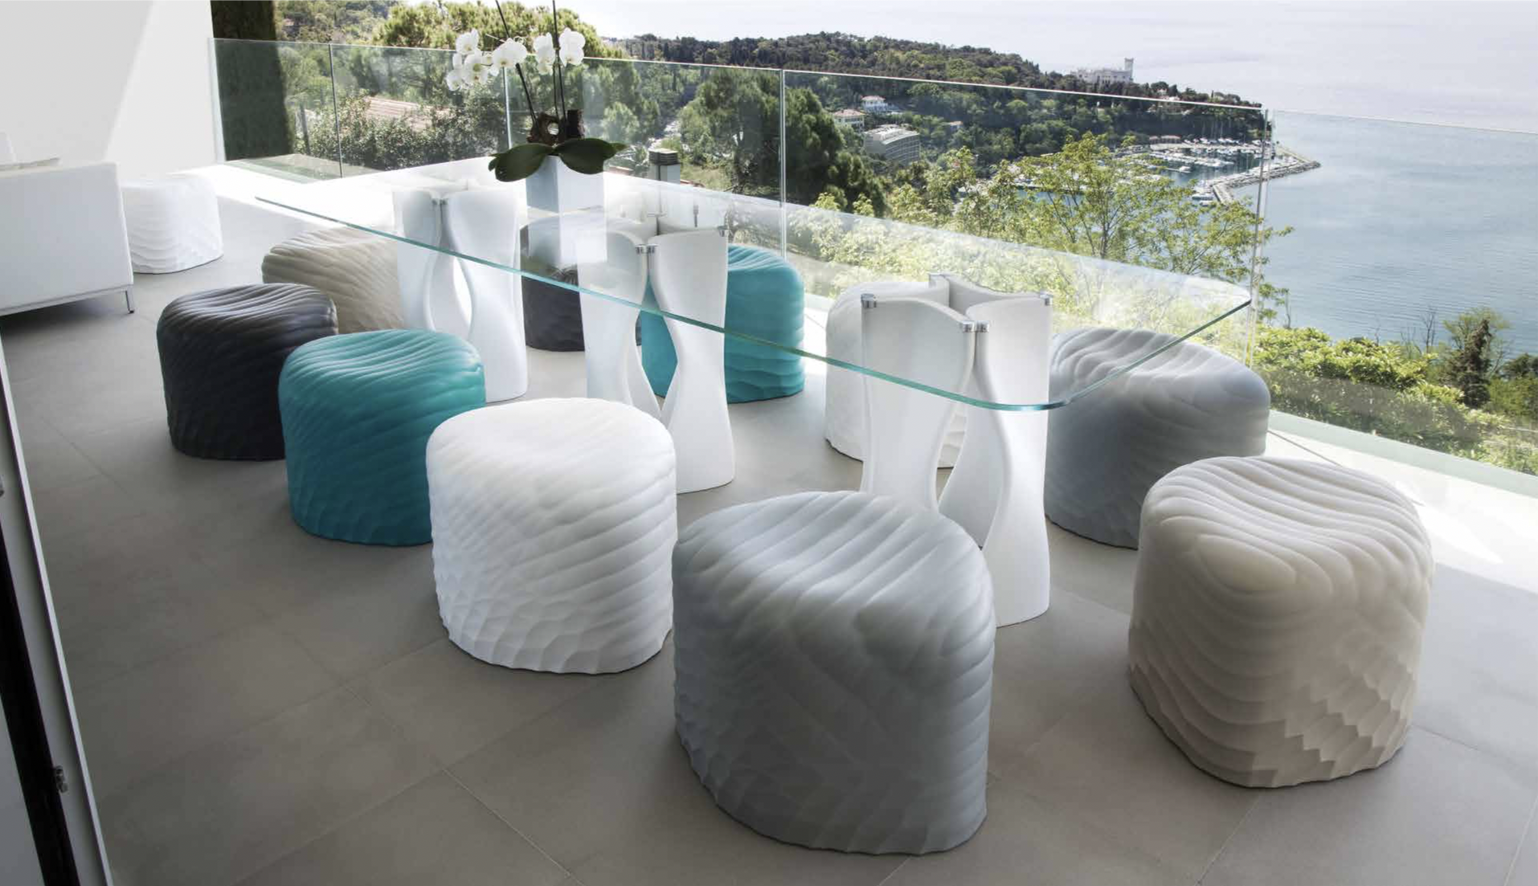

Slide 11
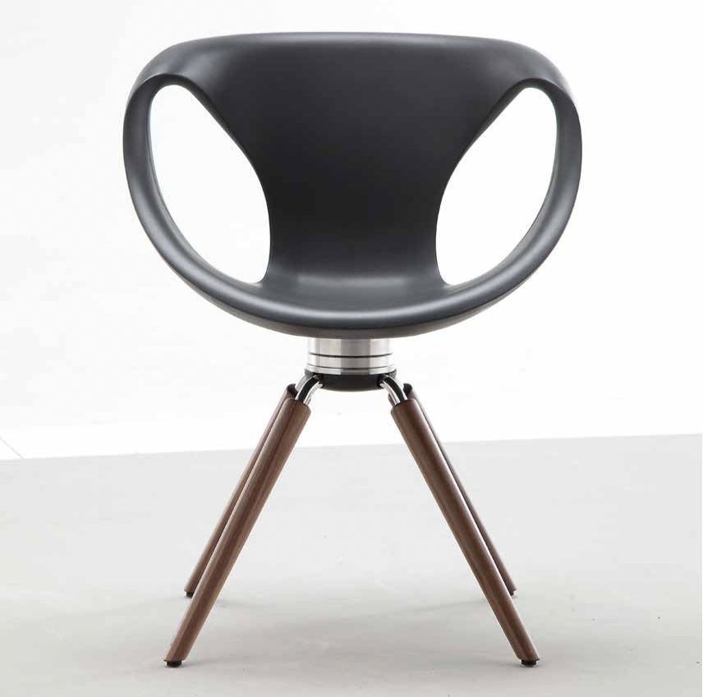
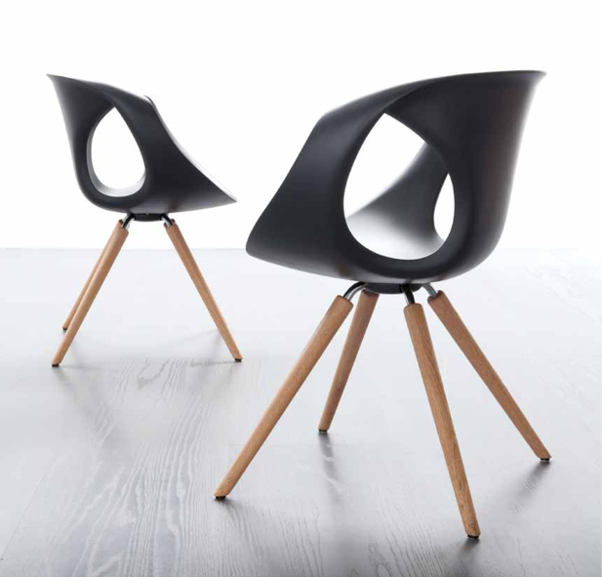
Up Chair

Slide 12
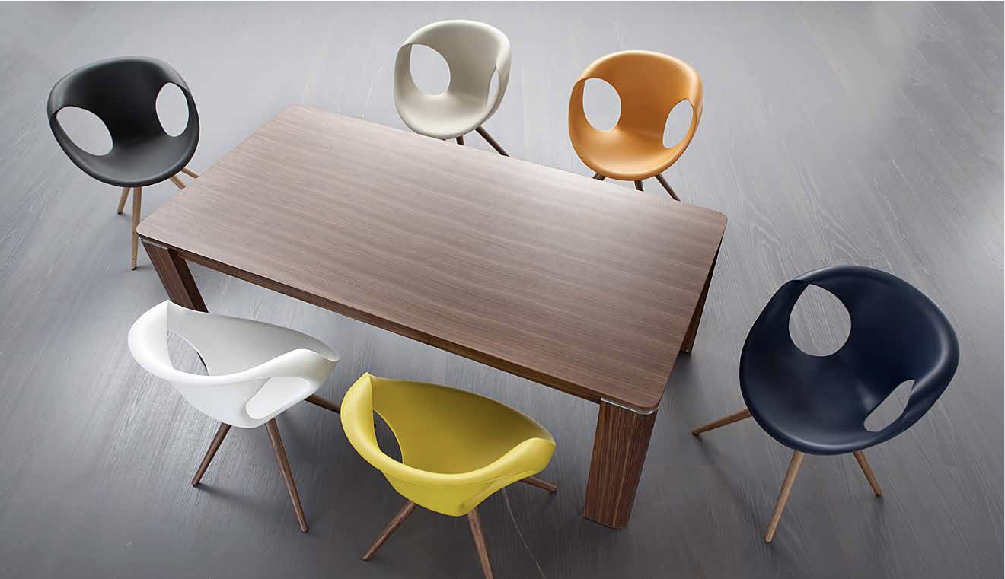

Slide 13
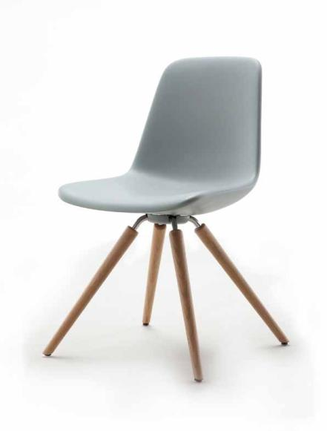
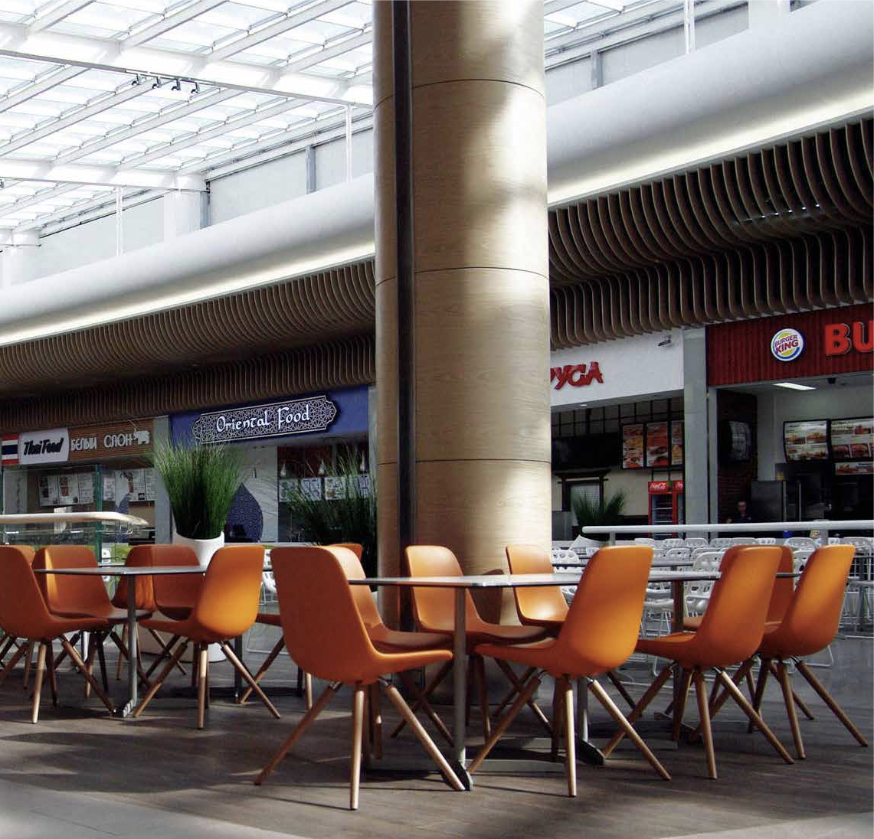
Step

Slide 14
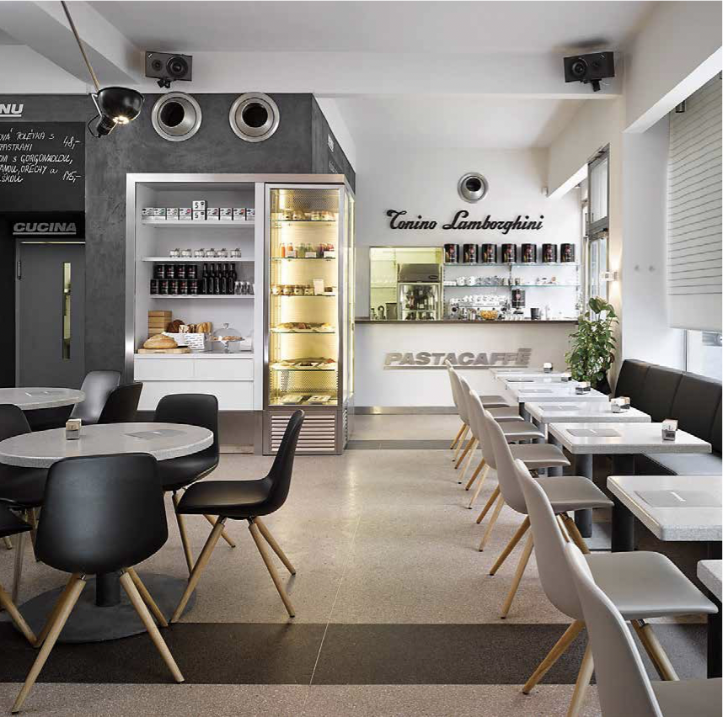
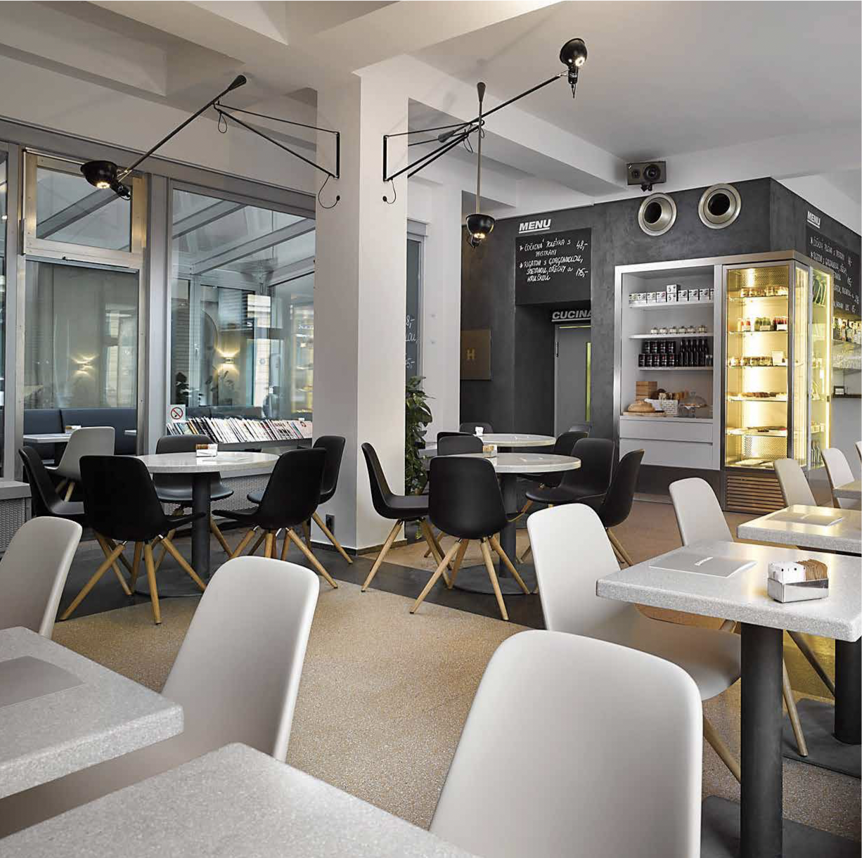

Slide 15
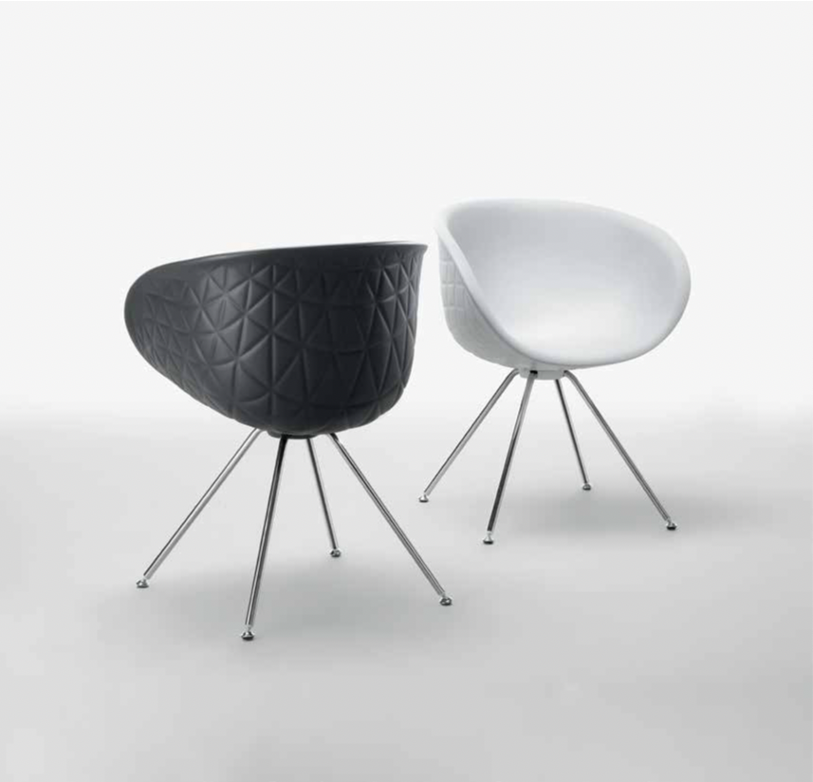
Structure

Slide 16
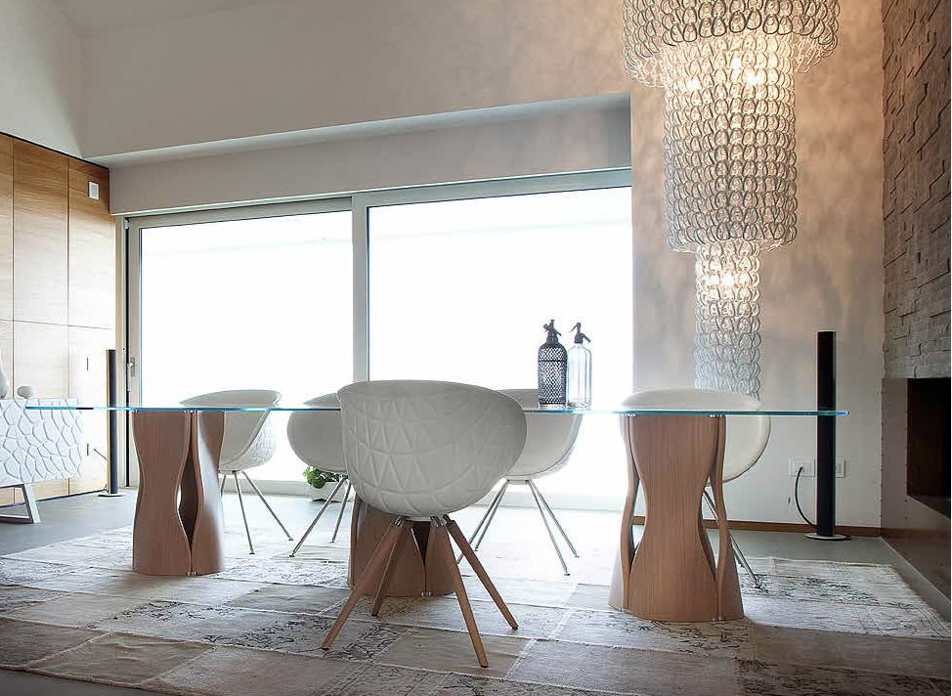

Slide 17
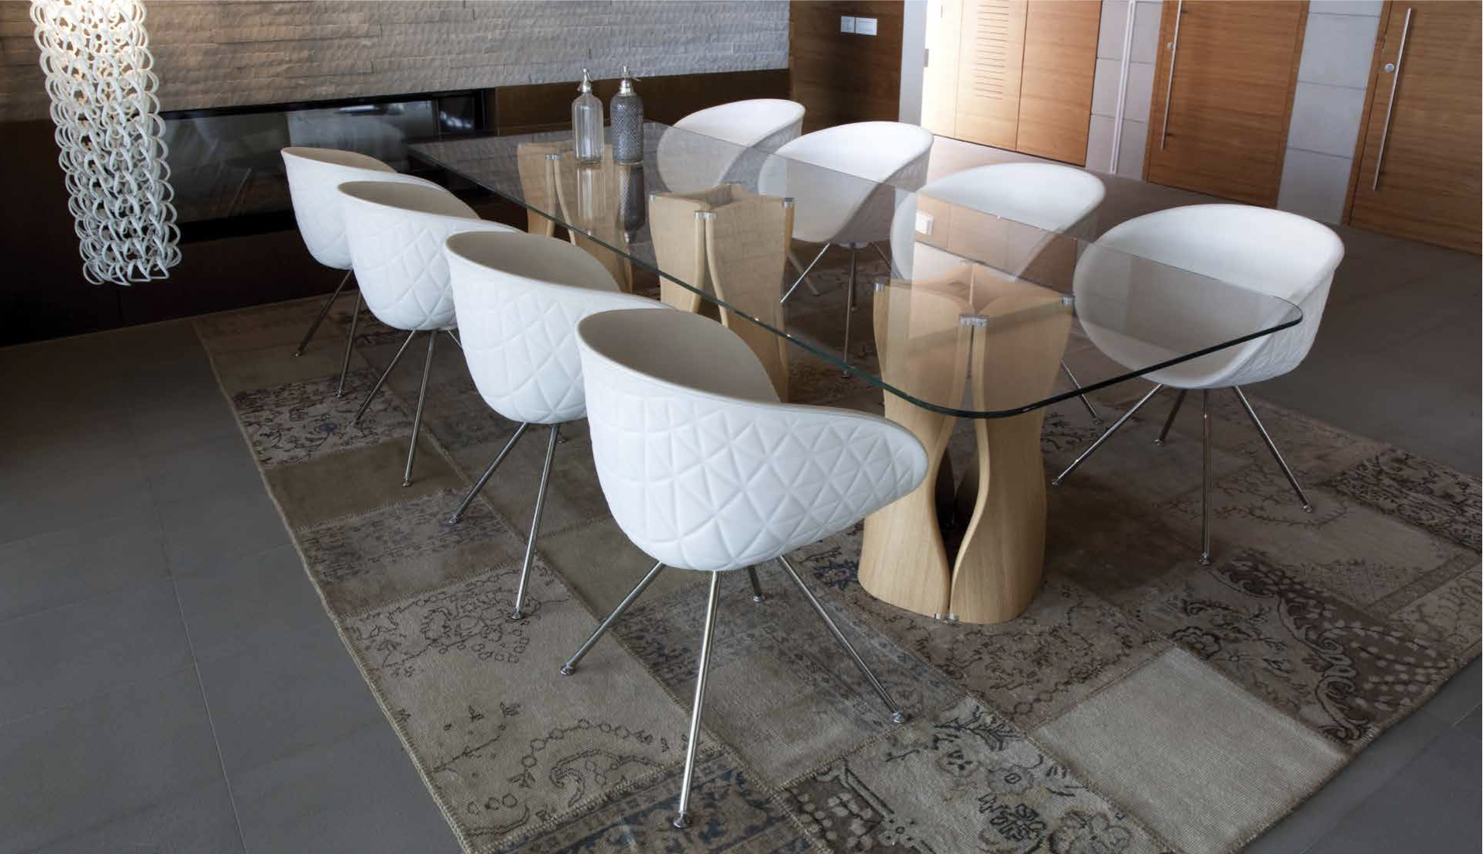

Slide 18
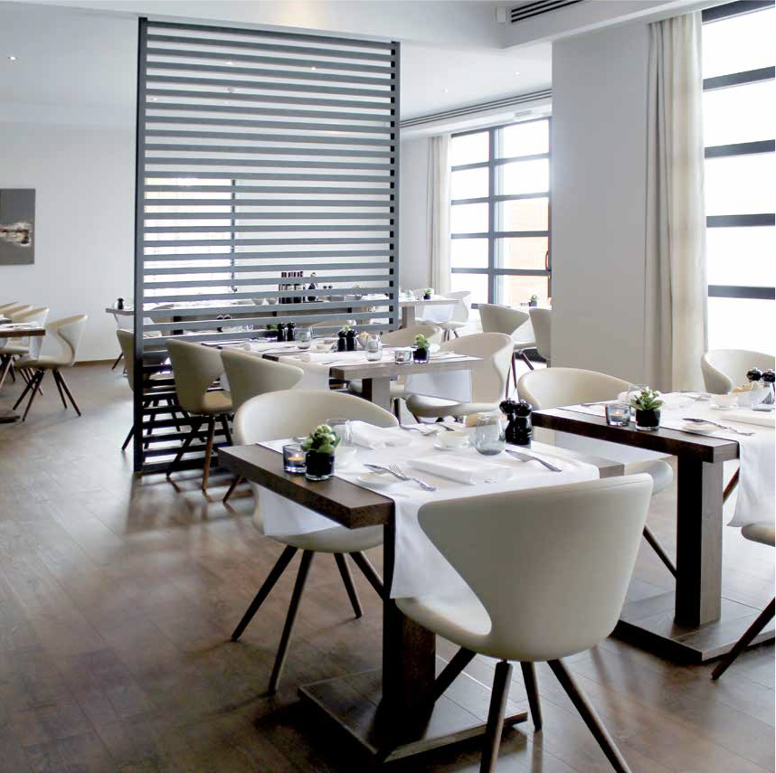
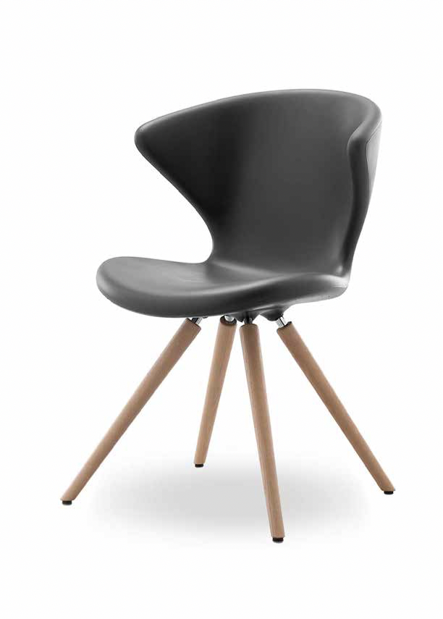
Concept

Slide 19
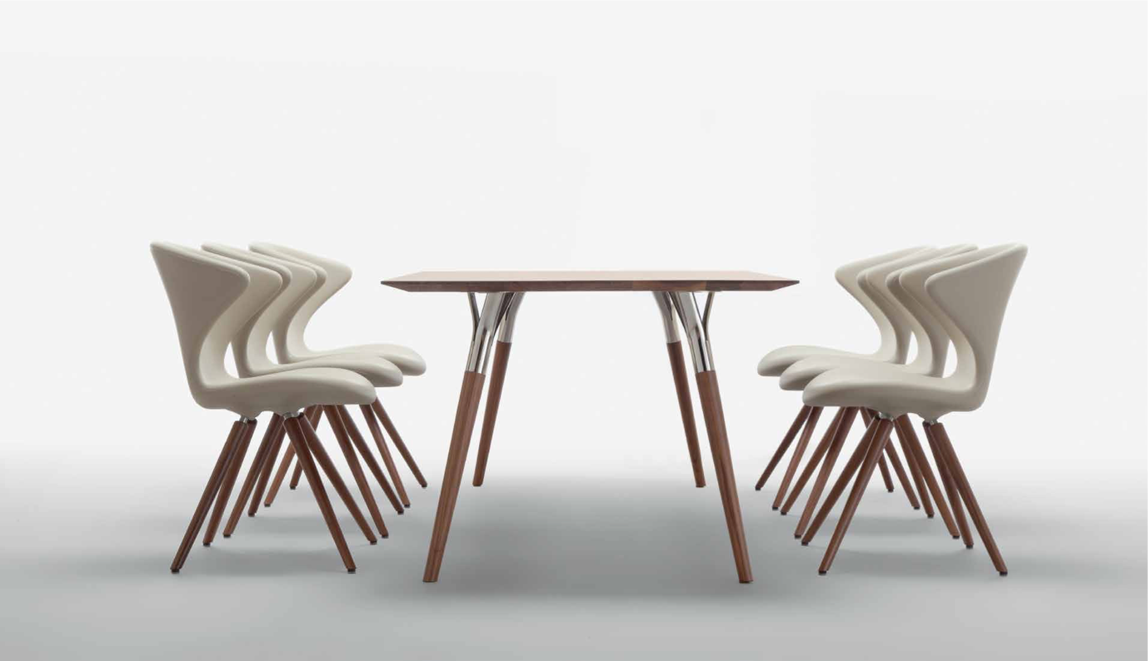

Slide 20
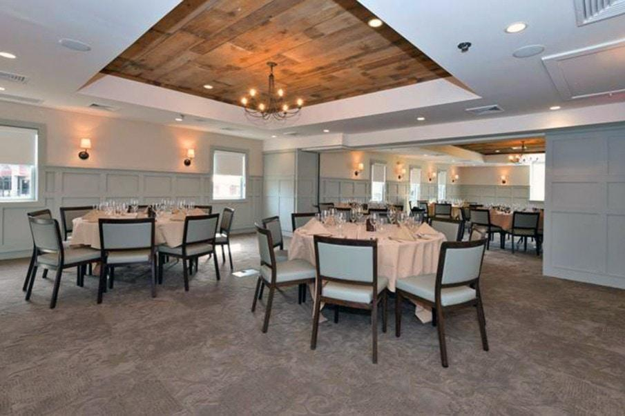
Woodlook Collection
Woodlook® is an established concept in seating designed to withstand the most punishing environments without compromising design. Our furniture is built from sturdy aluminum while maintaining an authentic wood appearance. The unique Woodlook® process offers unparalleled durability yet is lightweight, scratch resistant, competitively priced and can be customized to meet bespoke designs. The Woodlook® range is ideal for all high traffic situations including restaurants, hotels, casinos, cruise ships, healthcare, and education.

Slide 21
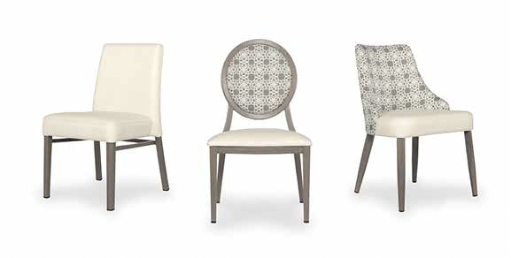
STRENGTH TESTED The Woodlook® collection not only meets the BIFMA standards for US seating, but far surpass them with an incredible weight capacity of 400 LBS
15 YEAR WARRANTY Woodlook frames can endure the toughest of environments and are guaranteed for 15 years.
Certifications on file. Please contact your local Sandler rep for a copy.

Slide 22
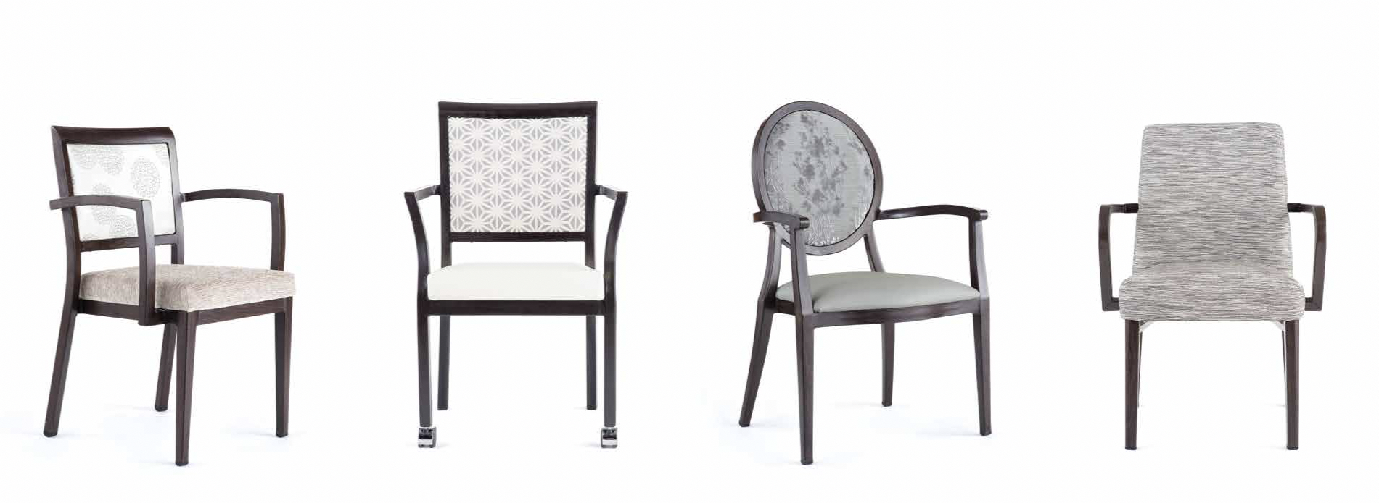

Slide 23
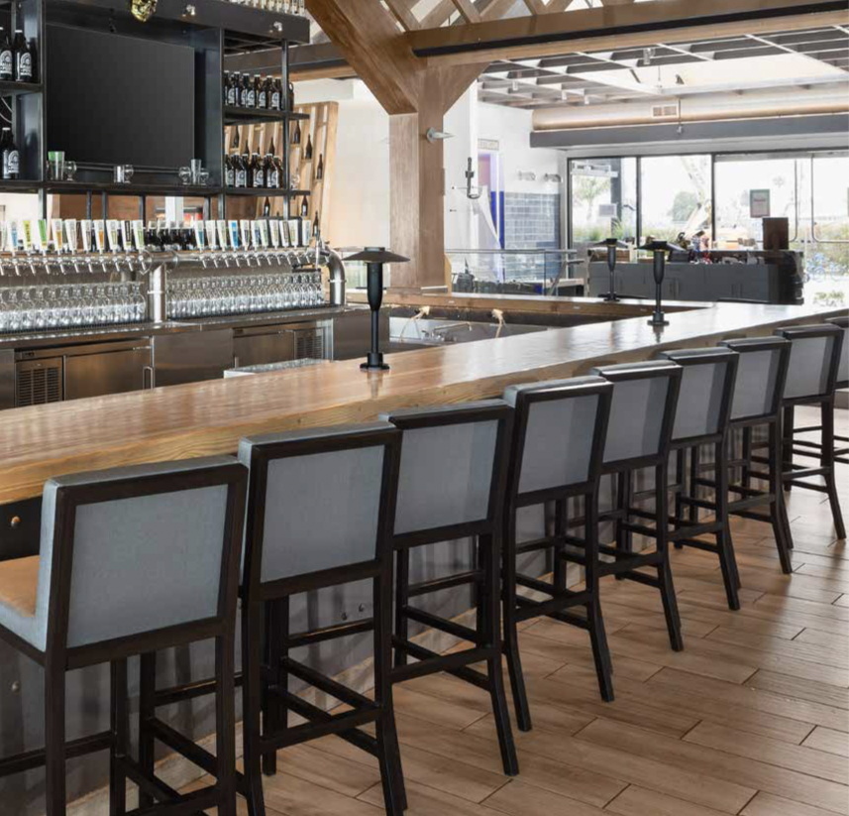

Slide 24
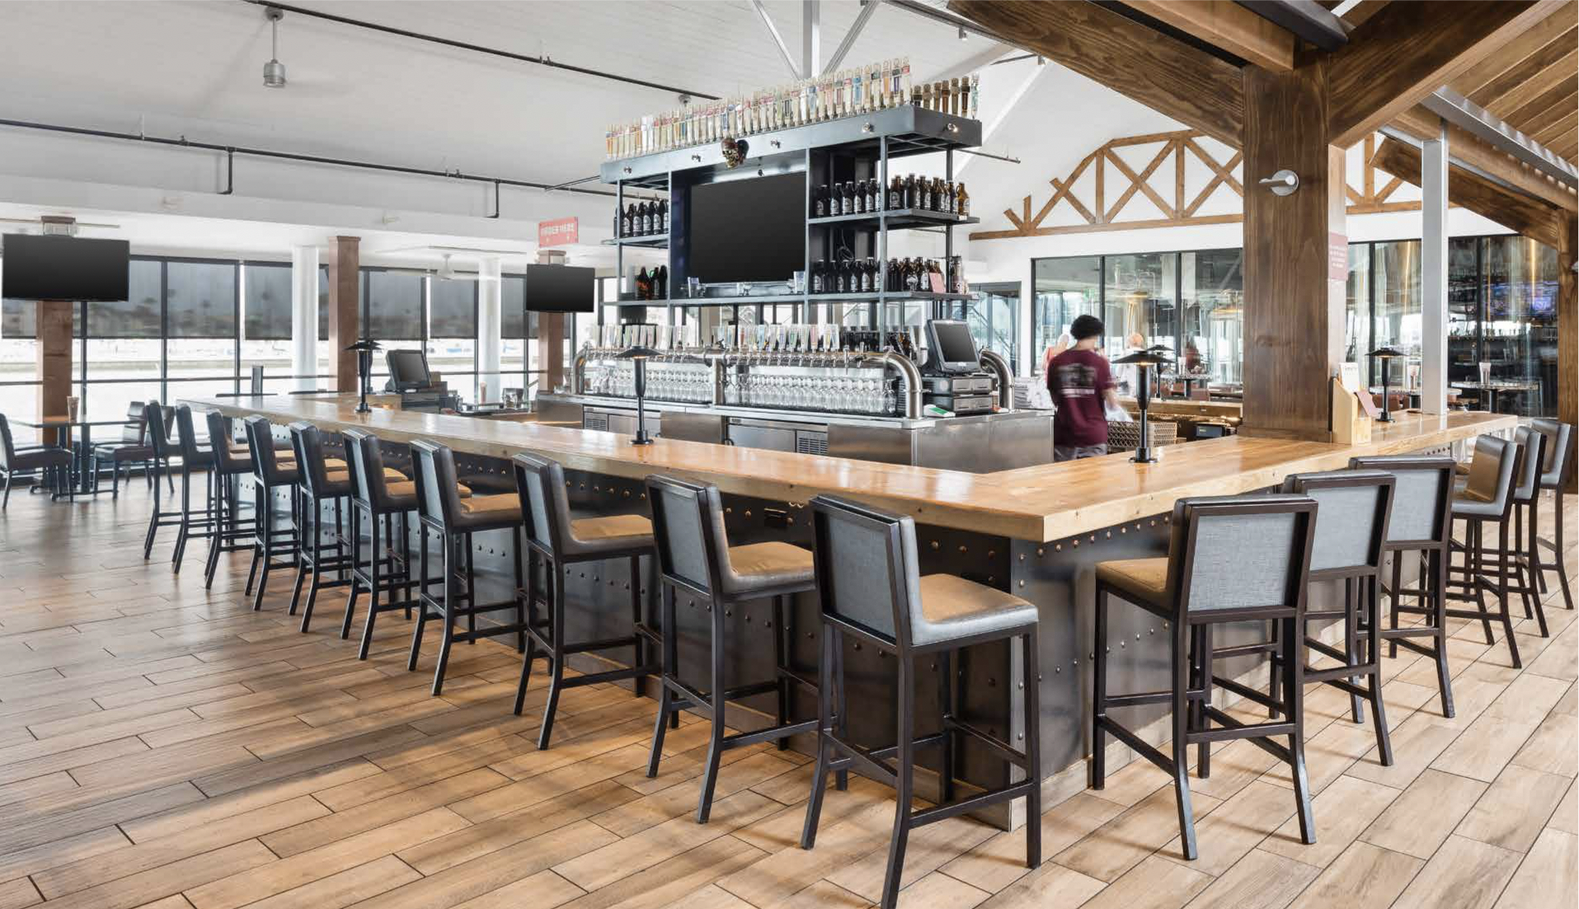

Slide 25
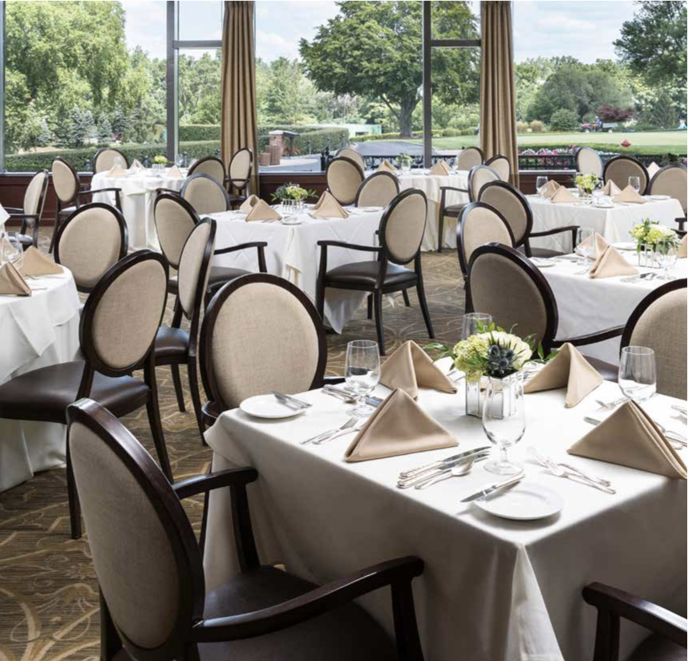
Woodlook 1.8 / 2.8 / 2.8C

Slide 26
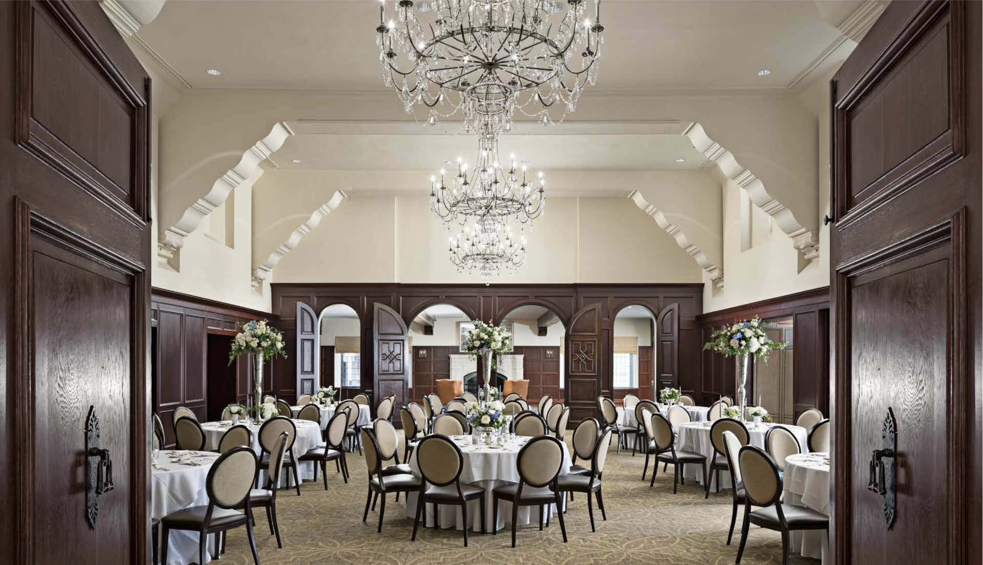

Slide 27
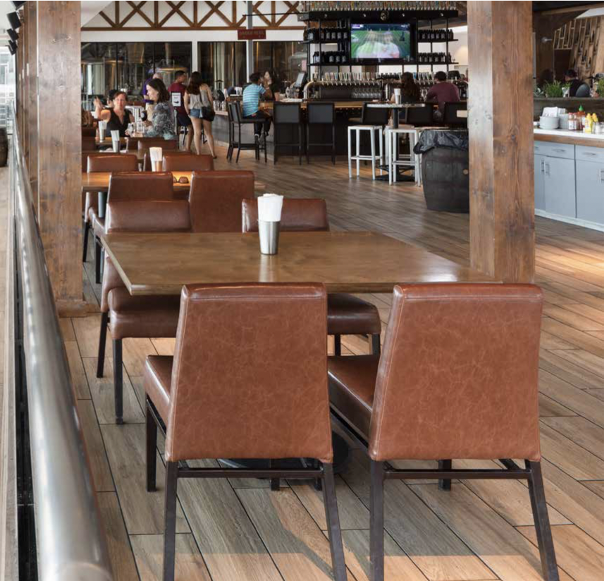
Woodlook 1.9

Slide 28
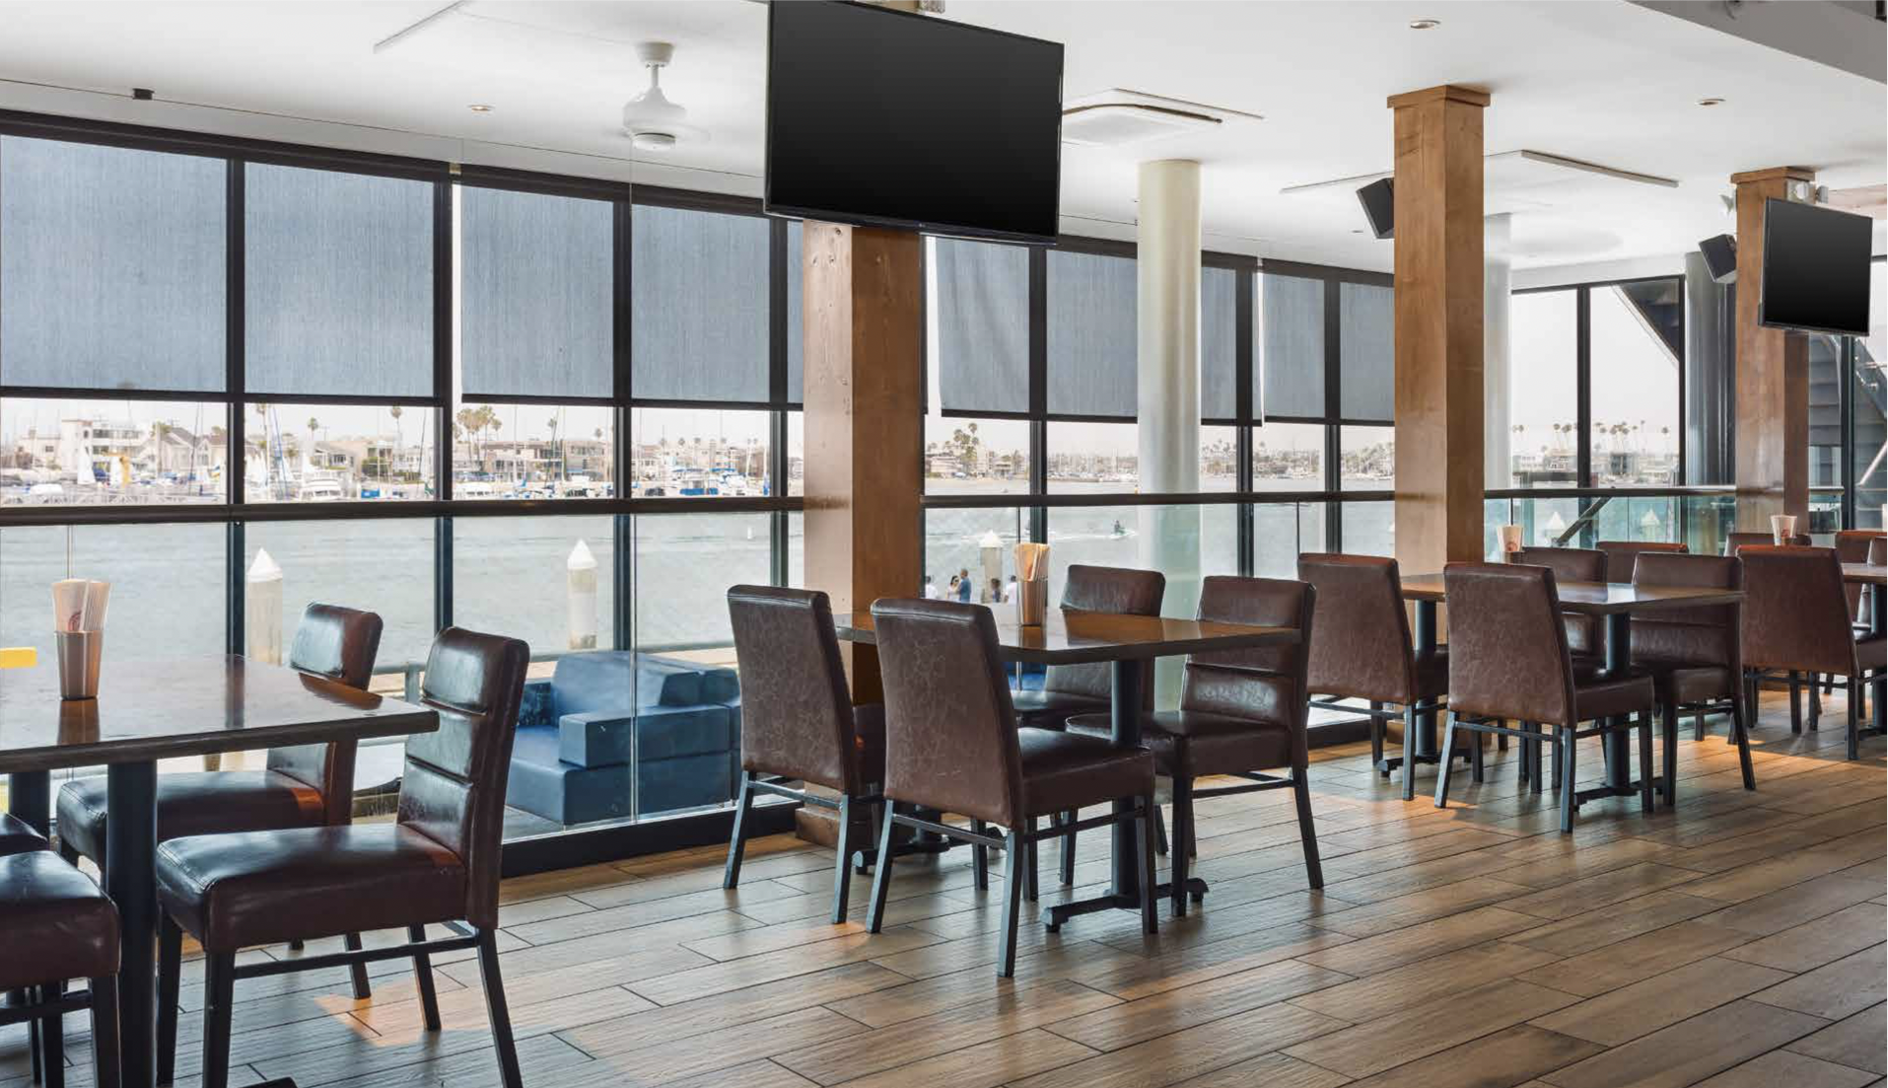

Slide 29
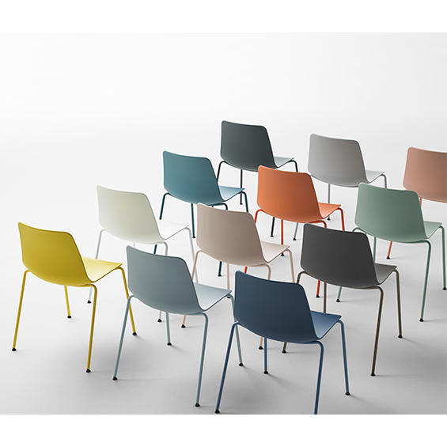
Polypropylene Collections
We have many family collections that are made from polypropylene. Polypropylene is an easy to clean and durable product that has an array of colors to choose from. Our offering includes, but is not limited to: Varya, Unnia, Cuba, Ibis, and Echo. Most of these families come with the option for side chair, arm chair, barstool and counter stool options.
For more of a complete list of our polypropylene families, please contact your local Sandler Rep.

Slide 30
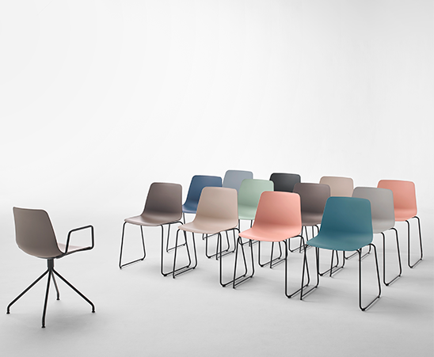
Varya Family

Slide 31
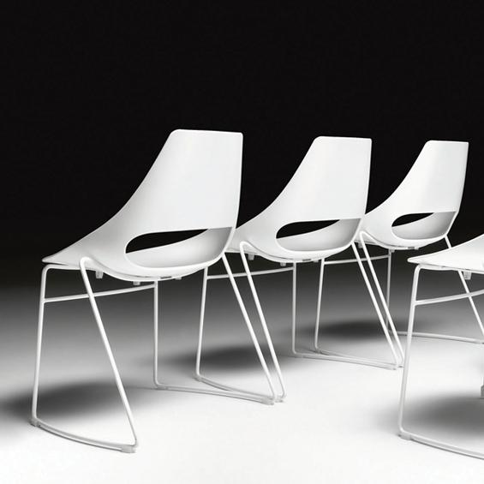
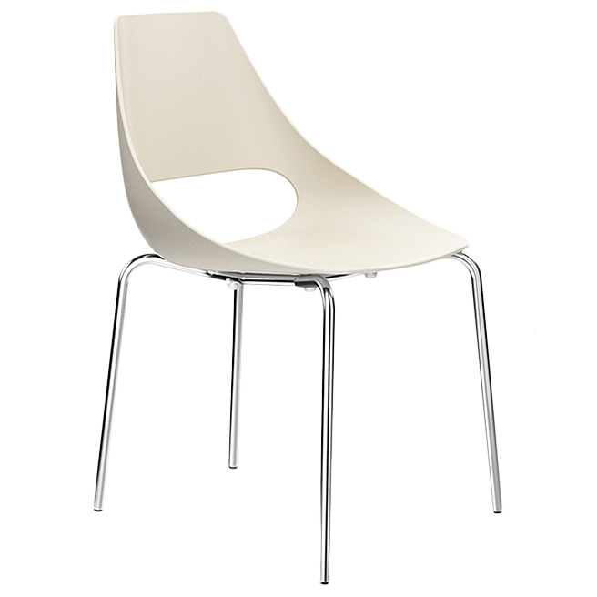
Echo Family

Slide 32
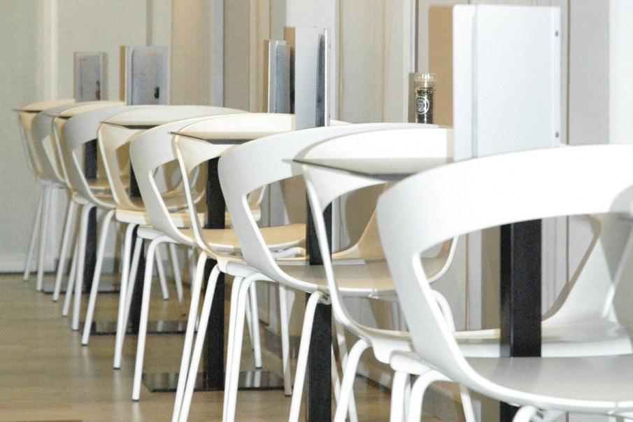
Ibis Family

Slide 33
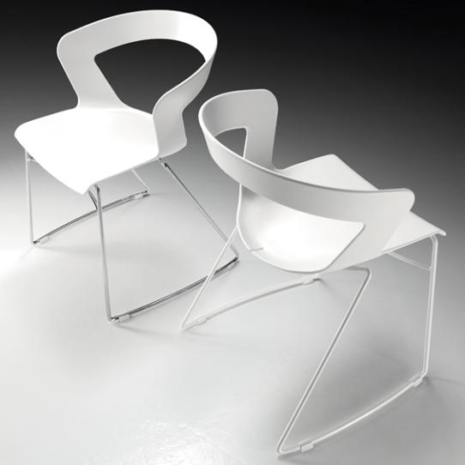
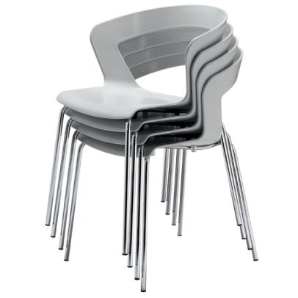

Slide 34
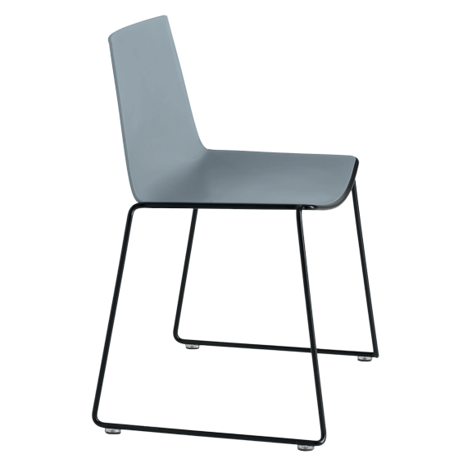
Cuba Family

Slide 35
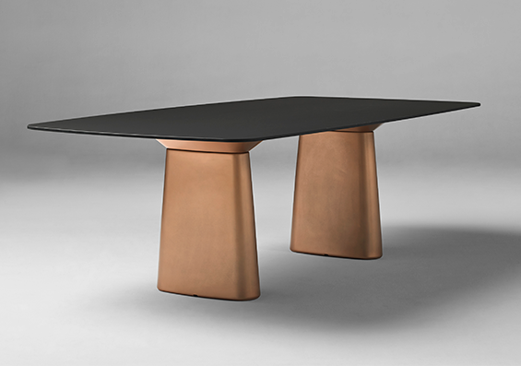
Table Tops: Fenix

Slide 36
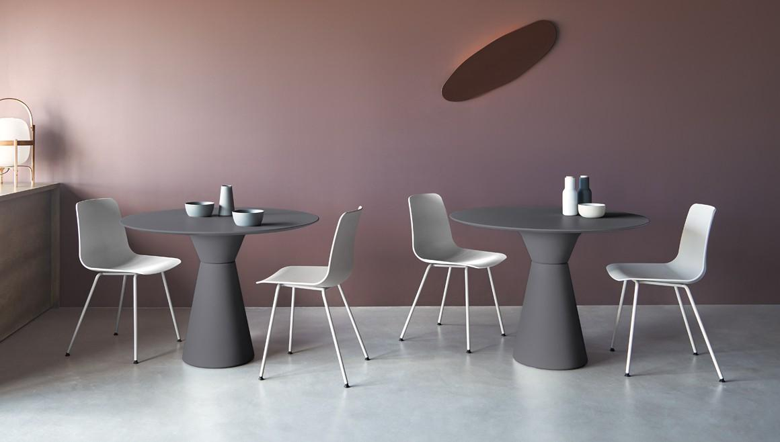
Table Tops: Fenix NTM
Fenix NTM - NTM stands for NanoTech Matte, and has many properties that make the surface an ideal surface for easy cleaning.
These include:
- Anti-Bacterial
- Mold-Resistant
- NSF Certified & meets Greenguard IAQ Standards for Chemical Emission Limits
- Highly Resistant to Moisture
- Light Scratches can be fixed with Thermal Repair

Slide 37
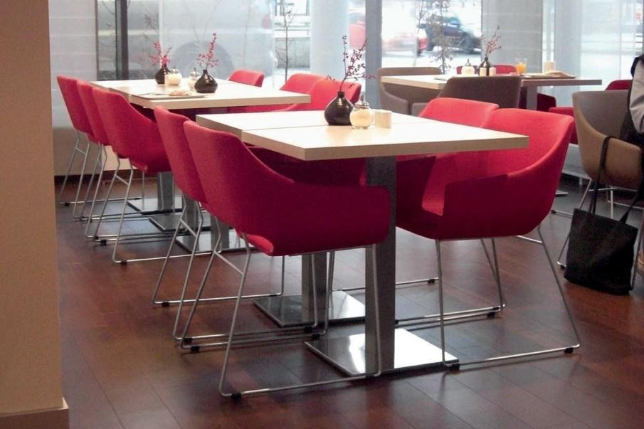
Table Tops: Linoleum
Linoleum has been in production for many years, and the superiority of the product provides an excellent surface for table tops. Made of Linseed Oil, Linoleum has many beneficial properties for sterile and clean environments.
The advantages include:
- Natural Anti-Bacterial Properties
- Very Durable
- All-Natural and Biodegradable
- Made with Renewable Materials
- Does not emit harmful VOCs

Slide 38
Healthier Hospitals Initiative/Health Care Without Harm has worked with Sandler to develop a list* of our products that meet the Healthy Interiors criteria. This initiative was developed as a tool to help eliminate hazardous chemical exposures in healthcare settings. Toxic chemicals in some products can migrate into the environment causing potential harm to human health and the world around us. In addition, entities other than hospitals have begun to adopt some of the same protocols as HHI/HWH.
Sandler is working with all of our suppliers to offer environ- mentally safe and in many cases, disinfectable furnishing solutions for our specifiers. Please click below to see the latest list, which will be updated periodically. Contact your local Sandler Sales Representative or our Customer Service Department for assistance with appropriate specification of HHI/HWH compliant projects.

Slide 39
Thank you!

