Slide 1
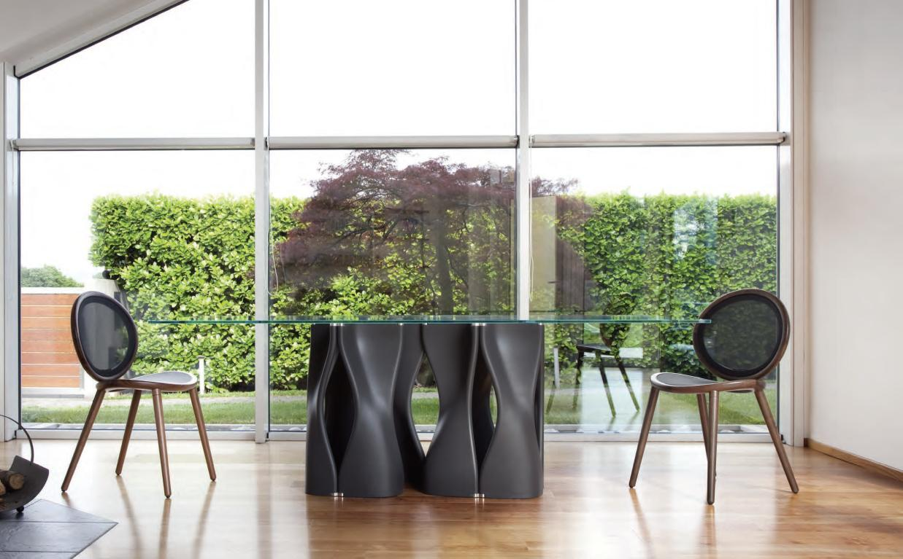
Conference + Meeting Spaces

Slide 2
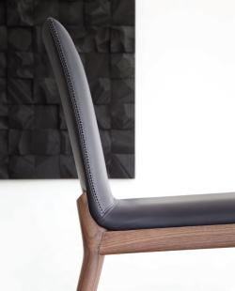
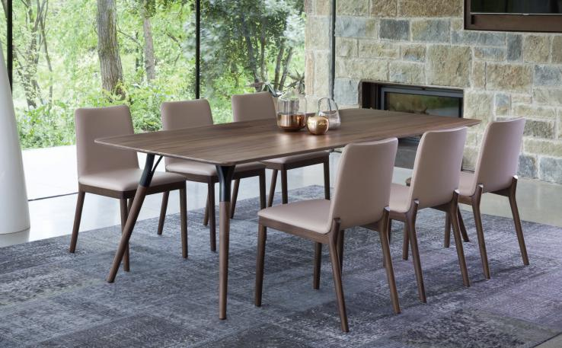
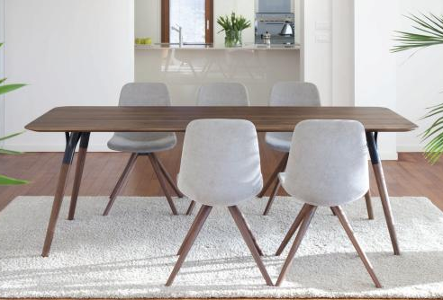
Salt + Pepper
TONON COLLECTION
Notes:
The beautiful Salt+Pepper Collection from Tonon. The stylish and affordable chair starting at $1,260 list COM and the stunning table available in a variety of wood species starts at $6,600 list.

Slide 3
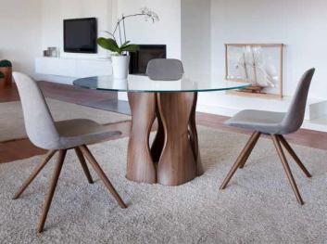
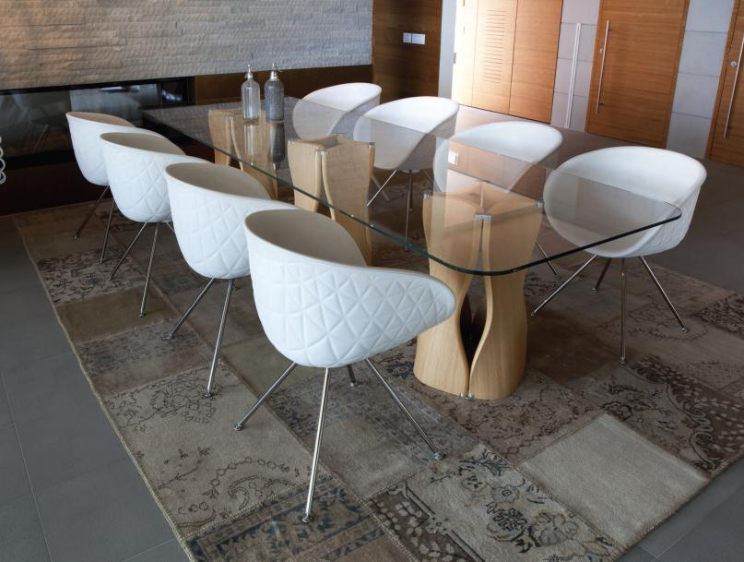
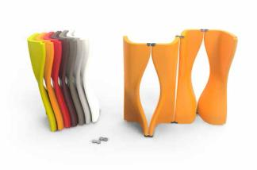
Mac’s Table
TONON COLLECTION
Notes:
Very unique in its design, the Mac’s Table is available with wood veneer bases or inherently cleanable Soft Touch urethane foam. Glass tops allow the shapely bases to become the focal point. Prices start at $3,500 list. Click on the video to see just how flexible Mac’s is!

Slide 4
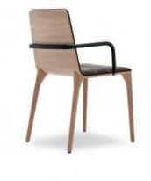
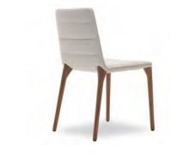
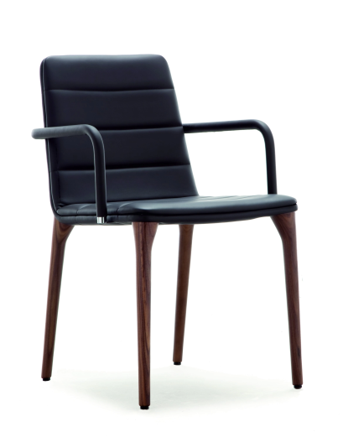
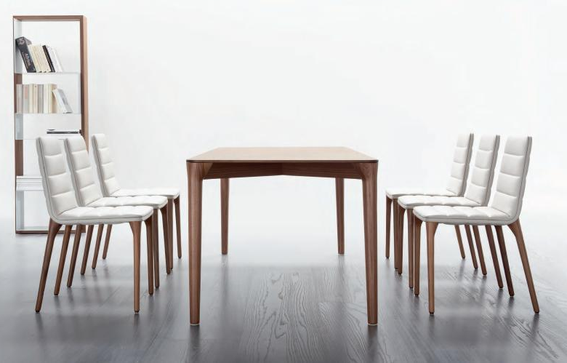
Pit
TONON COLLECTION
Notes:
Every C Suite deserves Pit. Wow factor everywhere you look. Impeccably designed and tailored. The armchair boasts leather wrapped arms. List price starts at $1,300 for the Soft Touch foam version up to $3,700 all tricked out in leather with arms. Table in Oak or Walnut starting at $5,770 list

Slide 5
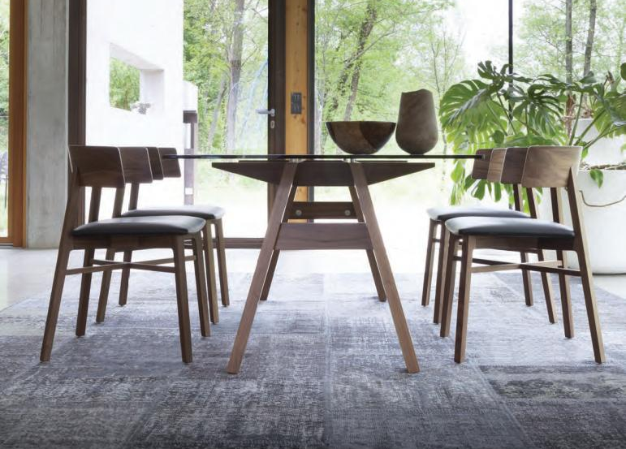
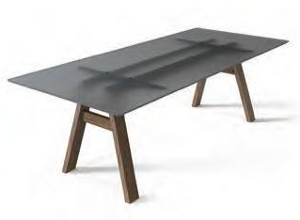
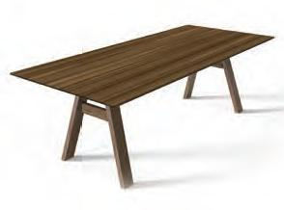
Tabula
TONON COLLECTION
Notes:
Conference or Dining, the Tablua looks great with a glass top or wood veneer. Starting at $6,700 list. Shown with the popular Triangolo chair.

Slide 6
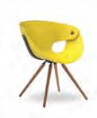
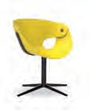
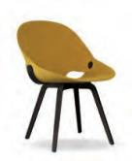
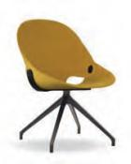
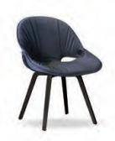
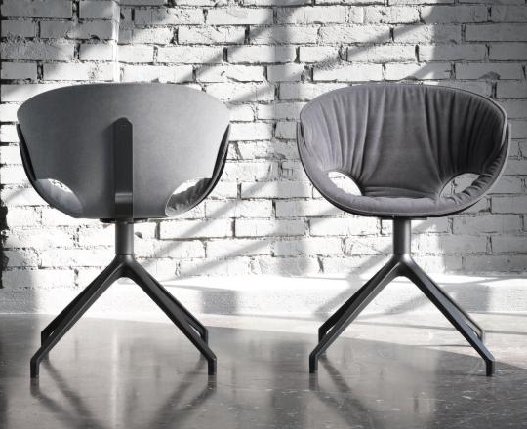
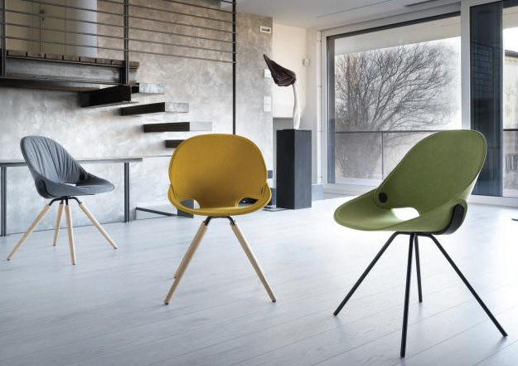
Flat / Flat Soft
TONON COLLECTION
Notes:
The award winning Flat and Flat Soft are the perfect meeting chairs. Not to large, but super comfortable. Great for any situation. Starting at $1,360 list

Slide 7
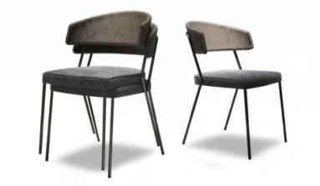
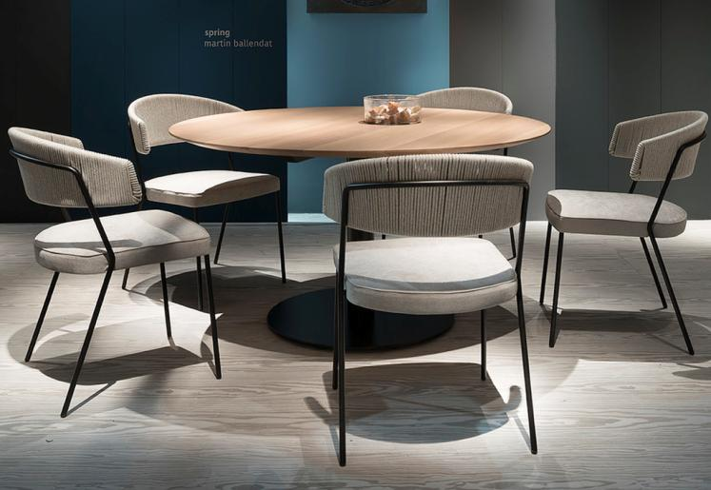
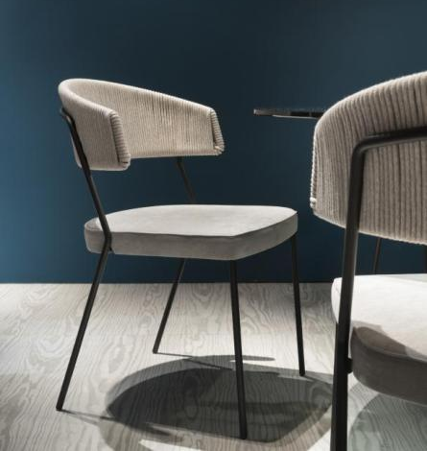
Spring
TONONCOLLECTION
Notes:
Last year’s Spring introduction. Unique hemp/cotton roping hand woven detail on the back available in 3 colors. Starts at $1,360 list COM

Slide 8
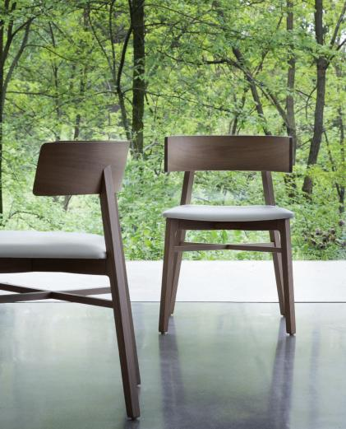
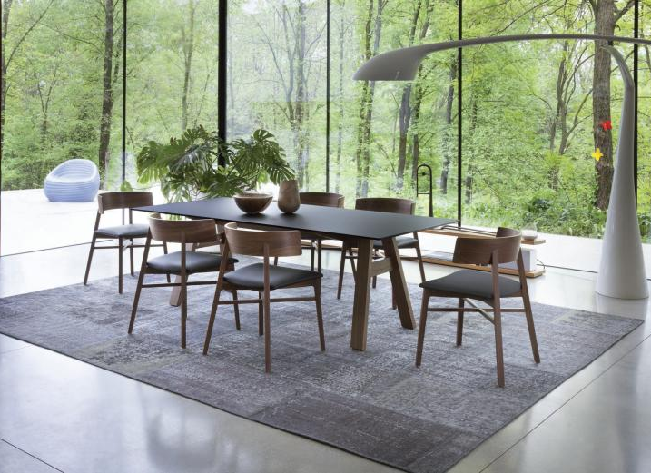
Triangolo
TONON COLLECTION
Notes:
Popular Triangolo. Distinctive exaggerated curved back is both an armless and an armchair at the same time. Starts at $1,620 list COM.

Slide 9
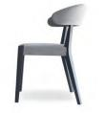
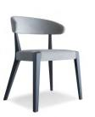
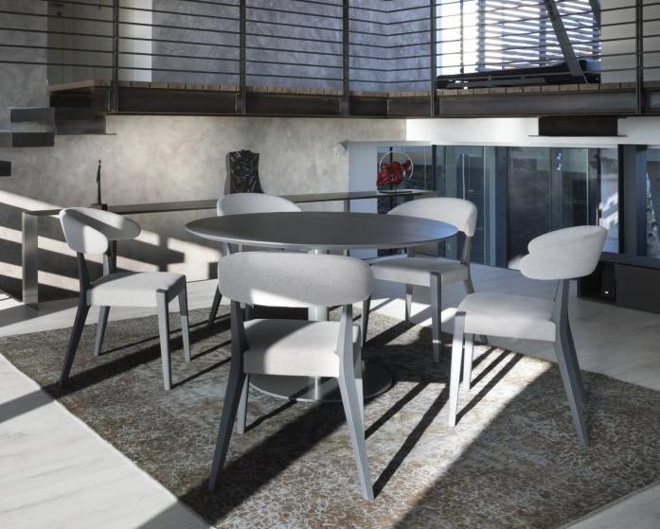
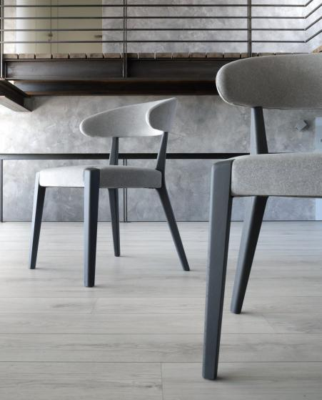
Wind
TONON COLLECTION
Notes:
Introduced last year, Wind is simple elegance. The exposed wood details are impeccable as is the attention to the upholstery detail around the exposed front legs. Wind lists for $1,580 COM

Slide 10
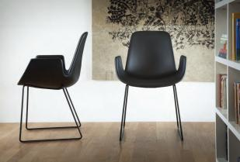
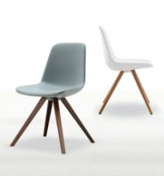
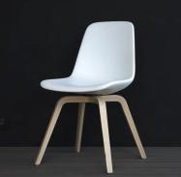
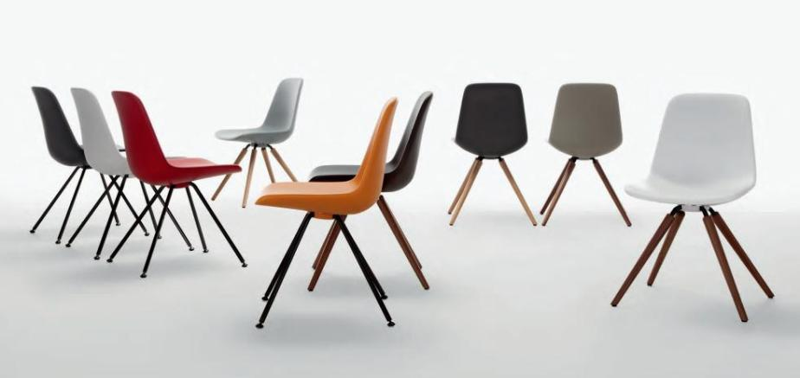
Step
TONON COLLECTION
Notes:
Step is a very broad collection from our Soft Touch collection. A wide variety of arm, armless and lounge pieces with many base options are offered. Primarily available in self skinned urethane, is highly cleanable with diluted bleach as well as able to be disinfected with harsh cleaning agents such as Virex. Step is also available upholstered. Starting at $920 list

Slide 11
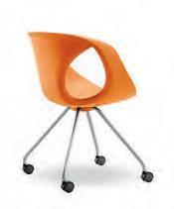
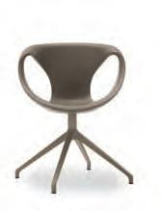
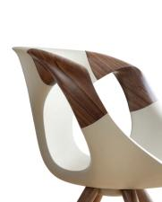
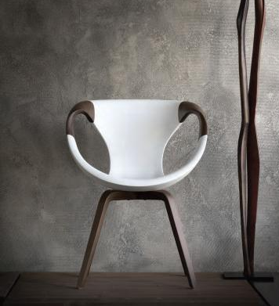
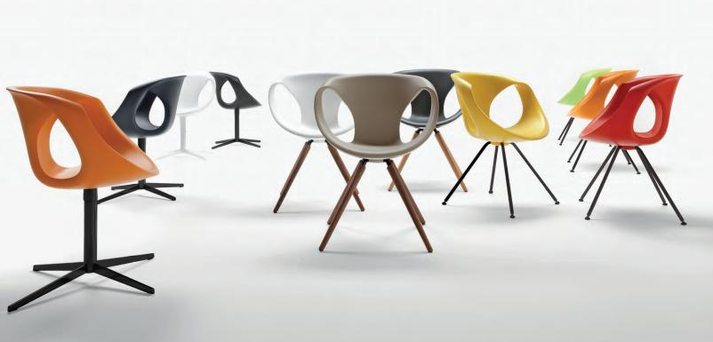
Up
TONON COLLECTION
Notes:
Up remains an ever-popular vast seating collection within the Tonon Collection. Soft Touch urethane as well as leather upholstered versions are available. Starting at $1,030 list

Slide 12
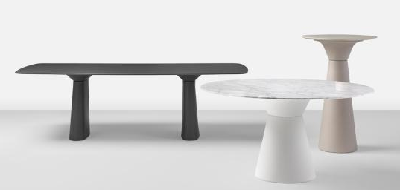
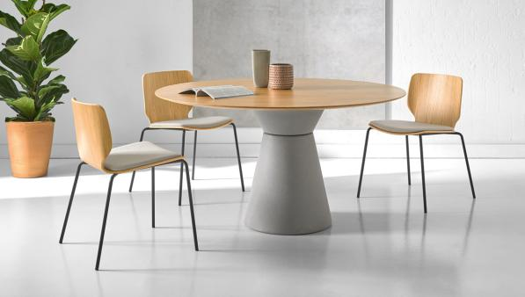
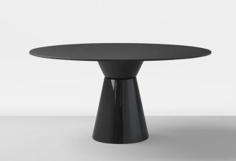
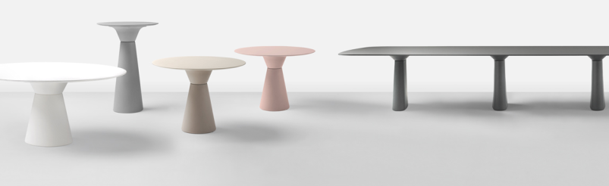
Essens
INCLASS COLLECTION
Notes:
Our most popular and very affordable Essens table. The base is available in a number of shapes and heights and is constructed of a unique rotary molded polyethylene. In this finish it is extremely durable and can even be used outdoors with appropriate tops. The base can also be painted in either a solid color or even in 3 metallic paints. And Essens is very affordable. For example, a 36” round solid HPL top with standard polyethylene base is $1,380 list.

Slide 13
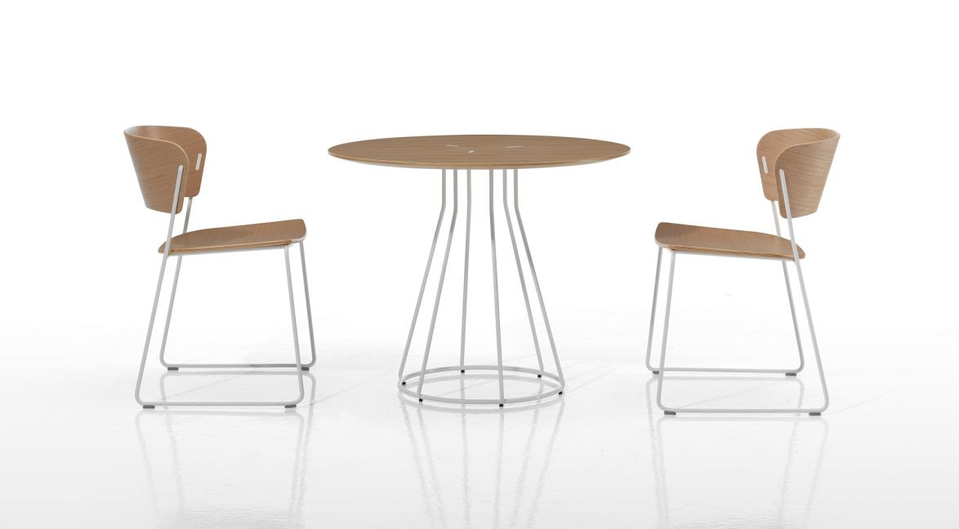
Arc Table + Chair
INCLASS COLLECTION
Notes:
For those small meeting areas, the Arc table and chairs is perfect. The beautiful metal detail in the top really sets it apart as does the wire frame base.Tops are available in wood only, but the table starts at an affordable $1,050 list. The Arc chair starts at $700 list and is available in all wood or with an upholstered seat.

Slide 14
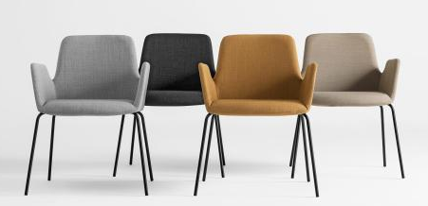
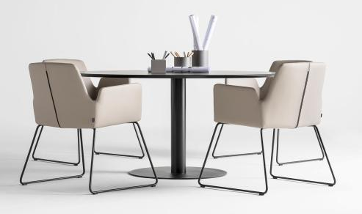
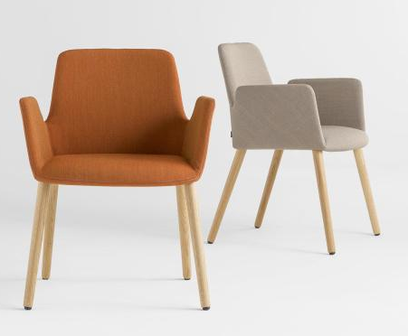
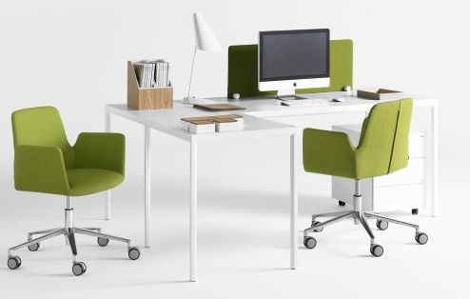
Altea
INCLASS COLLECTION
Notes:
Stylish and comfortable, The Altea line ranges anywhere from a metal 4 leg guest chair to a high back conference swivel. Starting list $1,320 COM

Slide 15
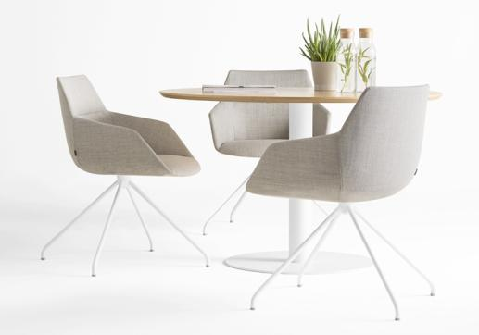
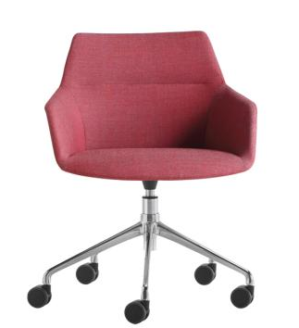
Dunas XS
INCLASS COLLECTION
Notes:
Extremely popular Dunas XS. Huge array of base options in both arm and armless versions. List prices start at 1,540 COM

Slide 16
Nim + Nim Wood
INCLASS COLLECTION
Notes:
Nim is perfect for any environment. The curved shell of the wood version is very inviting and the gorgeous seam detail on the upholstered version is unexpected. Nim starts at $590 list

Slide 17
Taia
INCLASS COLLECTION
Notes:
The latest guest/conference series from Inclass, Taia has 8 base options to complement its poly or upholstered shell. It’s even available with poly legs the in some colors give it the appearance of a wood base. All starting at an incredible $490 list.

Slide 18
Unnia
INCLASS COLLECTION
Notes:
Our popular Unnia chair in its conference mode. Many base options available and the gorgeous swivel and adjustable height conference chair is priced at a pretty reasonable $1,400 list COM.

Slide 19
Varya / Varya Wood / Varya Tapiz
INCLASS COLLECTION
Notes:
Our largest chair series with over 85 unique variations also makes a great conference option. The upholstered swivel shown in the upper right lists for $1,380 COM

Slide 20
Cono
MONTBEL COLLECTION
Notes:
The elegant and ever popular Cono table from Montbel is available in a variety of sizes and finishes. Bases start at $2,010. Add any top you choose!

Slide 21
Firenze
MONTBEL COLLECTION
Notes:
Huge array of options for this Montbel collection. Endless sizes and finishes available, including solid color lacquer! Please call for pricing.

Slide 22
Light
MONTBEL COLLECTION
Notes:
Popular Light series. Gorgeous exposed wood frame and ingenious integrated hand pull. Metal leg stacker too. Starts at $790 list COM

Slide 23
Niky
MONTBEL COLLECTION
Notes:
Niky arrived last year and is starting to really make her presence known! The exaggerated arm is unexpected and bases are available in wood or metal. Prices start at $1,430 list COM

Slide 24
Rose
MONTBEL COLLECTION
Notes:
Rose makes for a perfect smaller-scaled guest conference chair option. Many upholstery options are available as is a wood shell outer back. List $1,210 COM

Slide 25
Timberly
MONTBEL COLLECTION
Notes:
The Timberly armchair makes for a classic conference option, but don’t forget that many of our pieces have matching stools and many meetings take place at high top tables and in collaboration areas. Timberly starts at $1,100 COM in the arm version.

Slide 26
Salinero / Myra
ET AL COLLECTION
Notes:
There are some nice conference options in out Et al collection as well. Myra is fully upholstered and available with 3 base options starting at $1,090 list COM. And the Salinero table comes in a variety of sizes and finishes at a starting point of $2,700 list.

Slide 27
Kicca / Kontea
ET AL COLLECTION
Notes:
Kicca and Kontea are both great ideas for conference areas especially when a small scale chair is required. Both start at $830 list COM.

Slide 28
Marka
ET AL COLLECTION
Notes:
Classic styling sets the mood for the Marka. 4 base options available with the 5 star caster base option starting at a very affordable $1,150 list COM

Slide 29
Nassau / Uni-Ka
ET AL COLLECTION
Notes:
And finally, for those budget-conscious, casual meeting areas, Nassau and Uni-Ka in their upholstered versions make a great choice. Starting at $460 COM

Slide 30
www.sandlerseating.com

