Slide 1
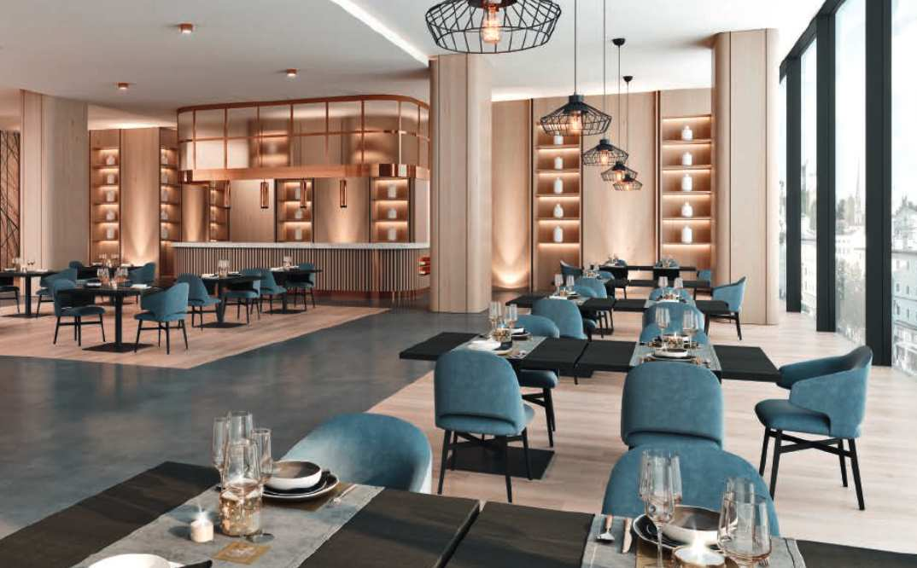
DINING COLLECTION

Slide 2
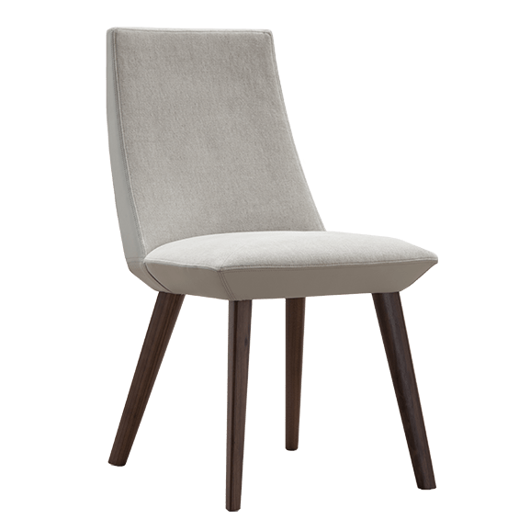
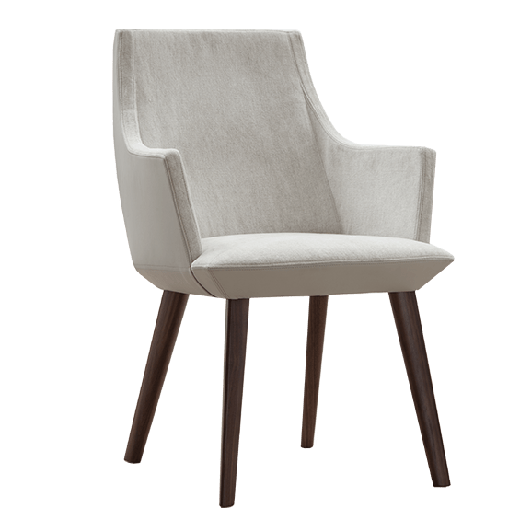
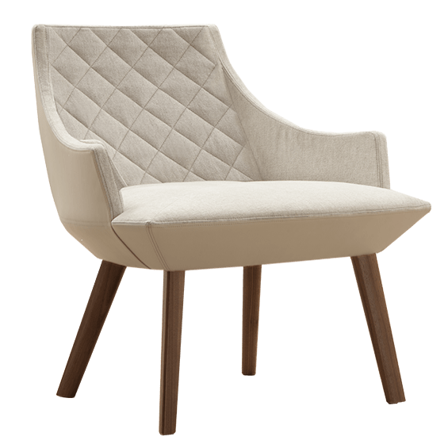
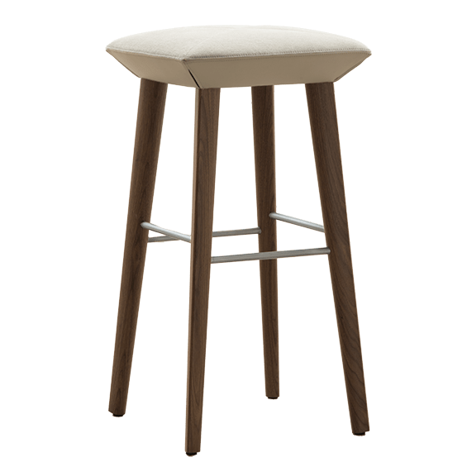
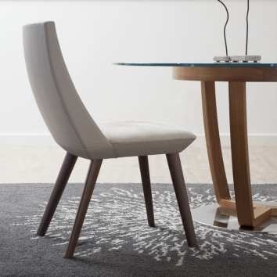
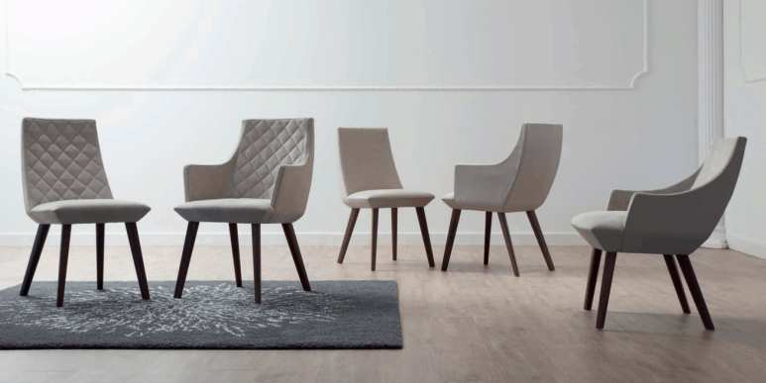
Beret
TONON COLLECTION
Notes:
Exquisite dining and guest option from Tonon. Luxurious diamond quilted pattern available. Unique beveled seat shape. Starting at $2,110 list COM

Slide 3
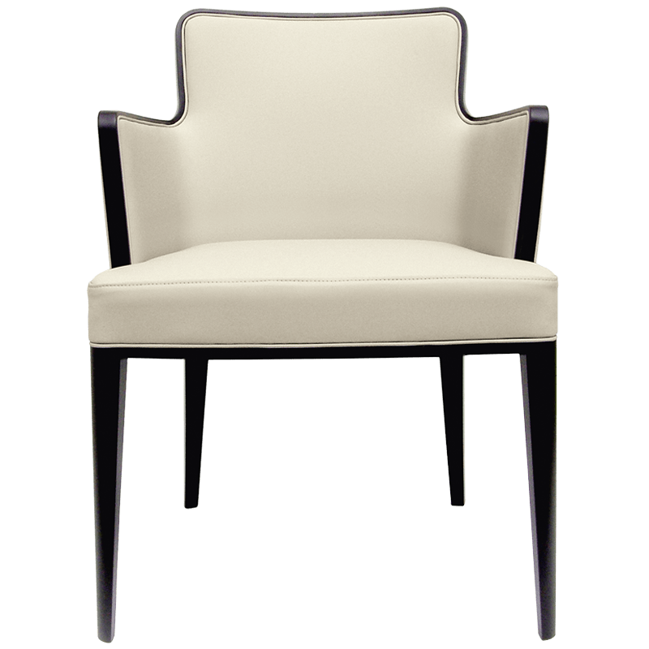
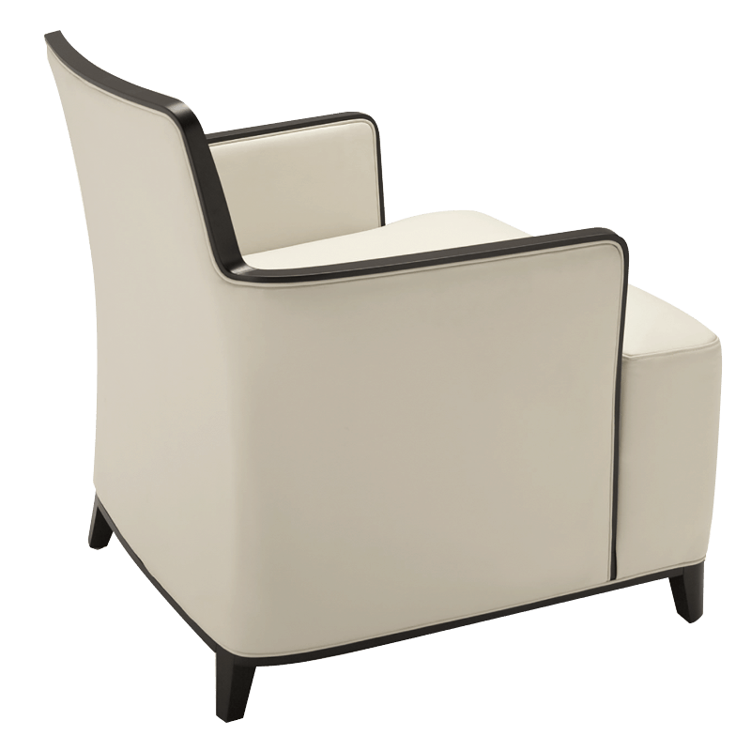
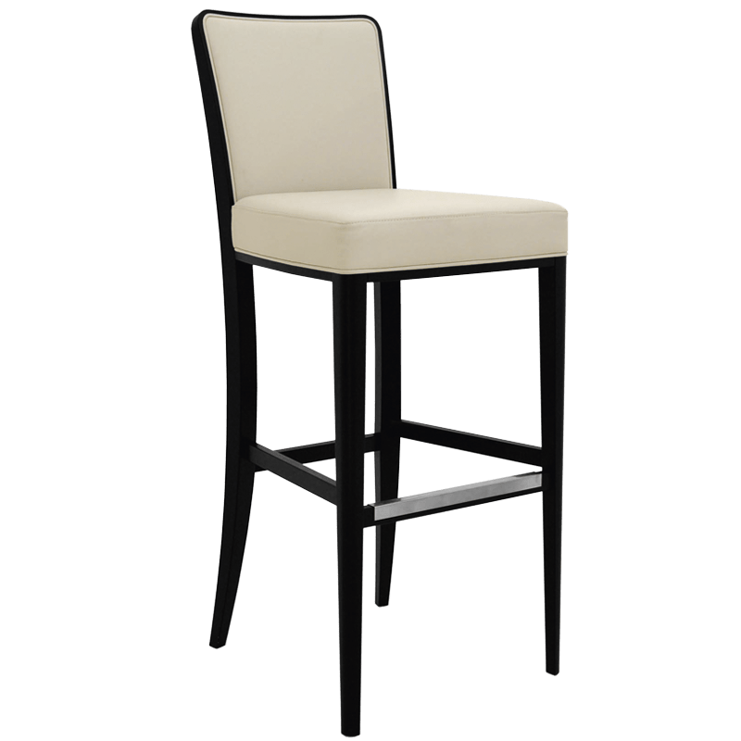
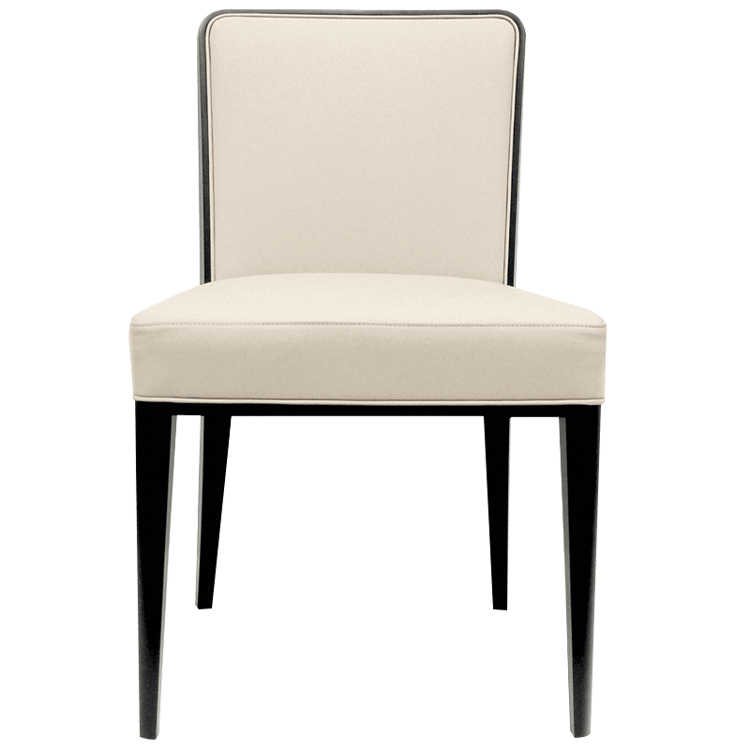
Princess
TONON COLLECTION
Notes:
Another luxury option from Tonon. Gorgeous exposed wood detail. Impeccable craftsmanship. Well priced starting at $1,420 list COM

Slide 4
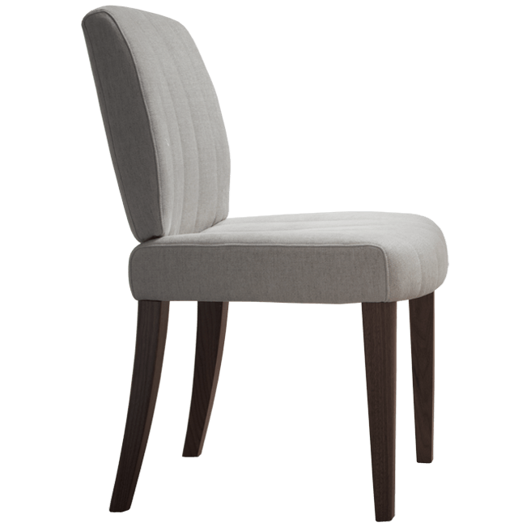
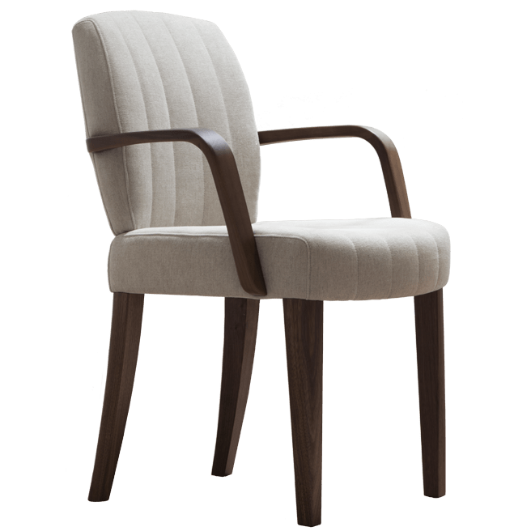
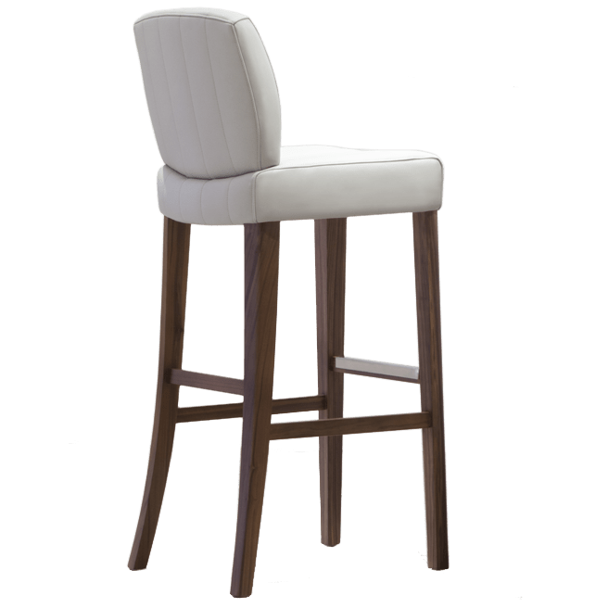
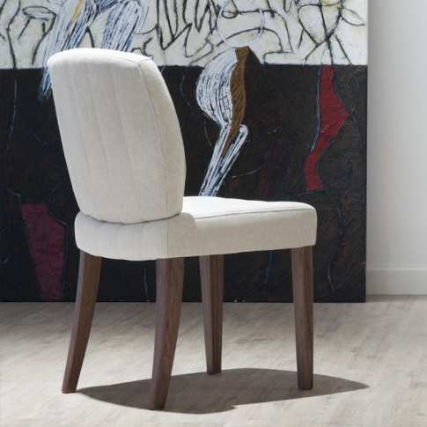
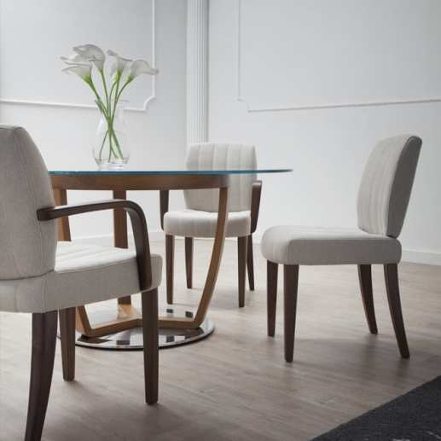
Gallant
TONON COLLECTION
Notes:
Incredibly comfortable, transitional dining option. Arm, armless and stool models available. Starting at $1,640 list COM

Slide 5
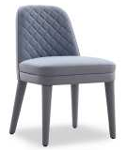
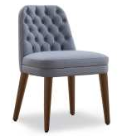
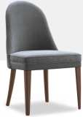
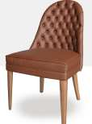
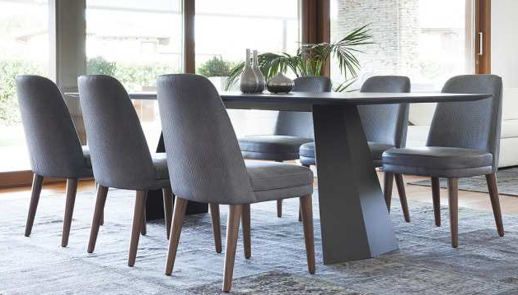
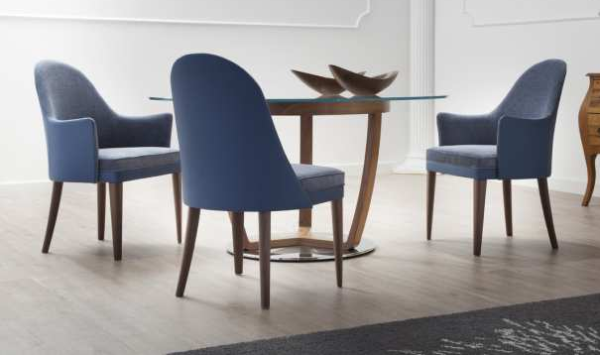
Signatures
Spirit
TONON COLLECTION
Notes:
Two of our traditional options. Elegant for any environment. Signatures starts at $2,250 list COM. Spirit at $2,500 list COM.

Slide 6
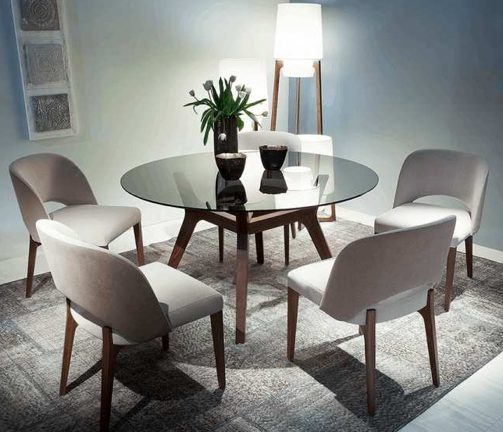
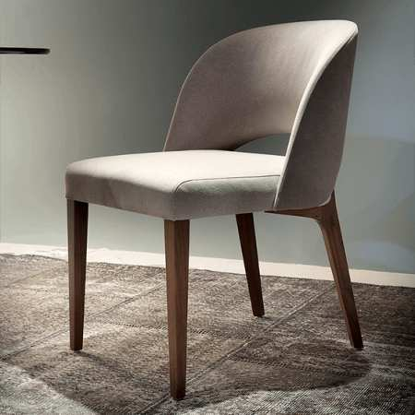
Libra
TONON COLLECTION
Notes:
The very popular Libra series. Transitional dining chair. A beautiful metal stretcher is available as required. Starting at $2,450 list COM

Slide 7
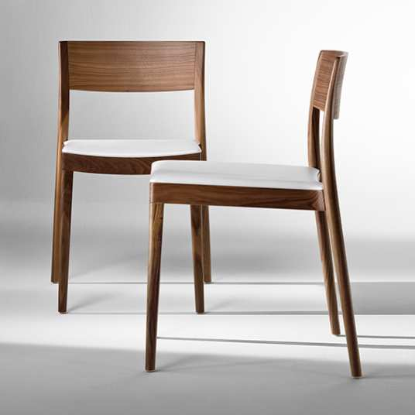
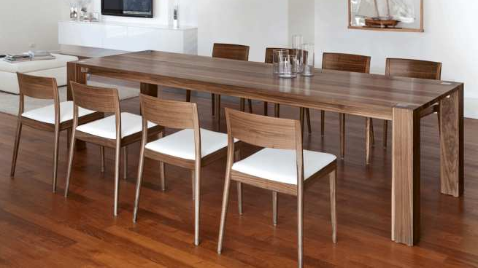
Miss
TONON COLLECTION
Notes:
Little Miss. The perfect petite dining chair. Stacks 6 high. Starting at $1,240 list COM

Slide 8
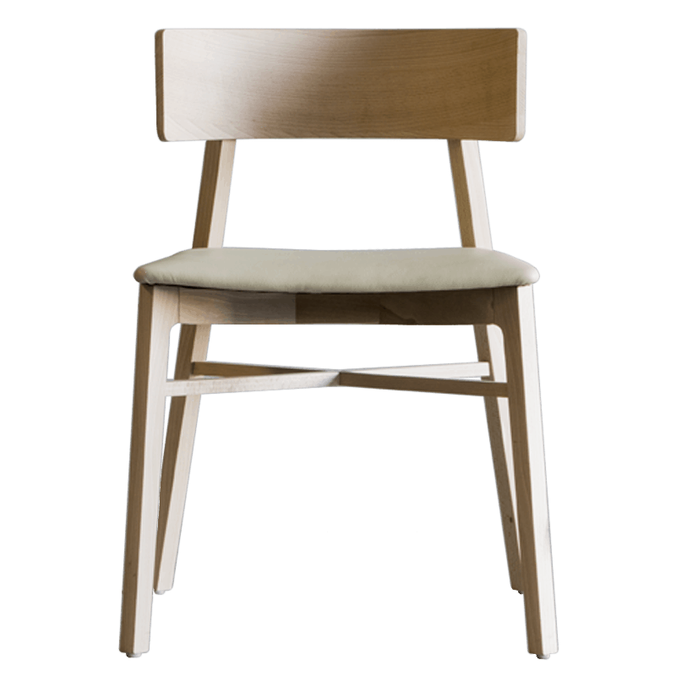
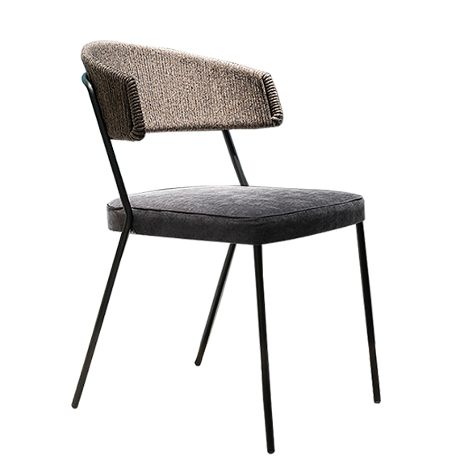
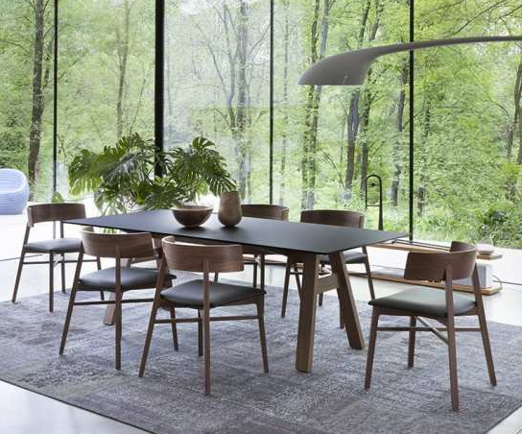
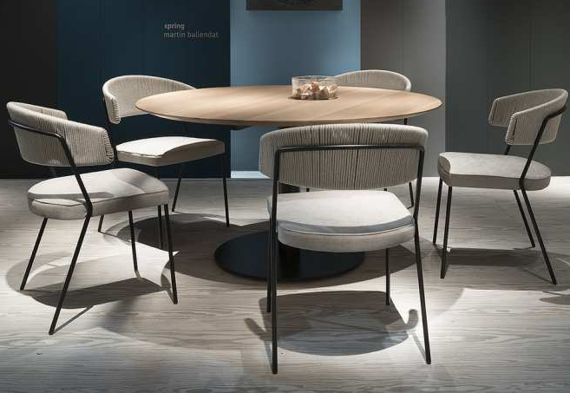
Triangolo
Spring
TONON COLLECTION
Notes:
Popular Triangolo. Distinctive exaggerated curved back is both an armless and an armchair at the same time. Starts at $1,620 list COM.
Last year’s Spring introduction. Unique hemp/cotton roping hand woven detail on the back available in 3 colors . Starts at $1,360 list COM

Slide 9
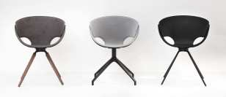
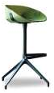
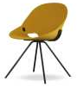
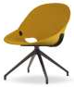
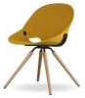
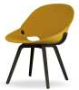
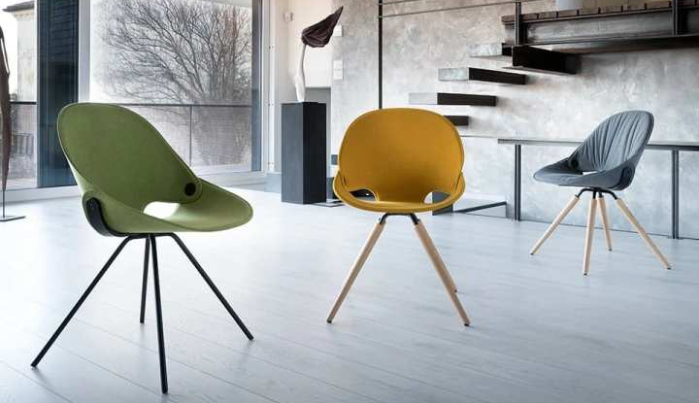
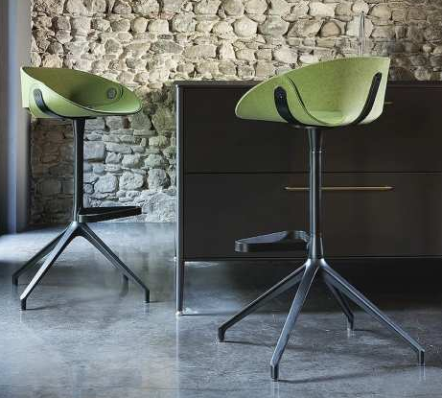
Flat
TONON COLLECTION
Notes:
The enormous Flat range. Multi-Gold award winner. Additional models available for both chairs and stools. Starts at $1,260 list.

Slide 10
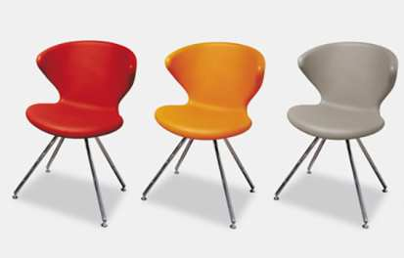
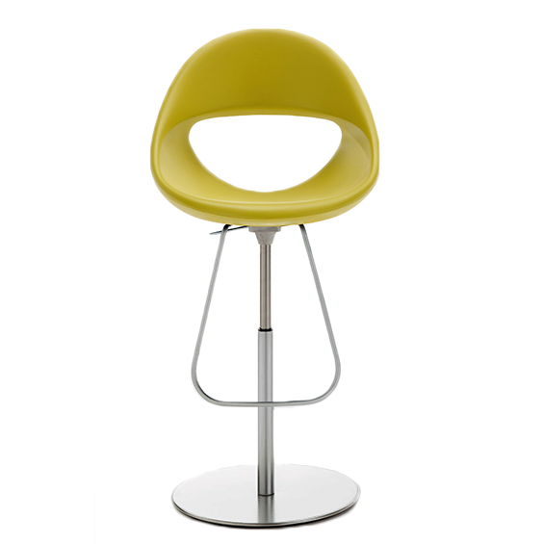
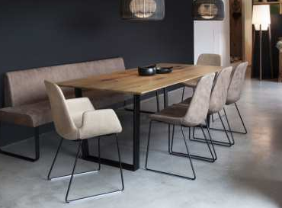
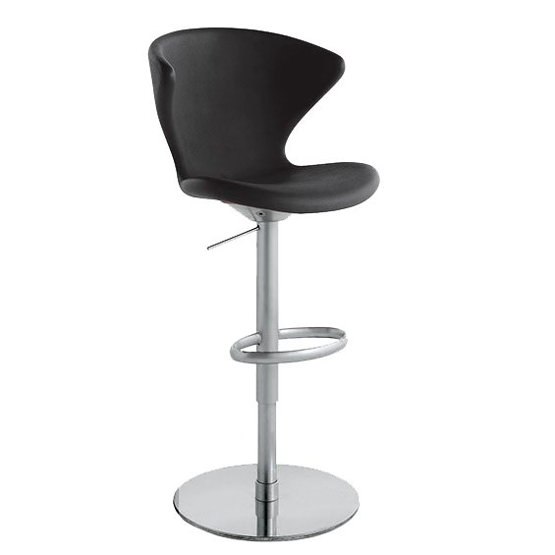
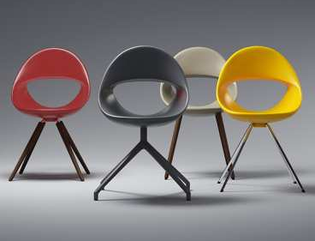
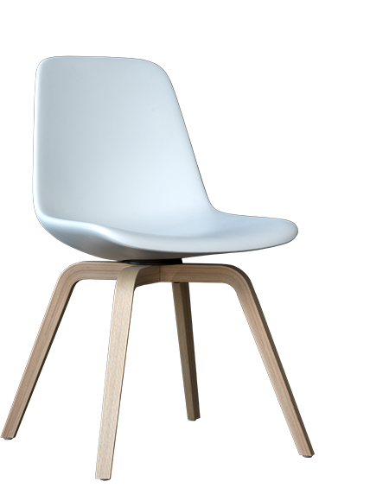
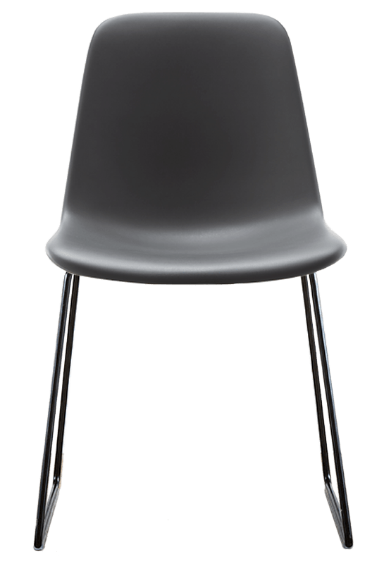
SOFT TOUCH COLLECTION
Step
Lucky
Concept
TONON COLLECTION
Notes:
A sampling of dining and bar options from our Soft Touch collection. This material is highly cleanable with diluted bleach as well as

Slide 11
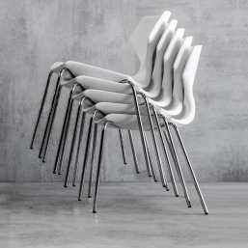
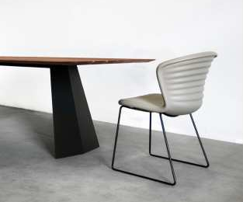
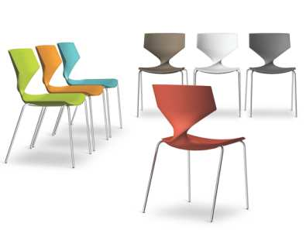
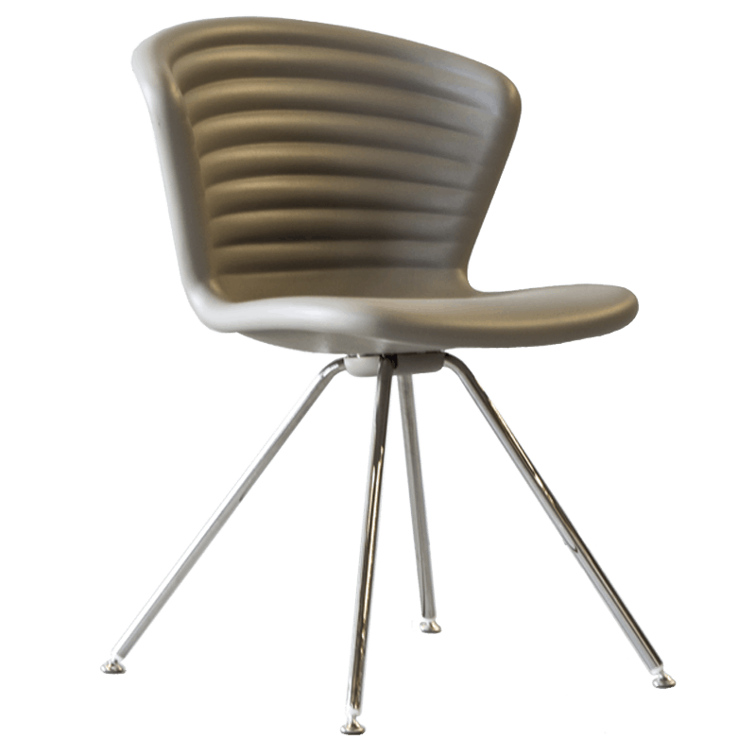
SOFT TOUCH COLLECTION
Quo
Marshmallow
TONON COLLECTION
Notes:
harsher disinfecting agents like Virex. Please see our Cleanability Brochure for more information. Soft Touch starts at $860 list

Slide 12
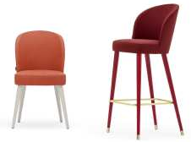
Rose
MONTBEL COLLECTION
Notes:
Extensive transitional lounge, ottoman, guest and dining collection. Many options available including custom stain options. Starting at $810 list COM

Slide 13
Danielle
MONTBEL COLLECTION
Notes:
Extensive transitional lounge, ottoman, guest and dining collection. Many options available. Shown with Trinity tables. Starting at $1,080 list COM

Slide 14
Leela
Niky
MONTBEL COLLECTION
Notes:
Two of the newer dining options from Montbel. Both are available with wood or metal legs. Starting at $1,040 list COM

Slide 15
Light
MONTBEL COLLECTION
Notes:
Popular Light series. Gorgeous exposed wood frame and ingenious integrated hand pull. Metal leg stacker too. Starts at $790 list COM

Slide 16
Azure
MONTBEL COLLECTION
Notes:
Transitional and contemporary. Azure’s extensive line of guest, dining and bar seating fits any environment or budget. Starting at $680 list COM

Slide 17
Flame
MONTBEL COLLECTION
Notes:
Sleek and elegant. Flame is moderately priced for fine dining and guest seating applications. Starting at $880 list COM

Slide 18
Mayfair
MONTBEL COLLECTION
Notes:
Classic contemporary design. Dining, bar and lounge models. Starting at $1,010 list COM

Slide 19
Opera
MONTBEL COLLECTION
Notes:
Beautifully detailed. Broad family of dining, bar and lounge options. Moderately priced starting at $1,090 list COM

Slide 20
Palm Beach
MONTBEL COLLECTION
Notes:
Value priced Palm Beach. Huge variety of options. Simple and elegant for any space. Starts at $550 list COM. This can net down to $235!

Slide 21
Senzo
MONTBEL COLLECTION
Notes:
Great looking Senzo. Over 15 models to choose from. Starting at $660 list COM. Don’t forget all the great color finishes available!

Slide 22
Timberly
MONTBEL COLLECTION
Notes:
A perennial Sandler favorite. Perfect for fine dining and guest areas. Stacks 4-5 high. Wood or upholstered backs. Starting at $920 list COM

Slide 23
Linear
MONTBEL COLLECTION
Notes:
Don’t forget that we have some great banquette options for those clients that want a freestanding option. Call for pricing.
Completely customizable, length and height….even ultra tall backs and arms are possible. Great for social distancing where needed.

Slide 24
Vicky
CANTARUTTI COLLECTION
Notes:
Super cute Vicky. Extensive family of products. Options include a contrasting color for the metal back brace. Starts at $710 for the 1.1

Slide 25
Coco
CANTARUTTI COLLECTION
Notes:
Delightful Coco. So many options including both back and backless benches and stools. Perfect dining chair. Starts at $670 for the 1.1

Slide 26
Timber
CANTARUTTI COLLECTION
Notes:
Large collection of dining, bar and lounge options. 4 back styles to choose from . Wood or upholstered combinations. Starting at $550 list COM

Slide 27
Dixie
CATARUTTI COLLECTION
Notes:
The competitor of Julia for our most popular dining and guest. A perennial favorite. Starting at $670 list COM

Slide 28
Yumi
CATARUTTI COLLECTION
Notes:
Simplicity, but plenty of options. Yumi was the perfect choice for this Atlanta restaurant. The food was great too! Starts at $880 list COM

Slide 29
Ribbon
CATARUTTI COLLECTION
Notes:
Enormous Ribbon collection Dozens of options. Let us know how we can help with this great café and dining series. Starts at $1,120 list

Slide 30
Julia
©Linda McManus
CATARUTTI COLLECTION
Notes:
Our best selling wood framed dining chair. Arm chair and stools also available. Exceptionally priced starting at $470 list COM

Slide 31
Eleanor
CATARUTTI COLLECTION
Notes:
Here’s another VERY popular dining and bar collection. Great for so many different types of properties. Starting at $1,050 list COM

Slide 32
Woodlook
WOODLOOK COLLECTION
Notes:
Perfect solution for today’s challenging environments. Highly cleanable and disinfectable aluminum frame with applied woodgrain film

Slide 33
Woodlook
WOODLOOK COLLECTION
Notes:
Highly scratch resistant. Weight limit to 400lbs. Unparalleled 15 year warranty. Stacks 4-6 high. Over 35 models to select from

Slide 34
Woodlook
WOODLOOK COLLECTION
Notes:
Many frames in our walnut 24A finish are in stock in our Conover, NC facility for quick turn around. Starting at $580 list COM Custom solutions too!

Slide 35
Woodlook
WOODLOOK COLLECTION
Notes:
Our new Gray Washed finish is perfect for today’s trends. One of 6 finishes available on Woodlook.

Slide 36
Ann
INCLASS COLLECTION
Notes:
Wood shell stacking chair and stools with wire rod 4 legs or sled base. Multiple finish options. Starting at $440 list

Slide 37
Nim
INCLASS COLLECTION
Notes:
Curved one piece wood shell chair and stools. 4 leg and sled base options. Multiple finish options. Starting at $520 list

Slide 38
Slim
INCLASS COLLECTION
Notes:
Contemporary poly sled base. Stacks 20 high. 7 poly color options. Chrome frame only. $450 list

Slide 39
Unnia
INCLASS COLLECTION
Notes:
Two piece shell allows for specification of two different poly colors if desired at no upcharge. 4 leg or sled base. Stacks 20 high. Starts at $430 list

Slide 40
Varya
INCLASS COLLECTION
Notes:
Extensive collection starting with this poly shell available with many different bases, finishes and upholstered seat options. Starting at $370 list

Slide 41
Varya
INCLASS COLLECTION
Notes:
Beautiful upholstery details in your choice of tight, channel stitch or gathered. 4 leg or sled base. Wood and metal leg options. Starting at $640 COM

Slide 42
Varya Wood
INCLASS COLLECTION
Notes:
Wood shell version of our popular Varya poly chairs and stools. 4 leg and sled base versions. Starting at $510 list

Slide 43
Ring
ET AL COLLECTION
Notes:
Ring series from Et al is a great little option for café spaces. Arm, armless and bar stool options. Starting at $590 list

Slide 44
Kontea
ET AL COLLECTION
Notes:
Super popular Kontea. Contemporary and transitional all at the same time. Wood or metal legs. Starting at $830 list COM

Slide 45
Flint
ET AL COLLECTION
Notes:
Flint has been very popular lately. Lots of requests coming in for this cute little guy. Many finishes and options. Starting at $660 list

Slide 46
Ibis
ET AL COLLECTION
Notes:
Modern and contemporary indoor/outdoor chair, and also can come in barstools. Shell comes in 7 shell colors, and base can be in a variety of VR colors. Side chair starts at $420 LIST.

Slide 47
Nassau
ET AL COLLECTION
Notes:
QUICK SHIP ITEM! Air molded polypropylene monobloc stacking chair, and very light weight. BIFMA tested. Side chair and arm chair available for ordering in multiples of 5, and stack 10 high. Stools available for ordering in multiples of 2, and stack 4 high.
3 colors stocked in North Carolina (Squirrel Gray, Turtle Dove and White). For non-upholstered versions, Et. Al keeps 300-400 pieces of every colors and style stocked in Italy. Lead time for stocked items is 4-6 weeks from receipt of deposit. Side chair starts at $240 LIST

Slide 48
Tables

Slide 49
Mac’s Table
TONON COLLECTION
Notes:
Indoors or out, Mac’s Table from Tonon is a unique option for many discerning clients. Starting at $3,530 list

Slide 50
Firenze
MONTBEL COLLECTION
Notes:
Huge array of options for this Montbel collection. Endless sizes and finishes available. Please call for pricing.

Slide 51
MT Series
ET AL COLLECTION
Notes:
One of many table options from Et al. More options than you can imagine. Some are stocked both in Conover and at Et al!

Slide 52
www.sandlerseating.com

