Slide 1
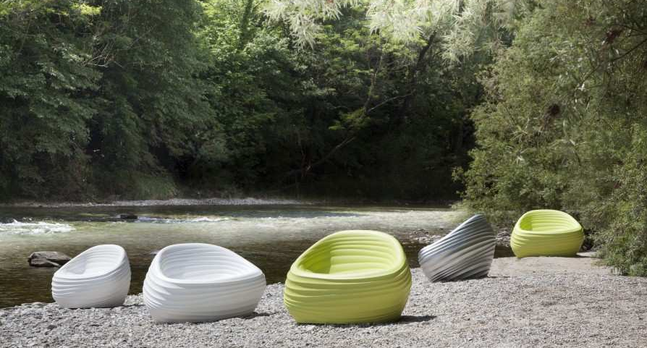
Outdoor Environments

Slide 2
Corda
TONON COLLECTION
Notes:
Full family from Tonon. 2 Weave patterns available – open and tight weave. 8 colors available. ALL pieces stack 5 high, including the 2-seater sofa – great attribute for storage. Sofa cushions available.
Cord 100% polyester, so at the end of the life cycle of the pieces, the entire piece is recyclable.
Open weave side chair starts at $1090 LIST

Slide 3
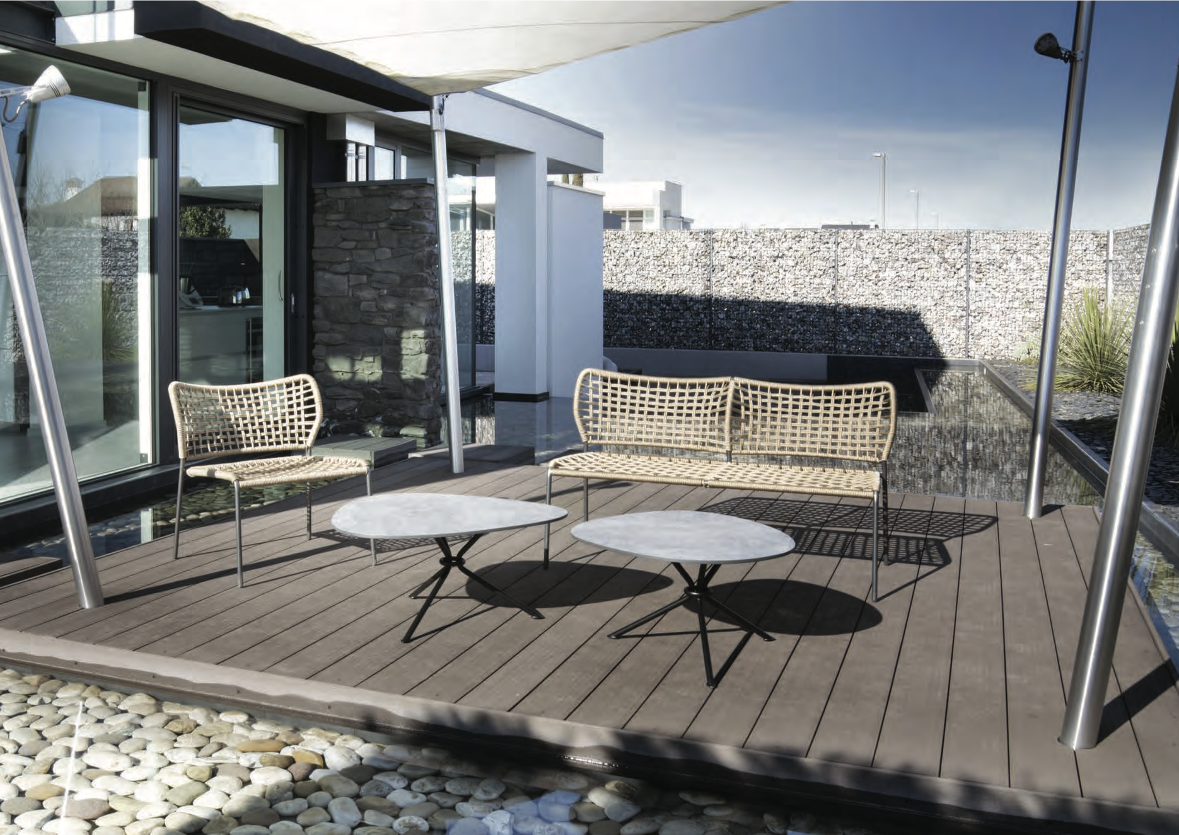
Corda
TONON COLLECTION
Notes:
Full family from Tonon. 2 Weave patterns available – open and tight weave. 8 colors available. ALL pieces stack 5 high, including the 2-seater sofa – great attribute for storage. Sofa cushions available.
Cord 100% polyester, so at the end of the life cycle of the pieces, the entire piece is recyclable.
Open weave side chair starts at $1090 LIST

Slide 4
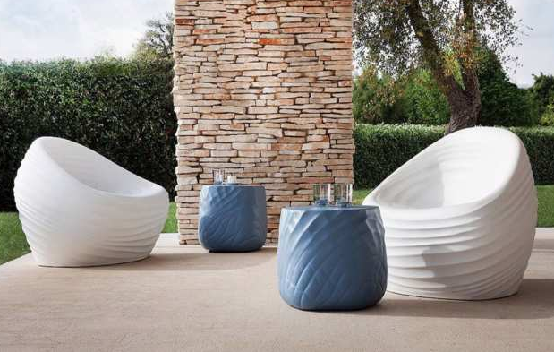
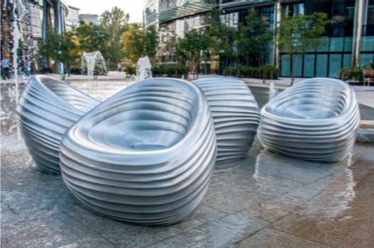
Riverside
TONON COLLECTION
Notes:
Part of the River family. Made from integral foam (same material as your car dashboard). Variety of colors. The water run off if the hole in the middle of the lounge chair. Can be weighted down, and a PVC sac can be inserted in the base for an upcharge Silver metallic finish is available for Riverside, but is NOT used for outdoor use. Starts at $1900 LIST.

Slide 5
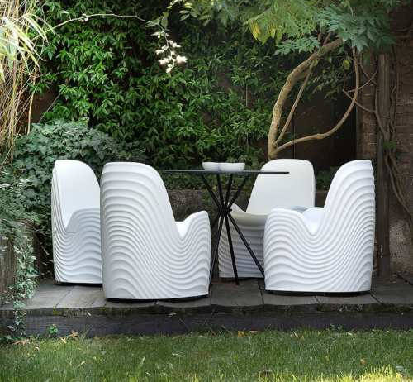
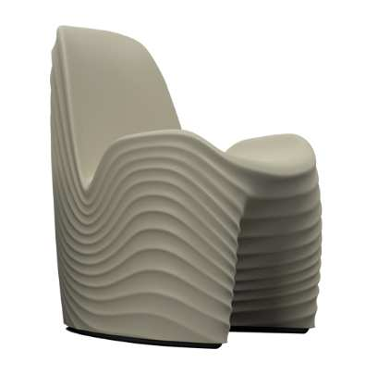
River Chair
TONON COLLECTION
Notes:
Part of the River Family. Made from integral foam (same material as your car dashboard). Variety of colors. Silver metallic finish is NOT available for River chair. Water run off feature is on the side of the chair. Starts at $1500 LIST.

Slide 6
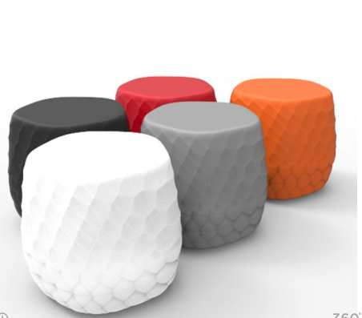
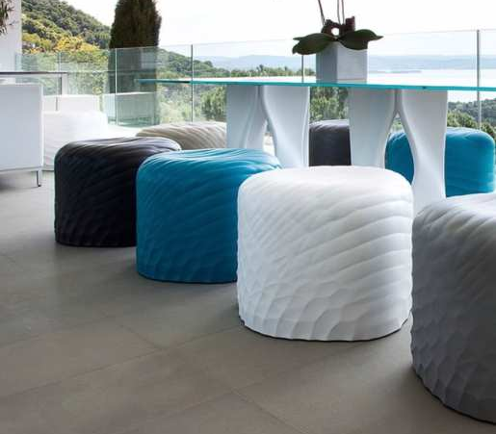
River Stone
TONON COLLECTION
Notes:
Part of the River Family. Made from integral foam (same material as your car dashboard). Variety of colors. Silver metallic finish is available for River chair, but NOT for outdoor use. 3 different sizes of the stone. Starts at $620 LIST.

Slide 7
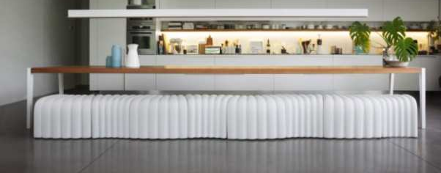
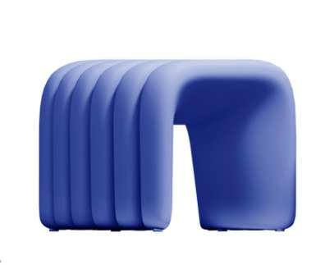
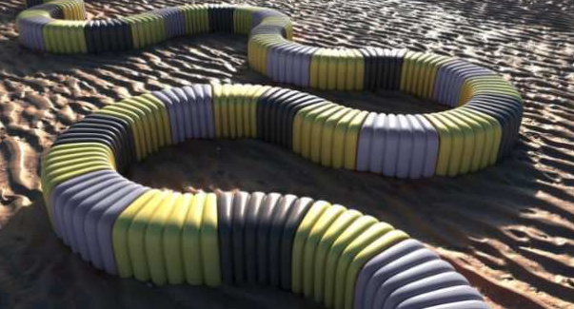
River Snake
TONON COLLECTION
Notes:
Part of the River Family. Made from integral foam (same material as your car dashboard). Variety of colors. Silver metallic finish is available for River chair, but NOT for outdoor use. Each link of the snake can be joined together with an Aluminum linking device (upcharge for linking device). Starts at $900 LIST.

Slide 8
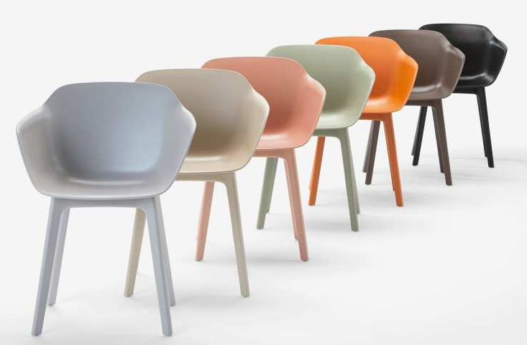
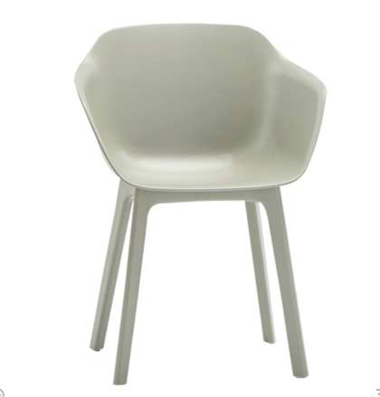
Taia Poly Leg
INCLASS COLLECTION
Notes:
Part of the Taia Family. Beautifully designed, and has a very comfortable sit. Legs can match the shell color, if desired. Other base styles available for inside use. Variety of colors available. Starts at $490 LIST

Slide 9
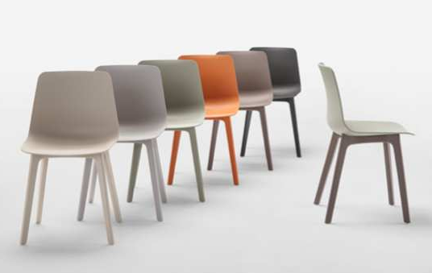
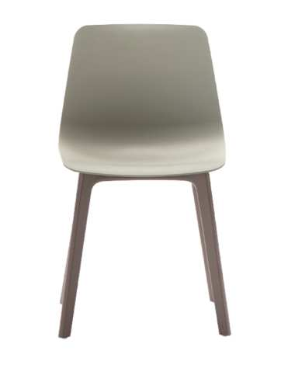
Varya Poly Leg
INCLASS COLLECTION
Notes:
Part of our VERY popular Varya family. Maximum comfort, with an elegant flex-back. Variety of colors available, and the legs can match the shell, if desired. Drain hole can be added (upcharge). DOES not stack. Starts at $350 LIST

Slide 10
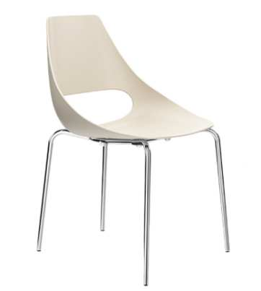
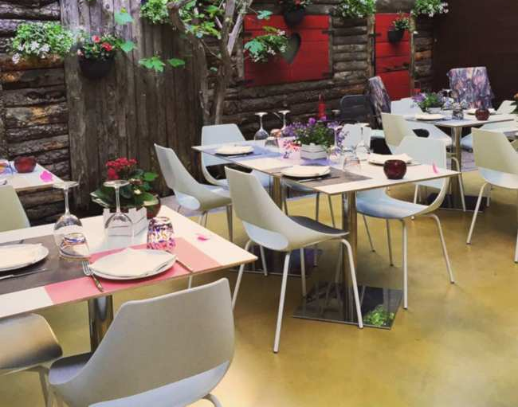
Echo
ET AL COLLECTION
Notes:
Modern indoor/outdoor chair, and also can come in barstools. Weight limit is 350lbs. Shell comes in 3 shell colors, and base can be in a variety of VR colors. Side chair starts at $360 LIST.

Slide 11
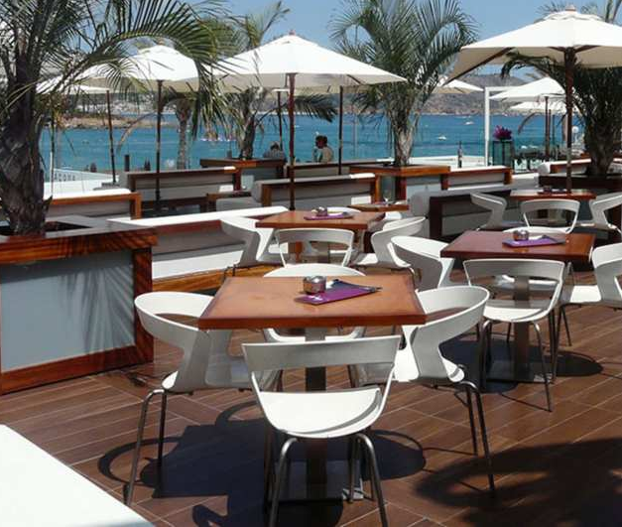
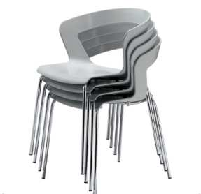
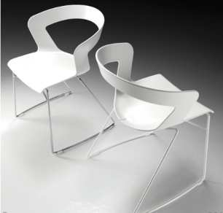
Ibis
ET AL COLLECTION
Notes:
Modern and contemporary indoor/outdoor chair, and also can come in barstools. Shell comes in 7 shell colors, and base can be in a variety of VR colors. Side chair starts at $420 LIST.

Slide 12
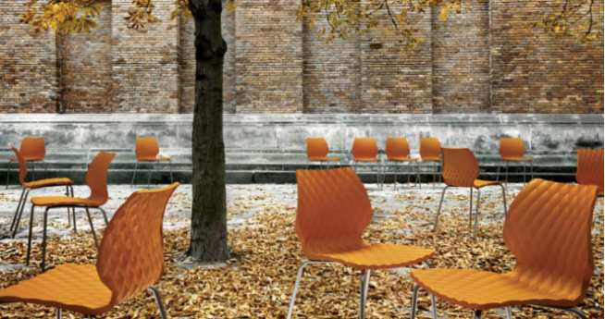
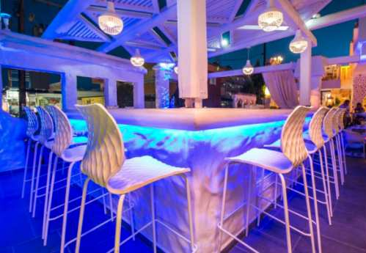
Uni
ET AL COLLECTION
Notes:
Modern side chair, with barstools available. Design is that of an inside of a ski boot. The designer broke his ski boot while skiing, and when he saw the diamond design inside his boot, it gave him the inspiration for Uni.
Side chair stacks 8 high, and comes in 12 standard colors. Other color options available for 200 MOQ. For the base, there are a variety of VR colors available. For indoor use, more base styles are available. Side chair starts at $340 LIST.

Slide 13
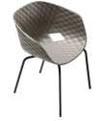
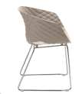
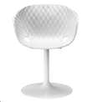
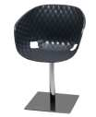
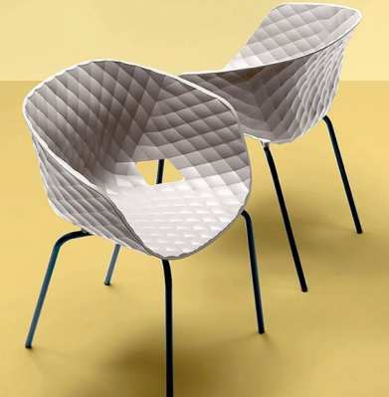
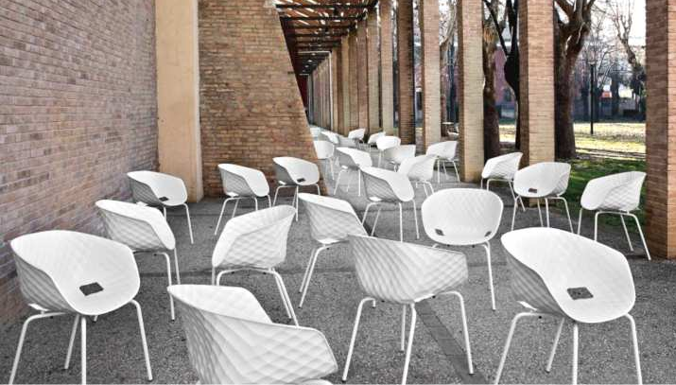
Uni-Ka
ET AL COLLECTION
Notes:
Modern arm chair. Design is that of an inside of a ski boot. The designer broke his ski boot while skiing, and when he saw the diamond design inside his boot, it gave him the inspiration for Uni.
Arm chair stacks 4 high, and comes in 10+ standard colors. Other color options available for 200 MOQ. For the base, there are a variety of VR colors available. For indoor use, more base styles and upholstery options are available. Side chair starts at $330 LIST.

Slide 14
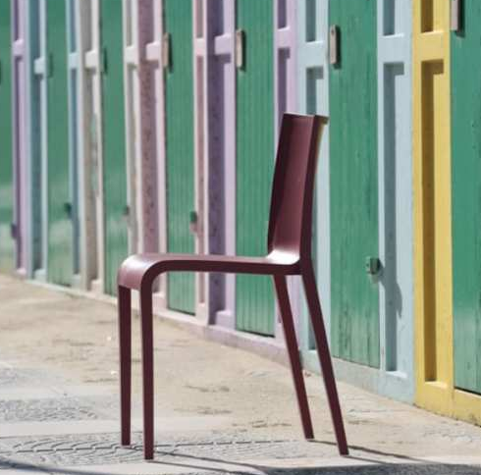
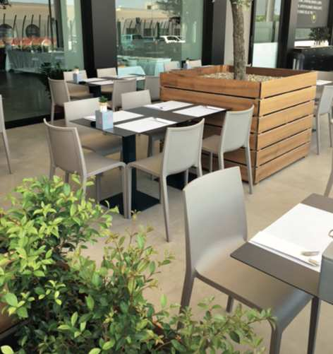
Nassau
ET AL COLLECTION
Notes:
QUICK SHIP ITEM! Air molded polypropylene monobloc stacking chair, and very light weight. BIFMA tested. Side chair and arm chair available for ordering in multiples of 5, and stack 10 high. Stools available for ordering in multiples of 2, and stack 4 high.
3 colors stocked in North Carolina (Squirrel Gray, Turtle Dove and White). For non-upholstered versions, Et. Al keeps 300-400 pieces of every colors and style stocked in Italy. Lead time for stocked items is 4-6 weeks from receipt of deposit. Side chair starts at $240 LIST

Slide 15
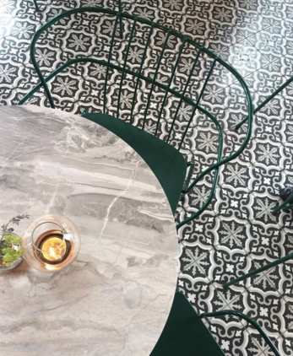
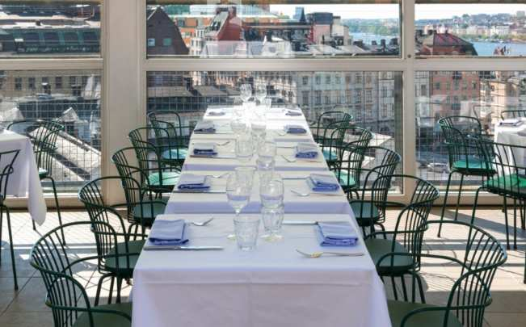
Flint
ET AL COLLECTION
Notes:
Art Deco inspired side and arm chair. Seat comes in 6 standard colors. Base can be in a variety of VR colors. Starts at $660 LIST.

Slide 16
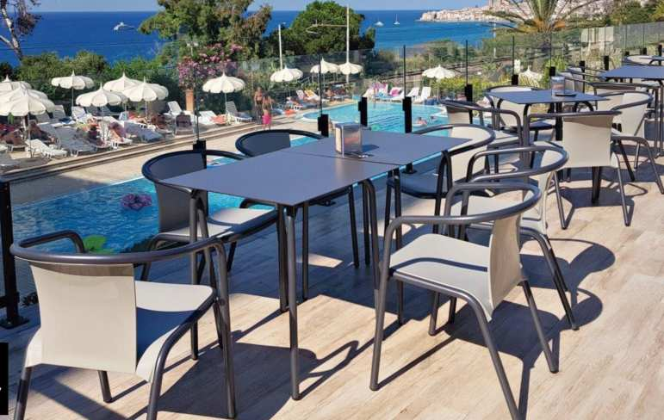
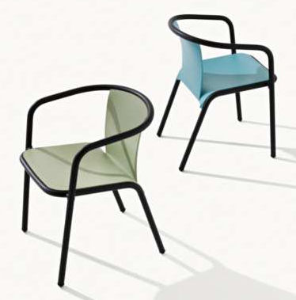
Mare
ET AL COLLECTION
Notes:
idden Gem in our outdoor collection. Stackable by 4, the Mare is a unique and classy arm chair. Seat and back comes in 6 options, and starts at $490 LIST. For indoor use, an upholstered seat pad is available.

Slide 17
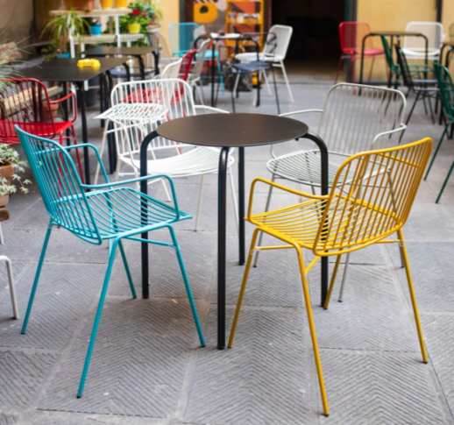
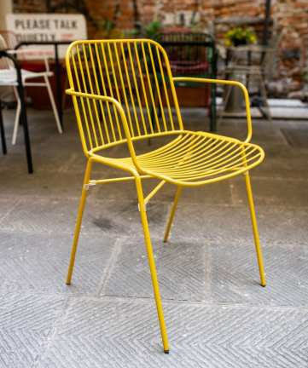
Shade
ET AL COLLECTION
Notes:
The Shade is designed after how the sun hits rebar, and the “shade” that is created by the reflection. The designer used 3 different type of metal diameters to create the family. Shade comes in a variety of VR colors, and has an optional cushion. Side chair and arm chair stacks 8 high. New Addition is the new Shade lounge. The stools stacks 6 high. Side chair starts at $570 LIST.

Slide 18
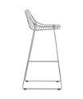
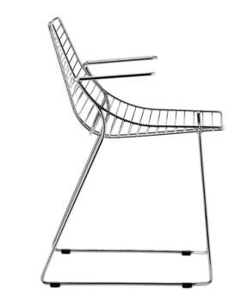
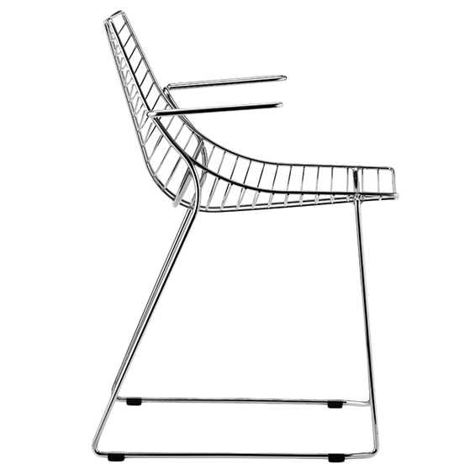
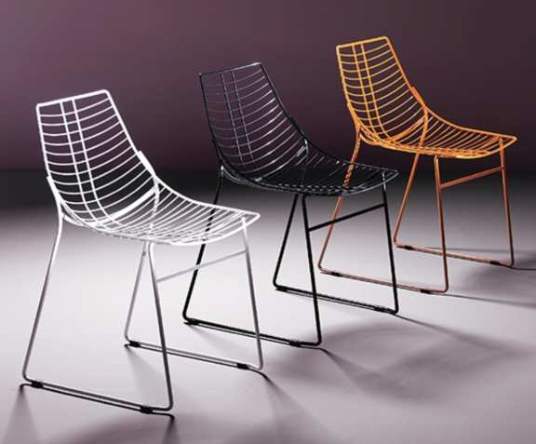
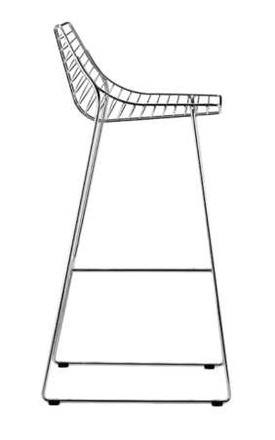
Net
ET AL COLLECTION
Notes:
Net is a classic and timeless design, and can comes with an optional cushion. Stacks by 4, and has a variety of VR colors to choose from. Family included arm and barstool.
Side chair starts at $620 LIST.

Slide 19
HDS
FORNASARIG COLLECTION
Notes:
Part of our High Density Stacker Family, the HDS 1.3 is galvanized steel, and comes in 3 standard colors. The cushion is magnetic, so not to blow away in the wind. It has also been tested to not de-magnetize credit cards. The side chair stacks 15 on the floor, and 45 on a dedicated trolly. The 5.1 (Lounge) is also available. The 1.3 starts at 540 LIST. The 5.1 starts at $760 LIST.

Slide 20
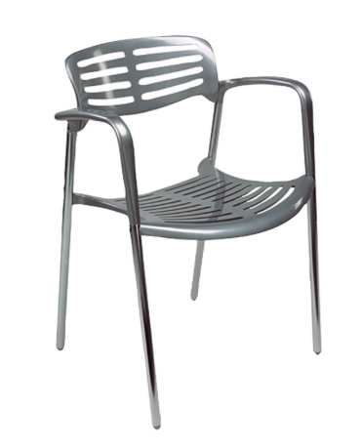
Art
LONDON COLLECTION
Notes:
Simplistic by design, the Art is constructed with aluminum. Starts at $620 LIST

Slide 21
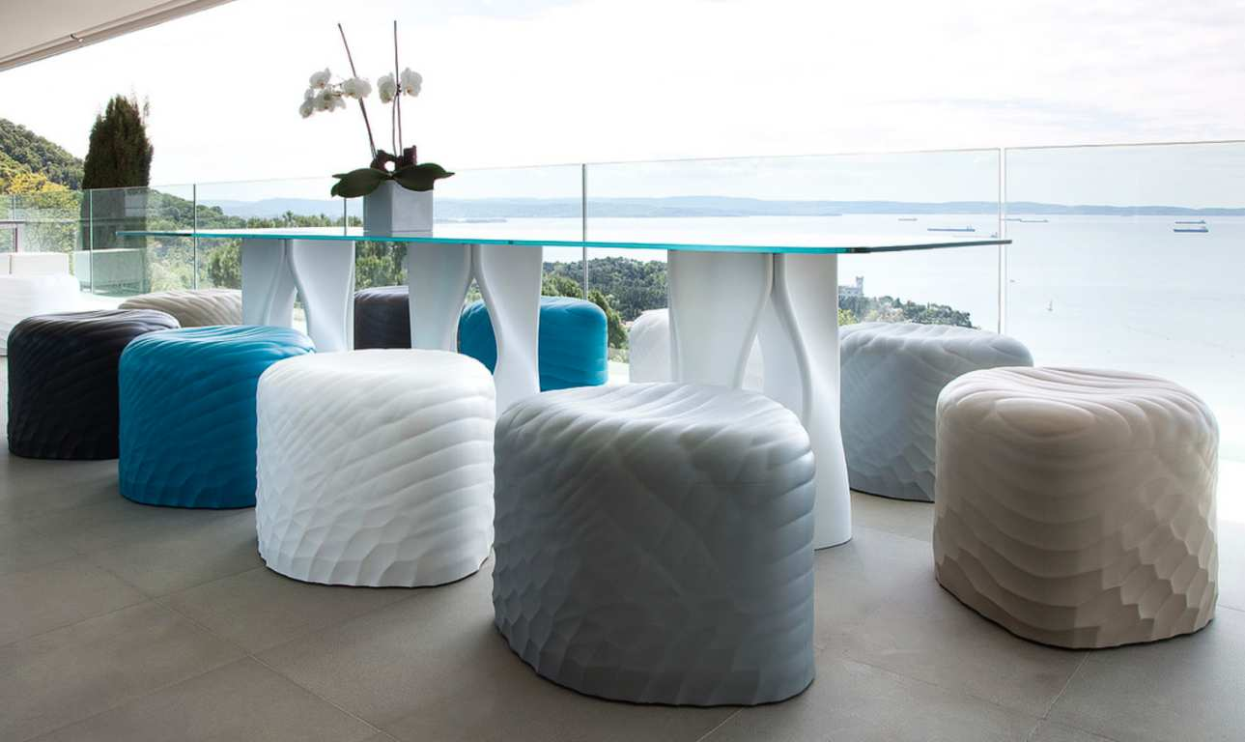
Tables

Slide 22
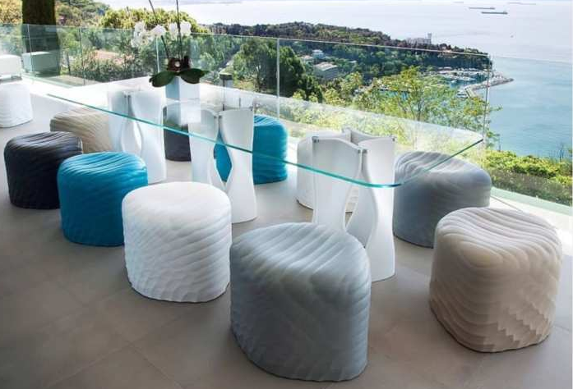
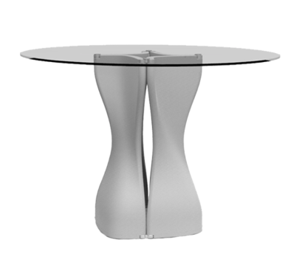
Mac’s Table
TONON COLLECTION
Notes:
Elegant in design by Tonon, the Mac Table comes in a variety of sizes. The base is constructed with polyurethane, made for outdoor use. A variety of colors to choose from. LIST pricing varies with base and table top size.

Slide 23
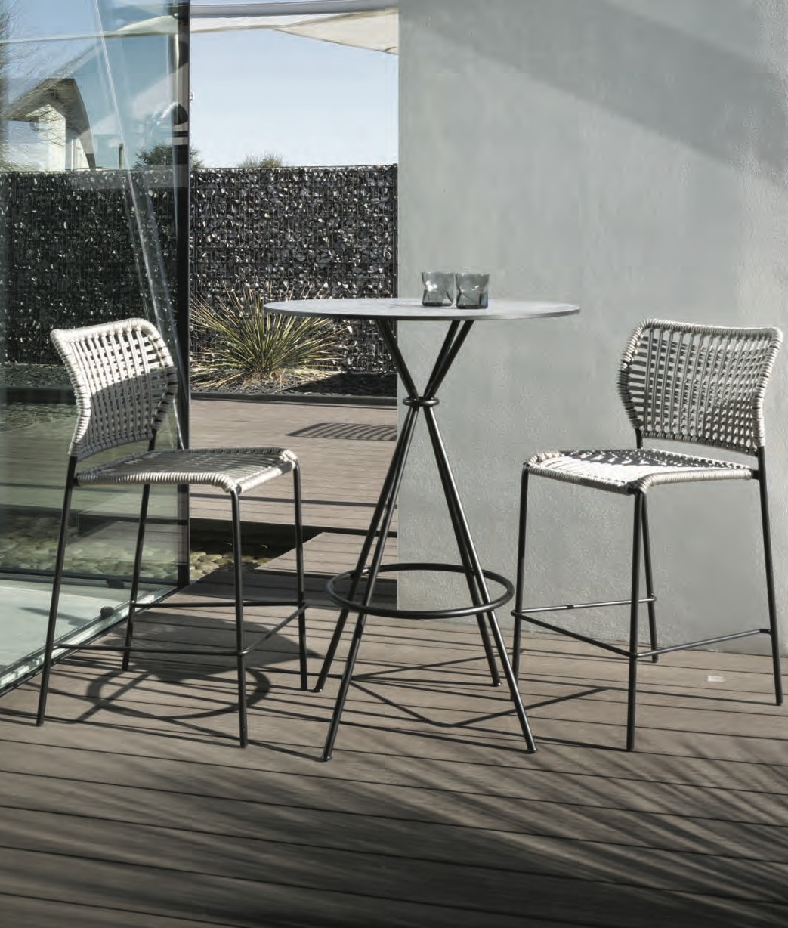
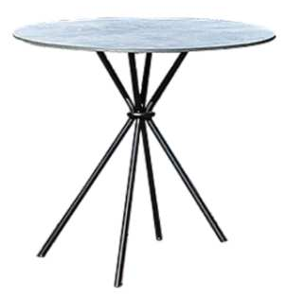
Corda
TONON COLLECTION
Notes:
Completing the Corda family, the Corda table is constructed with 10 layers of HPL, and available in 3 heights: Coffee table (15”), Dining (29.1”) and Bar (43”).
List pricing is: Coffee table $1150 LIST, Dining $1530 LIST and Bar $1660 LIST.

Slide 24
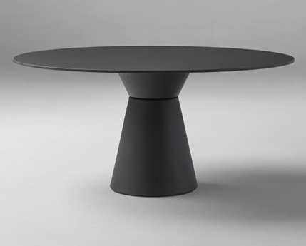
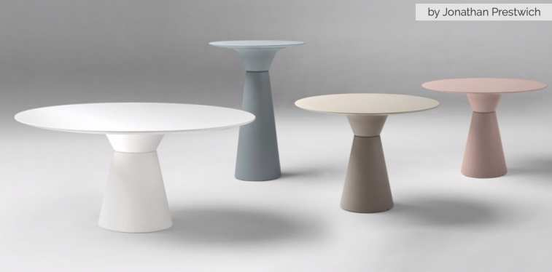
Essens
INCLASS COLLECTION
Notes:
Versatile table base, the Essens is a circular base base, made from polyethylene, and hollow. Available in a variety of heights and colors. For indoor use, the hollow base allows for cable management. Please call for LIST pricing.

Slide 25
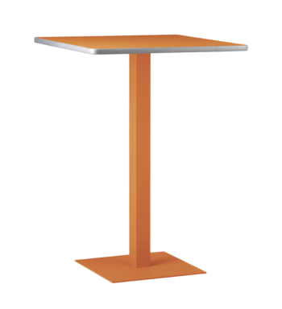
Bases & Tops
ET AL COLLECTION
Notes:
Please call for LIST pricing. Many styles and options available!

Slide 26
Art
LONDON COLLECTION
Notes:
Modern Aluminum table series. Call for LIST pricing.

Slide 27
Outdoor Environments
www.sandlerseating.com

