Slide 1
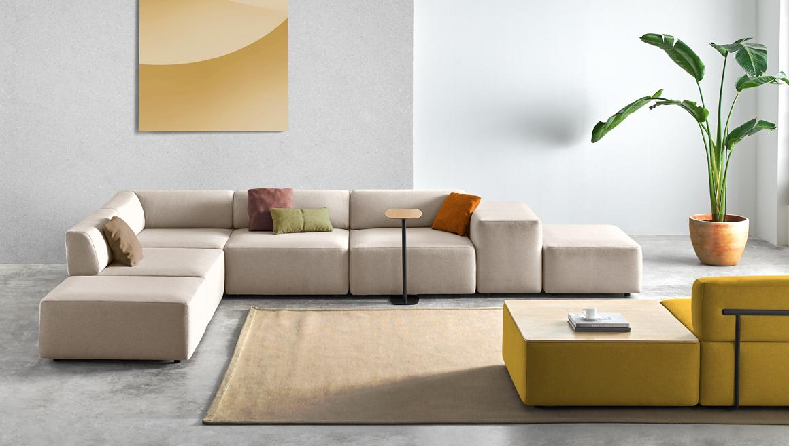
Lounge Seating

Slide 2
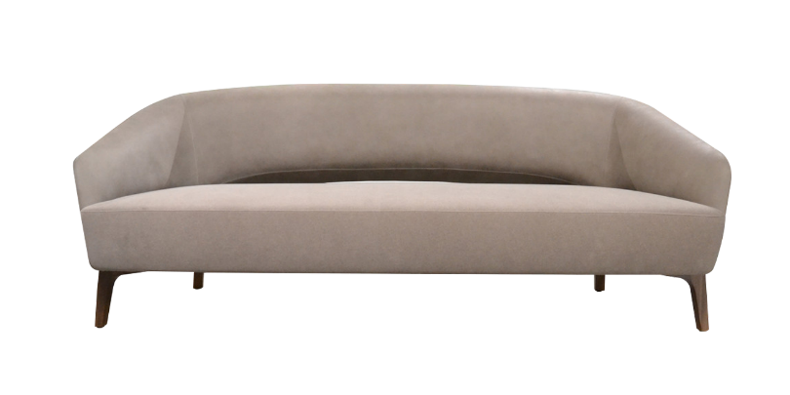
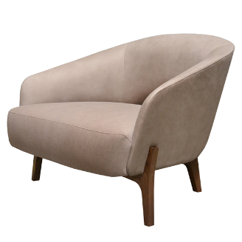
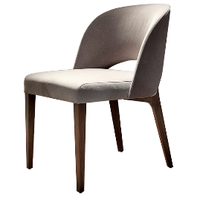
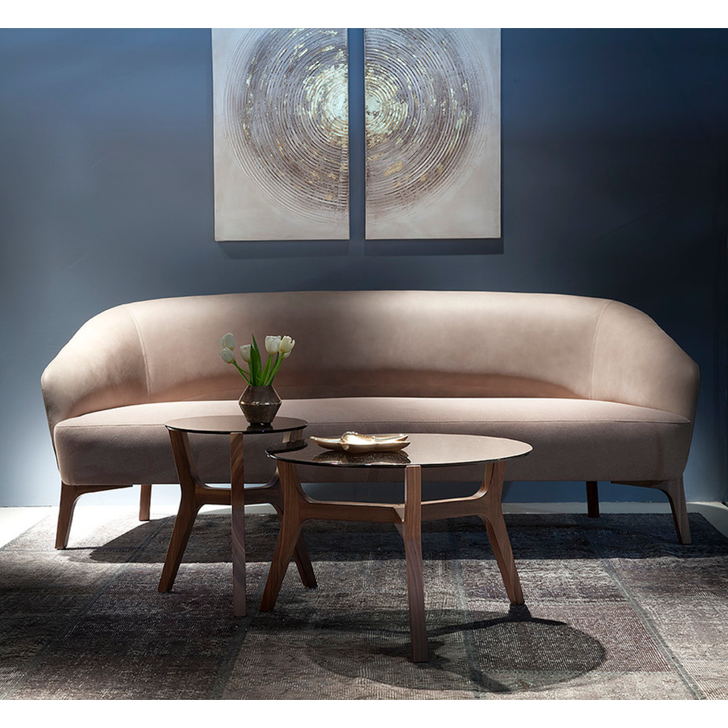
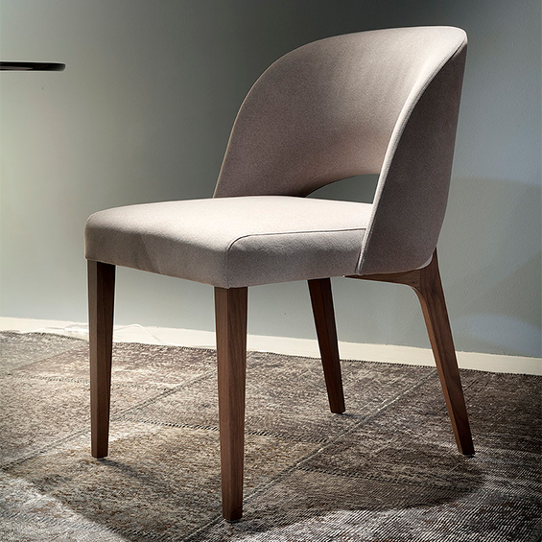
Libra
TONON COLLECTION
Notes:
Fully upholstered guest and lounge seating with matching tables. Sofa size is customizable. Starting at $2,450 list COM

Slide 3
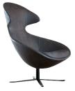
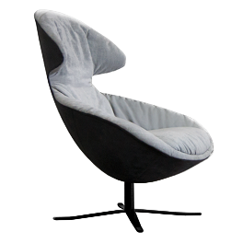
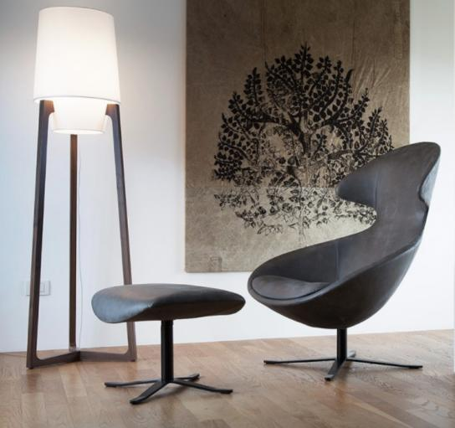
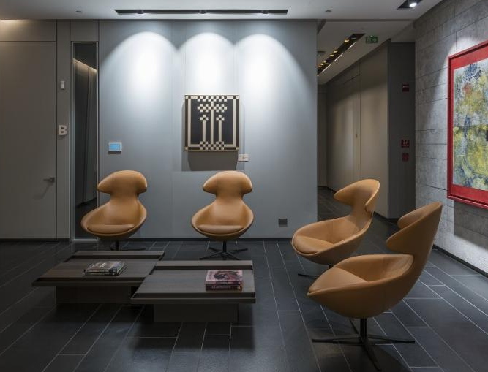
Loft
TONON COLLECTION
Notes:
Exquisitely comfortable lounge chair and ottoman. Tight and loose upholstery options. Starting at $1,800 list COM

Slide 4
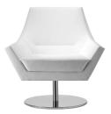
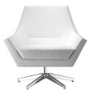
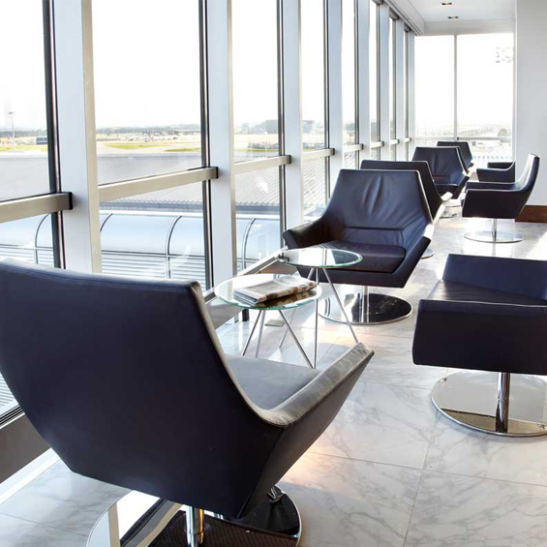
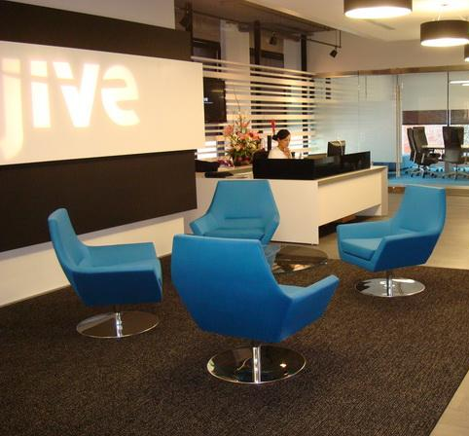
Fly Too
TONON COLLECTION
Notes:
Modern lounge chair with 360 degree swivel return. 5 star or disc base options. Starting at $3,470 list COM.

Slide 5
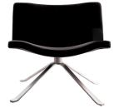
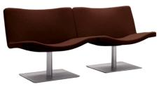
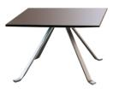
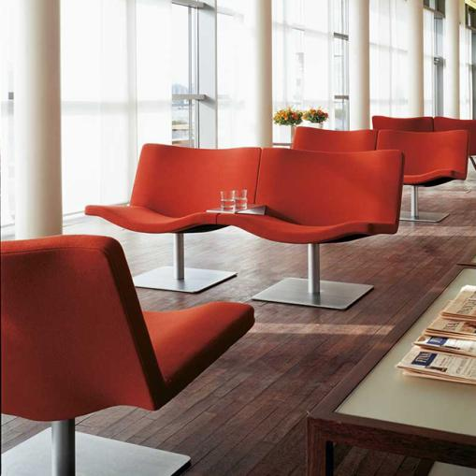
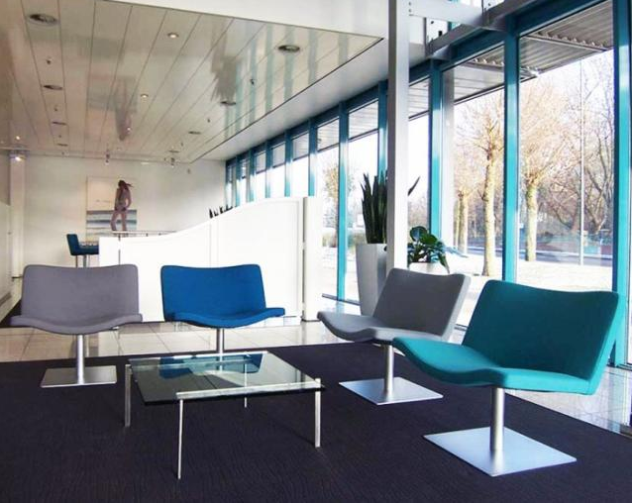
Wave
TONON COLLECTION
Notes:
Wave Series guest, lounge, stool and table series. Multiple base options, some with swivel/memory return. Starting at $1,200 list COM

Slide 6
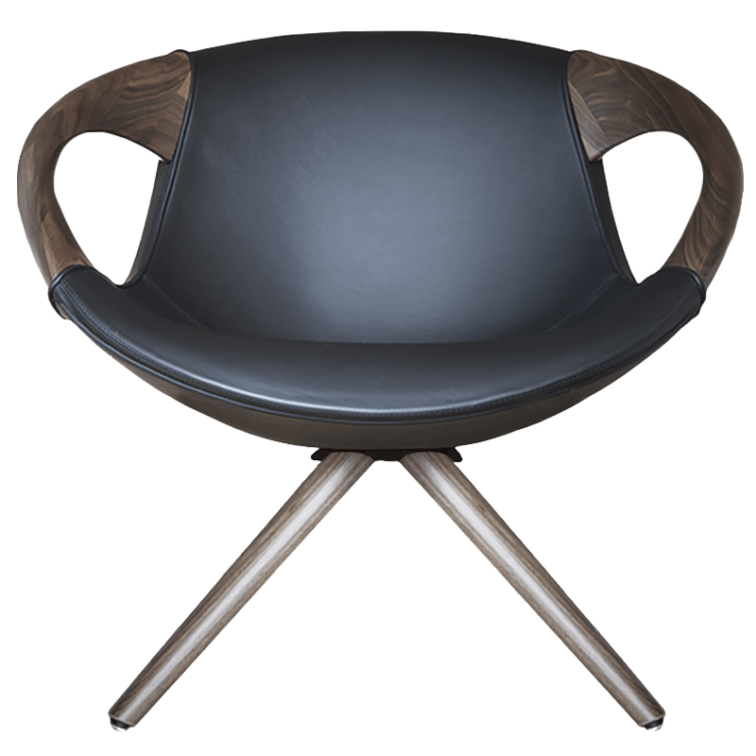
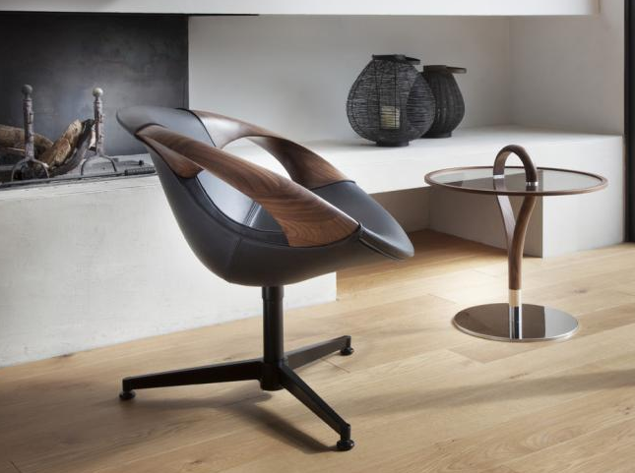
Up Lounge
TONON COLLECTION
Notes:
“C” Suite lounge chair with integral walnut arms. Four base options available. Starting at $6,800 list COM

Slide 7
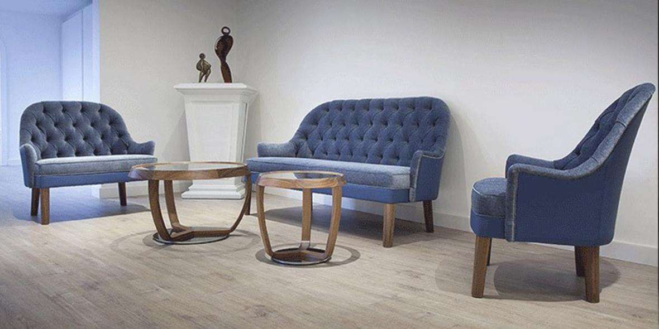
Spirit
TONON COLLECTION
Notes:
Traditional guest and lounge seating (shown with Time occasional tables). Tufted and non-tufted options. Starting at $2,730 list COM

Slide 8
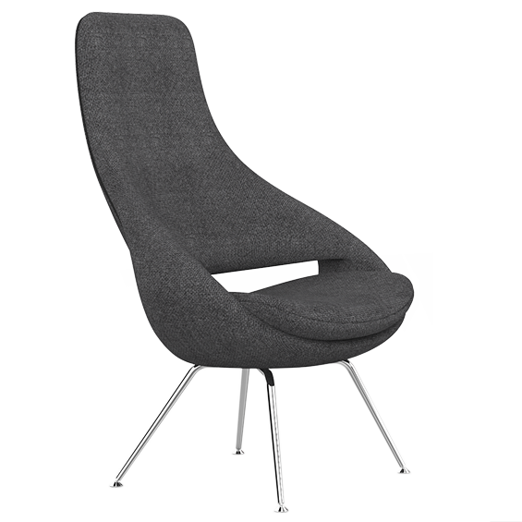
Ariane
LONDON COLLECTION
Notes:
Award winning lounge seating. Fixed and swivel base options. Unique zipper welting detail. Starting at $2,250 list COM

Slide 9
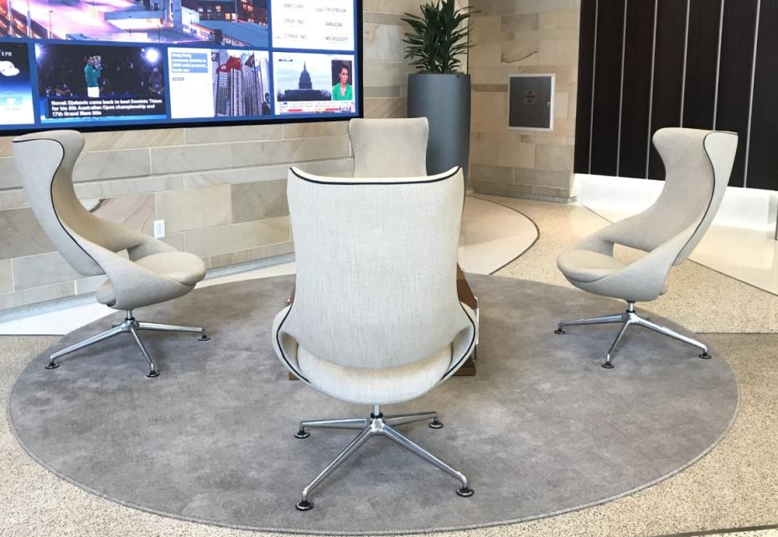
Ariane
LONDON COLLECTION
Notes:
Install of Ariane 1.1HB in Raleigh, NC

Slide 10
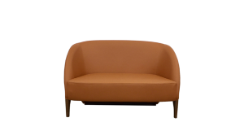
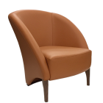
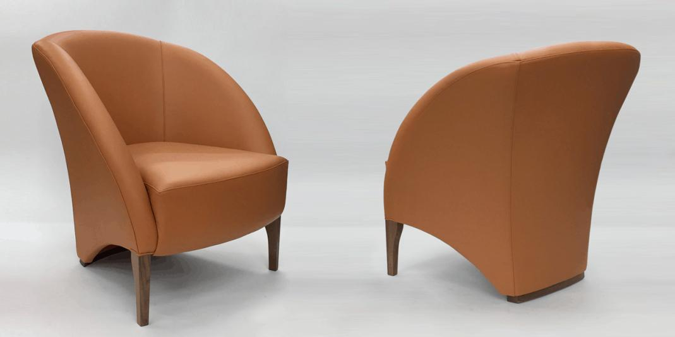
Premier Plus
LONDON COLLECTION
Notes:
Unique design lounge chair and settee. Value priced. Starting at $1,090 list COM.

Slide 11
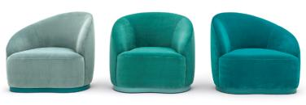
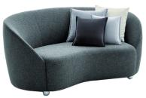
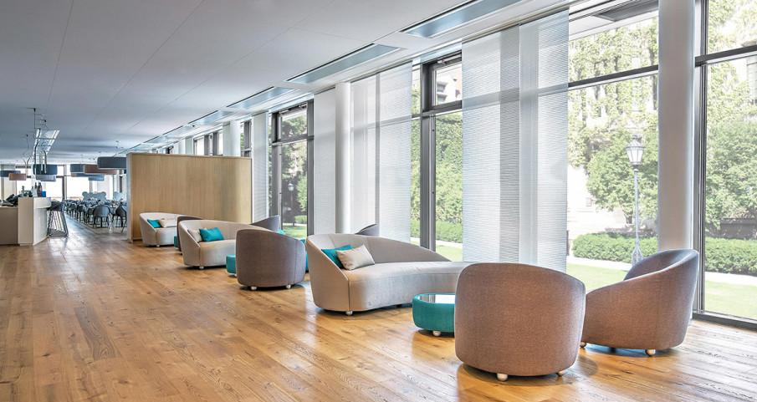
Luma
MONTBEL COLLECTION
Notes:
Massive collection of dining, guest, lounge, ottoman and table options. Custom pieces available. Lounge starting at $3,220 list COM

Slide 12
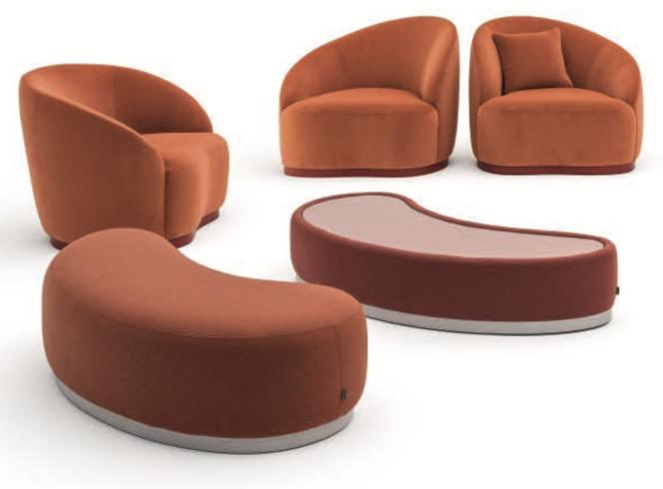
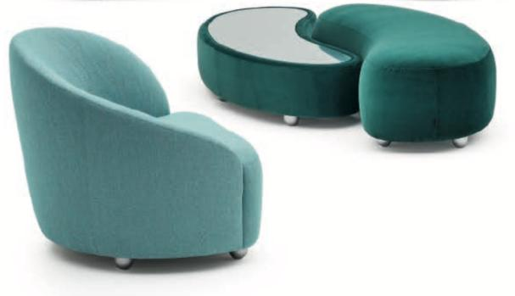
Luma
MONTBEL COLLECTION
Notes:
More from the Luma range. Notice the leg and plinth base options. Plinth bases can have LED lighting added.

Slide 13
Edgar
MONTBEL COLLECTION

Slide 14
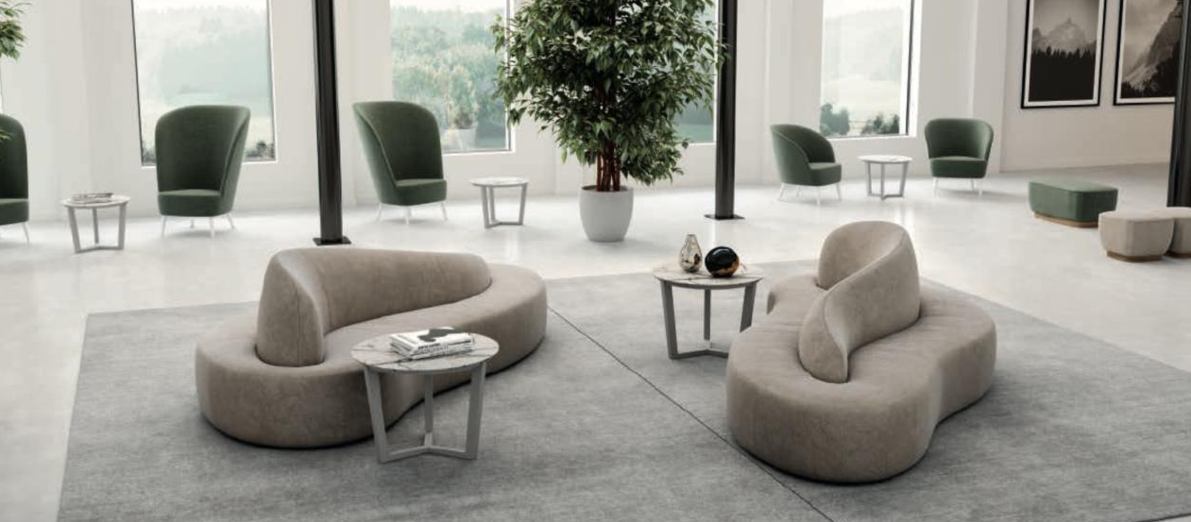
Star
MONTBEL COLLECTION

Slide 15
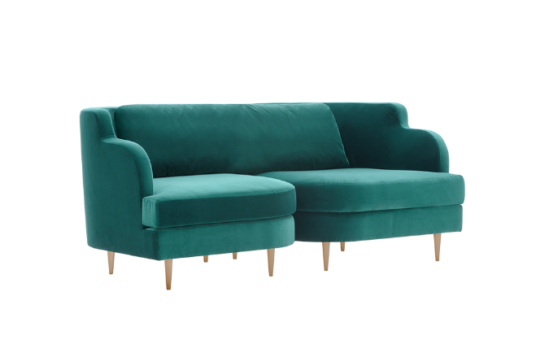
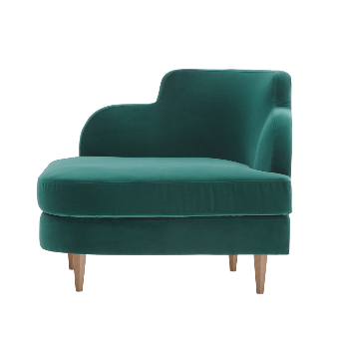
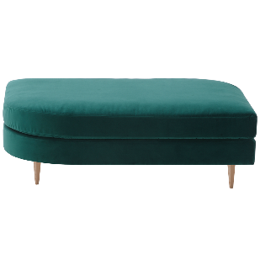
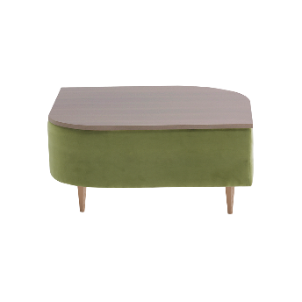
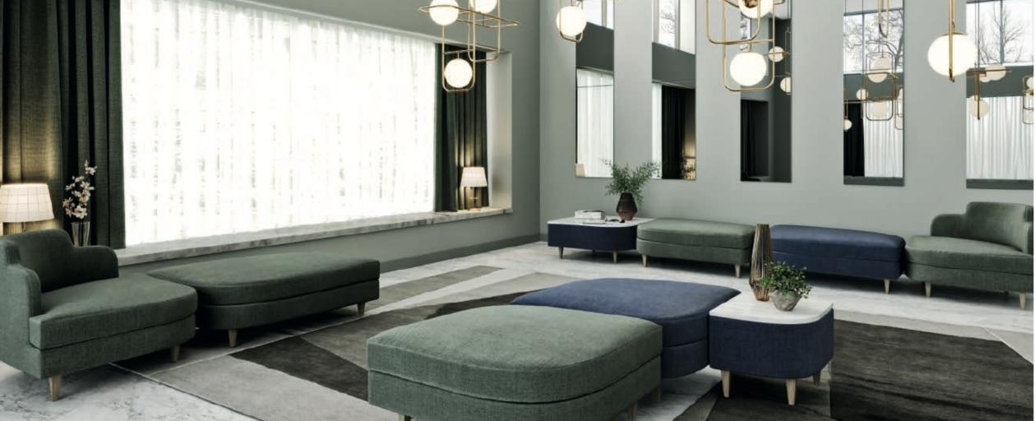
Delice
MONTBEL COLLECTION
Notes:
Art Deco inspired modular lounge, ottoman and table collection. Starting at $1,940 list COM

Slide 16
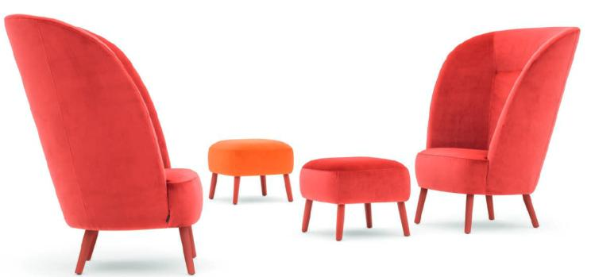
Rose
MONTBEL COLLECTION
Notes:
Extensive transitional lounge, ottoman, guest and dining collection. Many options available. Starting at $810 list COM

Slide 17
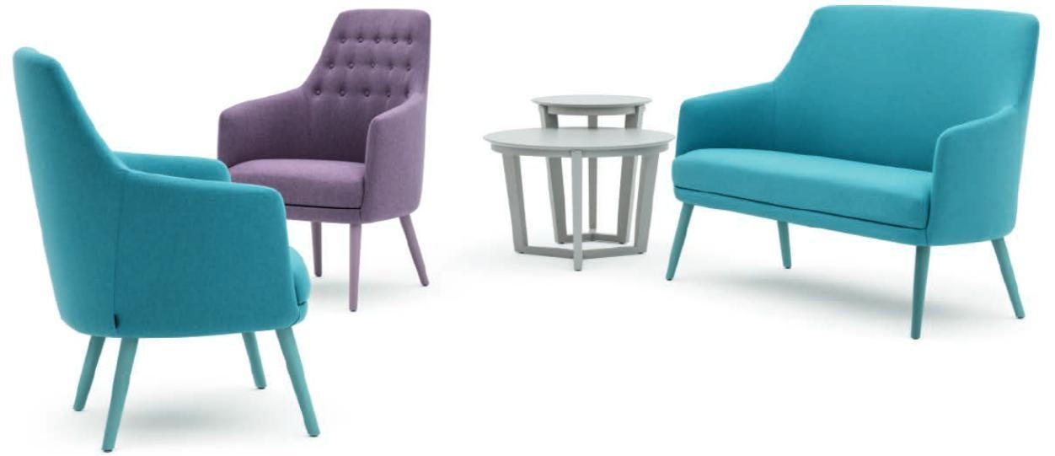
Danielle
MONTBEL COLLECTION
Notes:
Extensive transitional lounge, ottoman, guest and dining collection. Many options available. Shown with Trinity tables. Starting at $1,080 list COM

Slide 18
Entropy
INCLASS COLLECTION
Notes:
Beautiful modern low modular lounge (16.5”H). Deep seat, nearly endless array of sizes and configuration possibilities. Attractively priced.

Slide 19
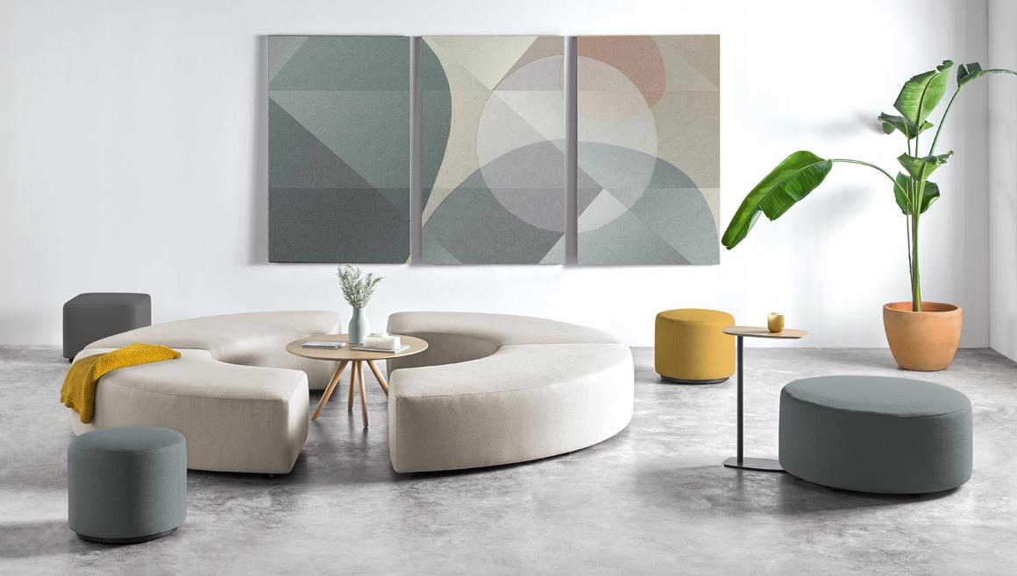
Entropy
INCLASS COLLECTION
Notes:
Perfect for amenity, collaboration and all types of lounge and gathering spaces. Note: not available in leather due to large scale.

Slide 20
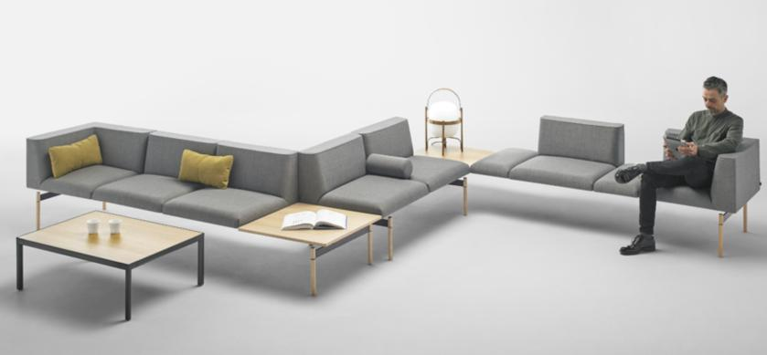
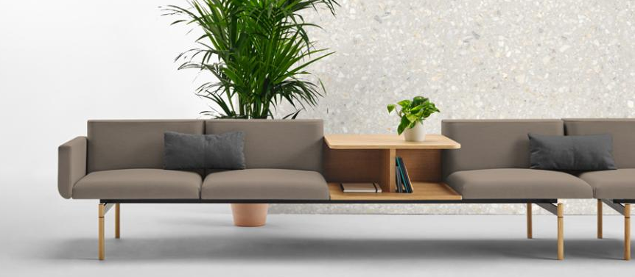
Lapse
INCLASS COLLECTION
Notes:
Transforms waiting areas into collaborative spaces for interaction, holding meetings or working in a team. Endless combinations for complete flexibility.

Slide 21
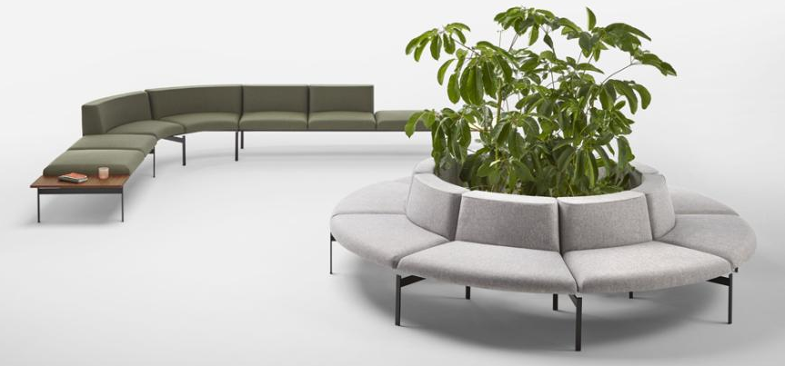
Lapse
INCLASS COLLECTION
Notes:
Injection molded foam core for a comfortable, somewhat firm sit. Pricing will vary based on configuration, but moderately priced.

Slide 22
Escalas
INCLASS COLLECTION
Notes:
Fantastic, affordable luxury in modular seating. Choose the frame, then configure to your liking. Legs are movable on track within the frame.

Slide 23
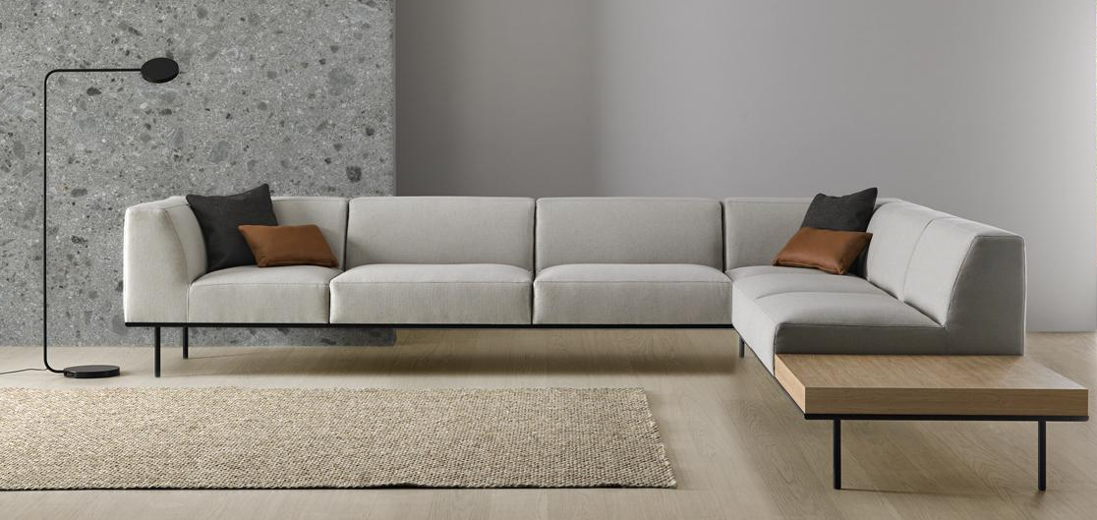
Escalas
INCLASS COLLECTION
Notes:
Legs can be spaced up to 3.5 full elements apart to create a sense of floating. Soft, but supportive cut foam inner cushions. Two back heights, two arm widths.

Slide 24
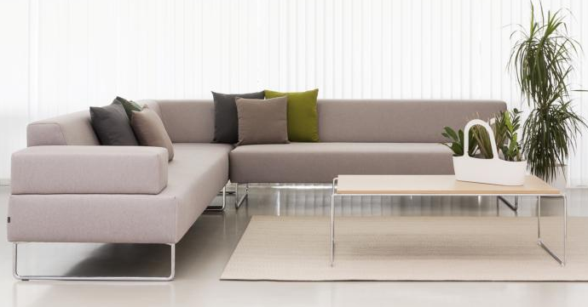
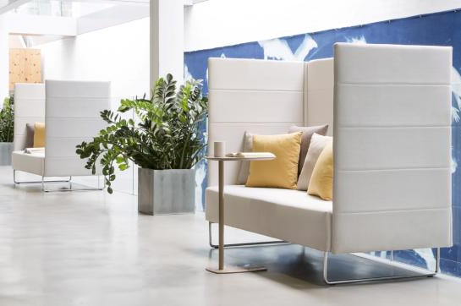
Tetris
INCLASS COLLECTION
Notes:
Upholstered geometric pieces on a rounded flat bar stock base. Perfect for reception areas and lounges as well as for informal meetings or simply places to unwind. Moderately priced.

Slide 25
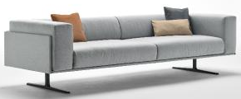
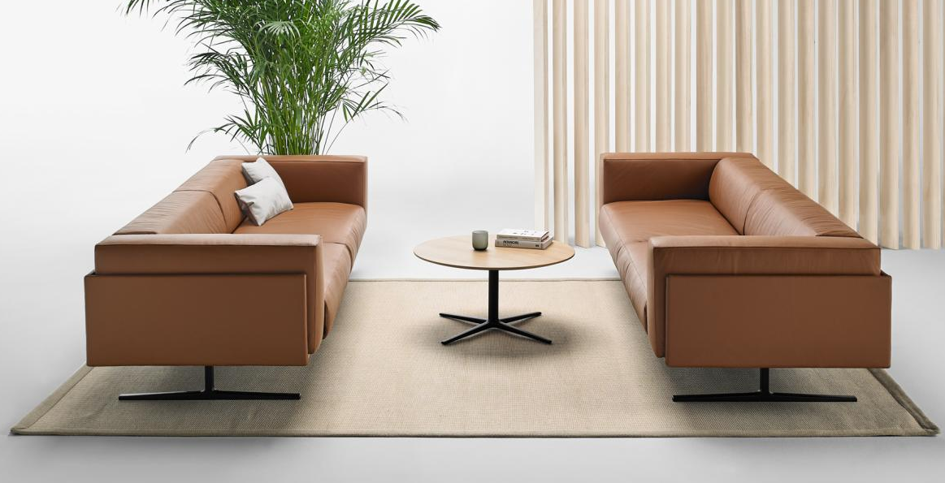
Marcus
INCLASS COLLECTION
Notes:
Luxurious lounge collection with unique wrap around shell and mid-century styling. Starting at $5,160 list COM.

Slide 26
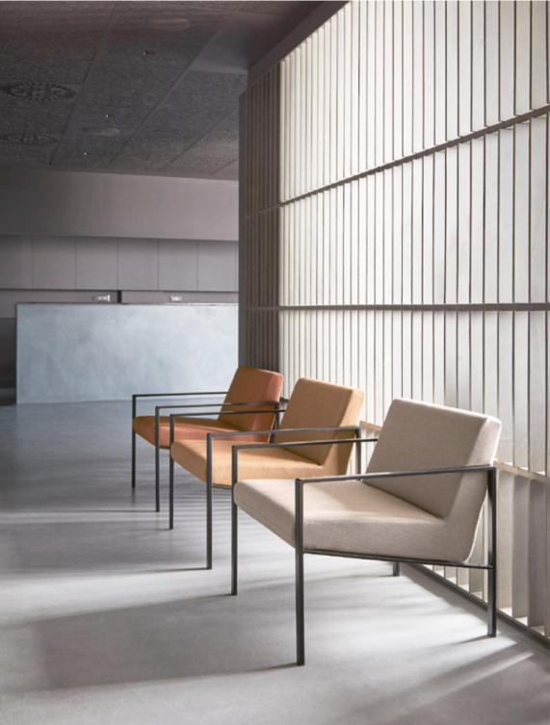
Lund
INCLASS COLLECTION
Notes:
Elegant lounge chairs and sofas available fully upholstered or upholstered with an exterior wooden shell. Arm caps optional. Starting at $2,010 list COM

Slide 27
Pau
INCLASS COLLECTION
Notes:
Modular upholstered lounge collection with a huge variety or options. Arms in wood, metal or upholstered. Custom shapes available.

Slide 28
Avalon
INCLASS COLLECTION
Notes:
Simple cubist style lounge chair, sette, sofa and table collection on a flat bar stock base. Starting at $2,680 list COM

Slide 29
Dunas XL
INCLASS COLLECTION
Notes:
Contemporary lounge chair series with numerous base options. Great for reception and collaboration spaces. Starting at $2,330 list COM

Slide 30
Unnia Soft
INCLASS COLLECTION
Notes:
Fully upholstered lounge version of our popular Unnia series. Arm/Armless versions as well as two base options. Starting at $1,570 list COM

Slide 31
Etnia
INCLASS COLLECTION
Notes:
Value priced lounge chair and tables. Simple modern design. Durable construction. Starting at $740 list COM

Slide 32
Cubik
INCLASS COLLECTION
Notes:
Architecturally simple value priced lounge chair with flat bar stock sled base. Matching table available. Starting at $1,370 list COM

Slide 33
Myra
ET AL COLLECTION
Notes:
Large family of sculptural lounge seating, ottomans and benches. Great contrast stitching option and unique tubular base. Starting at $730 list COM

Slide 34
Damon
ET AL COLLECTION
Notes:
Simple, streamlined arm and armless settees and sofas. Metal or wood legs in a variety of finishes. Starting at $2,360 list COM

Slide 35
www.sandlerseating.com

