Slide 1
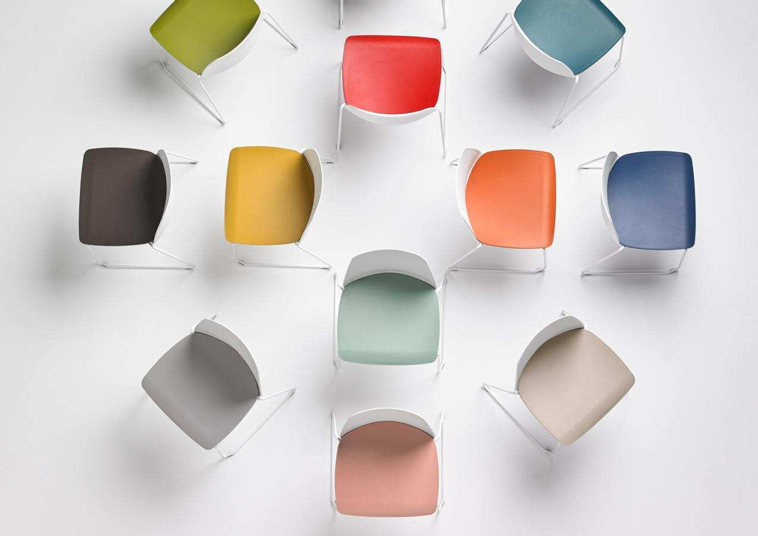
Stacking/Multipurpose Seating

Slide 2


Polypropylene & Polyurethane

Slide 3
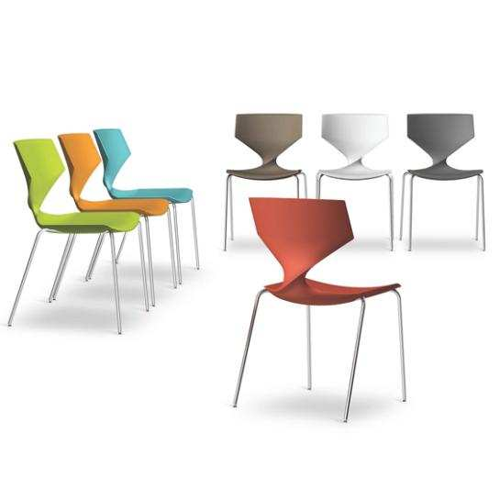
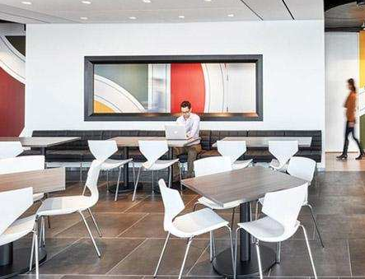
Quo
TONON COLLECTION
Notes:
Unique soft touch material is highly cleanable and disinfectable with Virex type agents or diluted bleach. Quo stacks 4 high and starts at $860 list

Slide 4

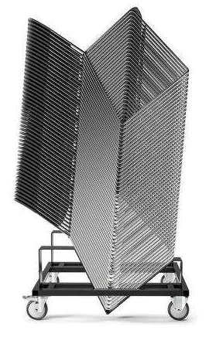
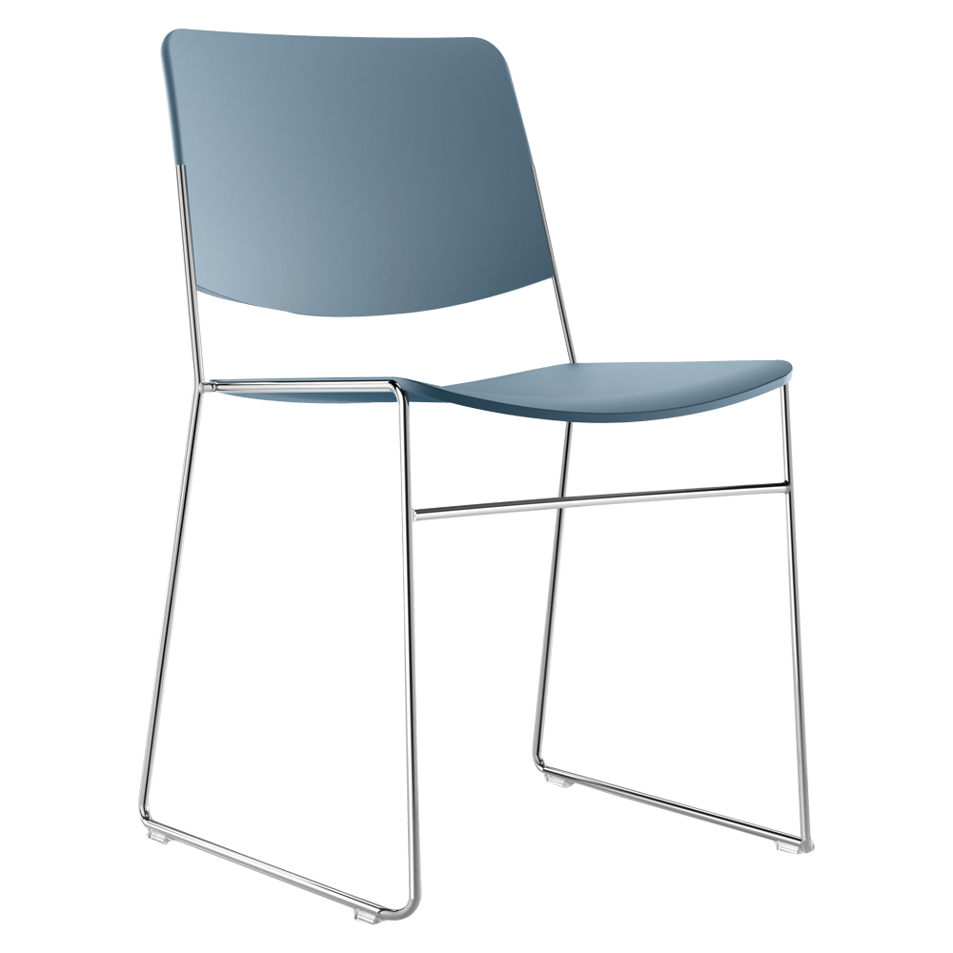
HDS
FORNASARIG COLLECTION
Notes:
Gold award winning, highest density stacking chair in the industry at 60 high on a dolly. Clean, modern design. Starts at $390 list

Slide 5
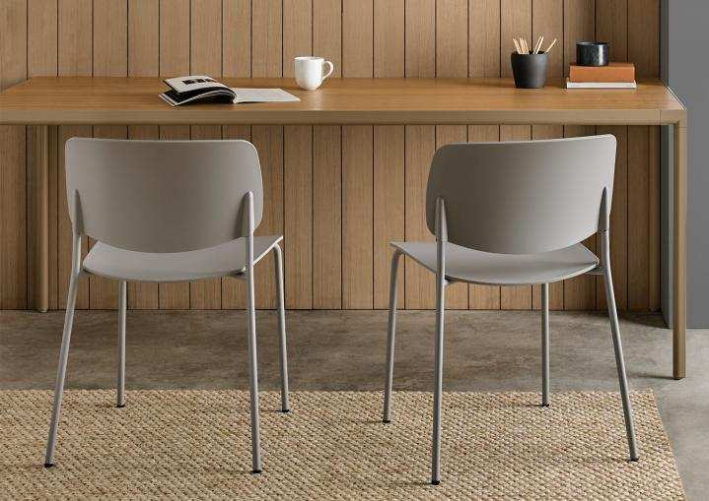
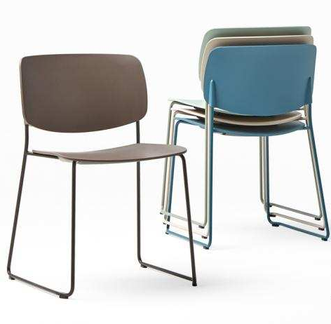
Aryn
INCLASS COLLECTION
Notes:
Newest addition to the Inclass collection of stacking chairs. 4 leg and sled base, multiple finish and color options. Starts at $440 list

Slide 6
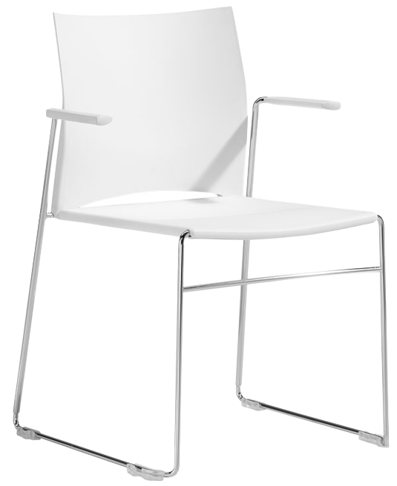
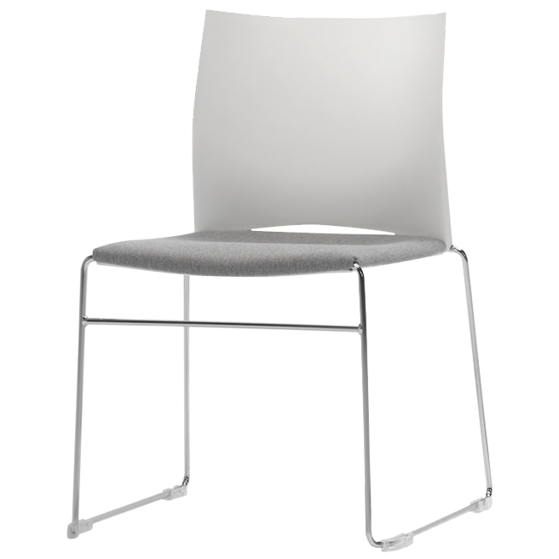
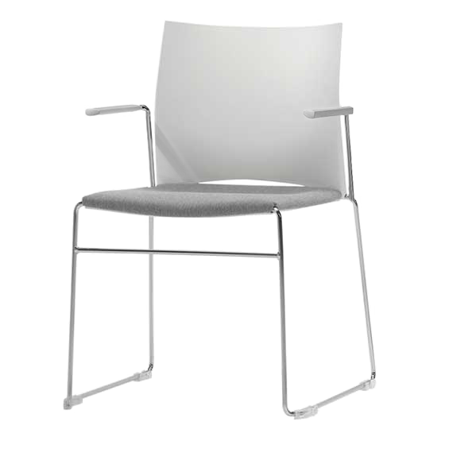
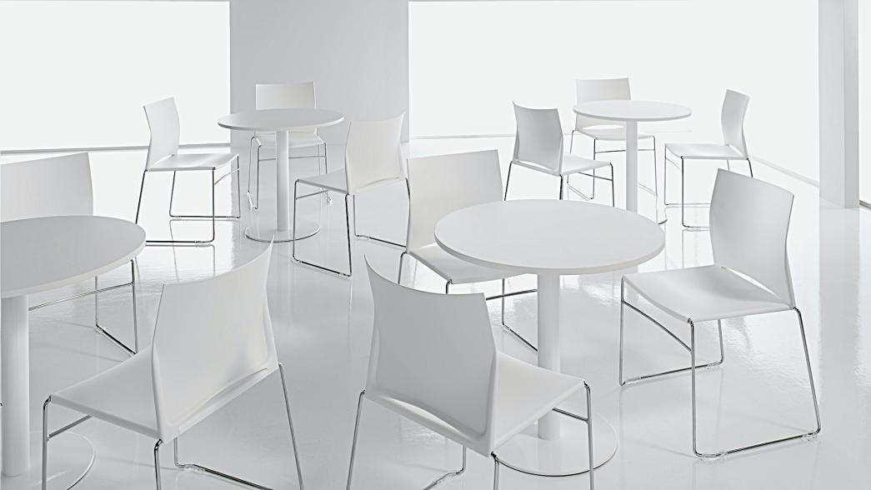
Slim
INCLASS COLLECTION
Notes:
Contemporary poly sled base. Stacks 20 high. 7 poly color options. Chrome frame only. $450 list

Slide 7
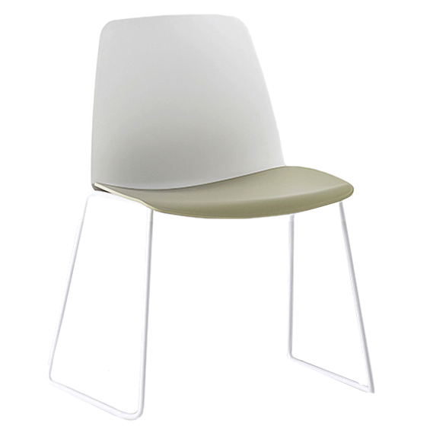
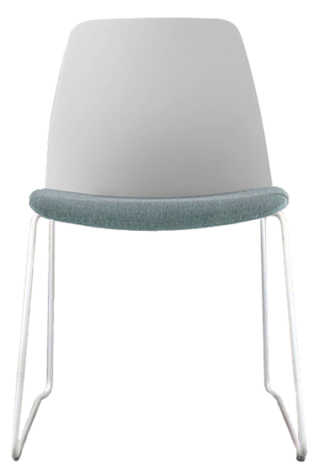
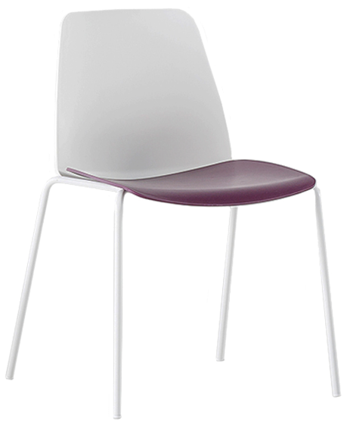
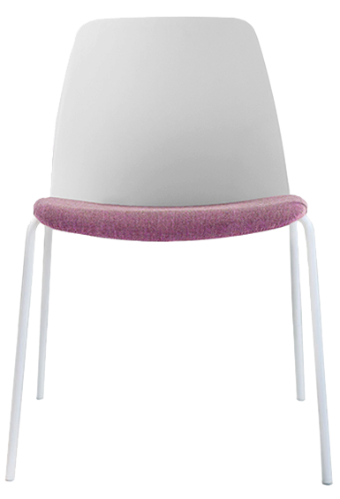
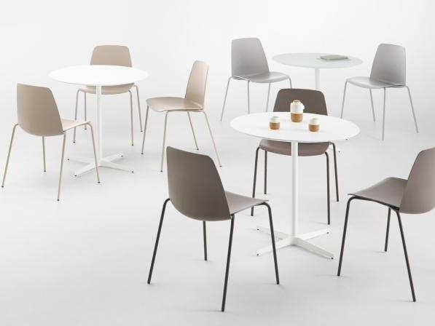
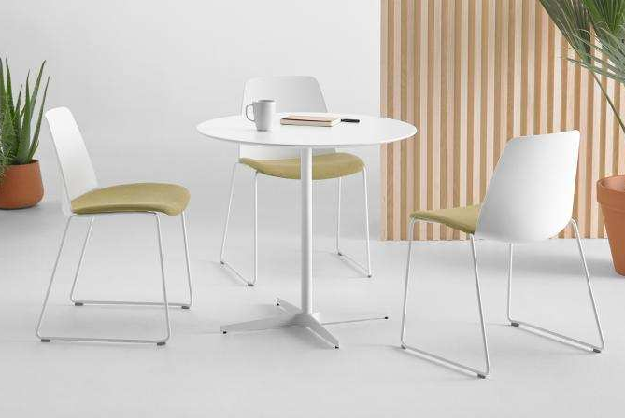
Unnia
INCLASS COLLECTION
Notes:
Two piece shell allows for specification of two different poly colors if desired at no upcharge. 4 leg or sled base. Stacks 20 high. Starts at $430 list

Slide 8
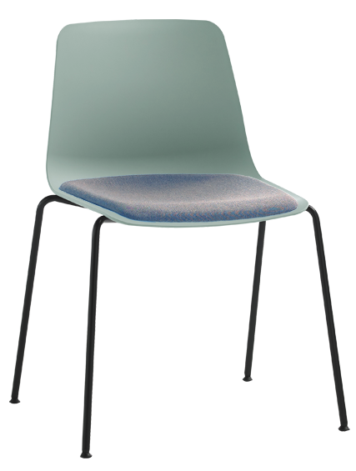
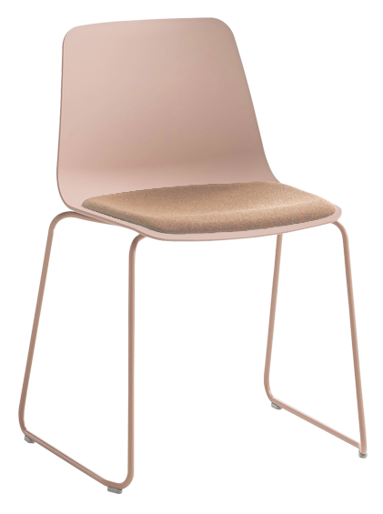
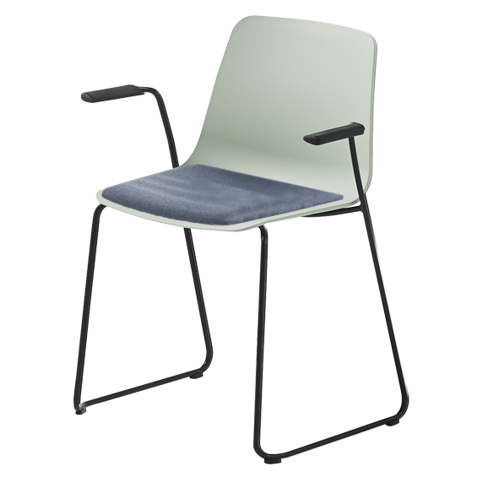
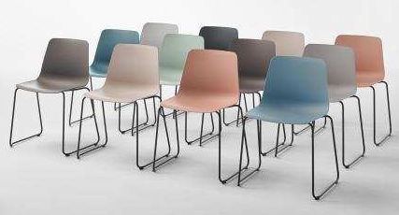
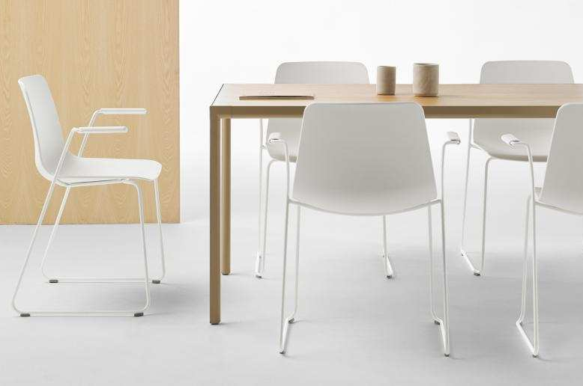
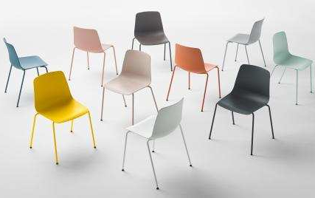
Varya
INCLASS COLLECTION
Notes:
Extensive collection starting with this poly shell available with many different bases, finishes and upholstered seat options. Starting at $370 list

Slide 9
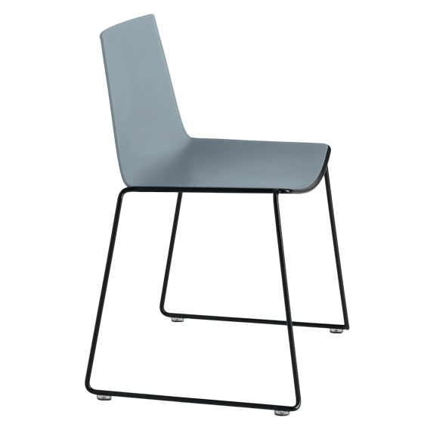
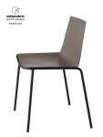
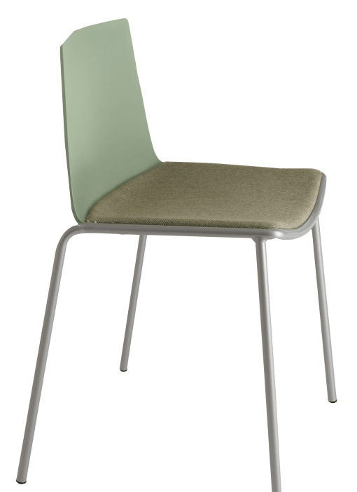
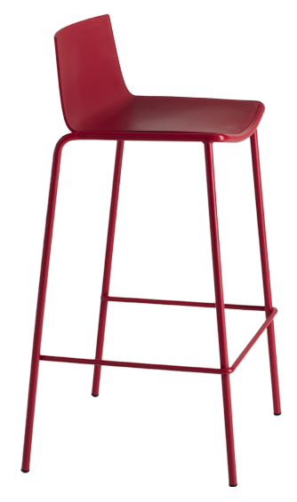
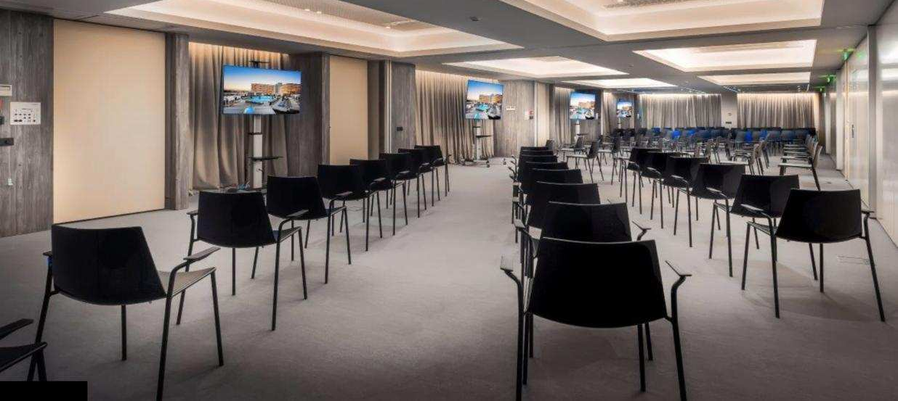
Cuba
ET AL COLLECTION
Notes:
Incredibly durable stacking chair and stool. 500lb weight capacity! 4 leg and sled base versions. Many finish options. Starting at $390 list

Slide 10
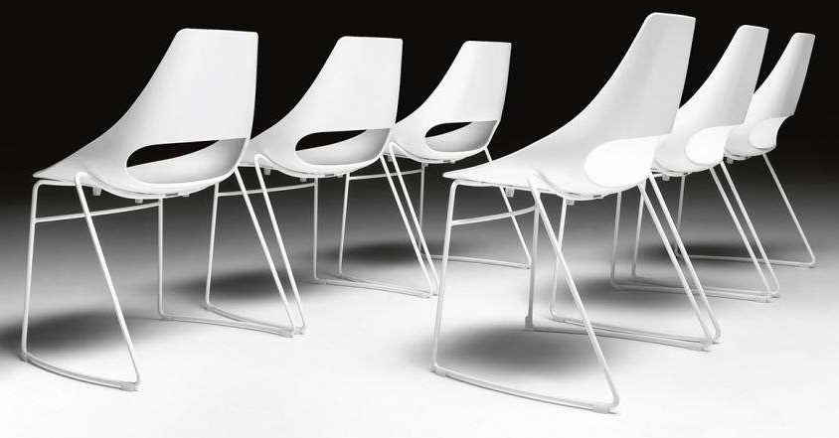
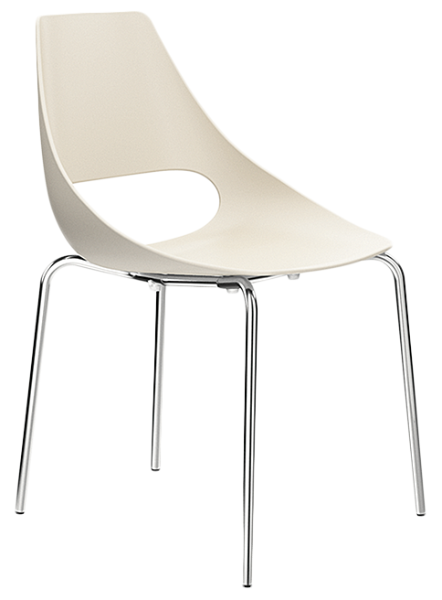
Echo
ET AL COLLECTION
Notes:
Timeless modern stack chair suitable for outdoor use in VR color option. Extremely durable. Weight tested to 300lbs. Starts at $370 list.

Slide 11
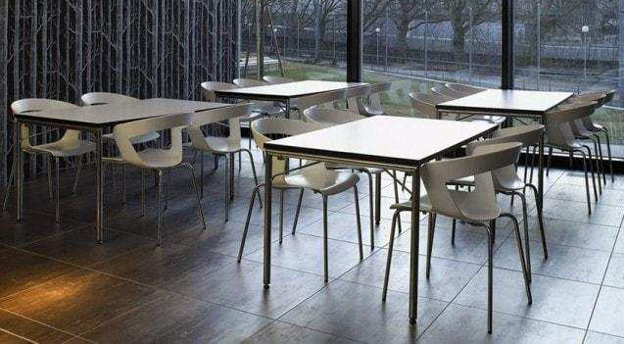
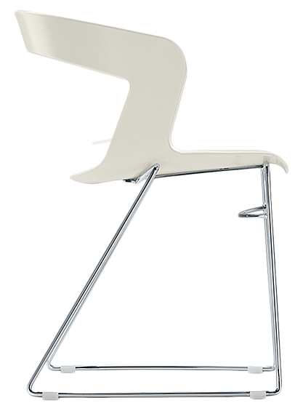
Ibis
ET AL COLLECTION
Notes:
Cousin to Echo. The perfect café chair for indoors or out (in VR colors). Stacks to 4 high. Weight tested to 300lbs. Starts at $420 list.

Slide 12
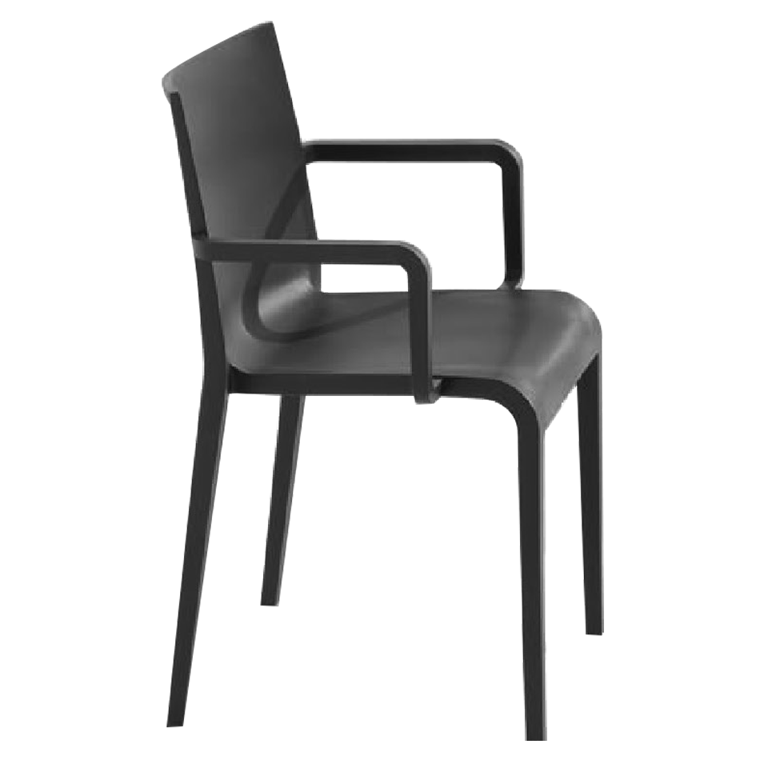
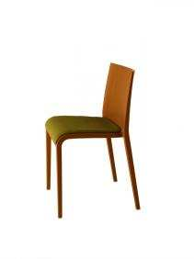
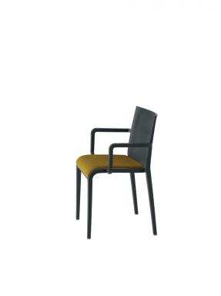
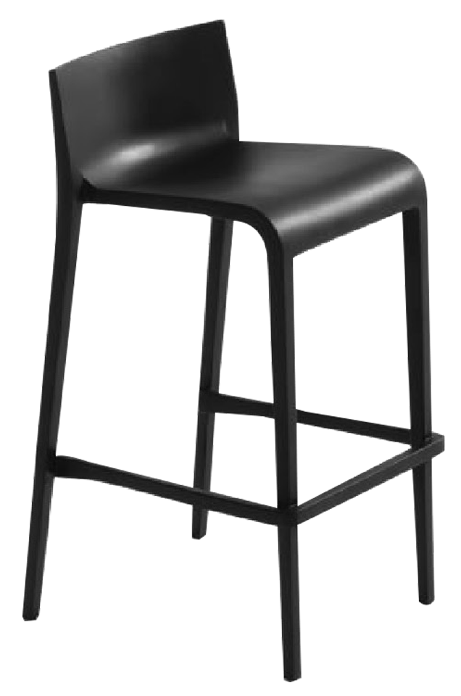
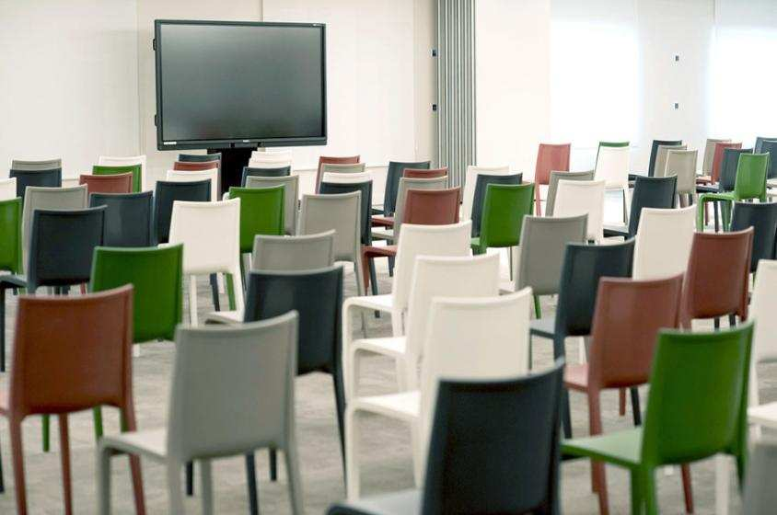
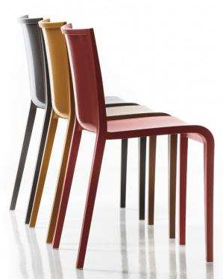
Nassau
ET AL COLLECTION
Notes:
Monoblock all Poly chair in fun colors suitable for indoors or out. Armchair and stool available. Stacks 10 high. Starts at an incredible $240 list!

Slide 13
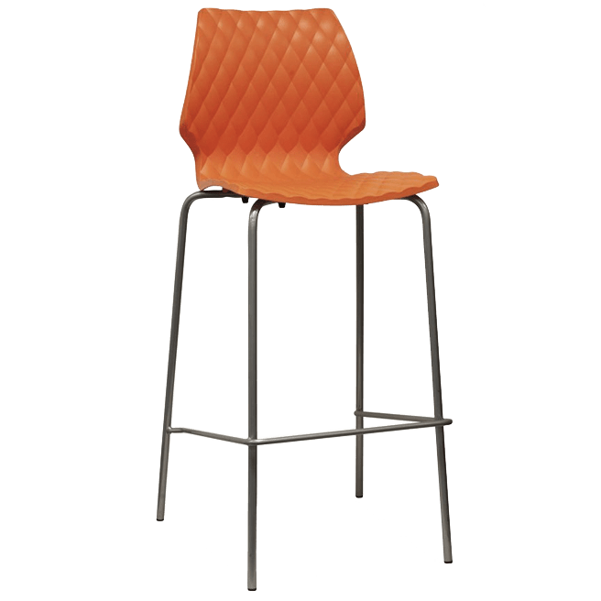
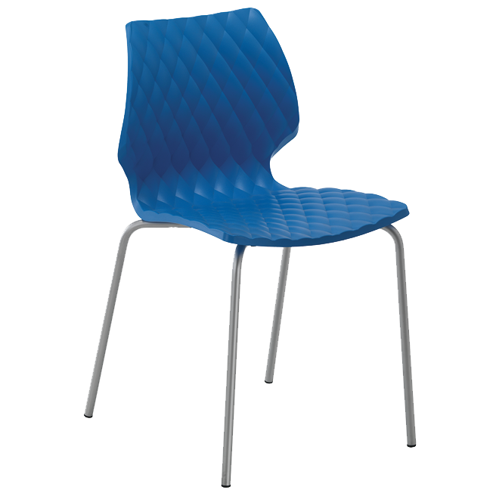


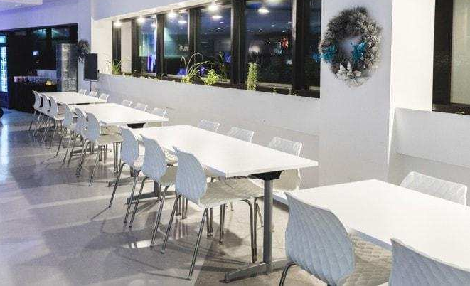
Uni
ET AL COLLECTION
Notes:
Whimsical embossed harlequin pattern design. Great café chair. Multiple base and color options. Stacks 8 high. Starts at $340 list

Slide 14
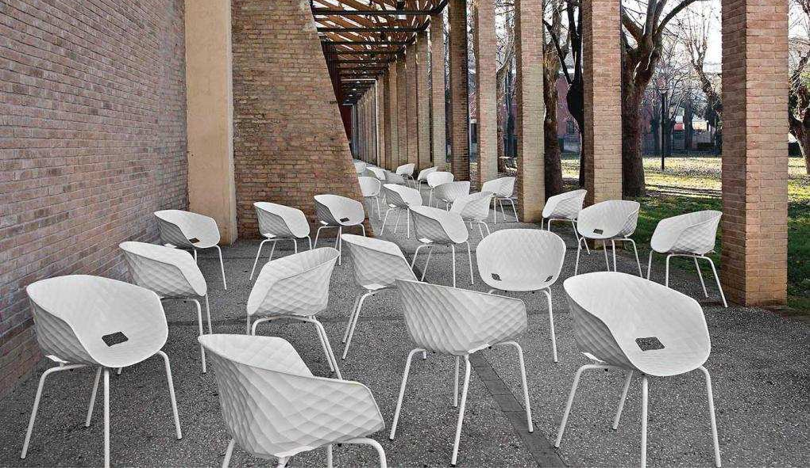
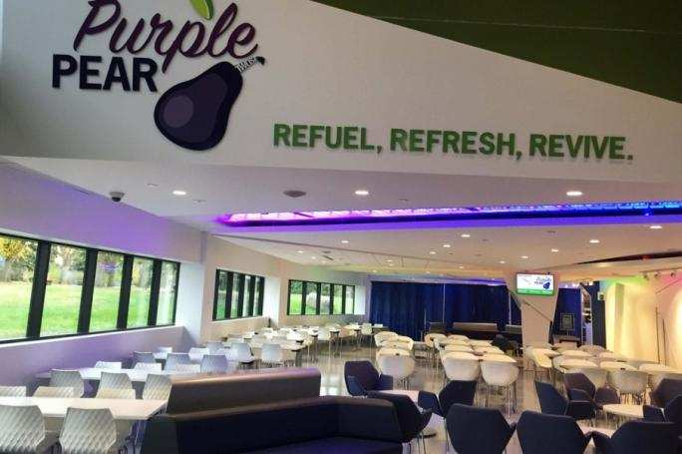
Uni-Ka
ET AL COLLECTION
Notes:
Armchair version of the Uni. Harlequin shaped textured finish. Outdoor compatible with VR frame. Stacks 4 high. Starts at $330 list

Slide 15
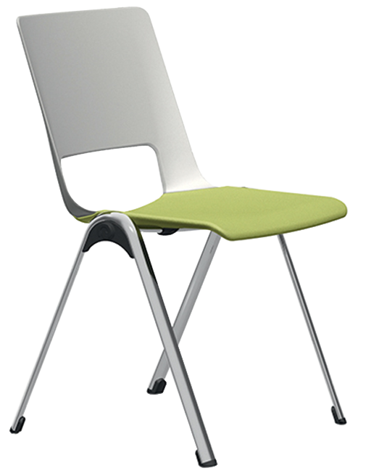
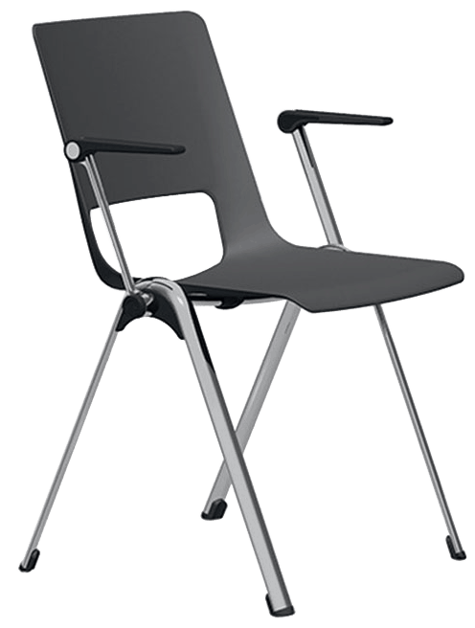
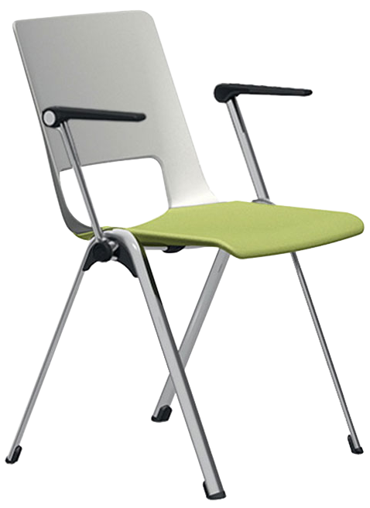
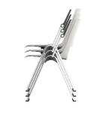
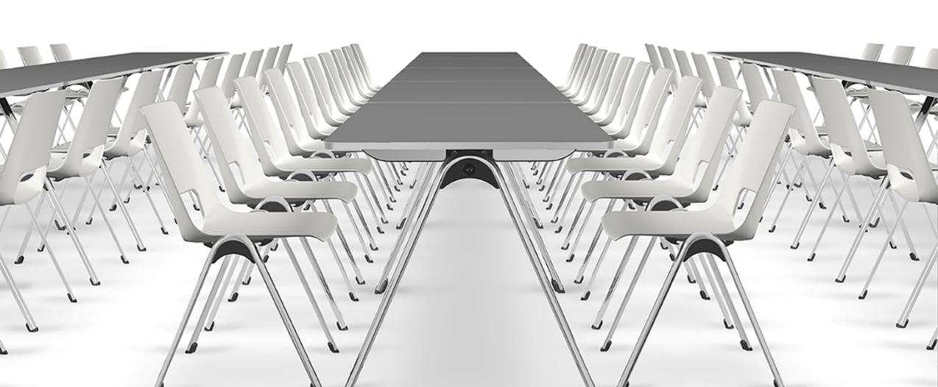
V-Stack
LONDON COLLECTION
Notes:
Unique vertical stacking chair and table. Suitable for assembly, meeting and other spaces. Stacks 25 high straight up. Starts at $490 list

Slide 16
Wood & Woodlook

Slide 17
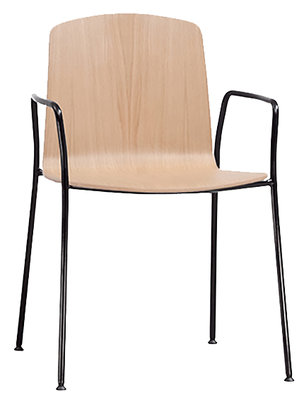
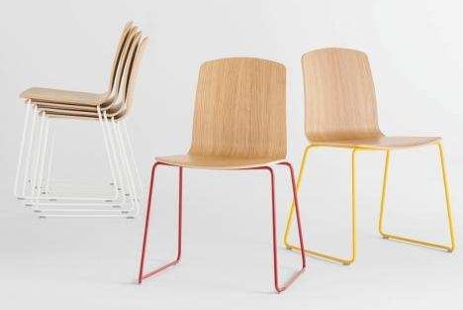


Ann
INCLASS COLLECTION
Notes:
Wood shell stacking chair and stools with wire rod 4 legs or sled base. Multiple finish options. Starting at $440 list

Slide 18





Arc
INCLASS COLLECTION
Notes:
Wood seat and back with wire rod 4 leg or sled base chair. Multiple finish options. Coordinating dining/café table. Starting at $700 list

Slide 19



Nim
INCLASS COLLECTION
Notes:
Curved one piece wood shell chair and stools. 4 leg and sled base options. Multiple finish options. Starting at $520 list

Slide 20



Varya
INCLASS COLLECTION
Notes:
Wood shell version of our popular Varya poly chairs and stools. 4 leg and sled base versions. Starting at $510 list

Slide 21


HDS
FORNASARIG COLLECTION
Notes:
Highest density (50 high) wood stacking chair on the market. Modern styling. Comfortable sit. Starting at $740 list

Slide 22





V-Stack
LONDON COLLECTION
Notes:
Wood shell version of our V-Stack chair. Available with optional folding arms as well as an upholstered seat. Stacks 25+ high. Starting at $560 list

Slide 23


Miss
TONON COLLECTION
Notes:
Sleek and slender Miss chair for dining environments. Stacks 6 high. Armless only. Starts at $1,240 list COM

Slide 24






Azure
MONTBEL COLLECTION
Notes:
Transitional and contemporary. Azure’s extensive line of guest, dining and bar seating fits any environment or budget. Starting at $680 list COM

Slide 25




Flame
MONTBEL COLLECTION
Notes:
Sleek and elegant. Flame is moderately priced for fine dining and guest seating applications. Starting at $880 list COM

Slide 26










Senzo
MONTBEL COLLECTION
Notes:
A great option for a lighter scaled wood framed dining or bar stool. Wood or upholstered back. Some models stack 6 high. Starting at $660 list COM

Slide 27



Timberly
MONTBEL COLLECTION
Notes:
A perennial Sandler favorite. Perfect for fine dining and guest areas. Stacks 4-5 high. Wood or upholstered backs. Starting at $920 list COM

Slide 28


Julia
GROOVE COLLECTION
Notes:
Our best selling wood framed dining chair. Arm chair and stools also available. Exceptionally priced starting at $470 list COM

Slide 29


Timber
GROOVE COLLECTION
Notes:
Large collection of dining, bar and lounge options. 4 back styles to choose from . Wood or upholstered combinations. Starting at $550 list COM

Slide 30




Yumi
GROOVE COLLECTION
Notes:
Scandinavian inspired wood/upholstered dining collection. Arm/Armless, chairs and stools. Starting at $870 list COM

Slide 31


Luna
ET AL COLLECTION
Notes:
Molded wood shell café chair with metal frame. Also available fully upholstered. Two stool options available. Starting at $440 list COM

Slide 32



Woodlook
WOODLOOK COLLECTION
Notes:
Perfect solution for today’s challenging environments. Highly cleanable and disinfectable aluminum frame with applied woodgrain film.

Slide 33



Woodlook
WOODLOOK COLLECTION
Notes:
Highly scratch resistant. Weight limit to 400lbs. Unparalleled 15 year warranty. Stacks 4-6 high. Over 35 models to select from.

Slide 34



Woodlook
WOODLOOK COLLECTION
Notes:
Many frames in our walnut 24A finish are in stock in our Conover, NC facility for quick turn around. Starting at $580 list COM Custom solutions too!

Slide 35
Upholstered

Slide 36



Ann
INCLASS COLLECTION
Notes:
Upholstered version of the classic Ann stacker. Painted or chrome 4 leg or sled base metal frame. Stools available Starting at $540 list COM

Slide 37





Varya Tapiz
INCLASS COLLECTION
Notes:
Beautiful upholstery details in your choice of tight, channel stitch or gathered. 4 leg or sled base. Wood and metal leg options. Starting at $640 COM

Slide 38



HDS
FORNASARIG COLLECTION
Notes:
Our highest density upholstered stacking chair (30 high). Stacking counter stool too! (10-12 high) Painted or chrome frame. Starts at $550 list COM

Slide 39






V-Stack
LONDON COLLECTION
Notes:
Vertical stacking chair with many options. Stacks 20-25 high. Poly or wood shell. Upholstered seat or fully upholstered inner shell. From $590 list COM

Slide 40


Nim
INCLASS COLLECTION
Notes:
Stylish 4 leg or sled base stacker with beautiful welting detail on edges and back. Stools also available. Starting at $670 list COM

Slide 41




Slim
INCLASS COLLECTION
Notes:
Gorgeous channel stitching is the highlight of this series. Tight upholstery detail also available. Stacks 15 high. Starting at $570 list.

Slide 42



Unnia
INCLASS COLLECTION
Notes:
Upholstered seat with poly back of fully upholstered. Two tone detail available at no upcharge. Many base options. Starting at $530 list COM

Slide 43
Outdoor

Slide 44


Corda
TONON COLLECTION
Notes:
Extensive collection of chairs and tables suitable for year-round outdoor use. Made with marine grade Kevlar nylon roping. Starting at $1,090 list

Slide 45


HDS
FORNASARIG COLLECTION
Notes:
Outdoor mesh version of our HDS stacker. Optional magnetic seat cushion. Lounge chair also available. Stacks 45 high. $540 list and up

Slide 46


Mare
ET AL COLLECTION
Notes:
Classic from our Et al collection. Poly seat and aluminum frame. Completely outdoor compatible. Upholstered seat also available. Starting at $490 list

Slide 47






Net & Shade
ET AL COLLECTION
Notes:
Light scaled indoor/outdoor wire frame chair and stools. Great painted color options. Stacks 8 high. Starting at $570 list.

Slide 48
www.sandlerseating.com

