Slide 1
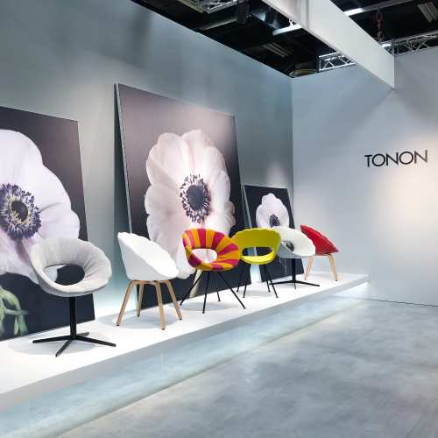
New Additions 2020- 2021

Slide 2
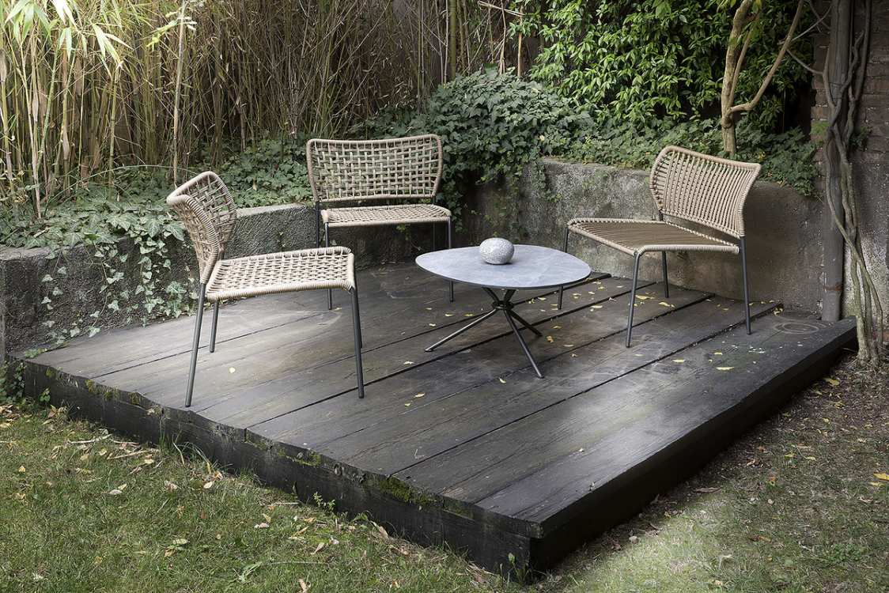
Tonon

Slide 3
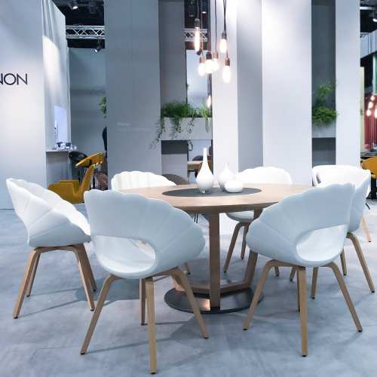
Flower
TONON COLLECTION

Slide 4
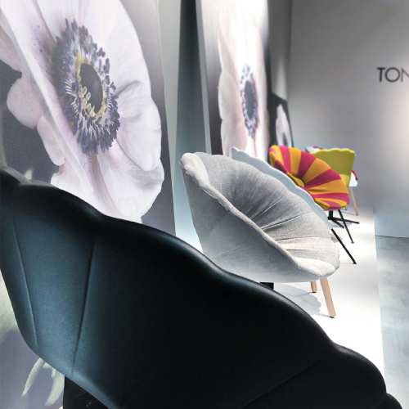
Flower
TONON COLLECTION

Slide 5
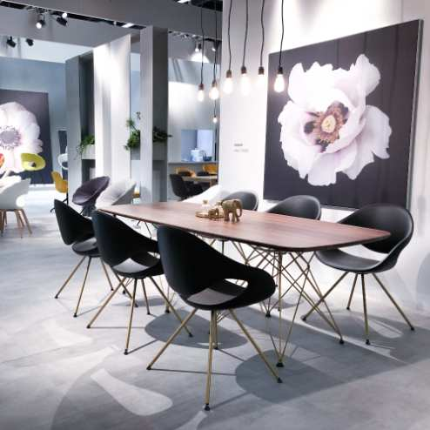
Moon
TONON COLLECTION

Slide 6
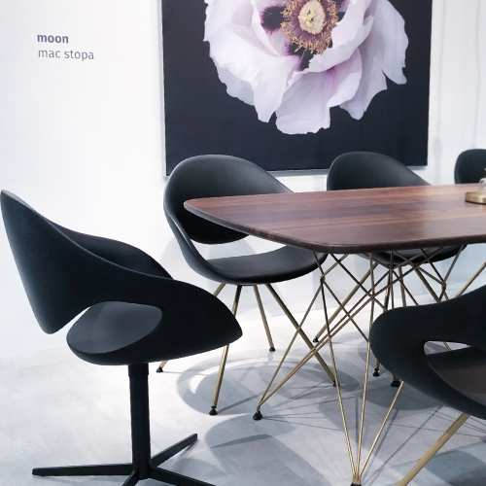
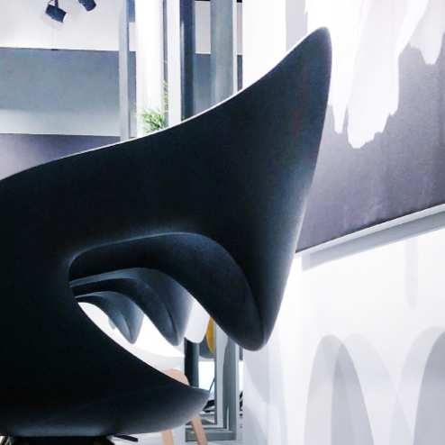
Moon
TONON COLLECTION

Slide 7
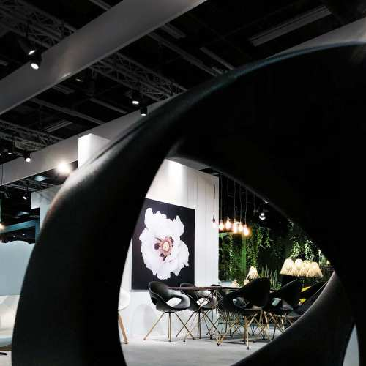
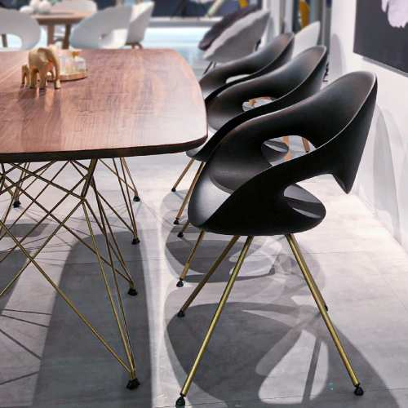
Moon
TONON COLLECTION

Slide 8
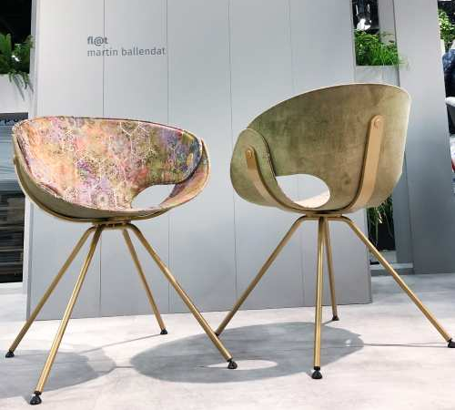
Fl@t
TONON COLLECTION

Slide 9
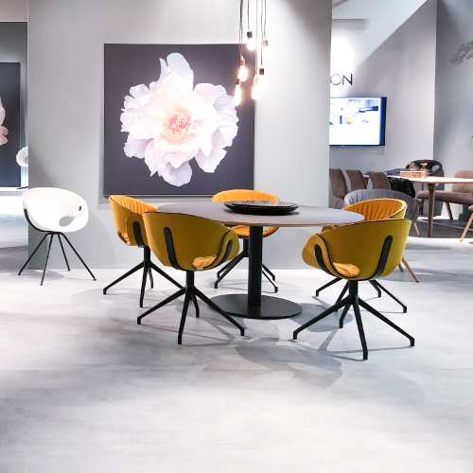
Fl@t Soft
TONON COLLECTION

Slide 10
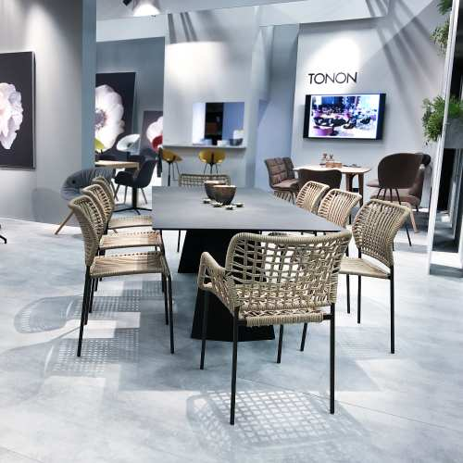
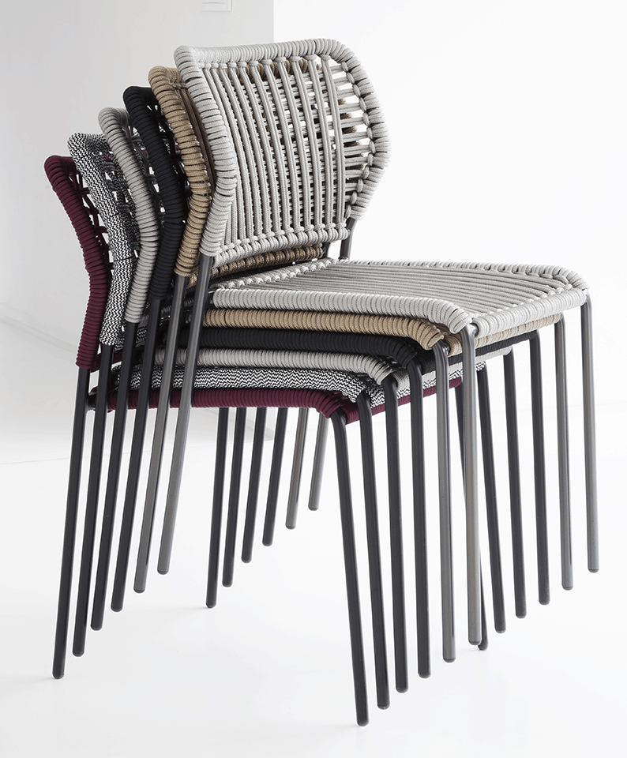
Corda
TONON COLLECTION

Slide 11
Corda
TONON COLLECTION

Slide 12
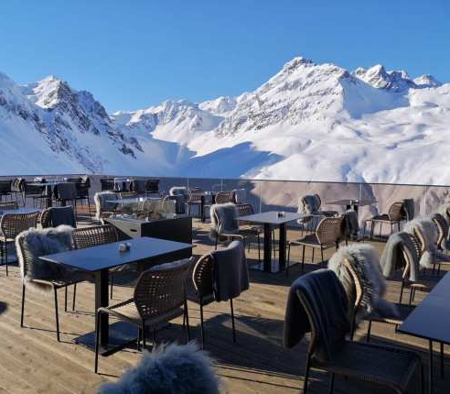
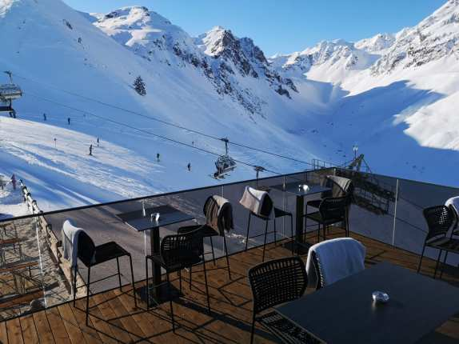
Corda
TONON COLLECTION

Slide 13
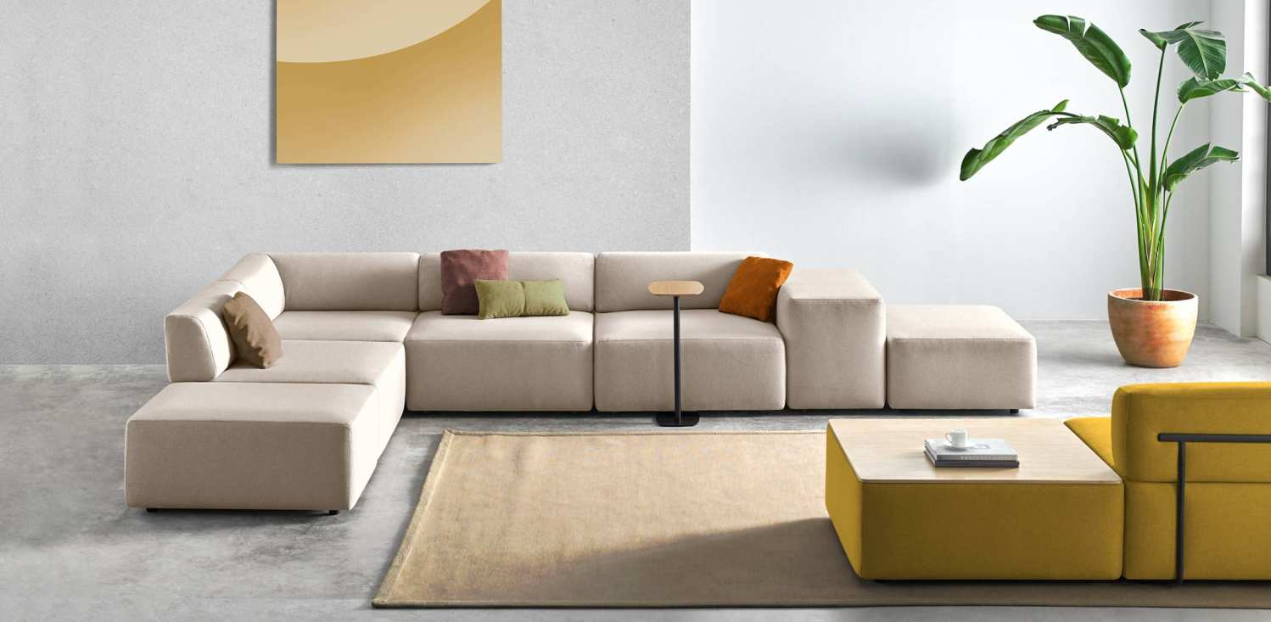
Inclass

Slide 14
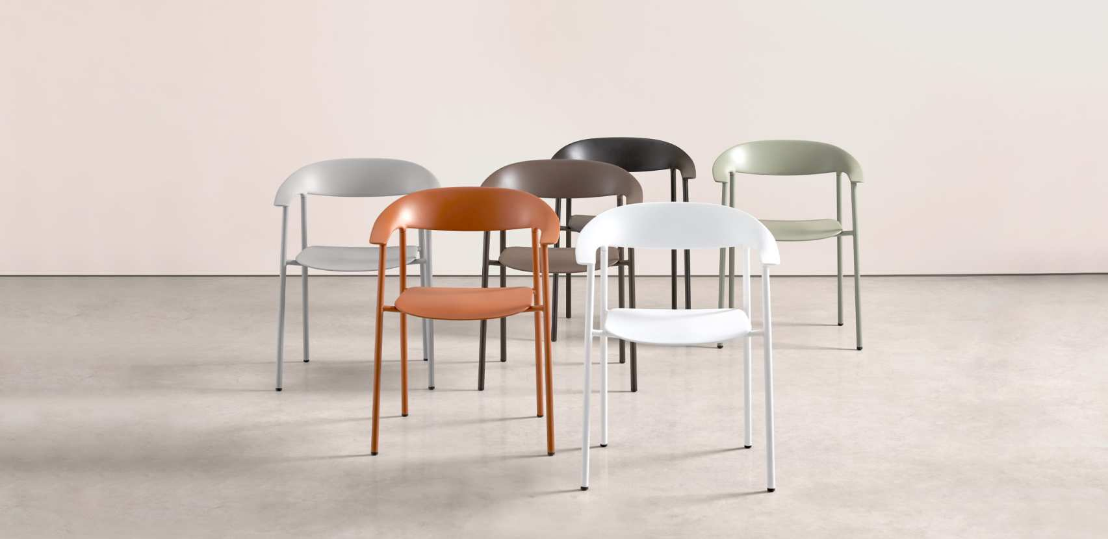
Arum

Slide 15
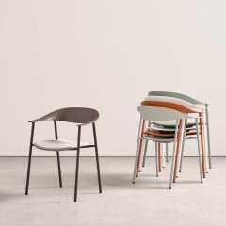
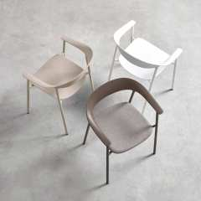
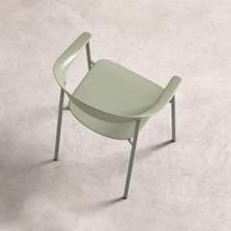
Arum
INCLASS COLLECTION

Slide 16
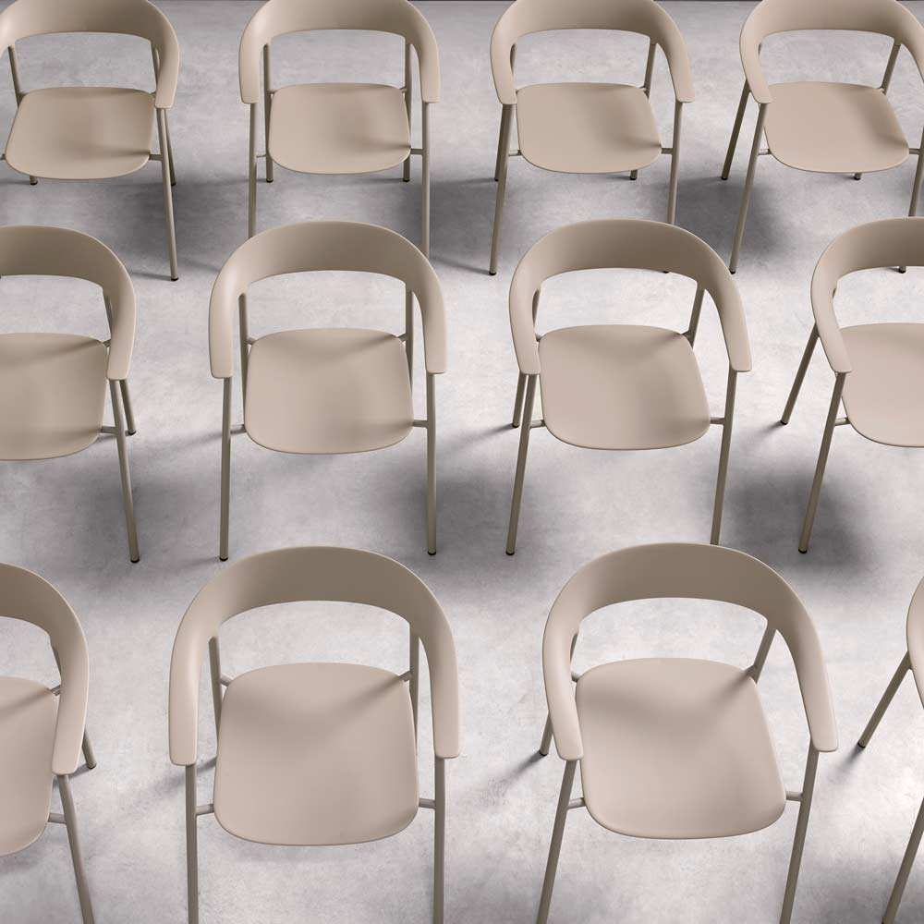

Slide 17
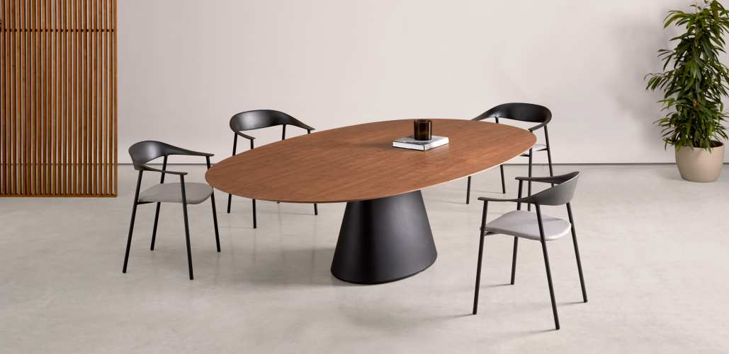
Essens Elliptical Table
INCLASS COLLECTION

Slide 18
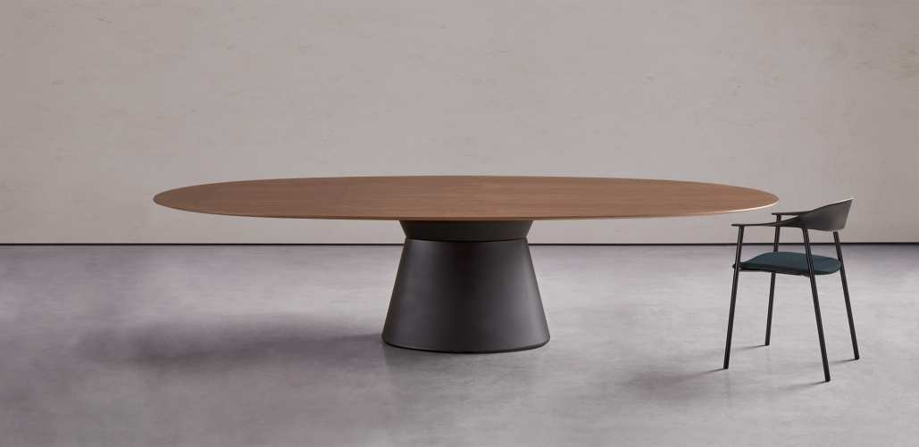
Essens Elliptical Table
INCLASS COLLECTION

Slide 19
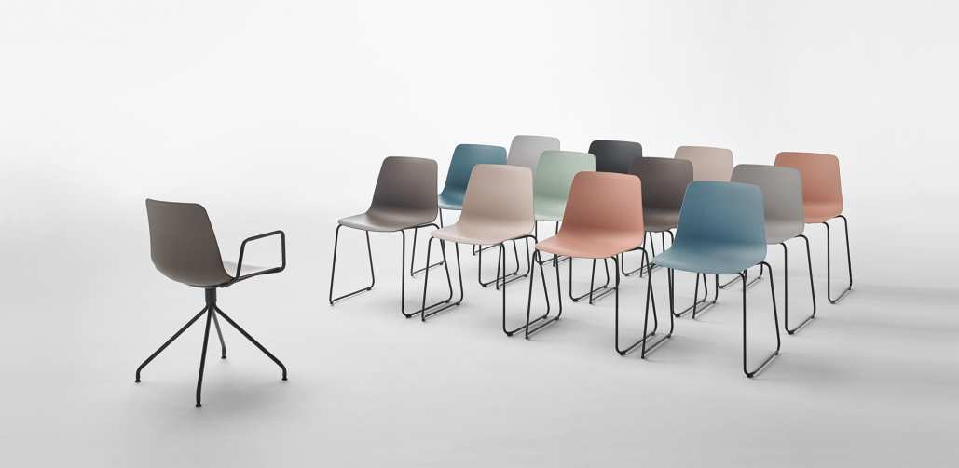
Varya
INCLASS COLLECTION

Slide 20
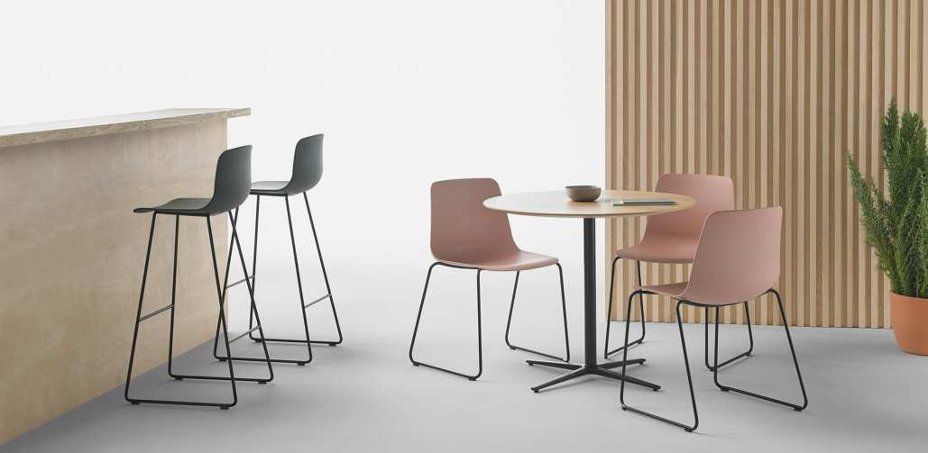
Varya
INCLASS COLLECTION

Slide 21
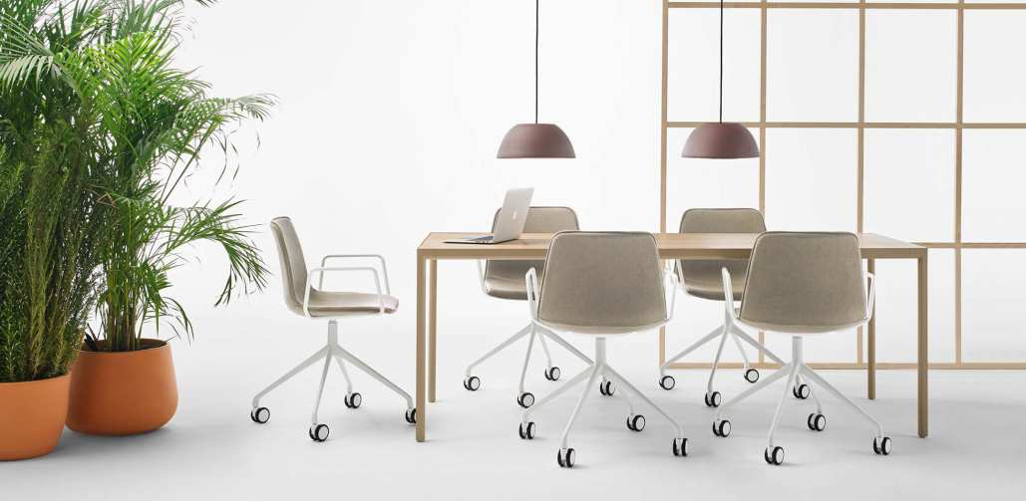
Varya Task Chair
INCLASS COLLECTION

Slide 22
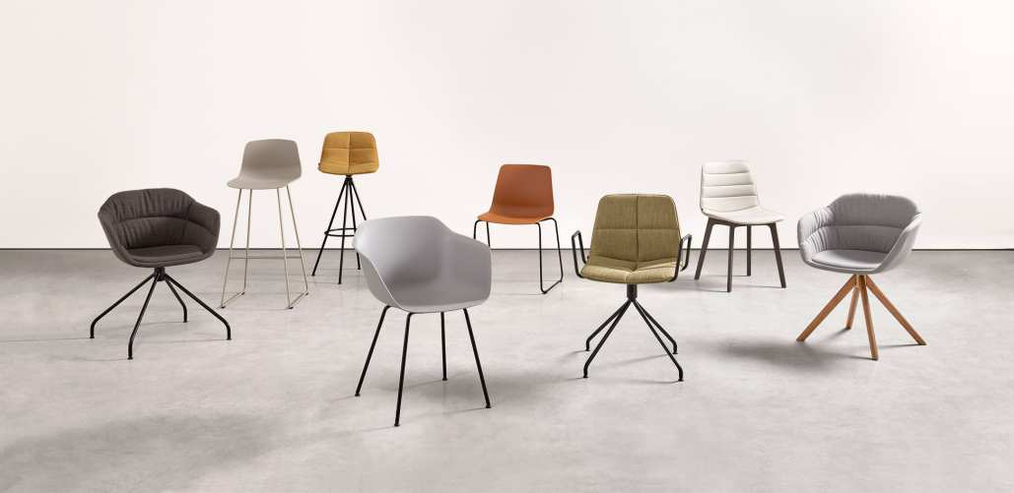
Varya Quilted
INCLASS COLLECTION

Slide 23
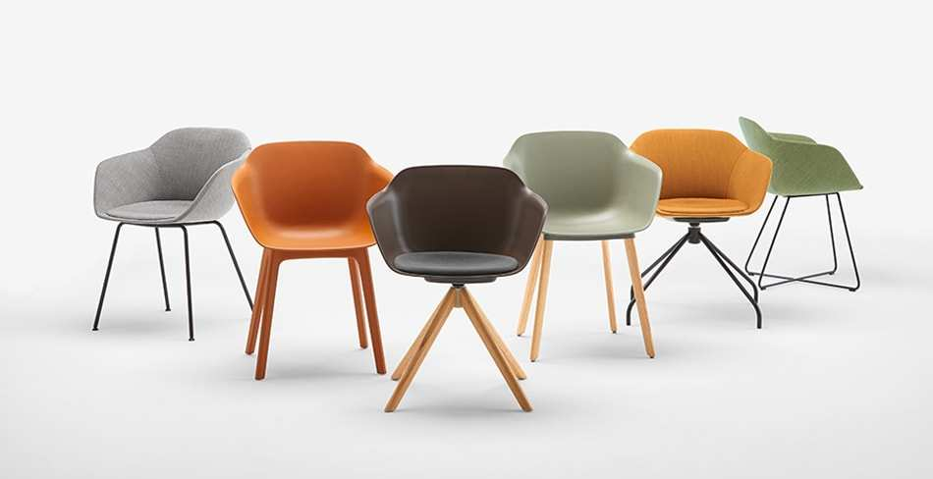
Taia Family
INCLASS COLLECTION

Slide 24
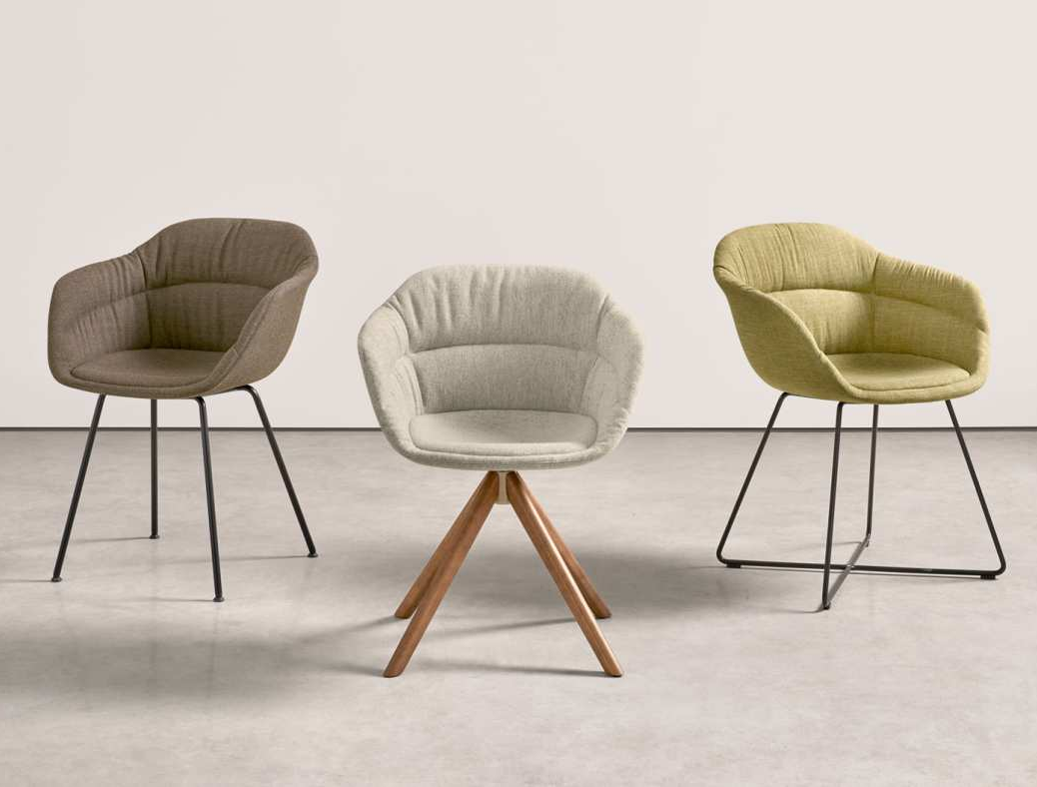
Taia Soft

Slide 25
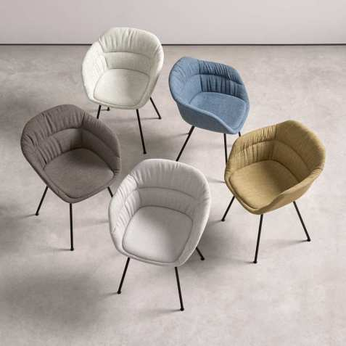
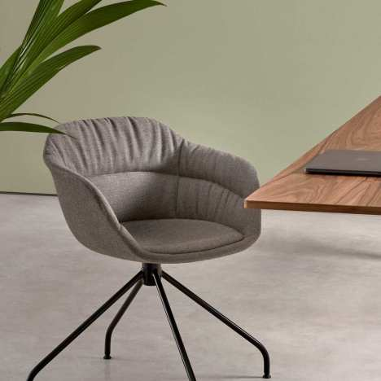
Taia Soft
INCLASS COLLECTION

Slide 26
Aryn
INCLASS COLLECTION

Slide 27
Aryn
INCLASS COLLECTION

Slide 28
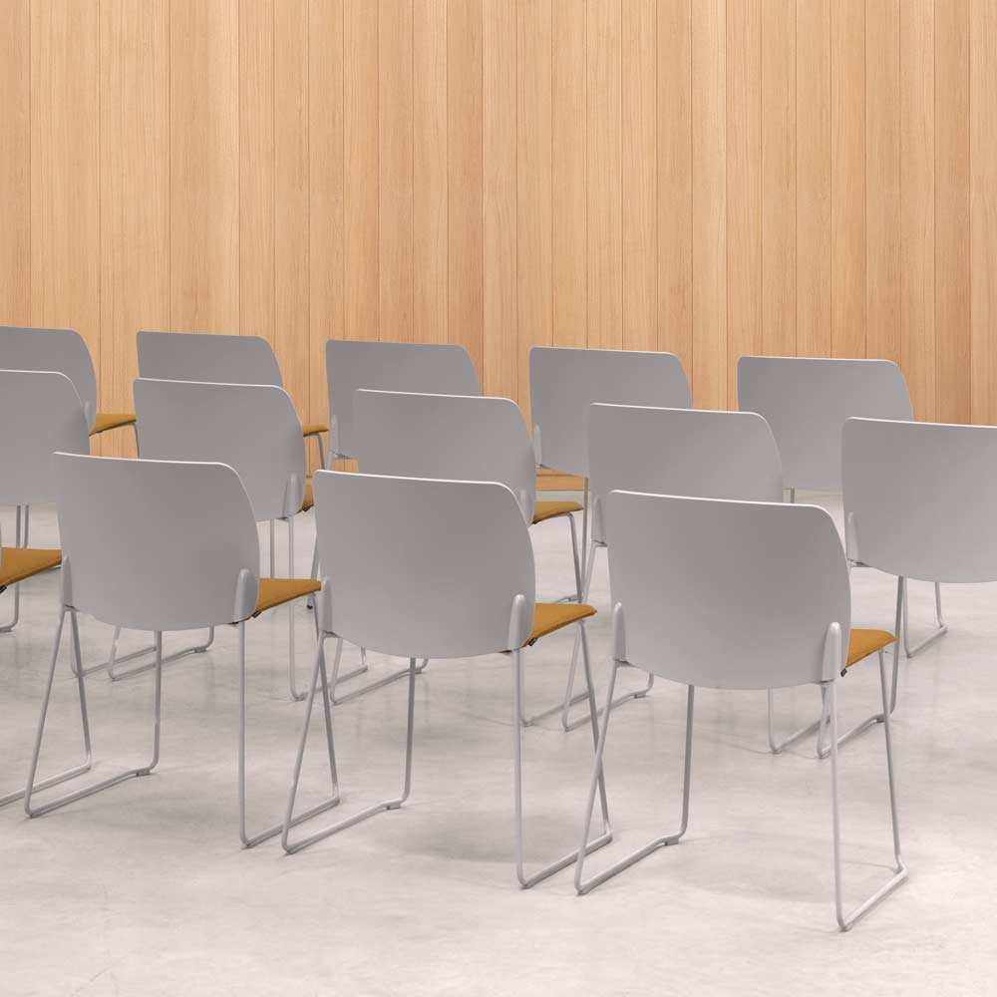
Aryn Max

Slide 29
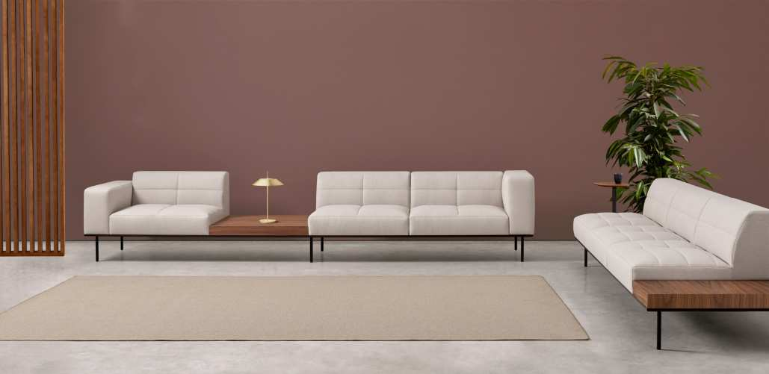
Escalas Quilted
INCLASS COLLECTION

Slide 30
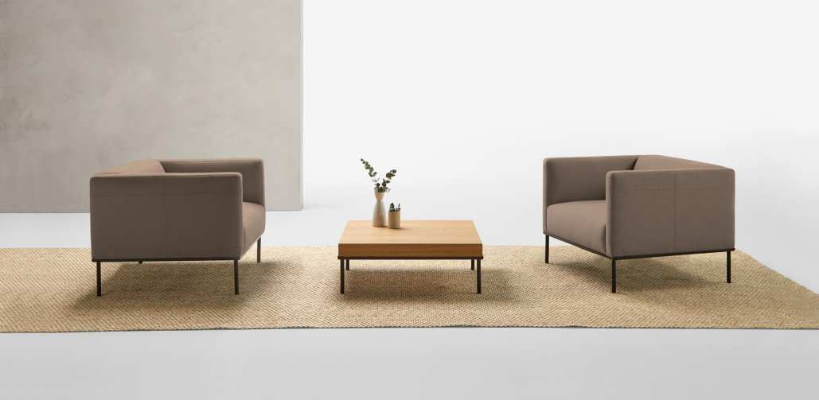
Escalas
INCLASS COLLECTION

Slide 31
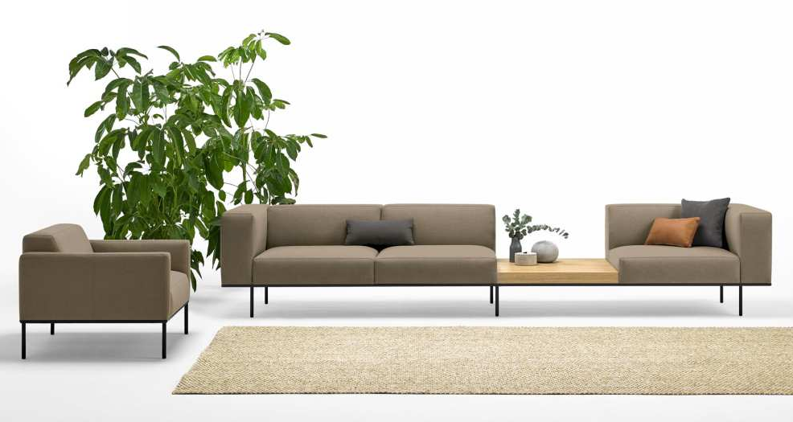
Escalas
INCLASS COLLECTION

Slide 32
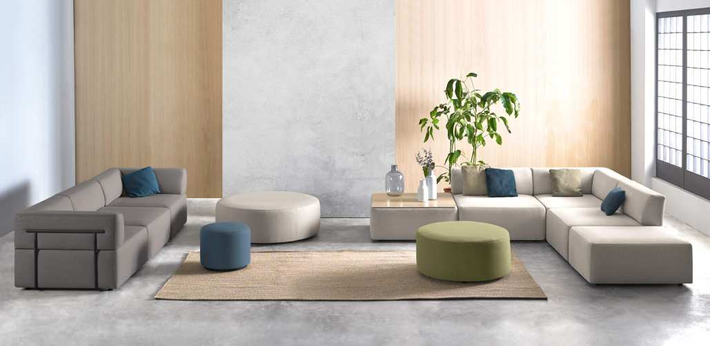
Entropy
INCLASS COLLECTION

Slide 33
Entropy
INCLASS COLLECTION

Slide 34
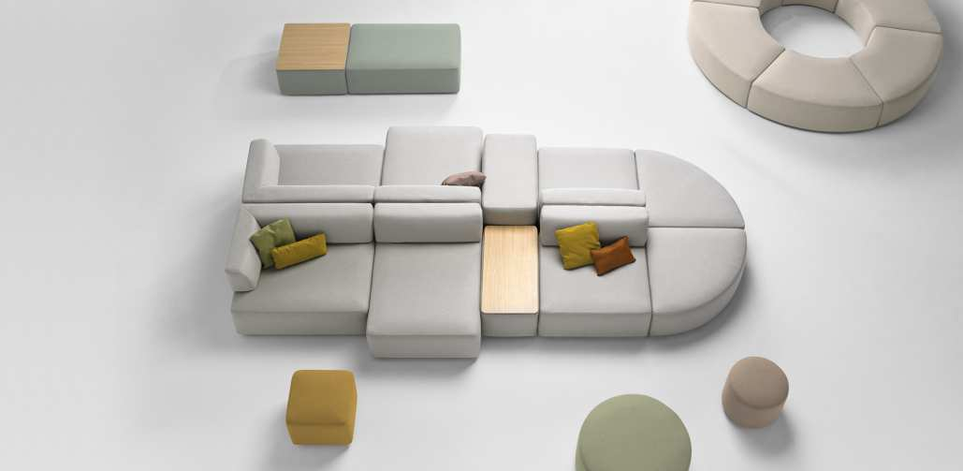
Entropy
INCLASS COLLECTION

Slide 35
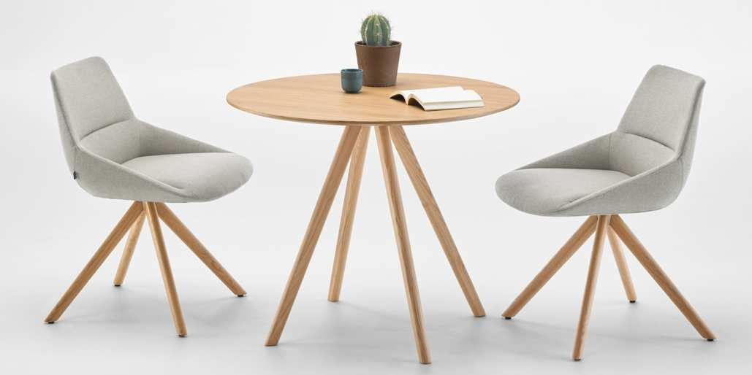
Dunas XS
INCLASS COLLECTION

Slide 36
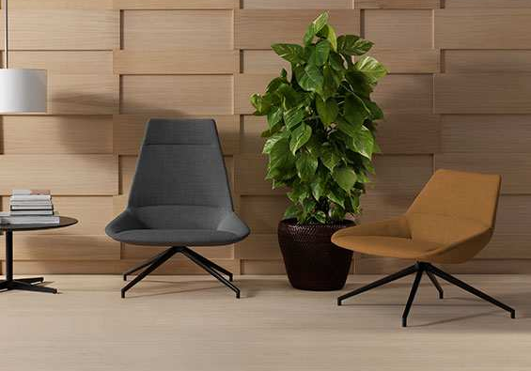
Dunas XL
INCLASS COLLECTION

Slide 37
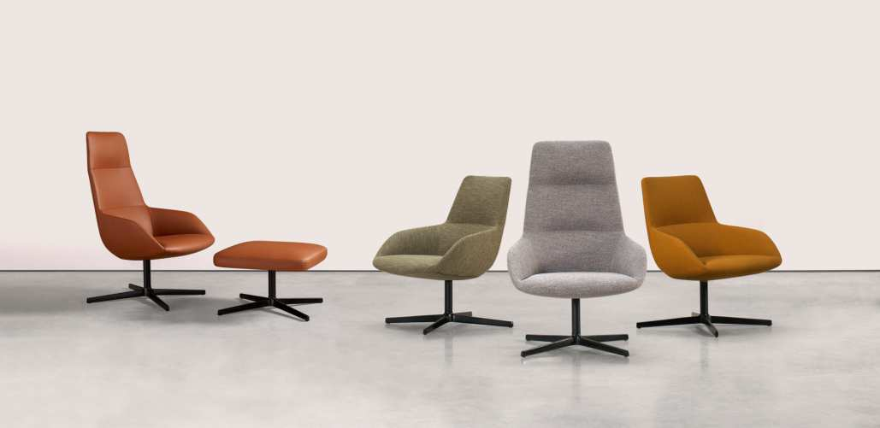
Dunas Arm Lounge
INCLASS COLLECTION

Slide 38
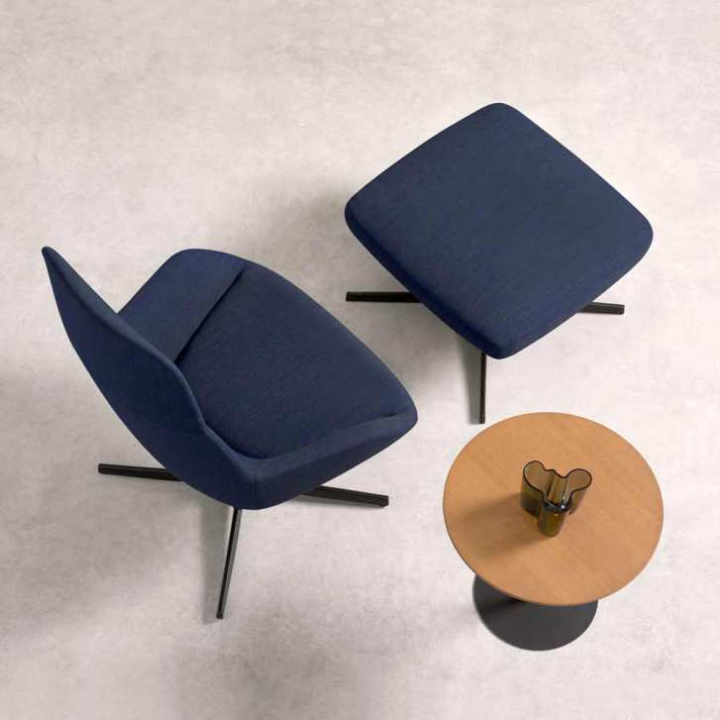
Dunas Arm Lounge

Slide 39
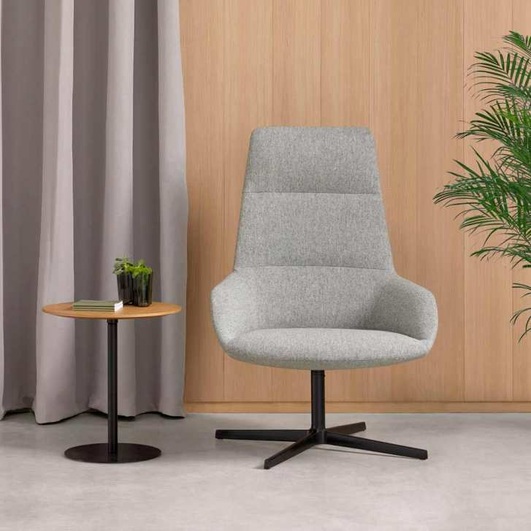
Dunas Arm
Lounge
INCLASS COLLECTION

Slide 40
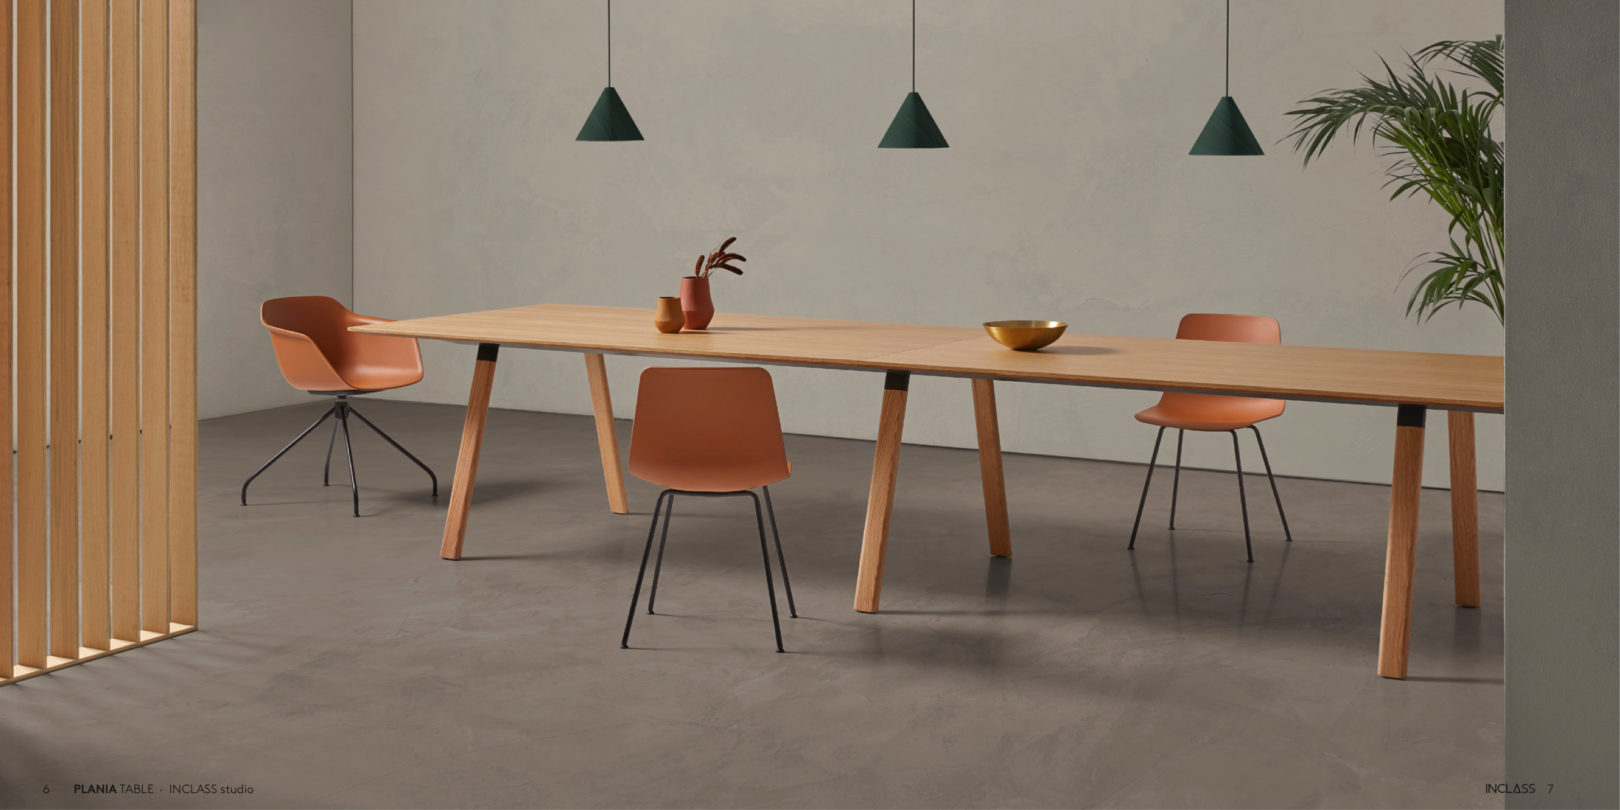
Plania Series

Slide 41
Plania: Tables

Slide 43
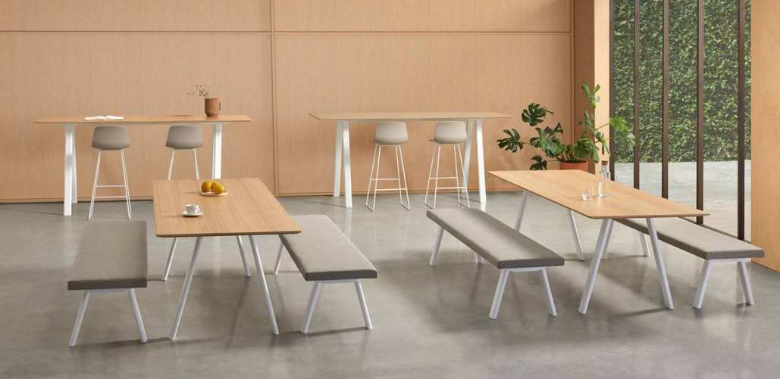

Slide 44
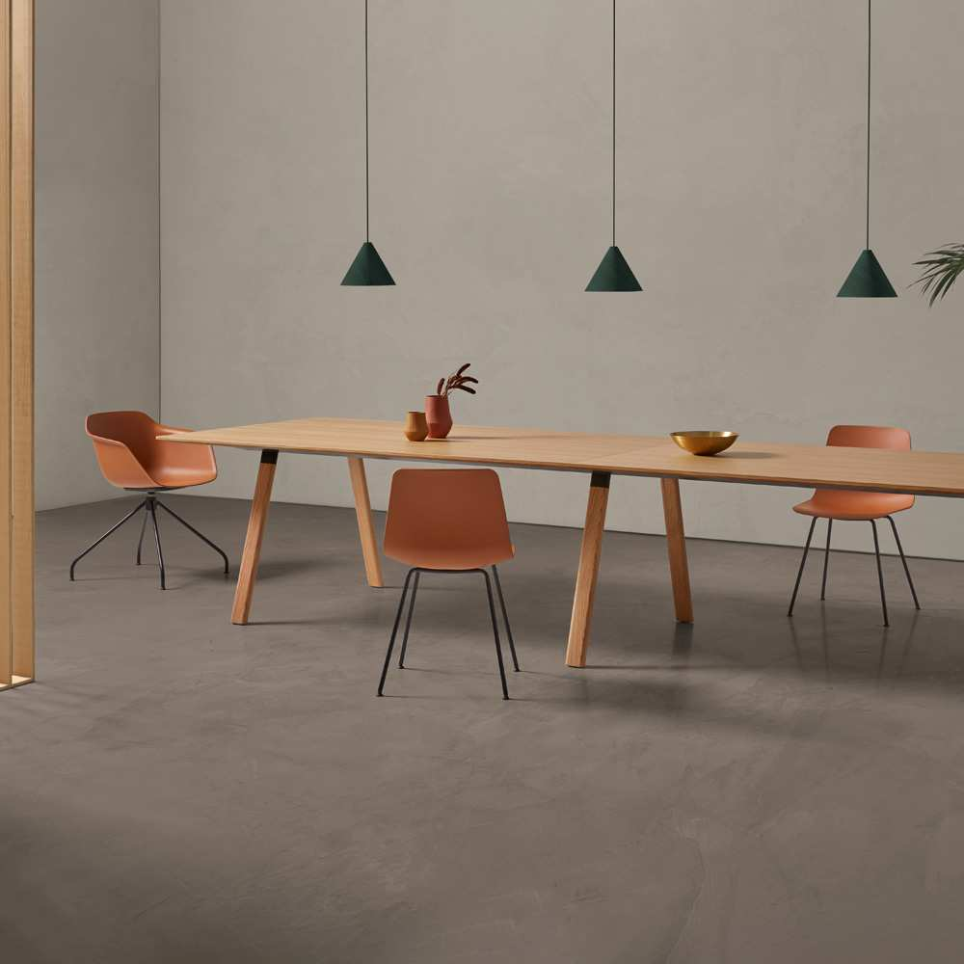

Slide 45
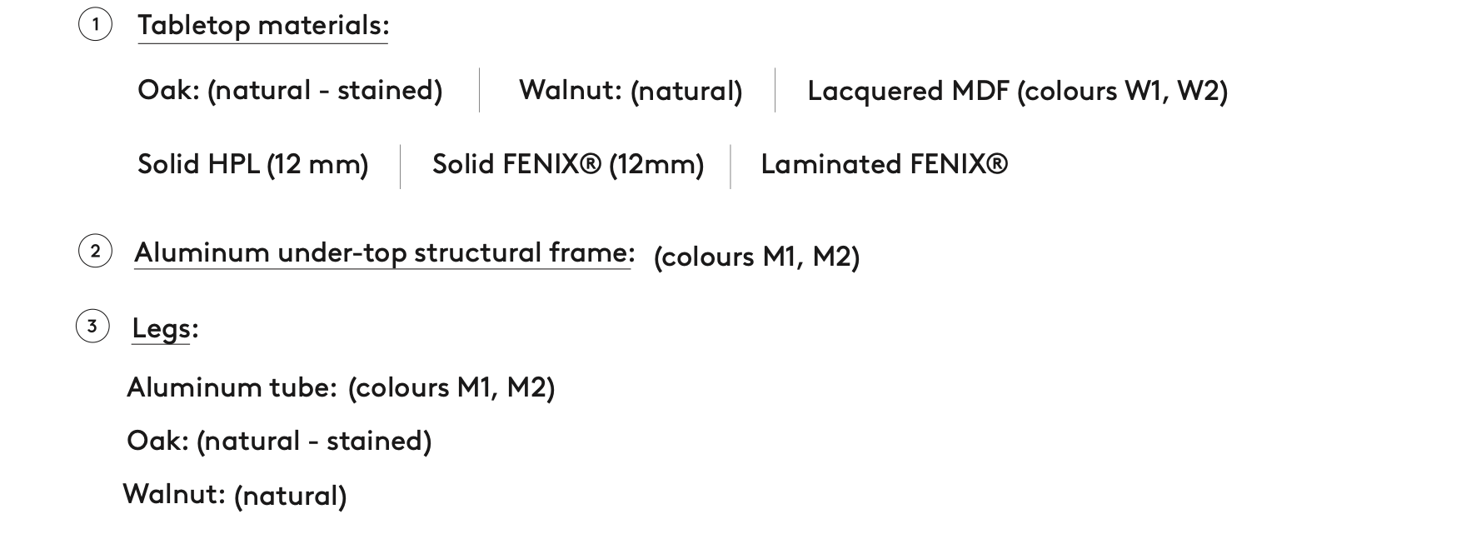

Slide 46
Leg Options

Slide 47
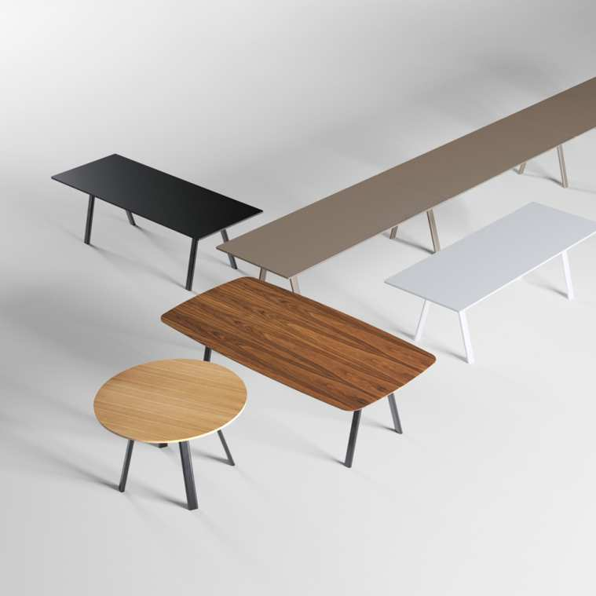

Slide 48
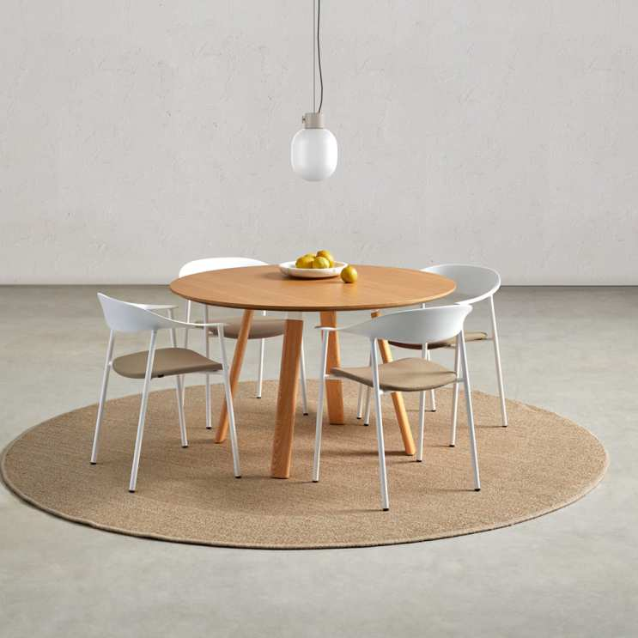

Slide 49
Heights
30”
36”
41”
Shapes
Rectangular
Rectangular - Oval
Round

Slide 50
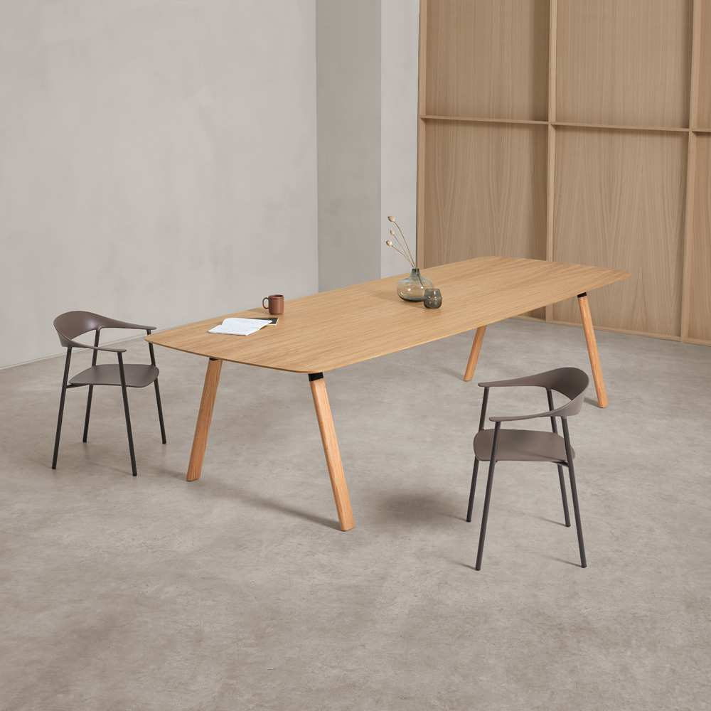

Slide 51
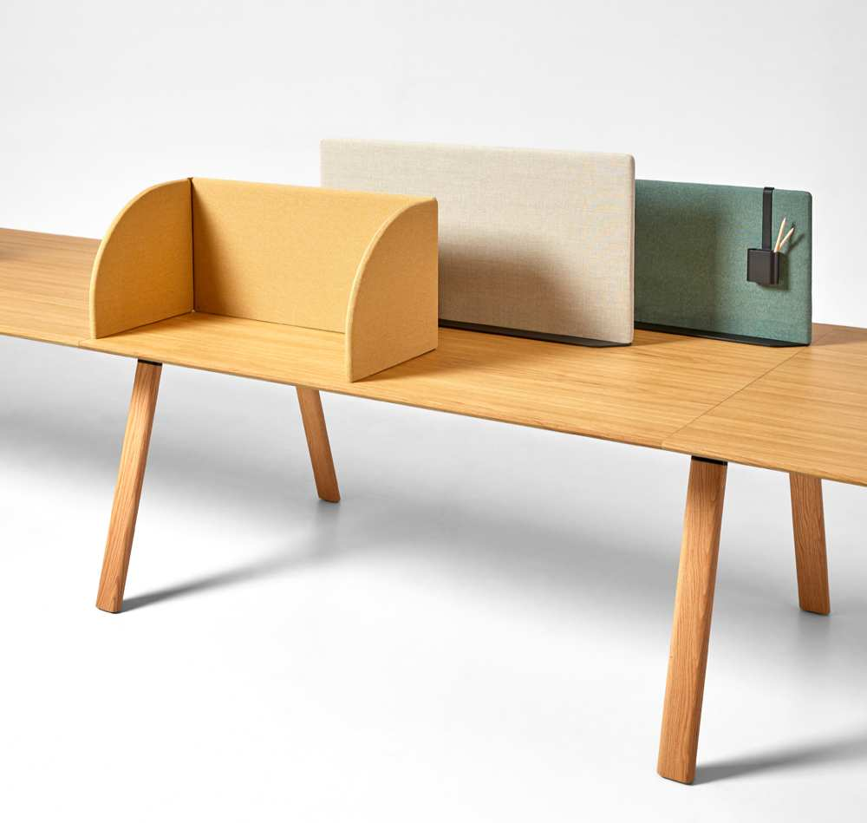
Plania:
Table Power & Accessories

Slide 52
Power: Cable Management

Slide 53
Power: Cable Management

Slide 54
Accessories: Divider Screens

Slide 55
Accessories: Divider Screens
A
B
C
D

Slide 56
Accessories

Slide 58
Plania: Bench

Slide 62
Plania Bench: Connections

Slide 66
Cantarutti

Slide 67
Timber
CANTARUTTI COLLECTION

Slide 68
Timber
CANTARUTTI COLLECTION

Slide 69
Timber Stack

Slide 70
Celine
CANTARUTTI COLLECTION

Slide 71
Coco
CANTARUTTI COLLECTION

Slide 72
Coco
CANTARUTTI COLLECTION

Slide 73
Vicky
CANTARUTTI COLLECTION

Slide 74
Vicky
CANTARUTTI COLLECTION

Slide 75
Yumi
CANTARUTTI COLLECTION

Slide 76
Hyppo
CANTARUTTI COLLECTION

Slide 77
Hyppo
CANTARUTTI COLLECTION

Slide 78
Et. al

Slide 79
Classy
ET.AL. COLLECTION

Slide 80
Classy
ET.AL. COLLECTION

Slide 81
Snap
ET.AL. COLLECTION

Slide 82
Snap
ET.AL. COLLECTION

Slide 83
Ambit
ET.AL. COLLECTION

Slide 84
Ambit
ET.AL. COLLECTION

Slide 85
Noodle
ET.AL. COLLECTION

Slide 86
Noodle
ET.AL. COLLECTION

Slide 87
Pillow
ET.AL. COLLECTION

Slide 88
Pillow
ET.AL. COLLECTION

Slide 89
Pillow
ET.AL. COLLECTION

Slide 90
Shade
ET.AL. COLLECTION

Slide 91
Milos
ET.AL. COLLECTION

Slide 92
Milos
ET.AL. COLLECTION

Slide 93
Montbel

Slide 94
Rose
MONTBEL COLLECTION

Slide 95
Rose
MONTBEL COLLECTION

Slide 96
Rose
MONTBEL COLLECTION

Slide 97
Danielle
MONTBEL COLLECTION

Slide 98
Danielle
MONTBEL COLLECTION

Slide 99
Niky
MONTBEL COLLECTION

Slide 100
Leela
MONTBEL COLLECTION

Slide 101
Leela

Slide 102
Diva
MONTBEL COLLECTION

Slide 103
Woodlook Collection

Slide 105
Woodlook

Slide 106
Woodlook

Slide 107
Woodlook 1.8 / 2.8

Slide 108
Woodlook 1.8 / 2.8

Slide 109
Woodlook

Slide 110
Woodlook

Slide 111
Woodlook

Slide 112
Woodlook

Slide 113
Notes:
Here is the big reveal… INSPEC! We are so excited to launch InSpec, which is a new division of Sandler. InSpec is created of 3 factories - Lammhults (Sweden), Randers+Radius (Denmark) and OMK (United Kingdom). Very elegant in design, InSpec is creating waves in the furniture market.

Slide 114
Lammhults
Notes:
Lammhults is our Swedish partner, based in the city of Lammhult, Sweden. These are their Top 10 Best Sellers in the states.

Slide 115
Quickly
Notes:
The Quickly table is the number 1 seller in the states. Quickly is just that - a folding table that folds “quickly” and in a matter of seconds. Starts at LIST $1600 +

Slide 116
Campus
Notes:
The Campus chair, a 28 year old design, launched in 1992, became an instant success. The design idea was clear: create a functional affordable volume chair for the international contract market. The response was Campus.
Available as a chair and an armchair, Campus comes in a number of variations, with four legs or sled base. The seat and back in can come in a wood veneer, upholstered seat, and/or seat and back. Starts at LIST $1070+

Slide 117
Campus Air
Notes:
The Campus design was moved forward with a new seat and back of fiberglass-reinforced polyamide plastic, creating Campus Air.
With an optional weather-resistant frame, Campus Air can be used outdoors. The durable solid polyamide surface resists scratching and is easy to clean. Starts at LIST $670+

Slide 118
Grade

Slide 119
Grade Plus
Notes:
With its graduated shell which has also given the series its name, Grade Plus has a unique design and its own expression that is recognized regardless of model and frame. With the armrest integrated into the shell, the designers have created a timeless and generous model focusing on high comfort in many different sitting positions.
The shell comes in five colors: white-grey, graphite, beige, dark red or black.
Grade Plus is offered in a variety of frames and an upholstered seat as an option.
Starts at $690

Slide 120
Spira
Notes:
The value of Spira is in its clever comfort features in a volume chair and its various versions.
Spira is available:
- Fully upholstered
- Upholstered seat in combination with wooden
- Polyurethane back or seat and back in cast polyurethane.
As a chair or armchair, with a stackable four-leg base, or swivel-tilt four-star base with glides or five-star base with casters. Armrests in black or white Woodfibre.

Slide 121
Spira Link
Notes:
Spira Link is unique linking chair, where the chairs are linked together by the arm of the chair next to it. To link, simply lift the chair arm over the arm of the chair next to it, and ta-da, it is linked. Reverse the method to unlink the chairs.

Slide 122
Add Accessories
Notes:
Add. It stores clothes. It stores journals. It even stores flowerpots. In fact, Add stores just about anything you need, simply and elegantly.
The storage elements are structural and thoughtfully simple, allowing them to be easily linked in any combination.
The powder-coated steel tubing elements (available in white or black) come in two widths, with fixed or swivel base.
Starts at LIST $1940

Slide 123
Add Accessories
Notes:
Add storage includes coat hanger and magazine rack/storage rack. Add table is an extension of the Add family, including a number chairs and stools as well as storage products.

Slide 124
Aperi
Notes:
Lifestyle is now workstyle, and Aperi addresses both in balance. Aperi arrives to the modern office where sitting has evolved to the welcoming touchstones of softness and support.
The dynamic office relies more and more on the comforts of home, while the home is often an office.
The compact monolithic form of Aperi brings a sense of calm to the work environment.
Starts at LIST $3630

Slide 125
Aperi
Notes:
Aperi is available as a single seat chair, as well as two and three seat versions, upholstered in fabric with stitched seams in diverging color as an option. Casters are available.

Slide 126
Add
Notes:
The Add chair is a further development of the flexible and graphic Add stool series. The contemporary workplace is an active seating area, and the Add stool has brought convenience to the active worker.
With its generous and embracing back and flexible frame, Add chair offers active and relaxed seating in one and the same chair.
Stool starts at LIST $960

Slide 127
Add

Slide 128
Add

Slide 129
Archal
Notes:
A more generous seat width, wider armrests and extra padding for better comfort. Archal XL constitutes yet another compliment to the Archal family. Carrying the Lammhults’ signature touch of elegance with utmost craftsmanship, Archal XL is available in either Lounge or Conference versions.
Starts at LIST $3110

Slide 130
Deco

Slide 131
Deco

Slide 132
Attach
Notes:
InSpec allows us to jump into the conference table game, starting with Attach.
Attach is a conference table that allows you to go 16 feet on just 4 legs. The legs can be placed as far as 9 feet apart in distance.

Slide 133
Attach
Notes:
Attach is a table system offering almost limitless possibilities in terms of size, shape and design. The Attach table series brings the simplified principles of basic physics to the function of table construction. Extruded anodized recycled aluminium beams and structural recycled aluminium legs are linked under the table and secured by gravity.
Technology marries art in the construction of this impressive table series. Using just a few simple basic elements, combined with a wide selection of table top materials and a choice of colours for the legs, Lammhults is offering a mass-produced yet unique table that can be freely adapted to the specific room and environment.

Slide 134
Ponto
Notes:
Ponto is ‘exclusivity and simplicity’ defined, where every detail breathes the designers and Lammhults’ sense of innovation and quality. Ponto is the table that allows modern technology to meet solid craftsmanship.
The legs of Ponto are made of carefully selected solid wood that is milled to fit the aluminum profiles that support the entire table. Nothing on Ponto is unnecessary, with a maximum length of 219.69", only four legs and table surfaces are all that is needed, no more no less, together they are whole and that is remarkable in its simplicity. Assembly is quick, by sliding the leg onto the aluminum profile to the desired position.

Slide 135
Ponto
Notes:
The Ponto tables come in a number of standard sizes, in height 29.13”.

Slide 136
Ponto

Slide 137
Dexter
Notes:
Dexter is a multifunctional set of solutions in one wire sculpture: seating, stacking and linking – a variety of applications with minimalistic simplicity.
Starts at $1290

Slide 138
Randers + Radius
Notes:
Randers + Radius (Denmark)

Slide 139
Mood
Notes:
The Mood chair collection helps you to create the right atmosphere and the right environment for your surroundings.
It has a beautifully shaped seat shell, and available in a variety of colors.
Starts at LIST $630

Slide 140
Mood
Notes:
Mood100% - a Mood chair with an upcycled shell. The shell is made from 100% upcycled plastic waste from the European car industry e.g. dashboards and door panels.
The shell is available in black and can be combined with all the different frames and upholstery combinations of the Mood collection, making it an extremely versatile chair and an ideal component of most modern interiors.

Slide 141
Mood Classic
Notes:
Mood Classic is an elegant, sustainable wooden armchair made of FSC solid wood. The shell, foam and fabric meet the criteria of the Ecolabel.
Flexible seat shell offers excellent comfort
The Mood Classic armchair differs from most wooden chairs by having a flexible back. Wooden chairs often have a slightly hard back, but with Mood Classic, the designer have gone an unconventional way by combining a beautiful classic wooden frame with all the benefits of a flexible seat shell.

Slide 142
Dry
Notes:
An Award wining chair, Dry is a highly versatile chair designed for several segments of the contract market and is ideal for almost all situations where large numbers of people have to be seated. Dry is characterized by its soft and flexible shell made of polyurthane, which also helps to provide a highly comfortable sitting experience.
Starts at LIST $1060

Slide 143
Dry
Notes:
The secret of Drys high comfort lies in the flexible polyurethane shell. The straight and flat looking shell surprisingly adapts to the shape of the body providing both support and comfort.
Its soft-touch surface also contributes to great room acoustics and the minimalistic expression of Dry can easily match any architectural surrounding. The shell in its final form is carefully hand finished by talented craftsmen.

Slide 144
Tono
Notes:
Tono was one of the first chairs on the market which was made of environmental friendly materials and at the same time is a sound absorbing chair with a shell made of felt from recycled PET bottles.
Starts at LIST $1700

Slide 145
Tono
Notes:
TONO is designed and developed for the contract market as a meeting room chair or a multifunctional chair for waiting rooms, offices etc. There has already been a strong interest in the chair, because it embraces and interprets the latest trends in offices furnished in softer and more textured materials

Slide 146
Tube
Notes:
Quality, which exceeds expectations
Tube is among the best in the world. A completely individual functional table with a level of quality, which exceeds expectations.
Tube is available in two versions - Tube Fold, which is a folding table, and Tube Stay, which is a fixed table. The Tube Fold also available in a Counter Height Table
Starts at LIST $2600

Slide 147
Tube

Slide 148
Tube

Slide 149
Flex
Notes:
FLEX – the flexible table
FLEX is a complete range of tables for conferences, seminar and assembly rooms as well as canteens and auditoriums. The diversified Flex table with its flexible construction is the perfect solution in multipurpose areas serving many purposes, many people and many different demands.
Starts at LIST $1810

Slide 150
Flex
Notes:
Flex is available in two versions: a fixed table and a folding table.
The Flex table is well-known for being a strong, robust and stable table. Also consisting of modesty panels, cable management, linking devices and transport trolleys, the Flex range is even more suitable and prepared for any area of use.

Slide 151
Thank you!
www.sandlerseating.com

