Slide 1
Entropy

Slide 2
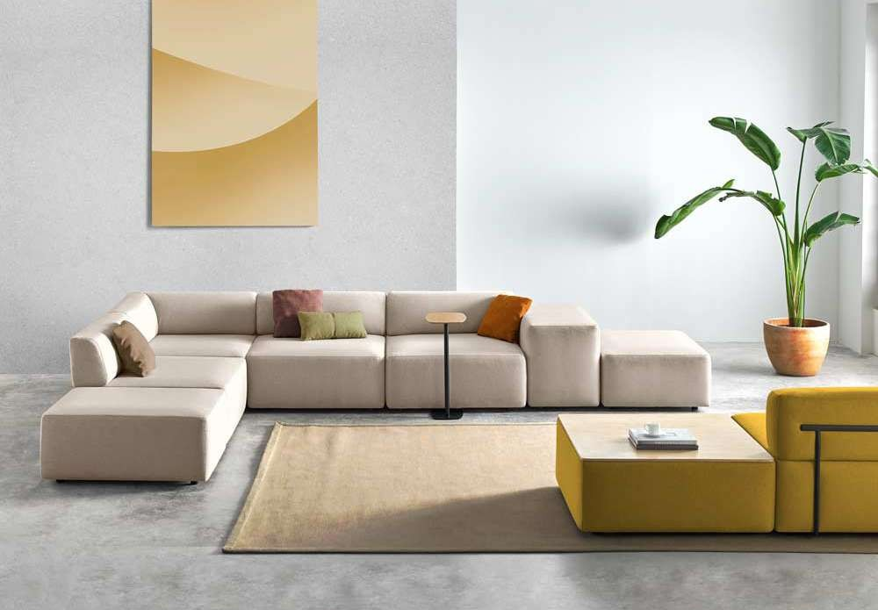
Entropy / Inclass Collection

Slide 3
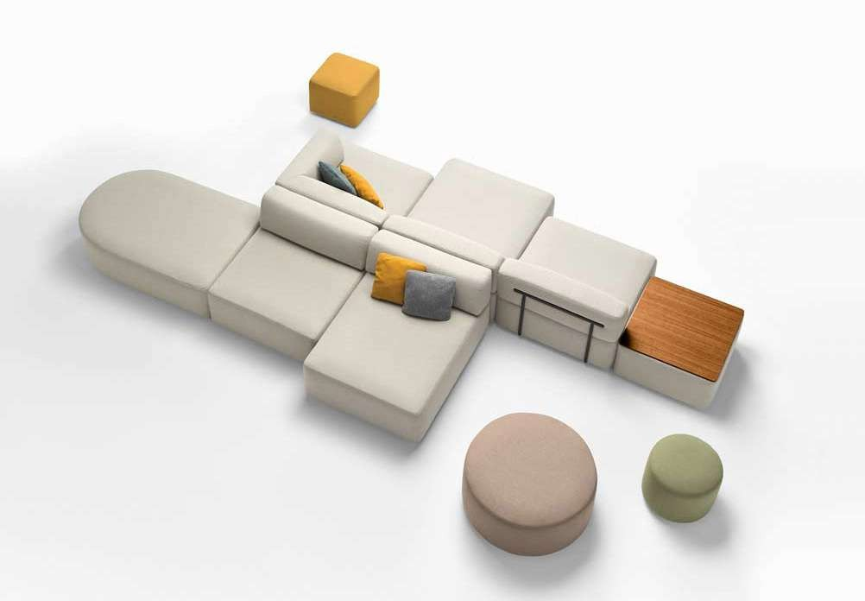
Entropy / Inclass Collection

Slide 4
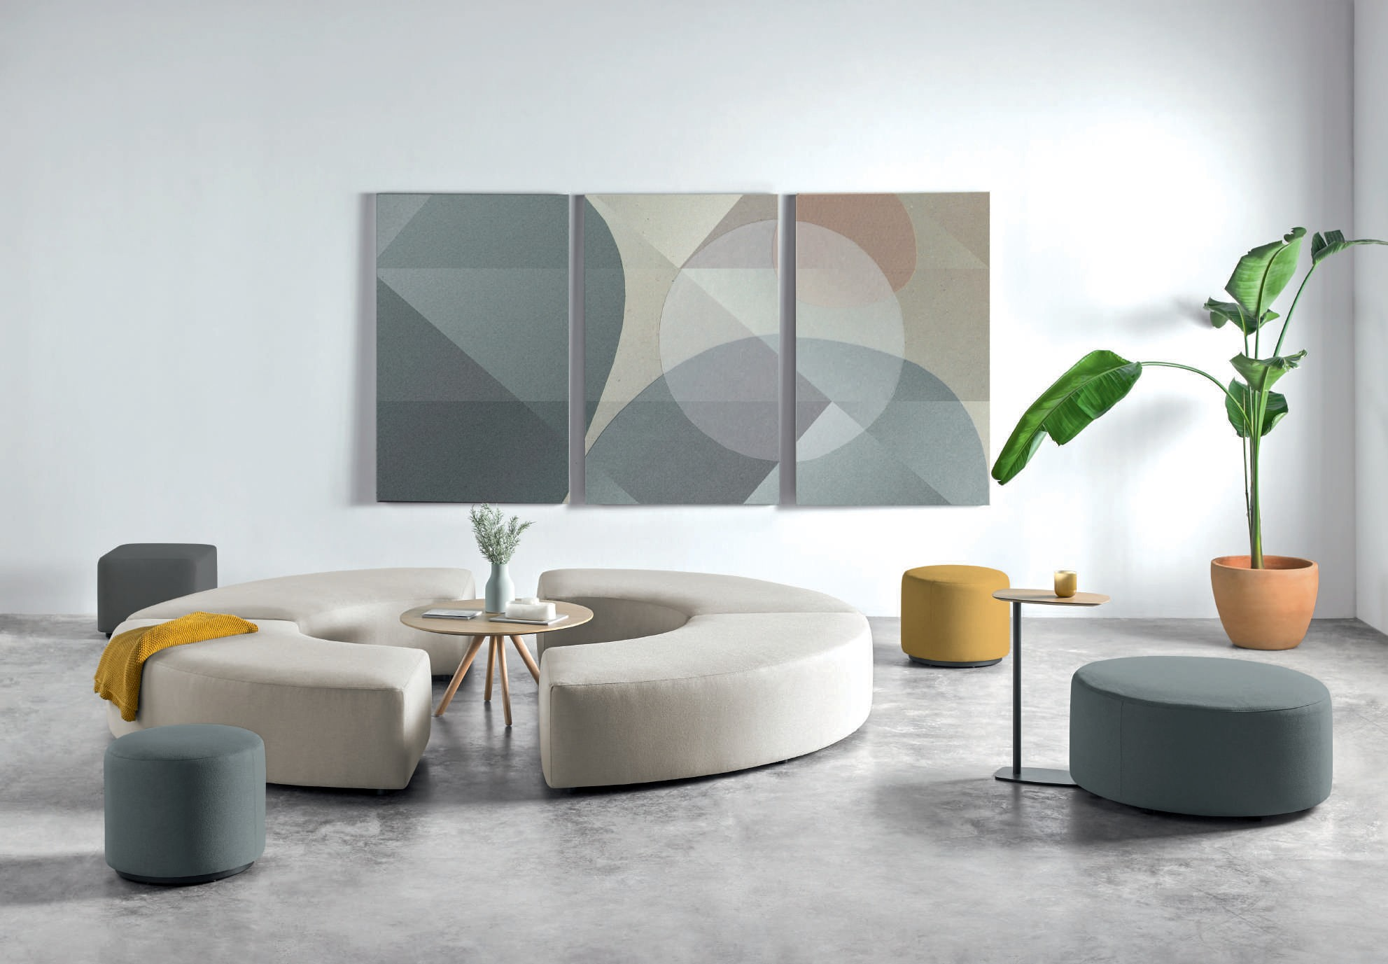
Entropy / Inclass Collection

Slide 5
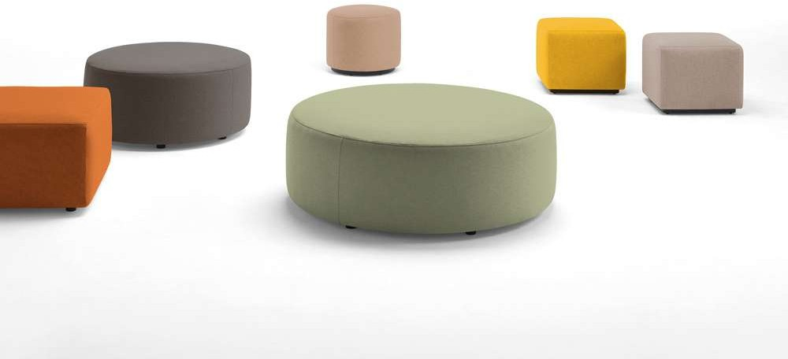
Entropy / Inclass Collection

Slide 6
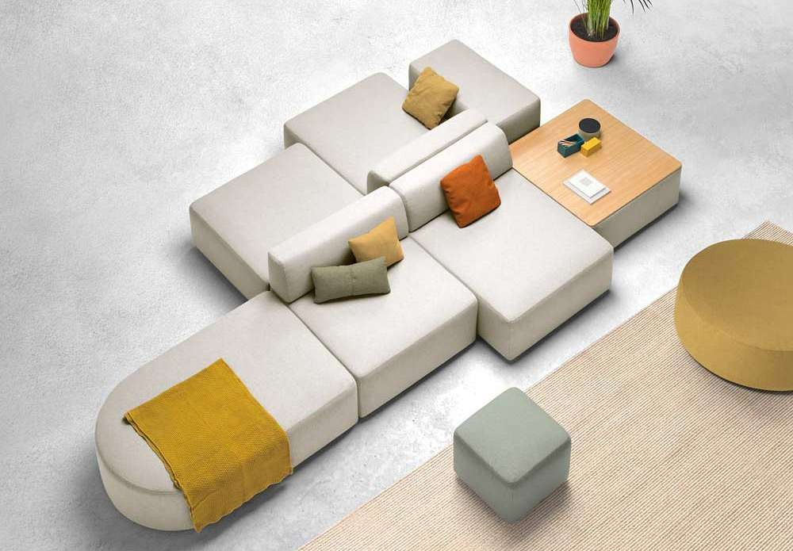
Entropy / Inclass Collection

Slide 7
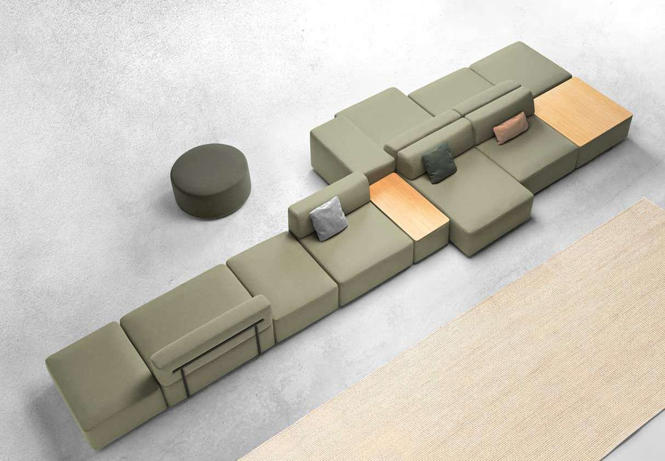
Entropy / Inclass Collection

Slide 8
Escalas

Slide 9
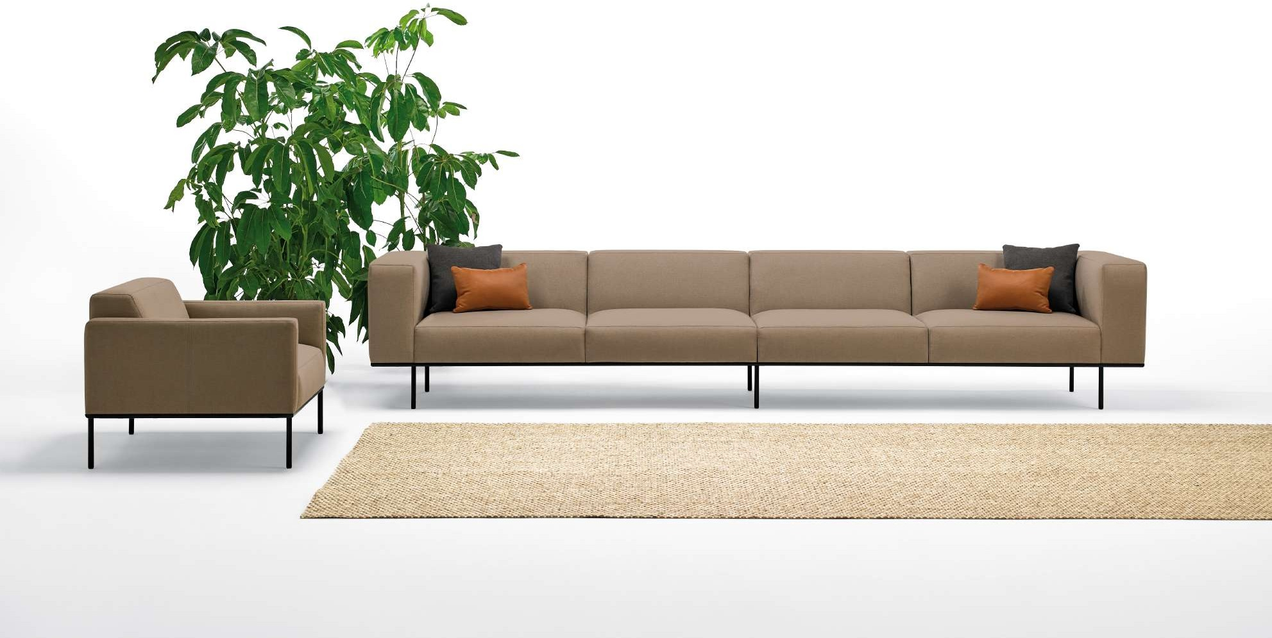
Escalas / Inclass Collection

Slide 10
Escalas / Inclass Collection

Slide 11
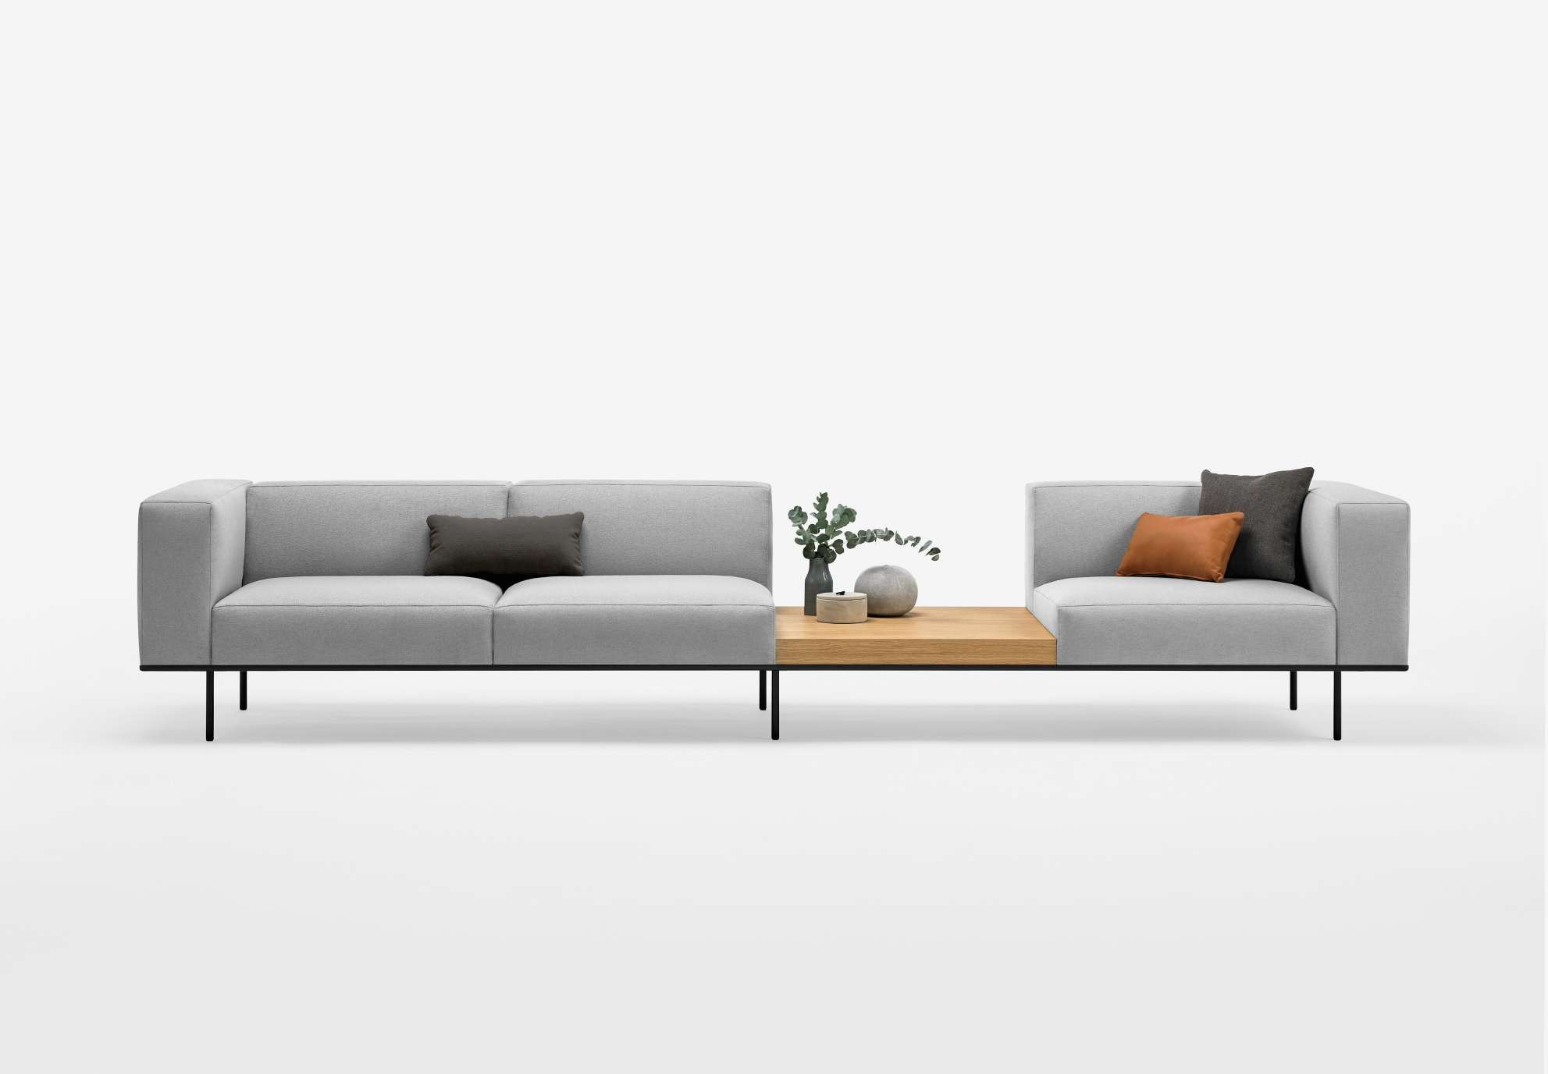
Escalas / Inclass Collection

Slide 12
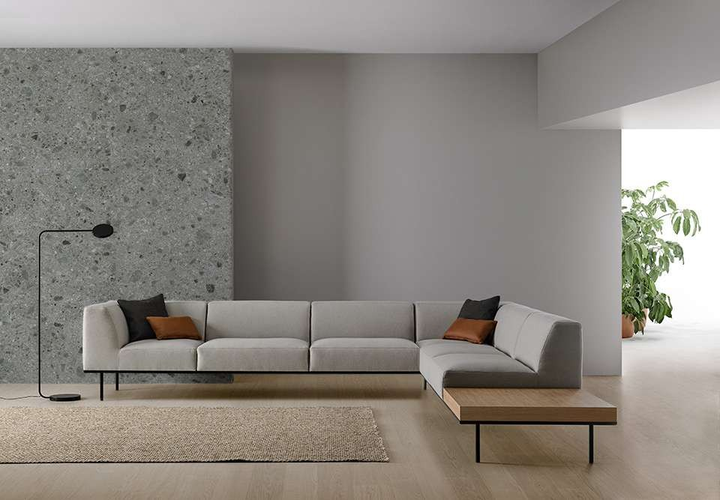
Escalas / Inclass Collection

Slide 13
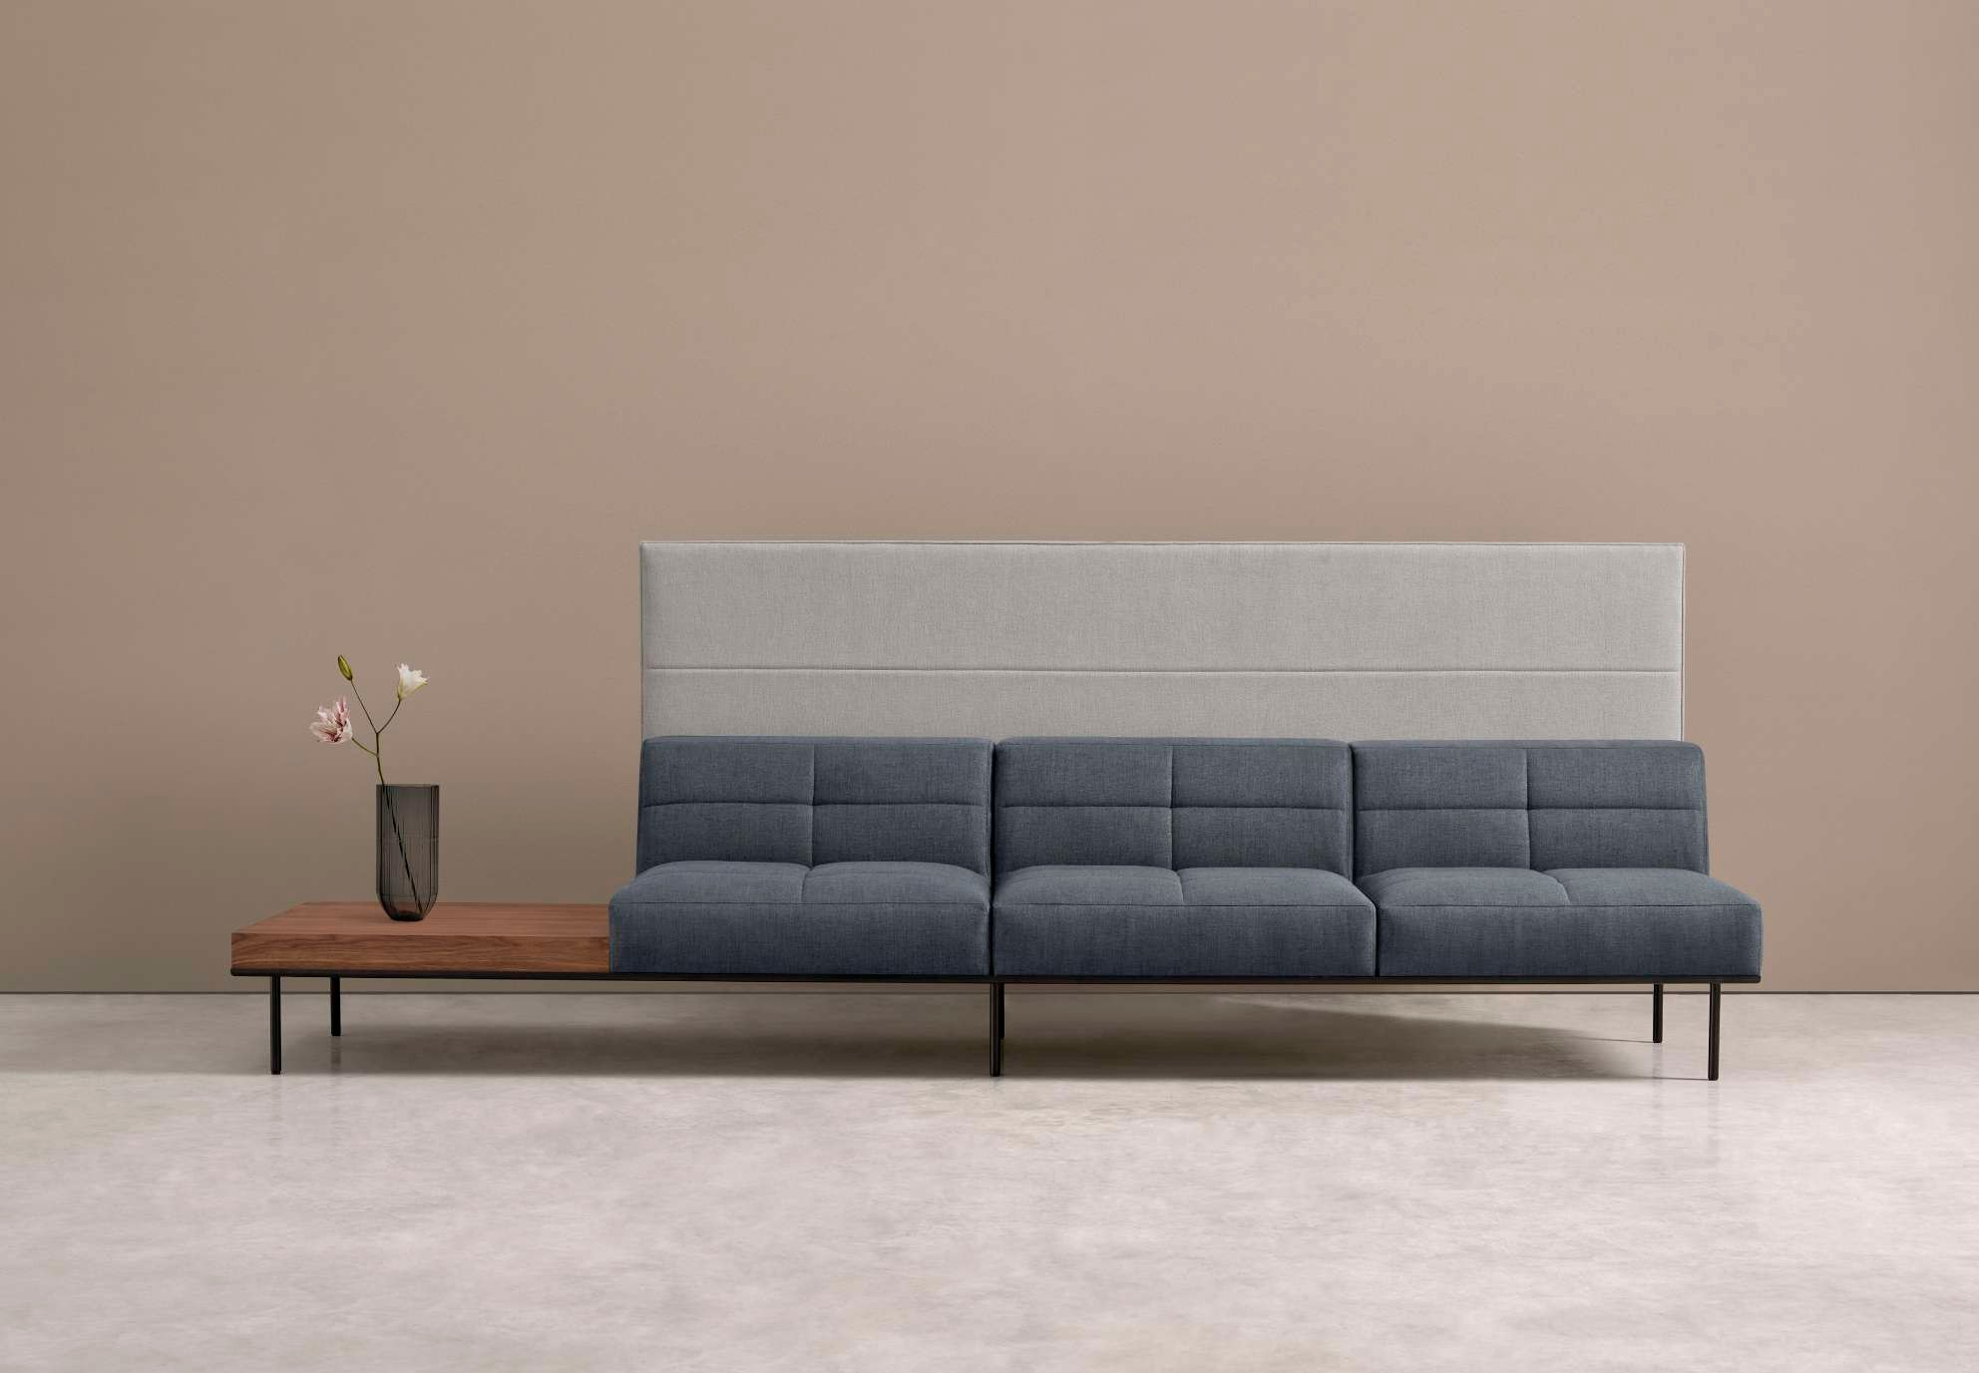
Escalas / Inclass Collection

Slide 14
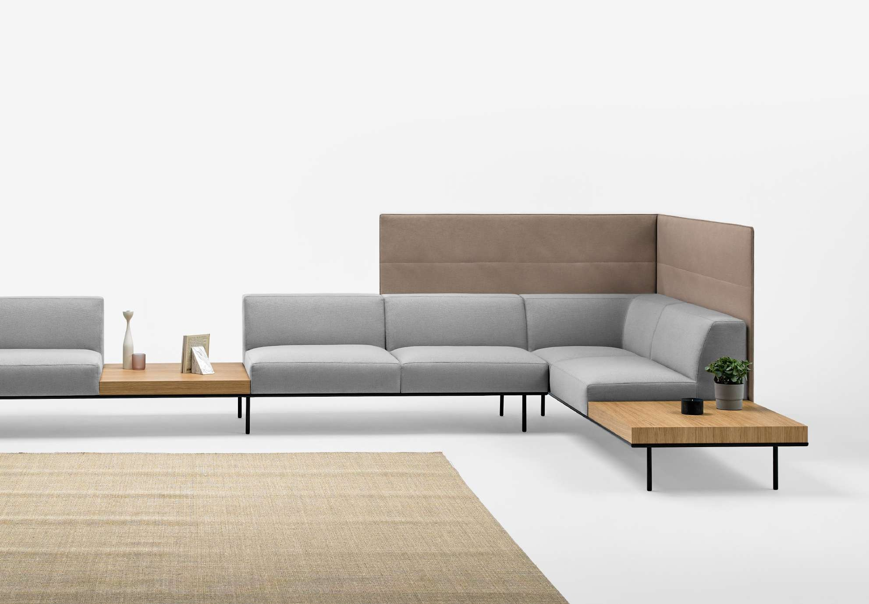
Escalas / Inclass Collection

Slide 15
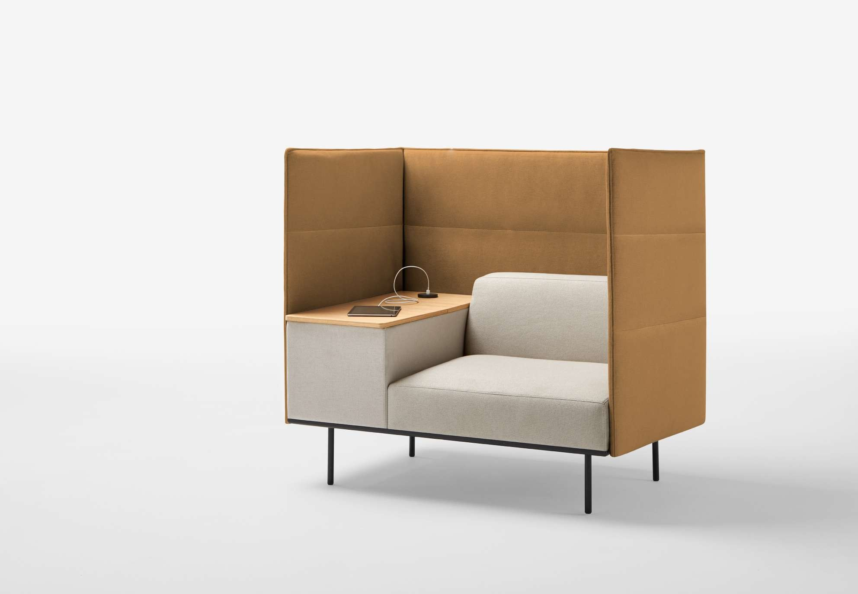
Escalas / Inclass Collection

Slide 16
Lapse

Slide 17
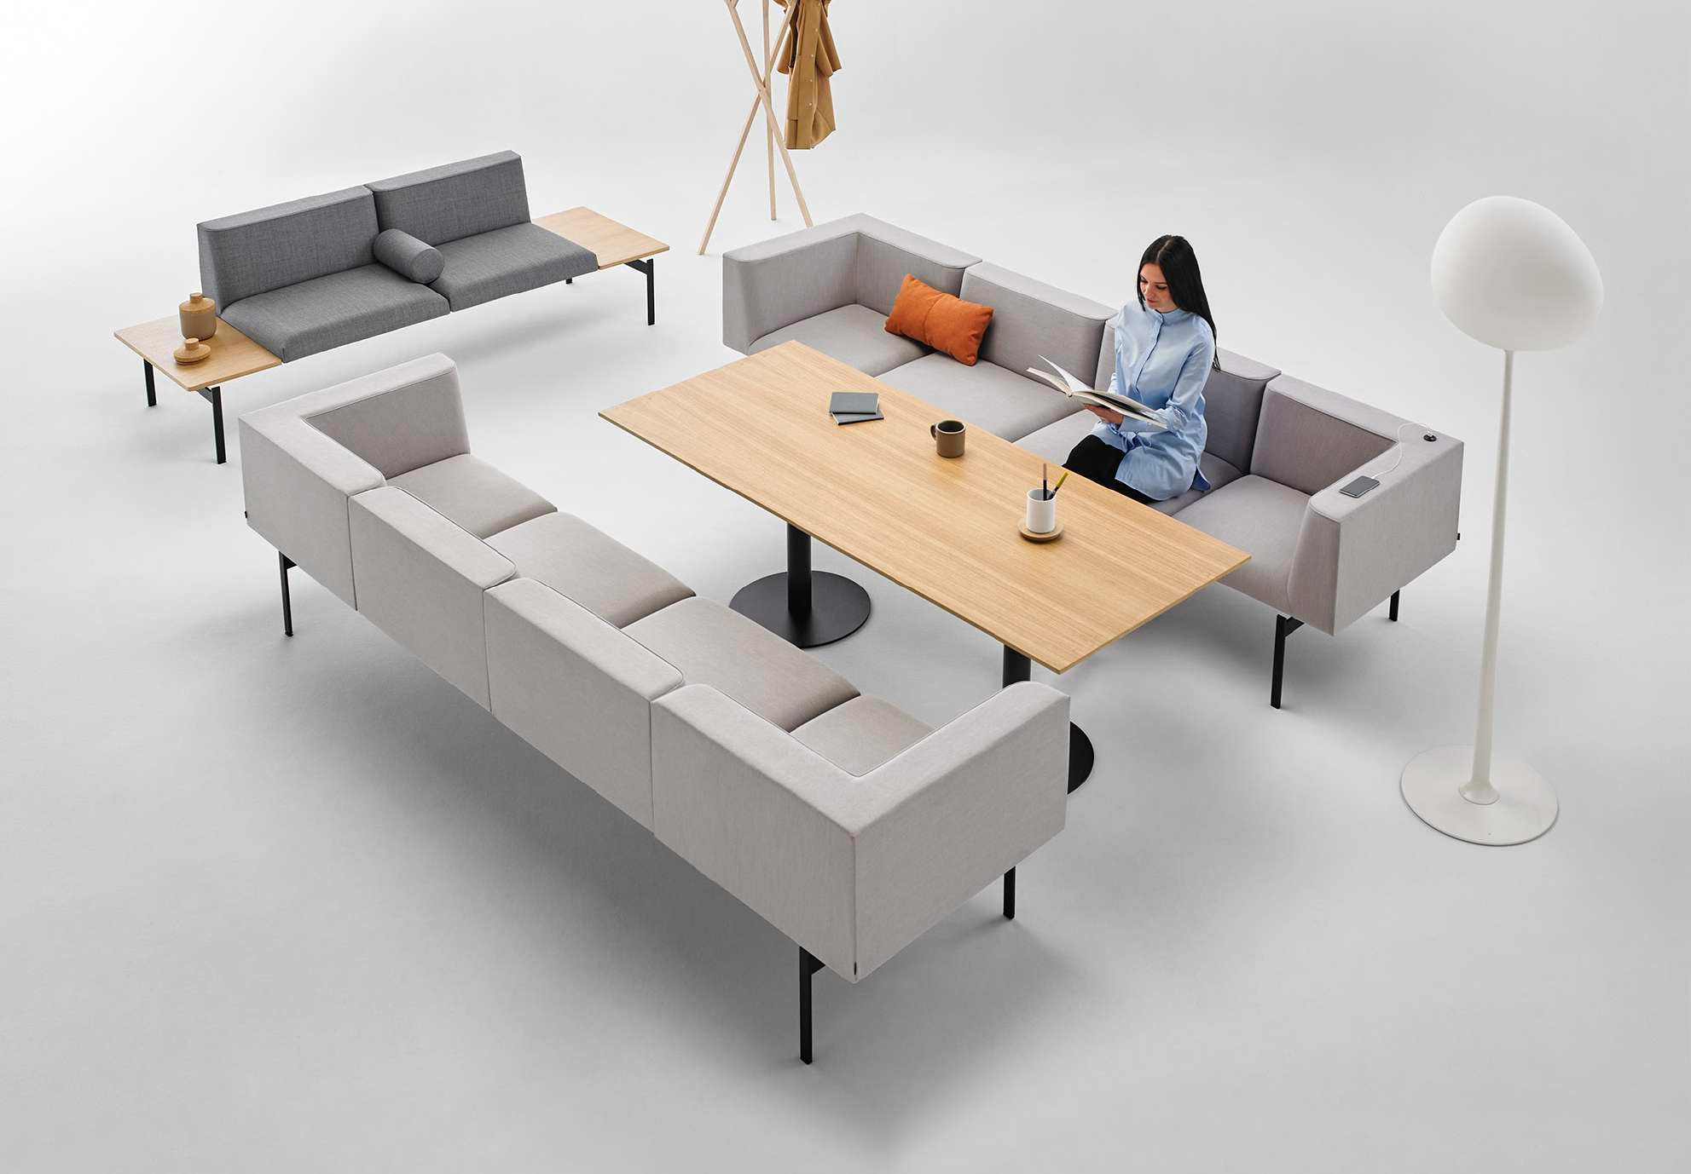
Lapse / Inclass Collection

Slide 18
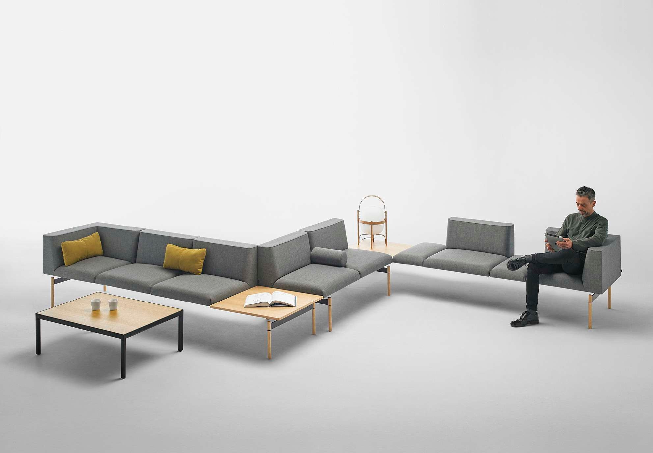
Lapse / Inclass Collection

Slide 19
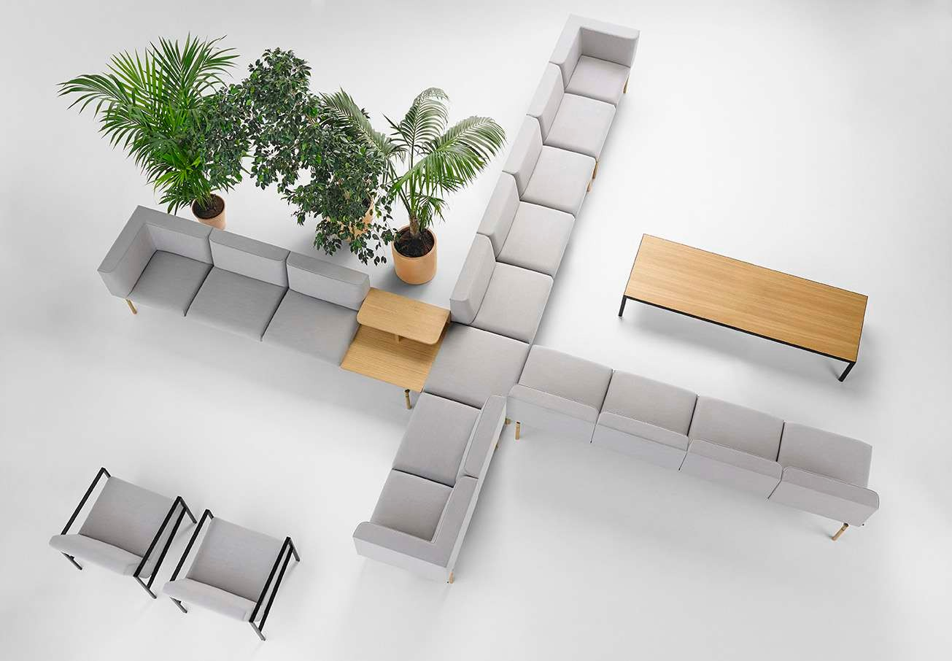
Lapse / Inclass Collection

Slide 20
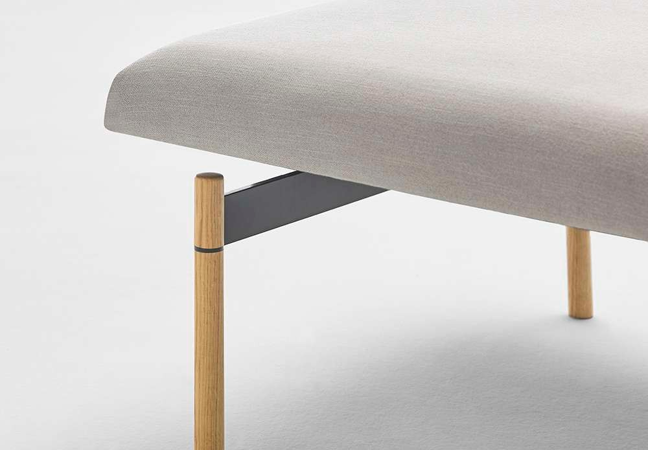
Lapse / Inclass Collection

Slide 21
Bau

Slide 22
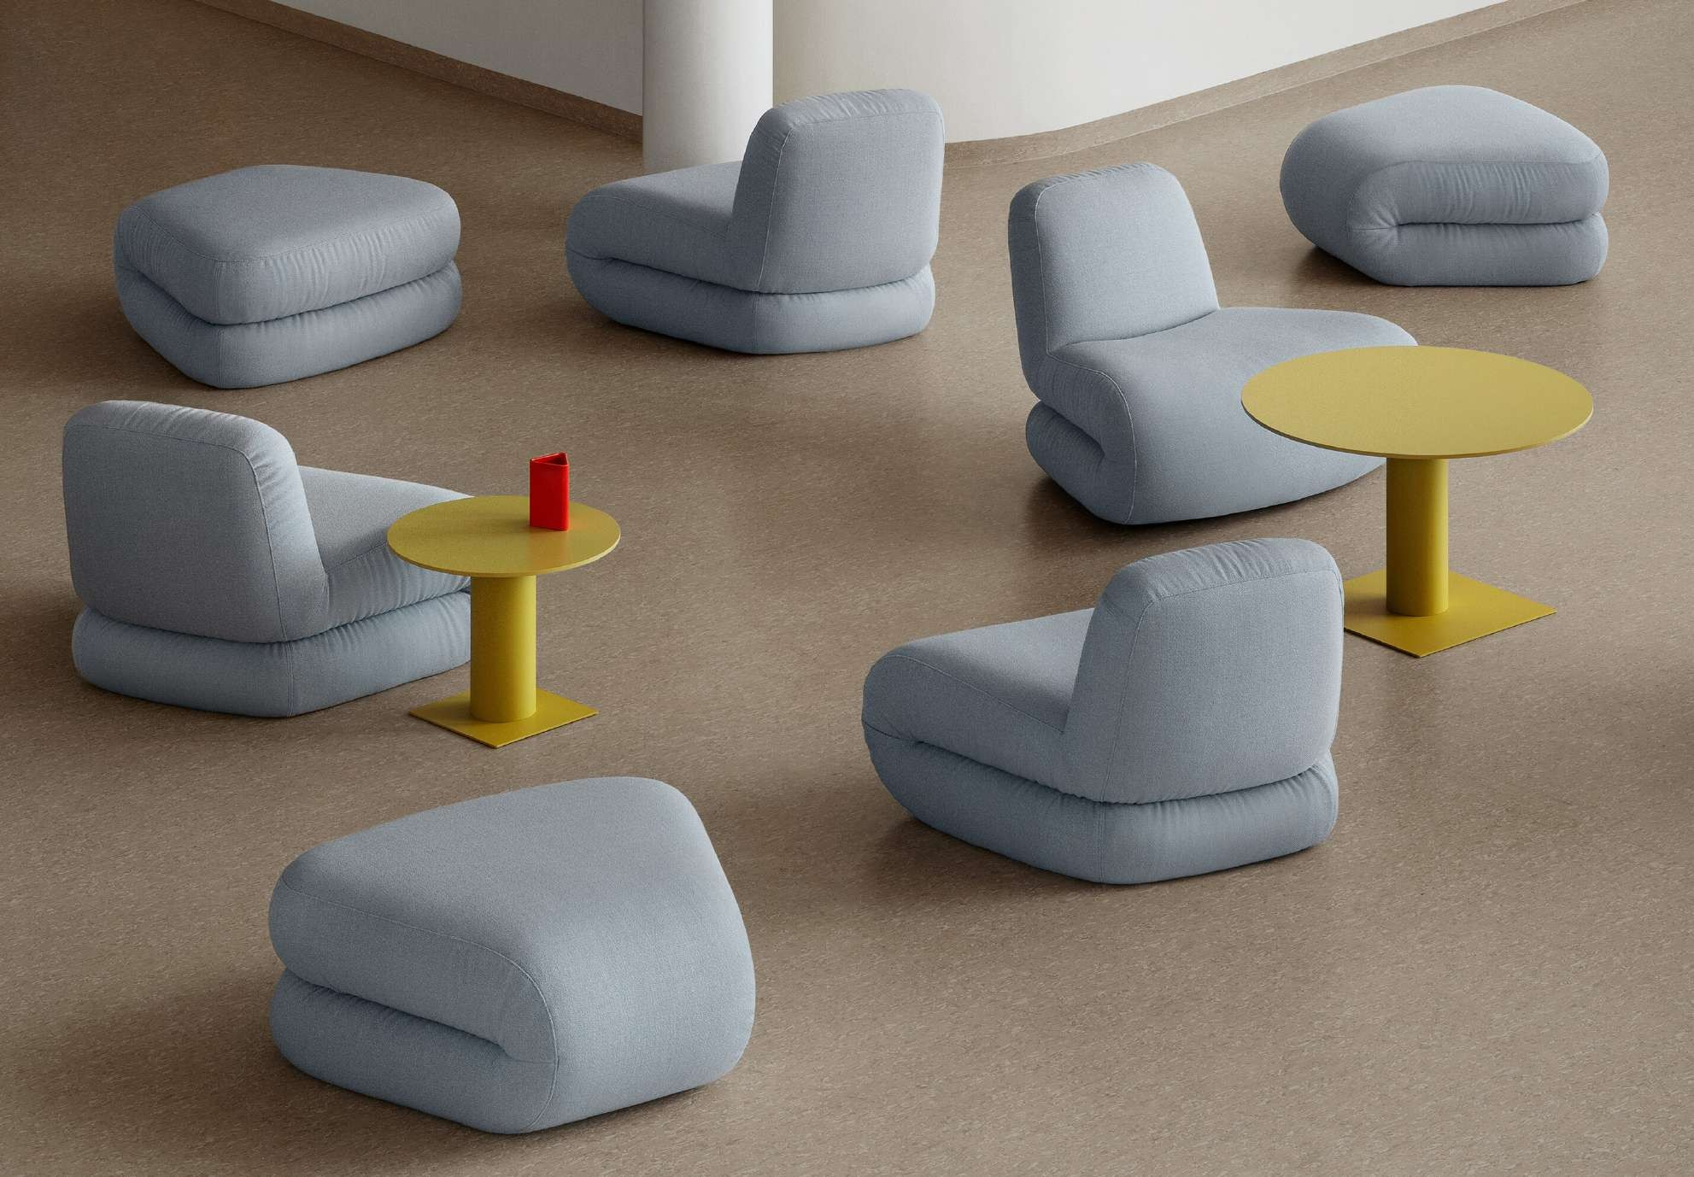
Bau / Lammhults Collection

Slide 23
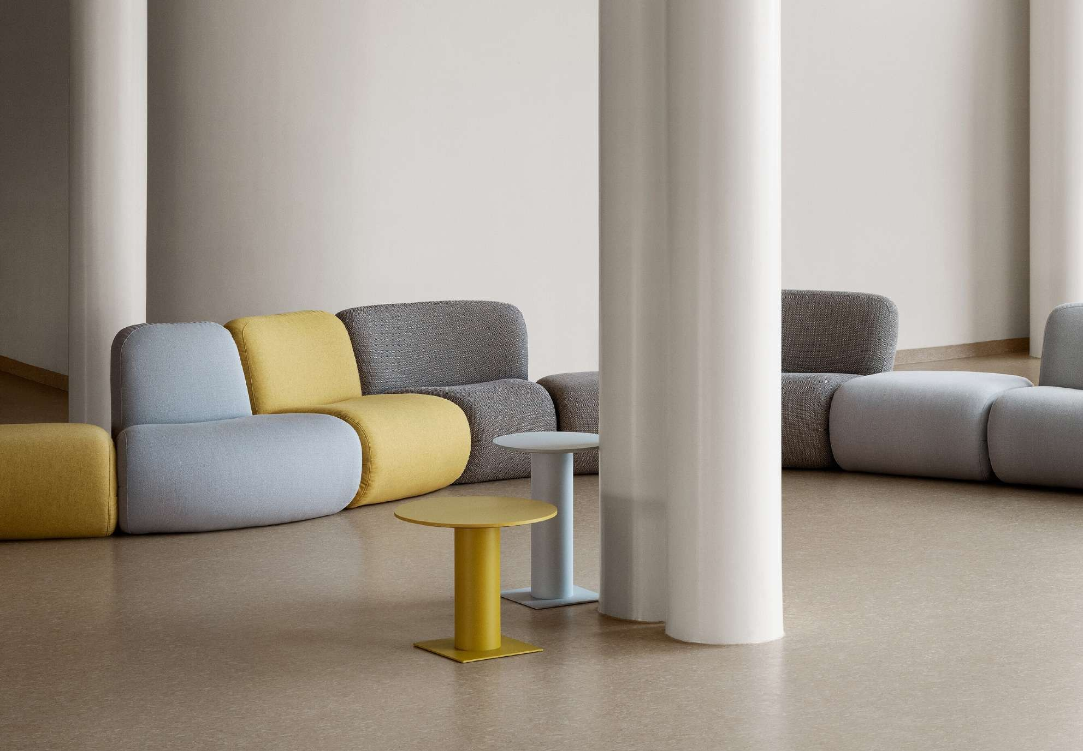
Bau / Lammhults Collection

Slide 24
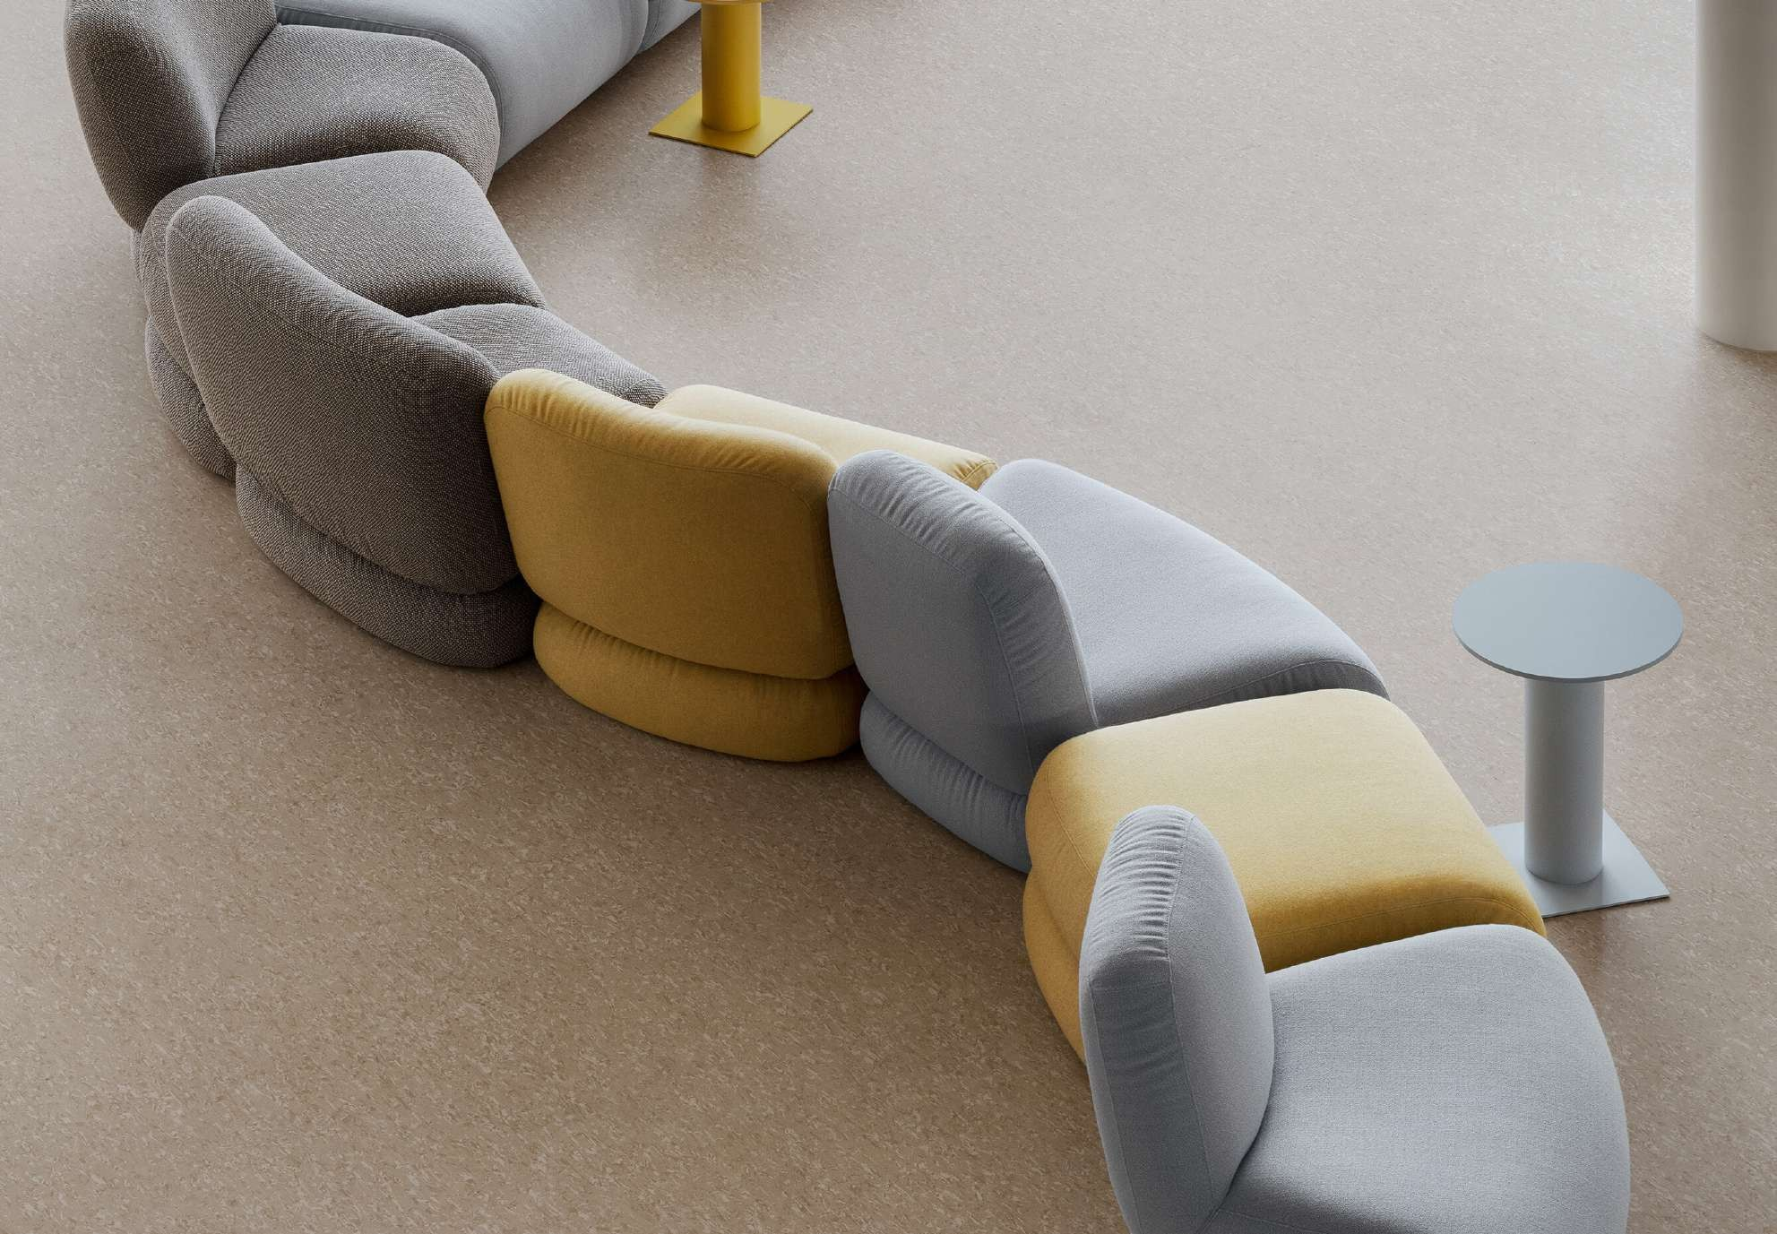
Bau / Lammhults Collection

Slide 25
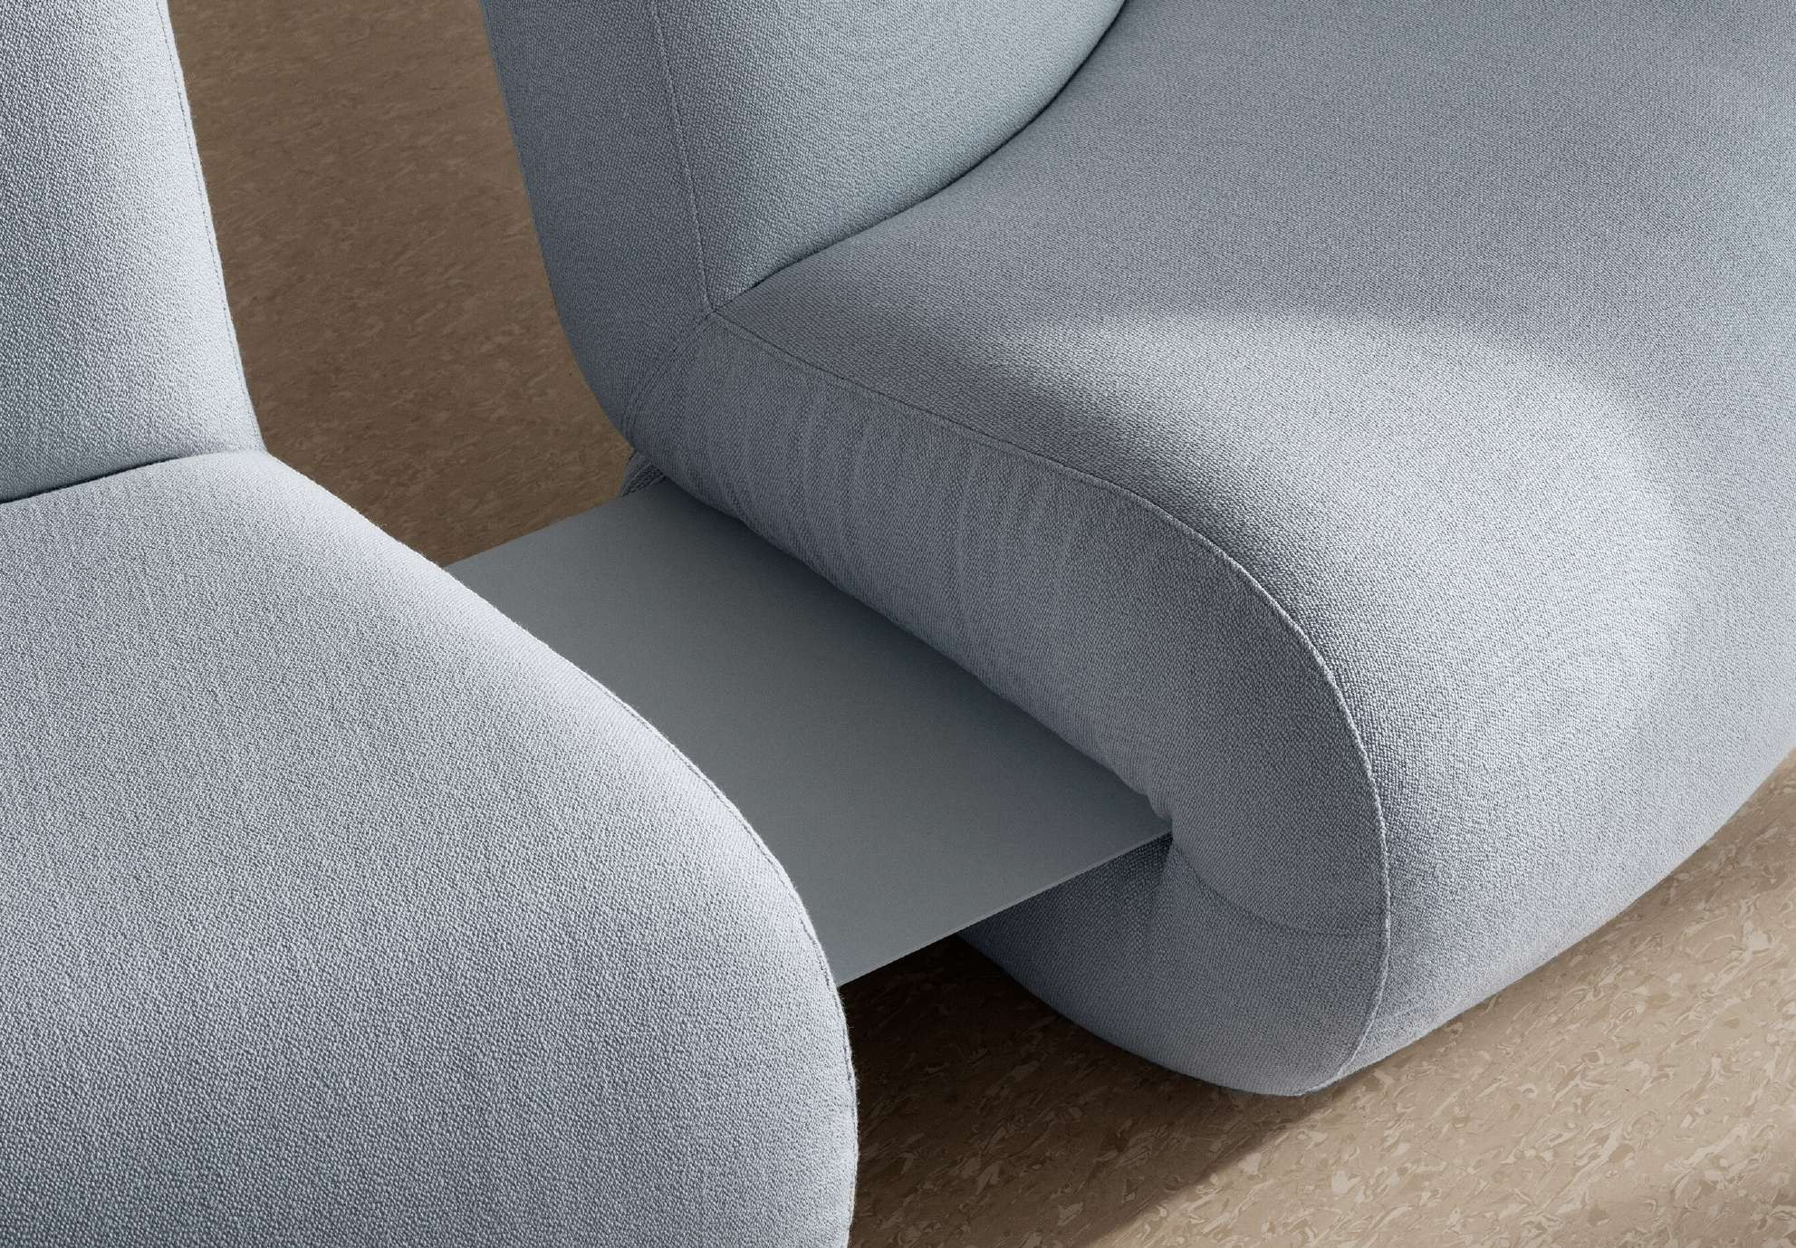
Bau / Lammhults Collection

Slide 26
Addit & Area

Slide 27
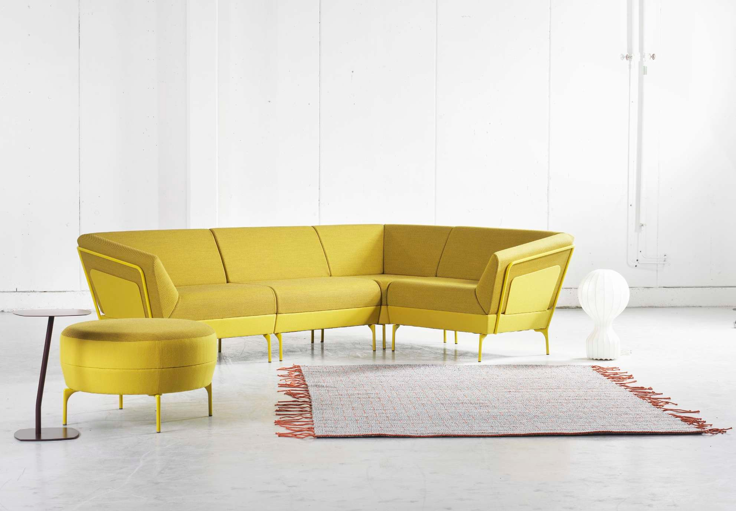
Addit / Lammhults Collection

Slide 28
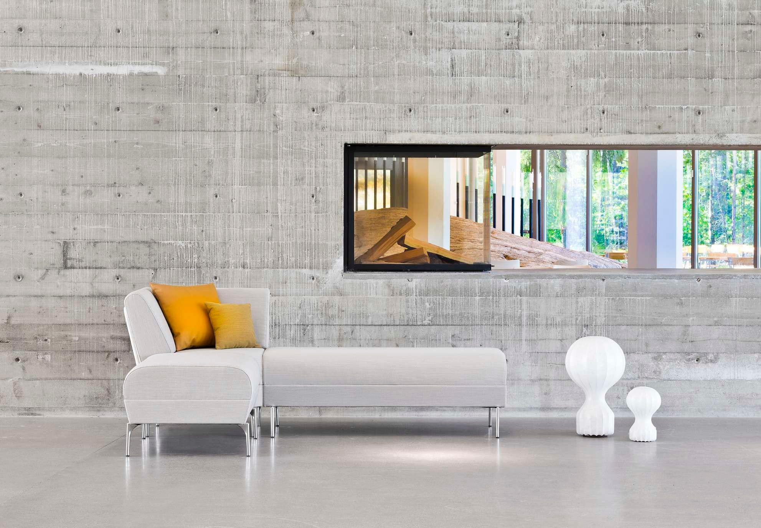
Addit / Lammhults Collection

Slide 29
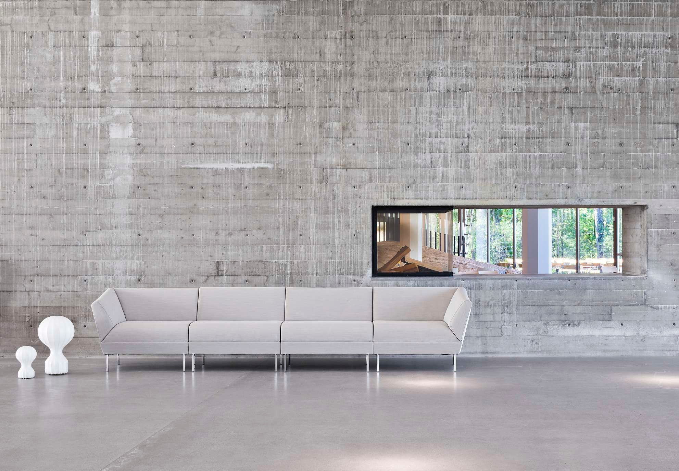
Addit / Lammhults Collection

Slide 30
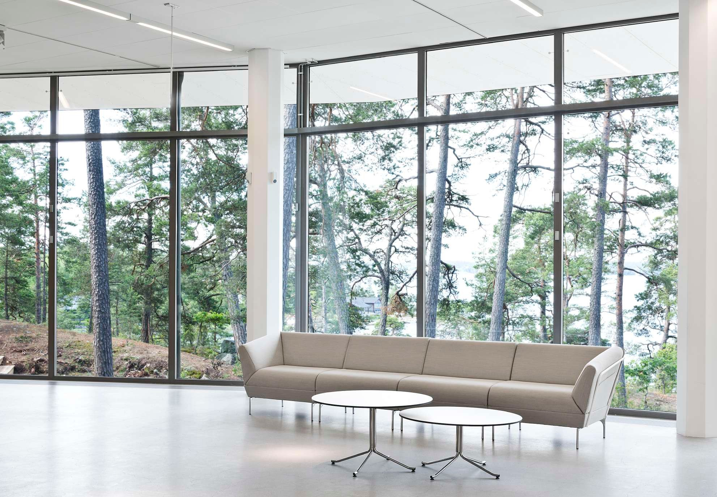
Addit / Lammhults Collection

Slide 31
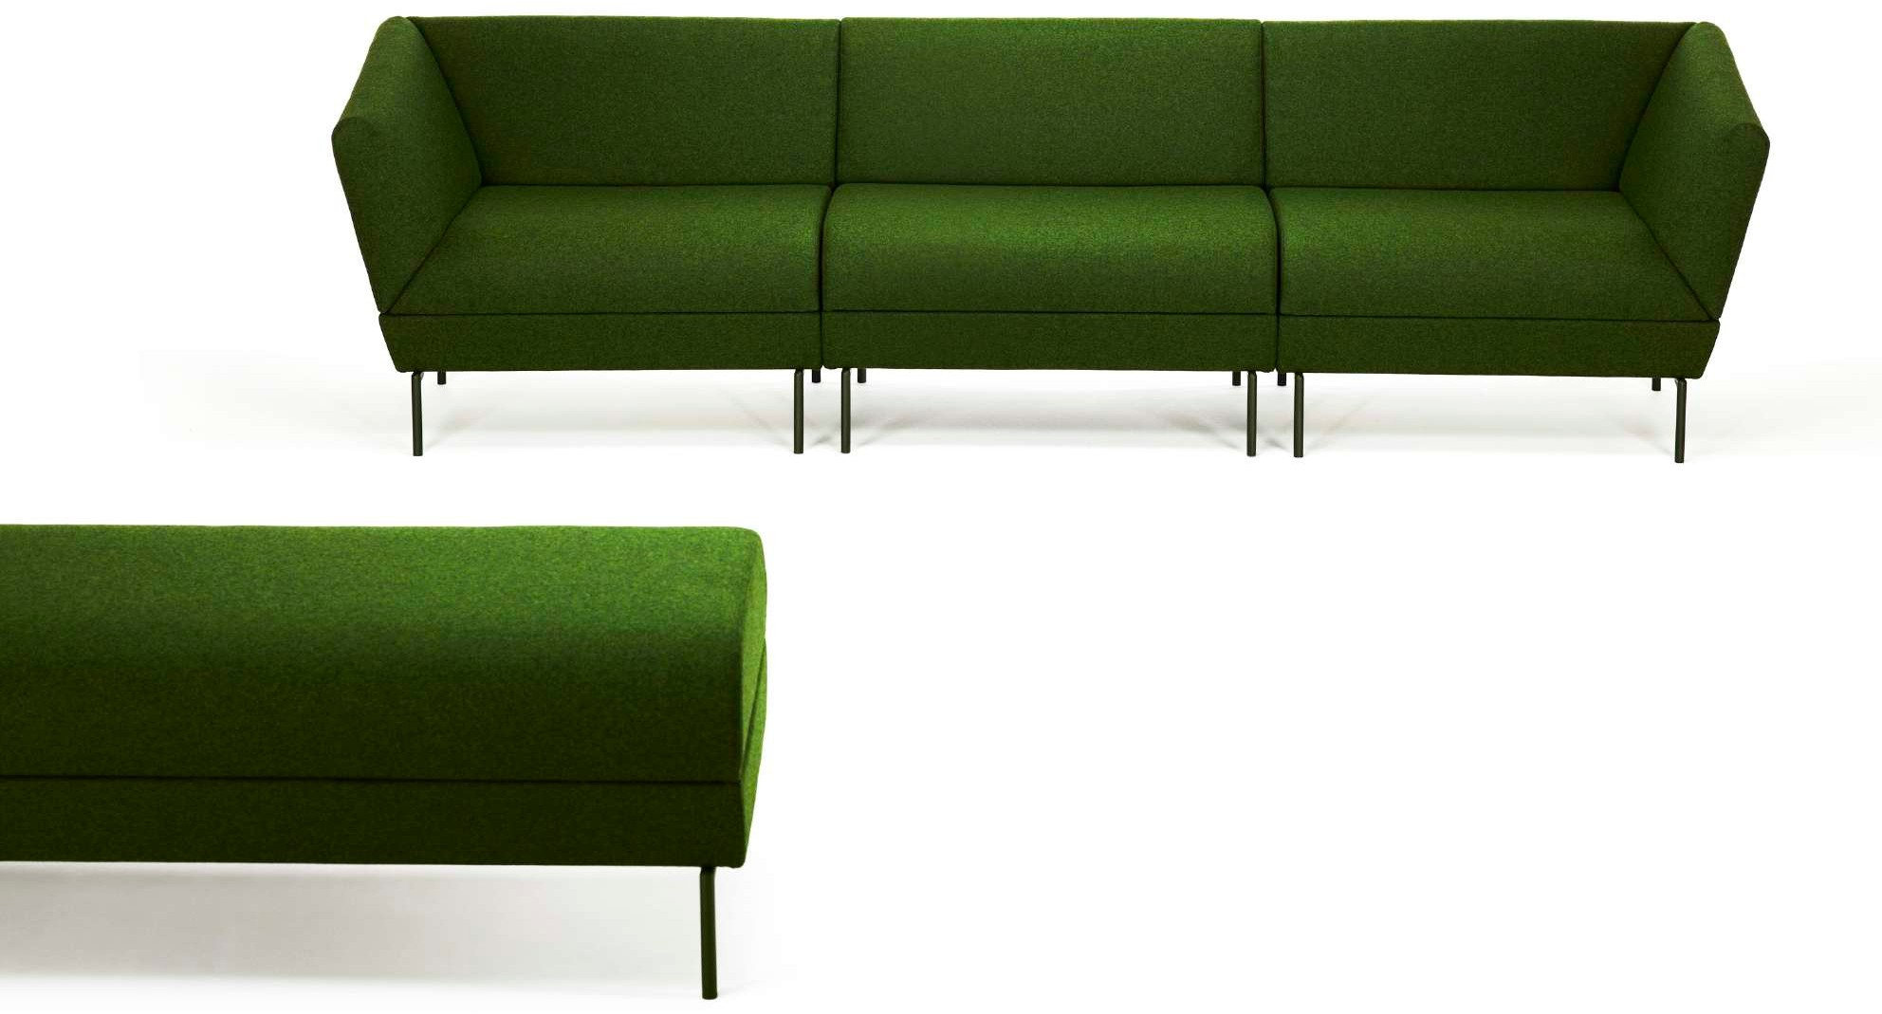
Addit / Lammhults Collection

Slide 32
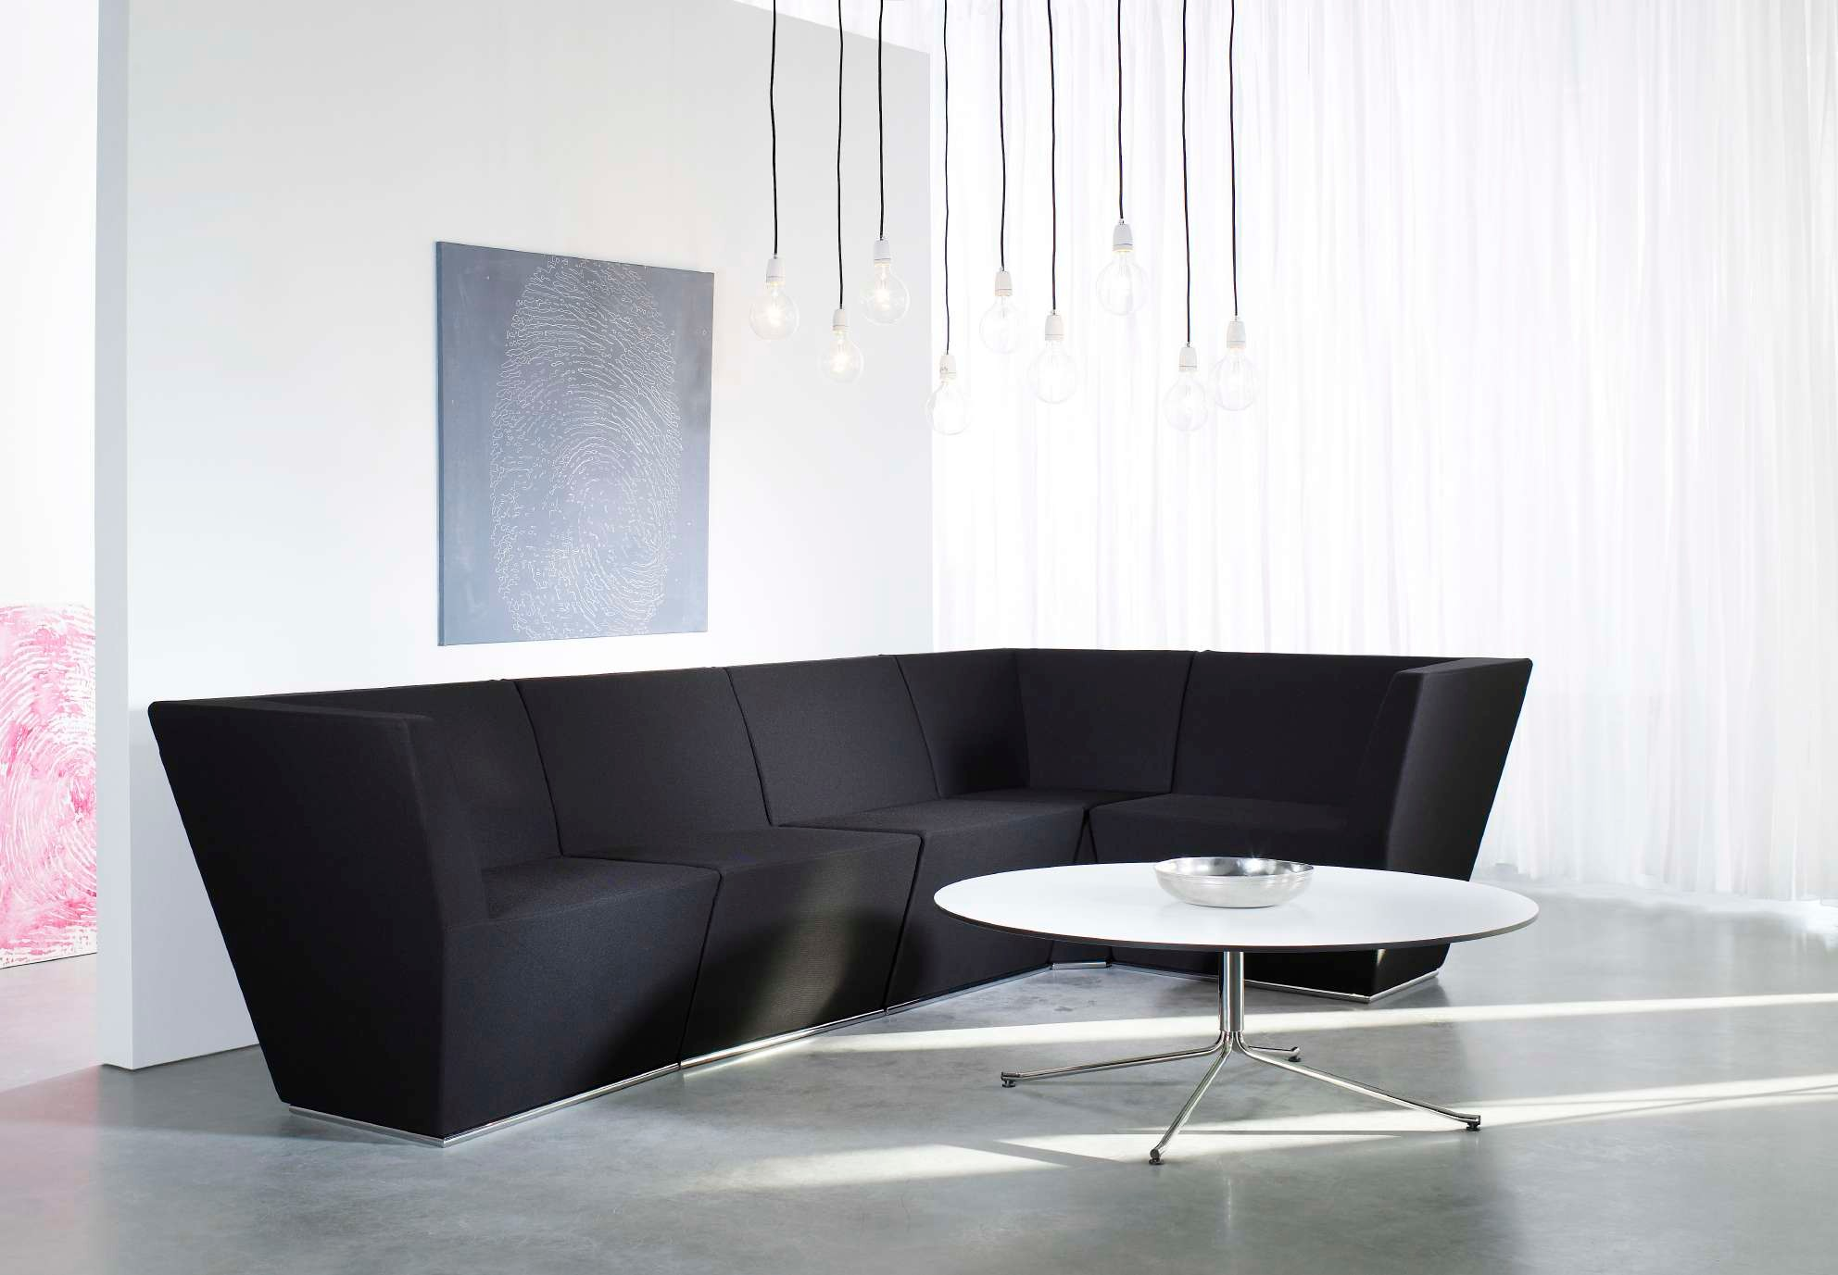
Area / Lammhults Collection

Slide 33
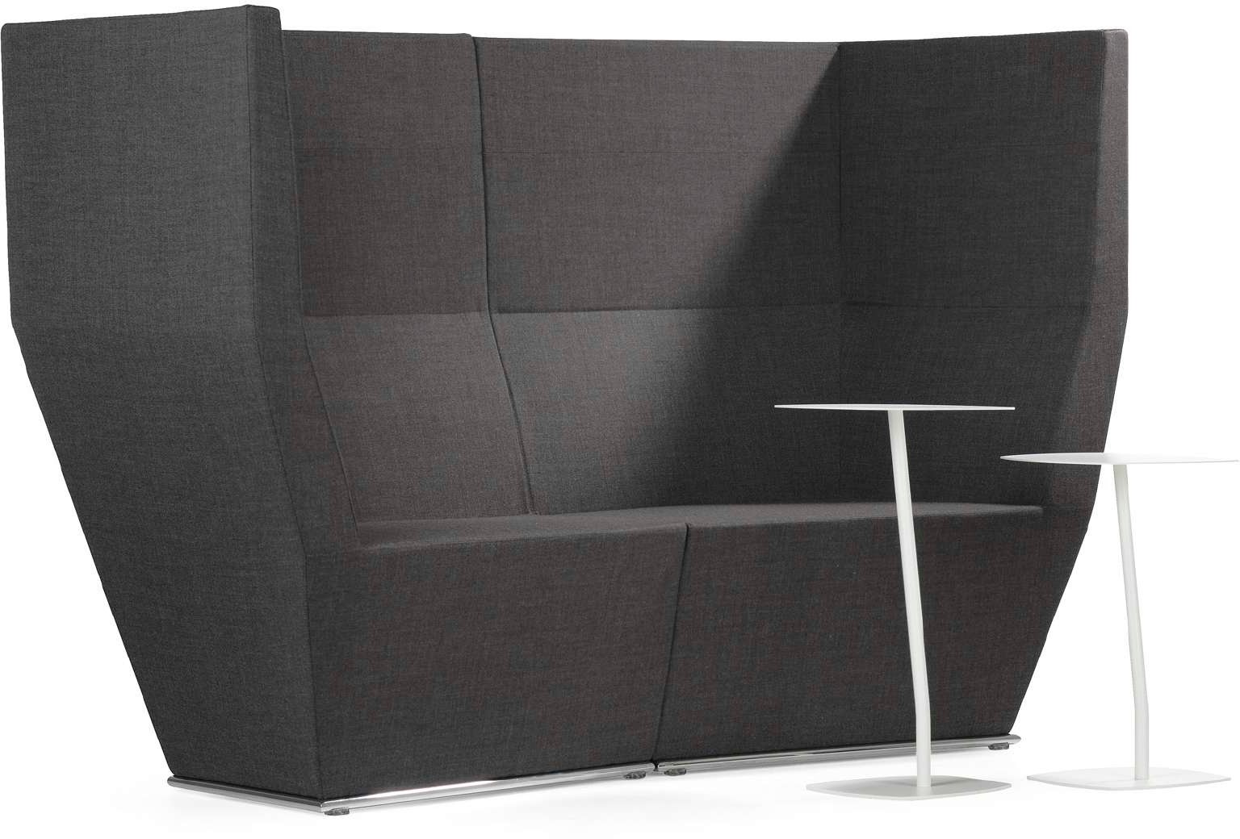
Area / Lammhults Collection

Slide 34
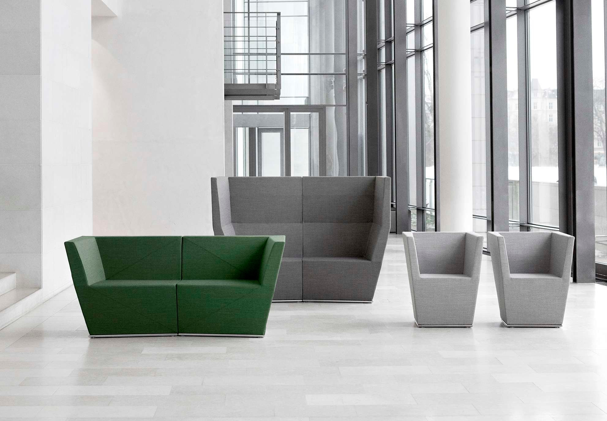
Area / Lammhults Collection

Slide 35
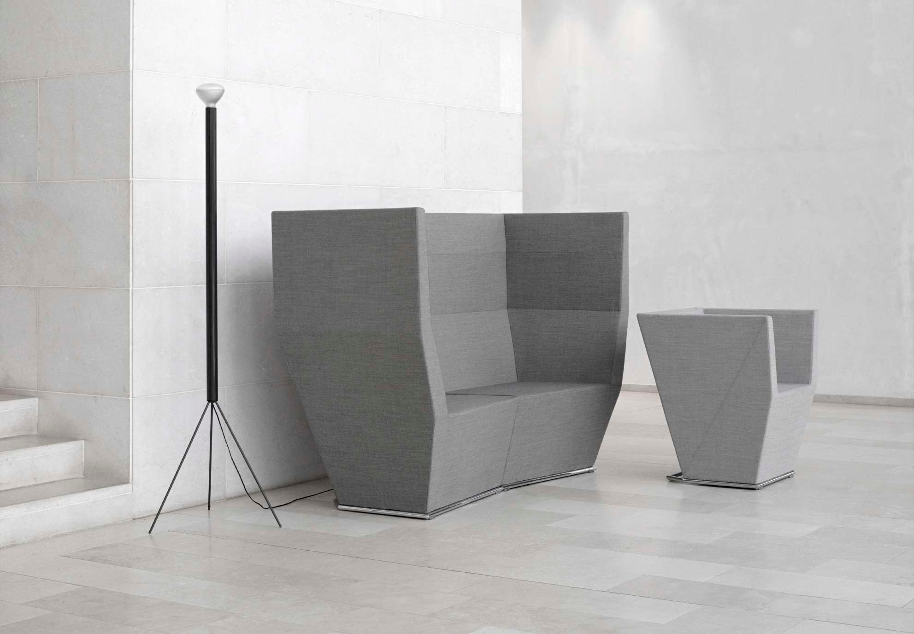
Area / Lammhults Collection

