Slide 1
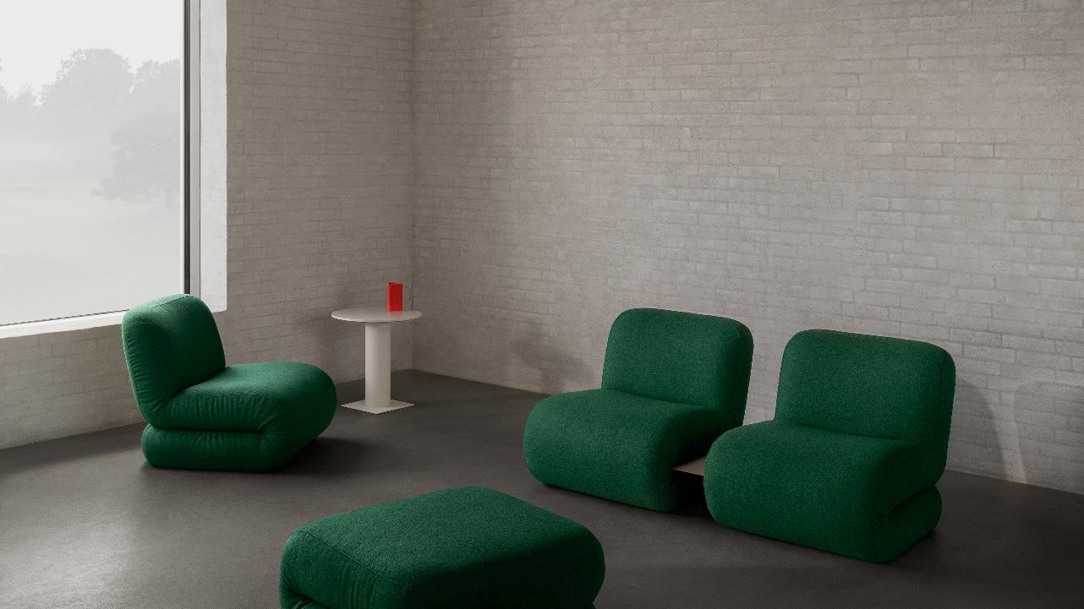
SANDLER + INSPEC 2023

Slide 2
bau

Slide 3
Notes:
List range per unit COM: $4300 for back, poufs/ ott’s $3500 depending on size.

Slide 4
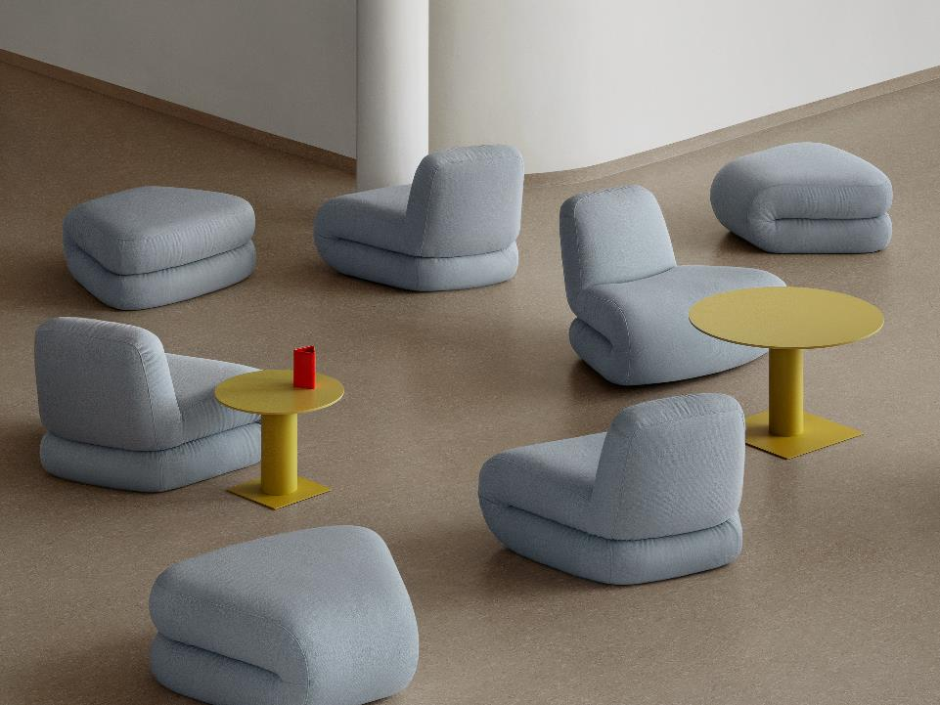
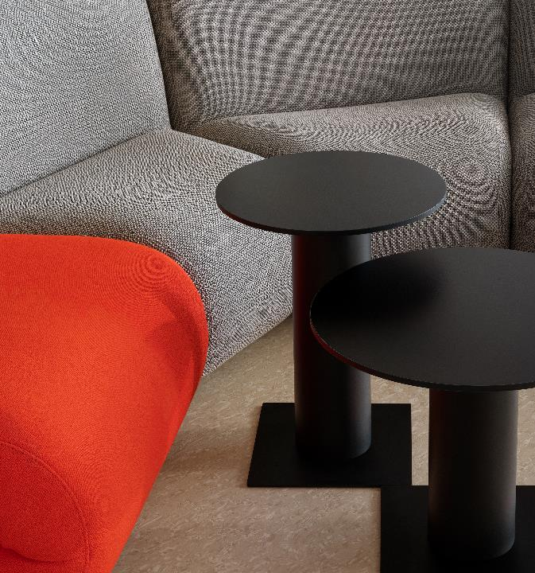

Slide 5
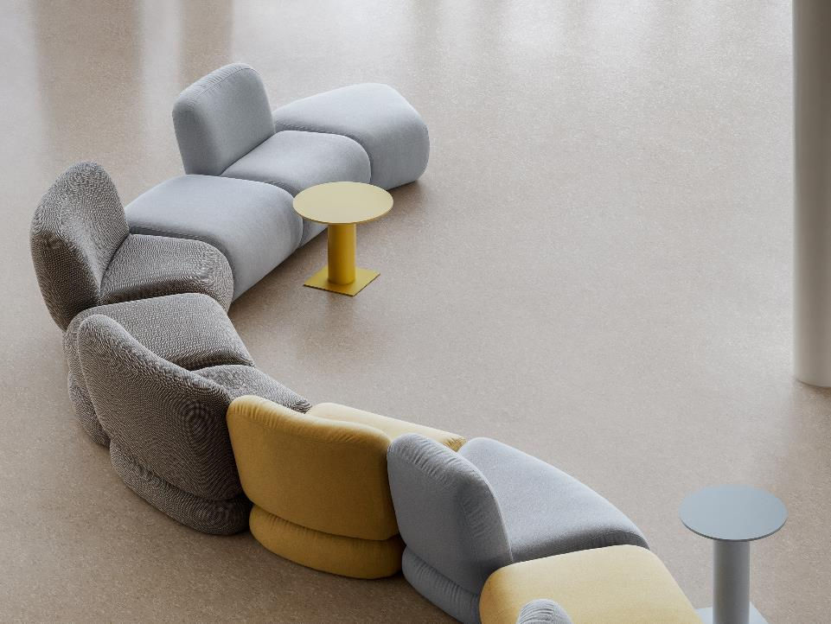
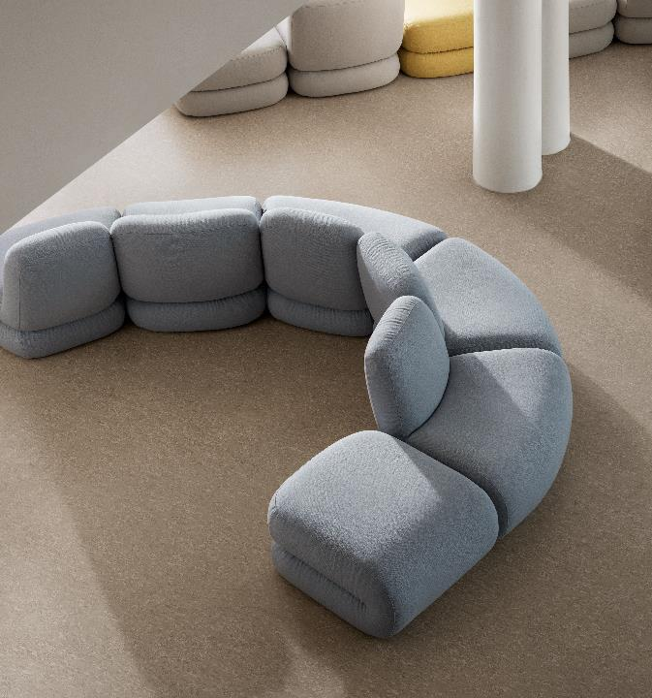

Slide 6
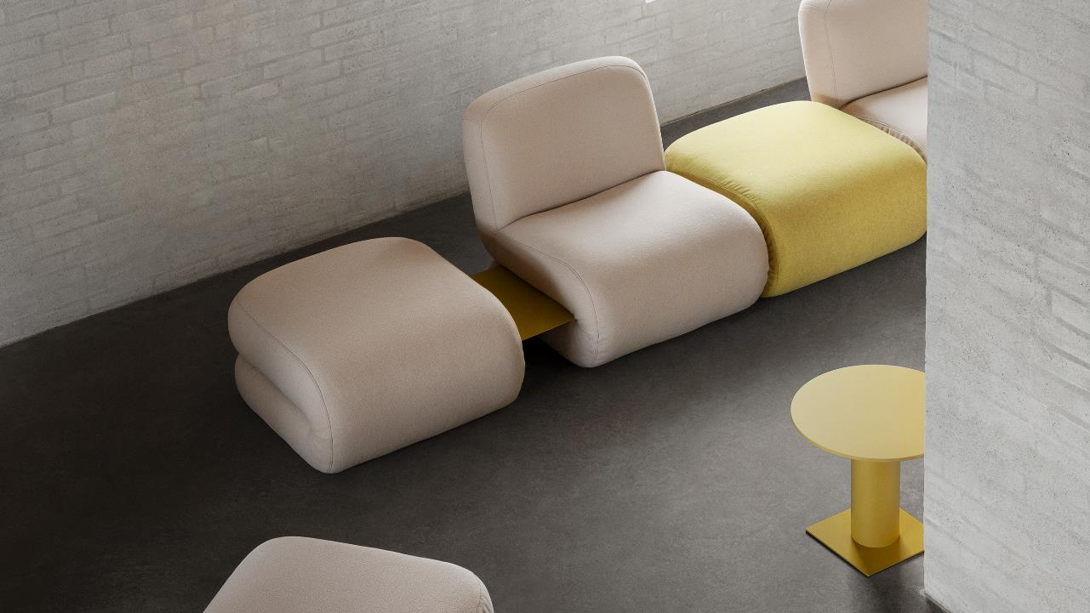

Slide 7
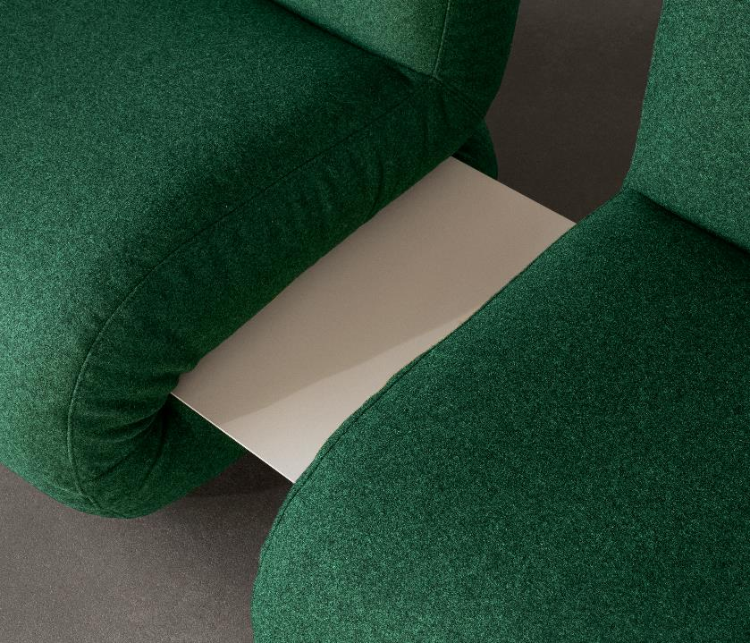
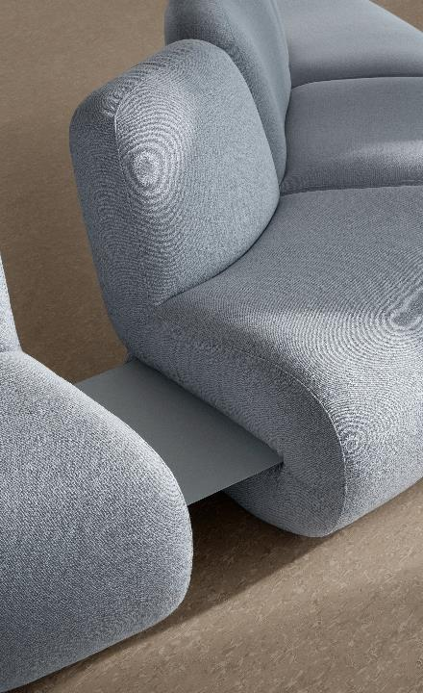

Slide 8
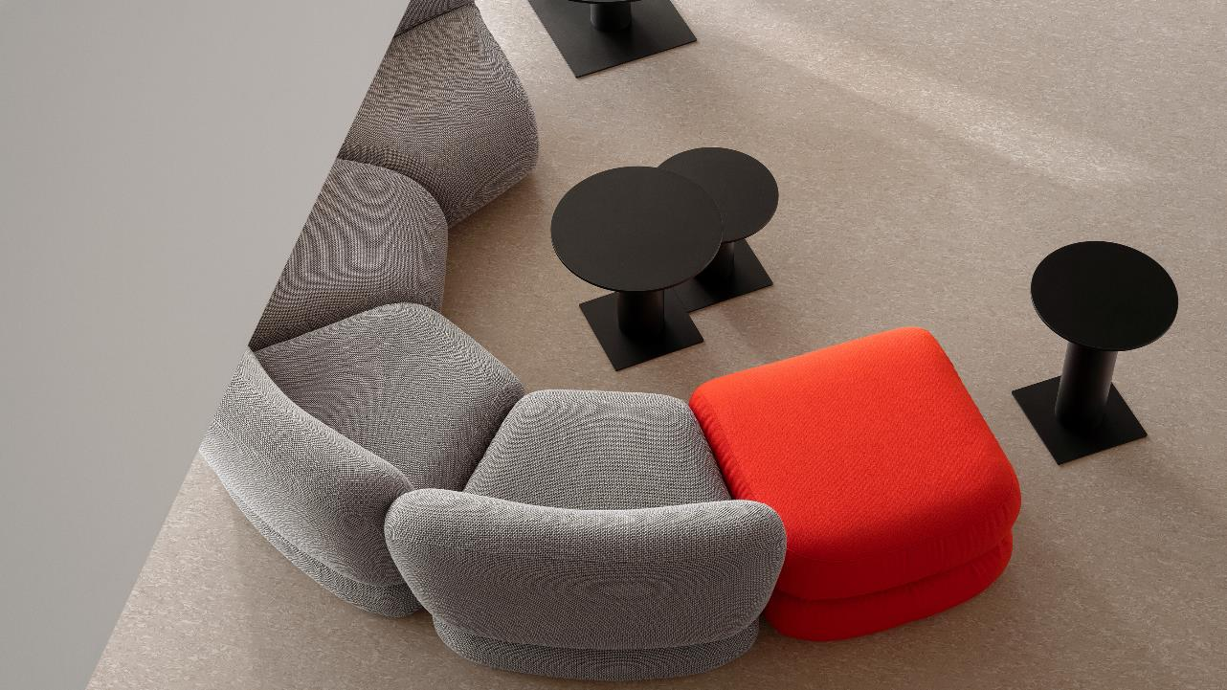
ciao
Notes:
Through its interplay of geometric shapes, the Ciao table manages to balance expressiveness with lightness and crisp elegance. Available in three heights, 32, 42, and 52”. Top sizes: 40”, 50”, and 80”
Pillar base of powder coated steel tubing, foot plate of sheet steel. Felt glides. Table top of 16 mm MDF with high pressure laminate. Standard colors: White / Black / Light beige / Light yellow / Light blue

Slide 9
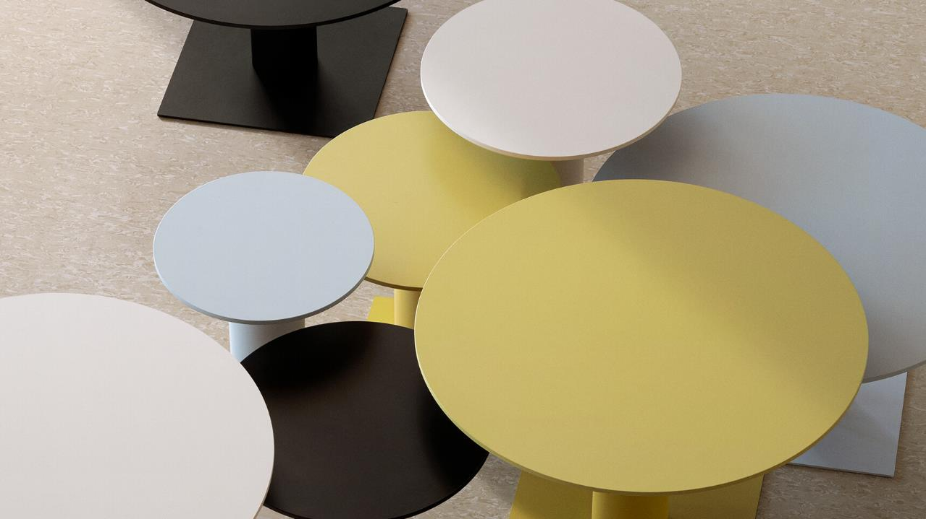
Notes:
List range: 1850 – 1750, depending on finishes, size.

Slide 10
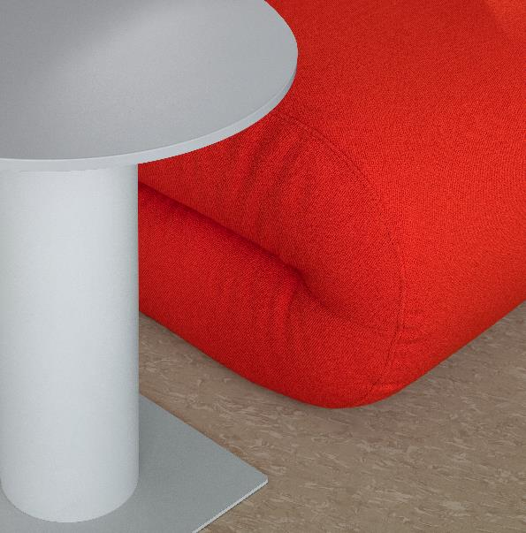
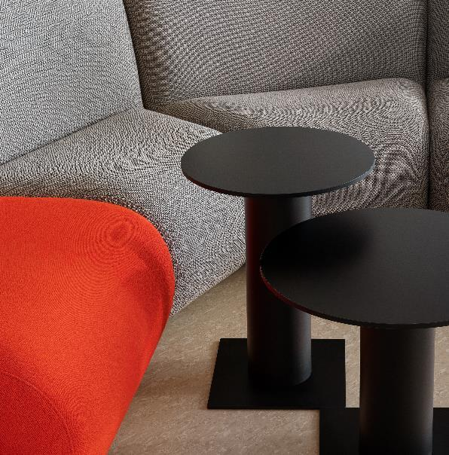

Slide 11
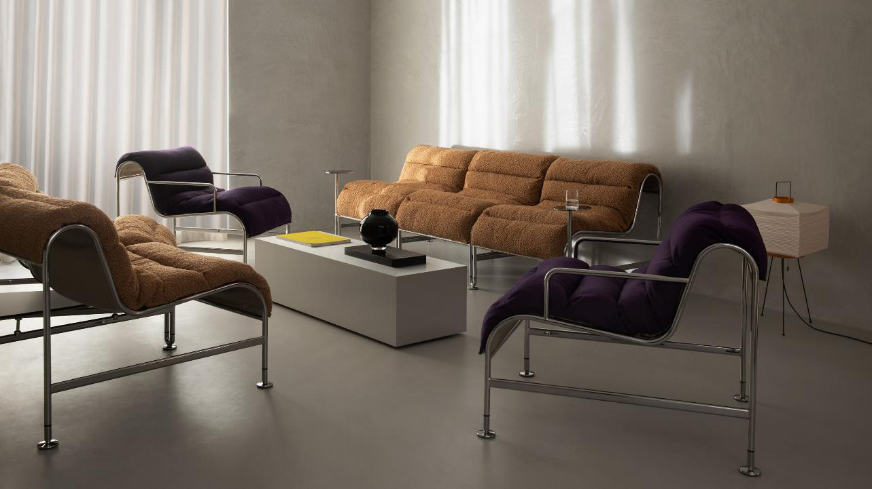
SUNNY
Notes:
Sunny range List: 5600 – 6200 depending on powder coat, chrome, arm or armless.

Slide 12
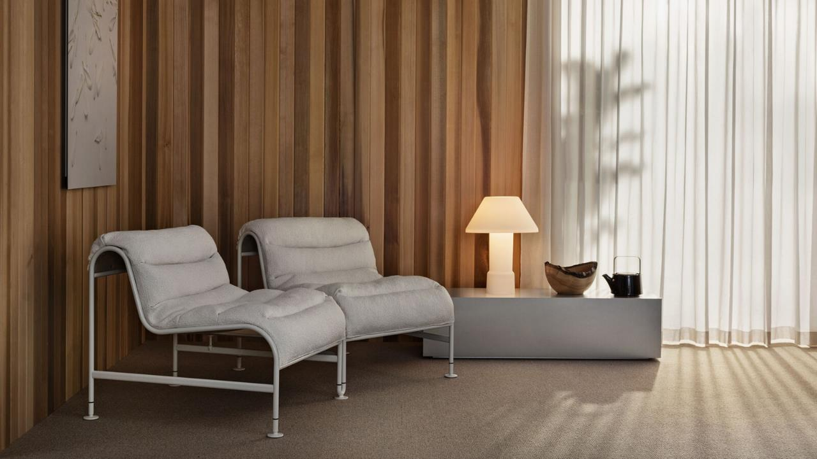

Slide 13
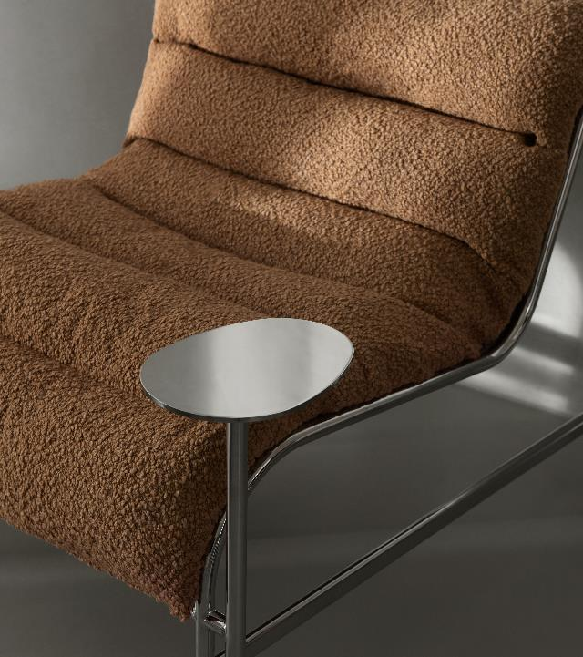
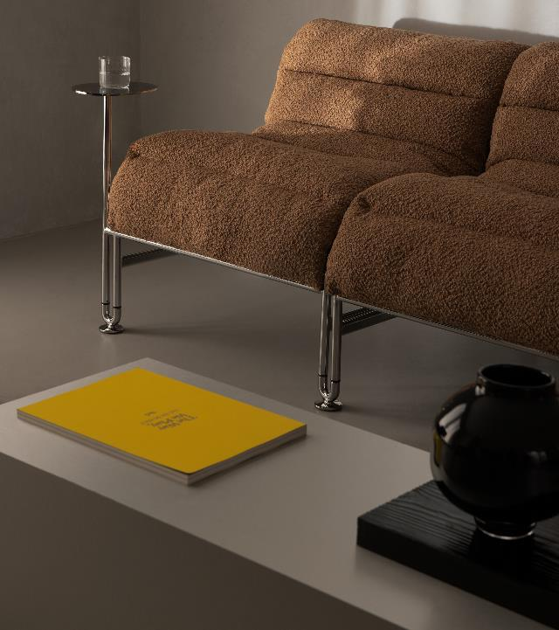

Slide 14
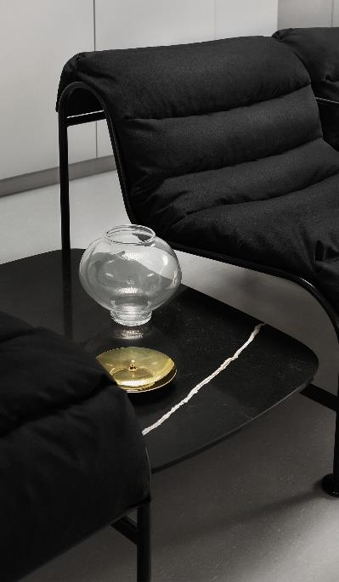
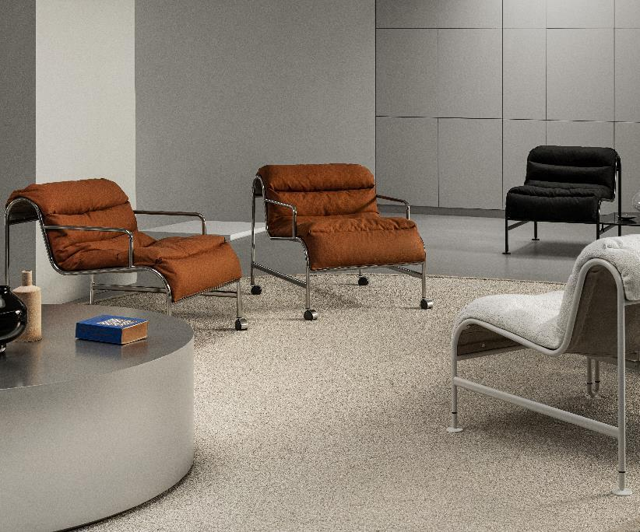

Slide 15
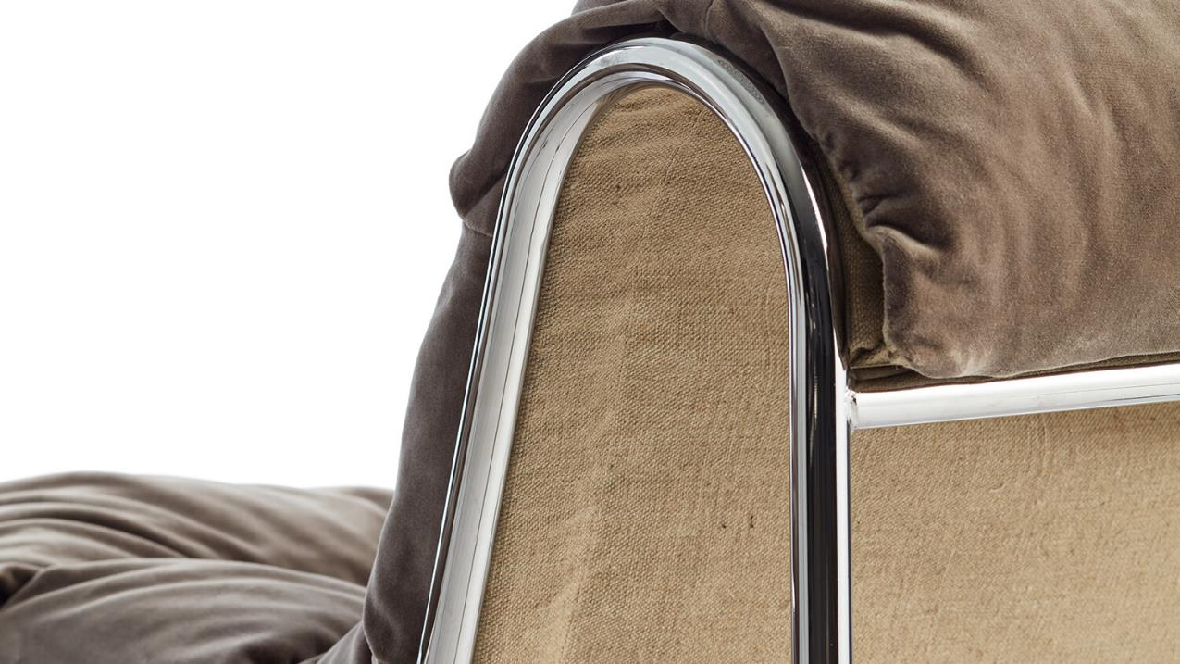

Slide 16
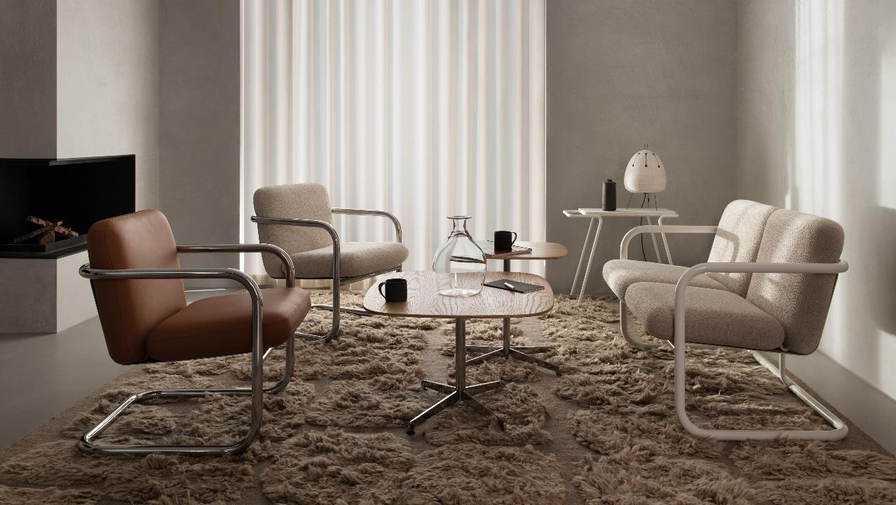
S70-4 + S70-5
Notes:
S70-4: 2600 list
S70-5: 4400 listS

Slide 17
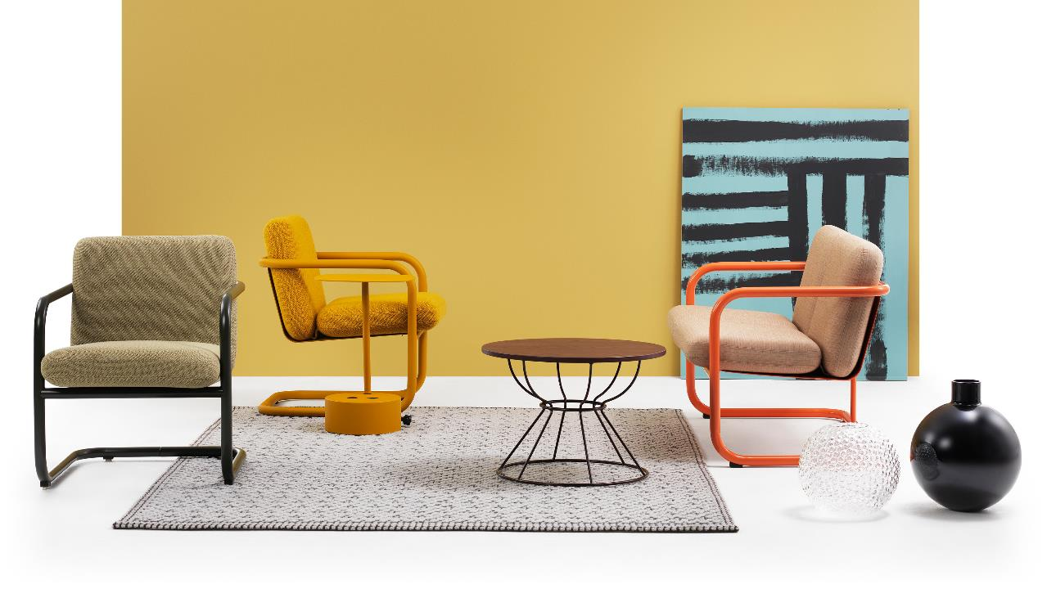

Slide 18
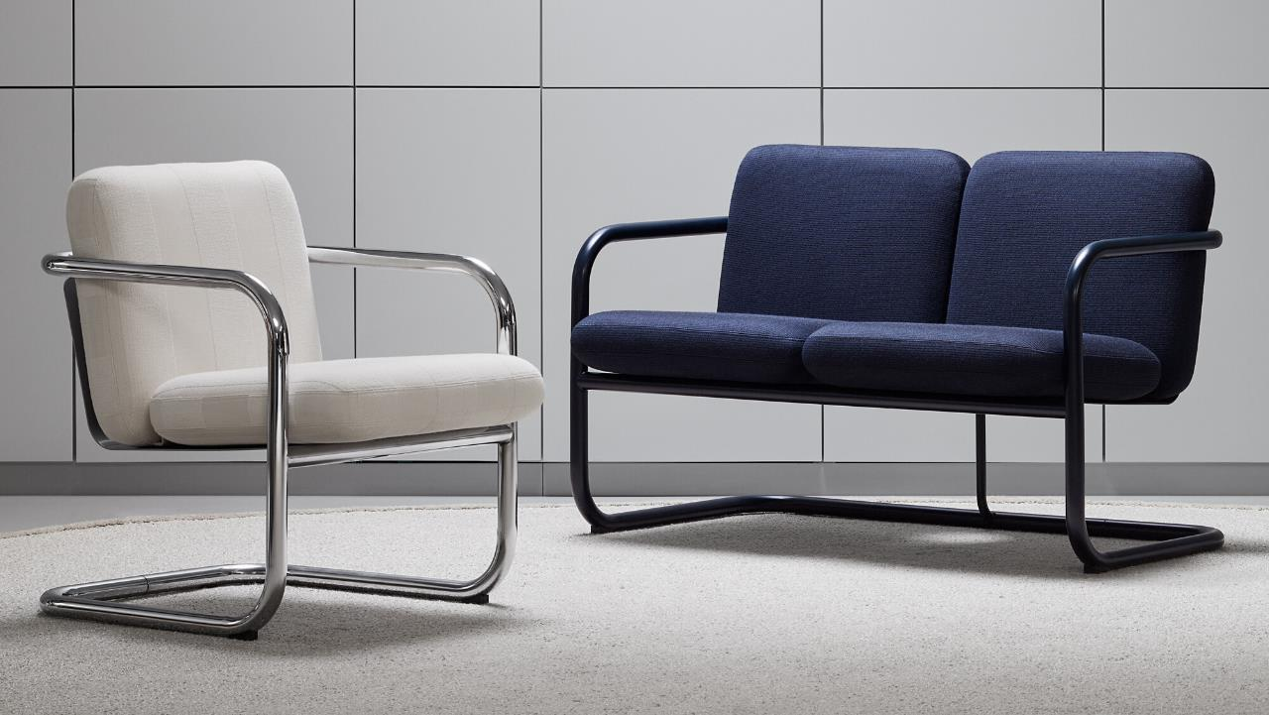

Slide 19
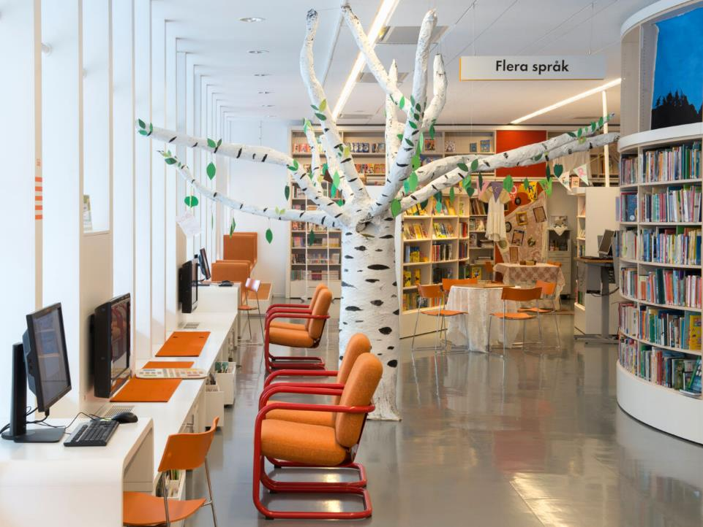
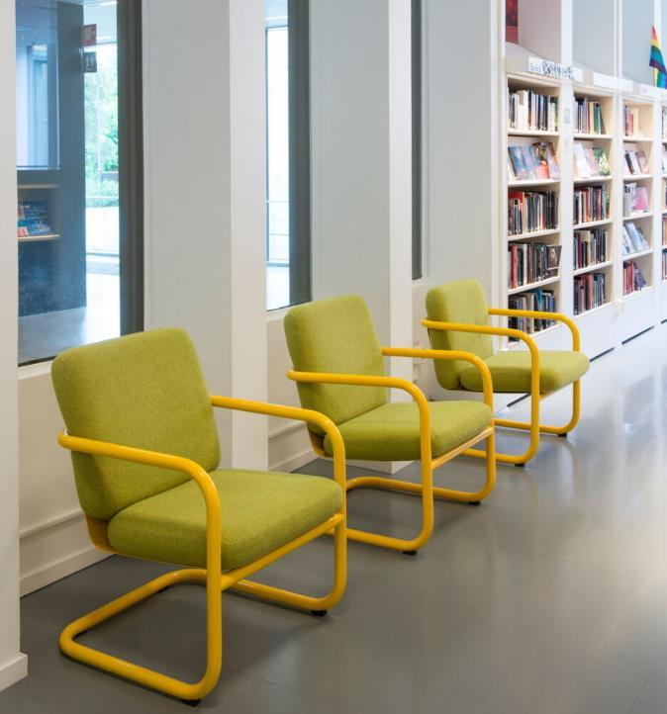

Slide 20
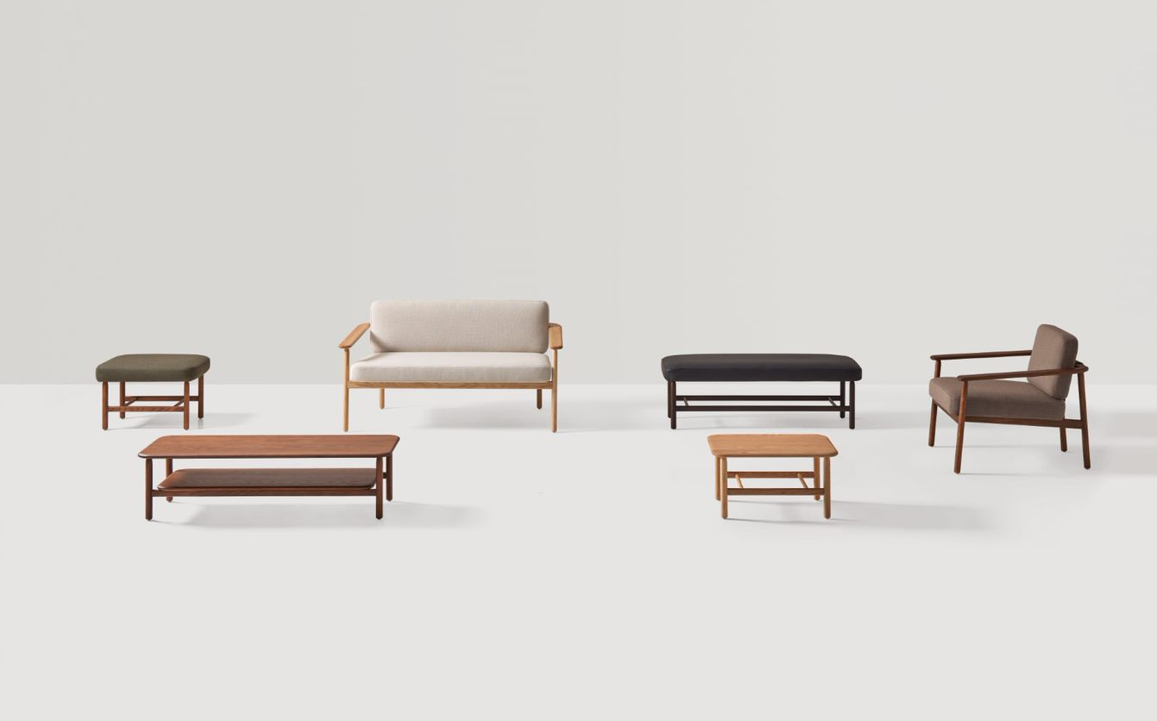
WUDI
Notes:
Wudi is a collection of armchairs, benches and side tables for lounge areas that combine tradition and modernity through the use of wood. The armchair is a timeless and comfortable design, characterized by its expressive armrests. A backrest supported by a fabric stretched like a sail contributes to the light and relaxed spirit of the piece. The rounded solid wood structure radiates warmth and softens its image, while the upholstery and high-quality details lend it great elegance. The collection is completed with original upholstered benches and side tables that can be easily integrated into multiple spaces.
Wudi 5.1 – 3160 COM, 3350 COL LIST (armchair)
7.1 – 4900 COM, 5250 COL (sofa)
8.1- 1270 COM, 1340 COL (uph. Ottoman)
8.2 – 1800 COM, 1940 COL (2 seater bench uph.)
9.1 – 1480 stain (wood side table, no insert)

Slide 21
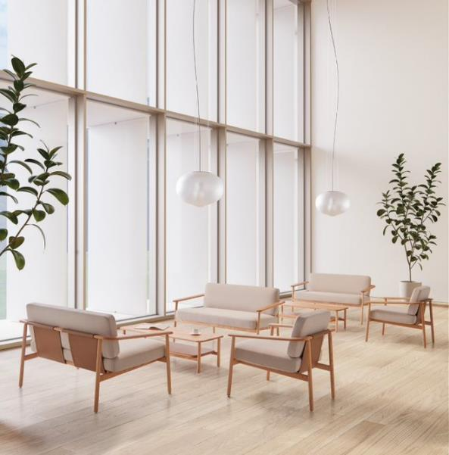
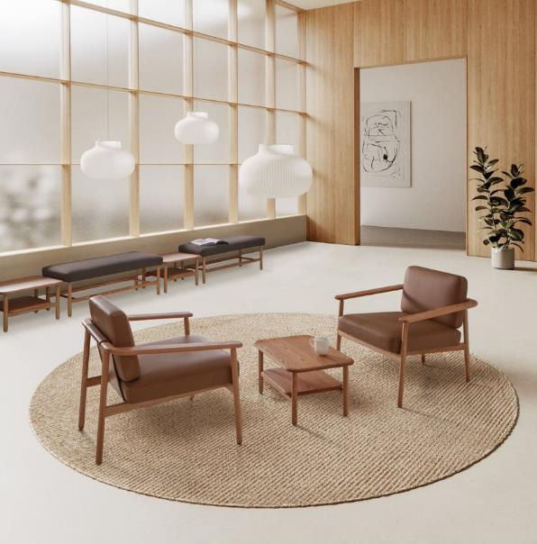

Slide 22
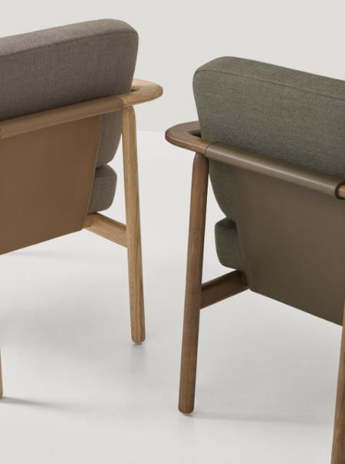
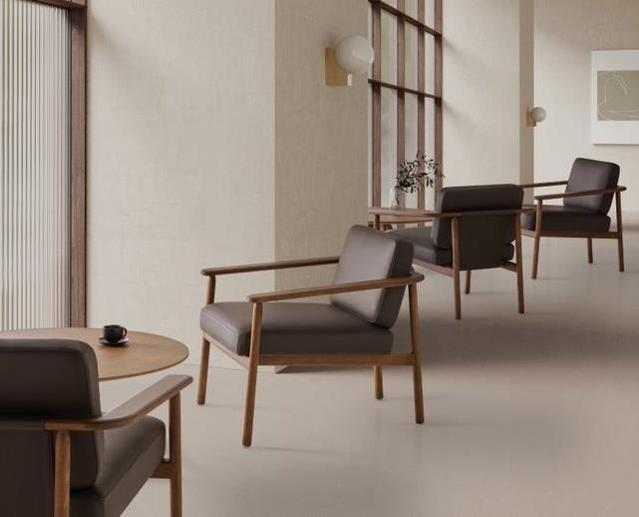

Slide 23
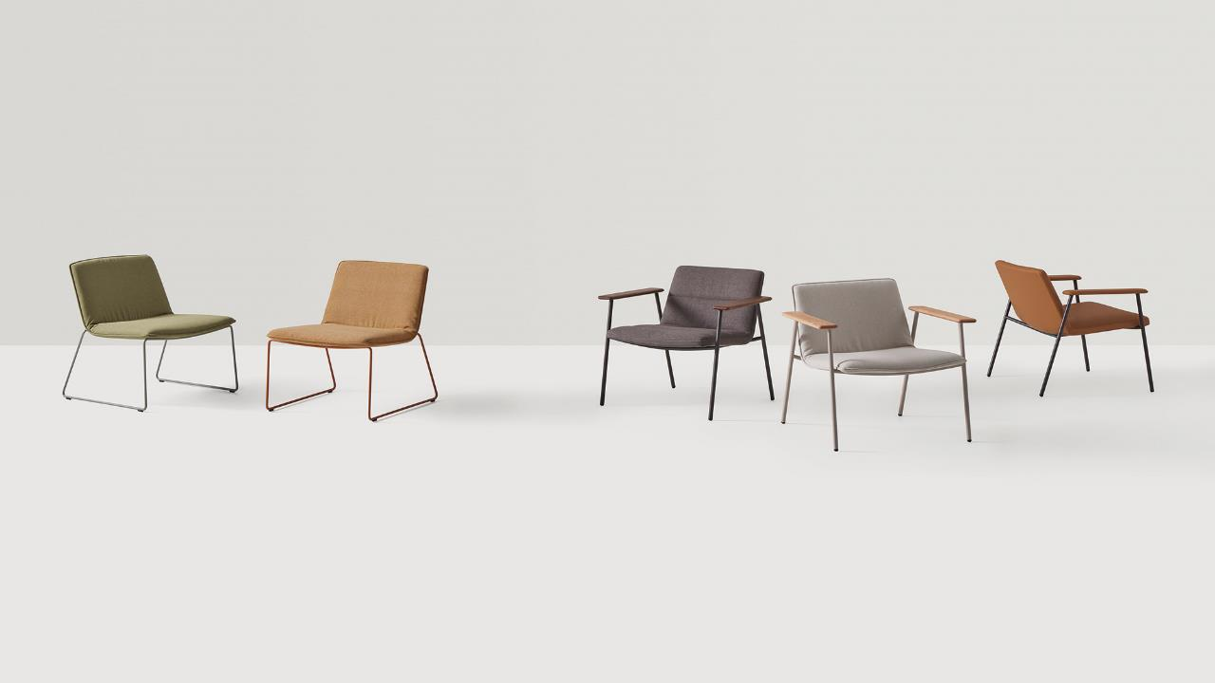
XAIL
Notes:
XAIL is a collection of armchairs for lounge areas that are characterized by their comfort and a timeless design of essential elegance. A generous seat with soft and flowing shapes configures a welcoming place to rest and unwind. XAIL seats are available with three upholstery options: soft, classic and with horizontal stitching. The structures are manufactured in two versions: rod sled or four leg in steel with oak or upholstered armrests. The seats and structures are available in a wide selection of finishes that allow multiple combinations, facilitating their integration in multiple lounge or waiting spaces.
5.1 – sled base, standard epoxy, armless – 1490 list
5.4 – 4 leg, arms standard uph, epoxy – 1900
5.7 – 4 leg, arms, uphol. Arms standard paint/ COM - 1740

Slide 24
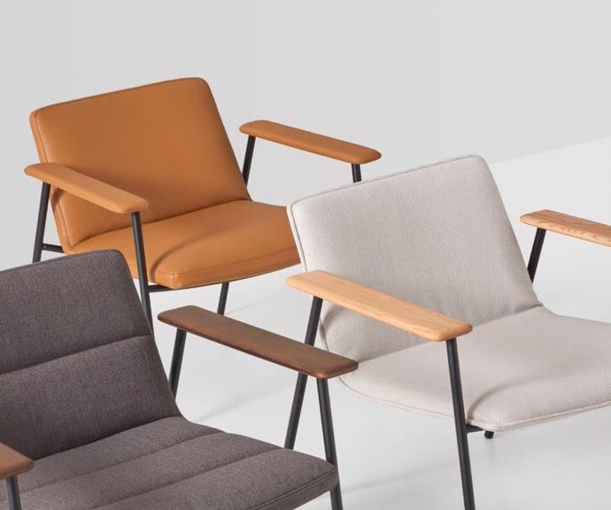
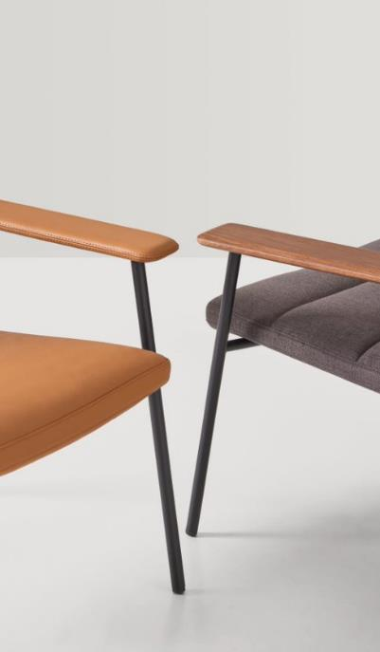

Slide 25
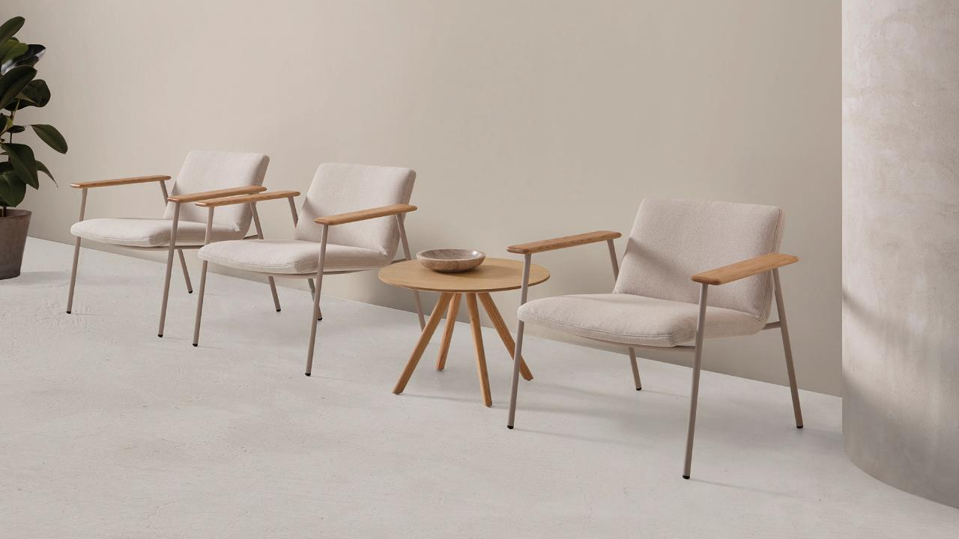

Slide 26
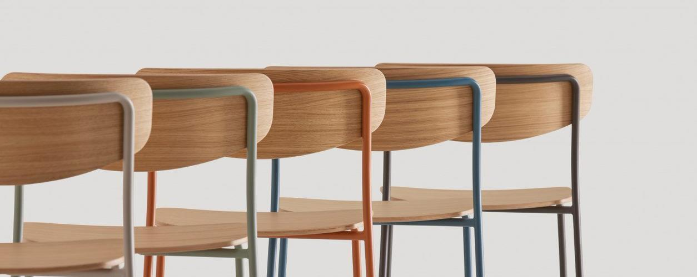
Lea

Slide 27
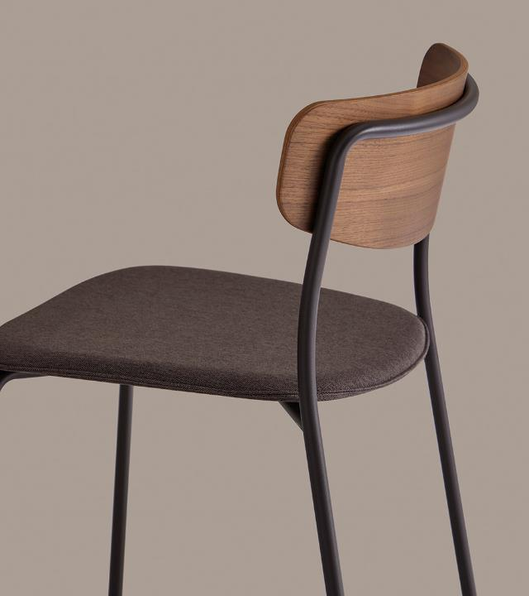
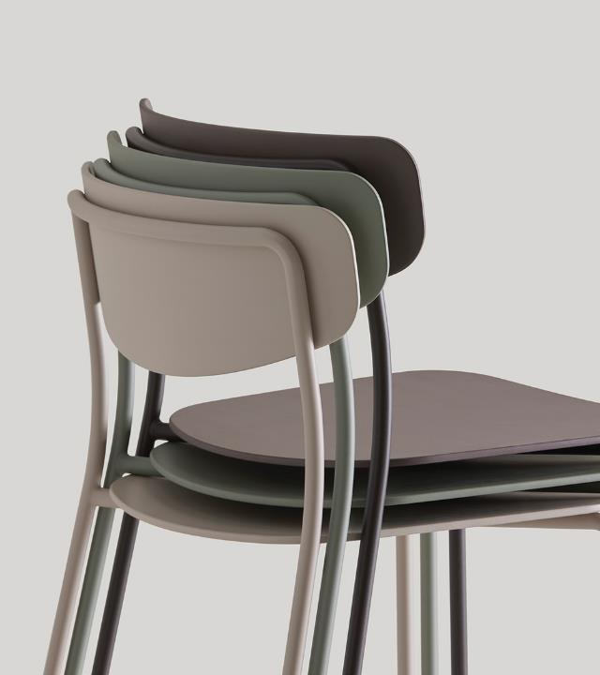

Slide 28
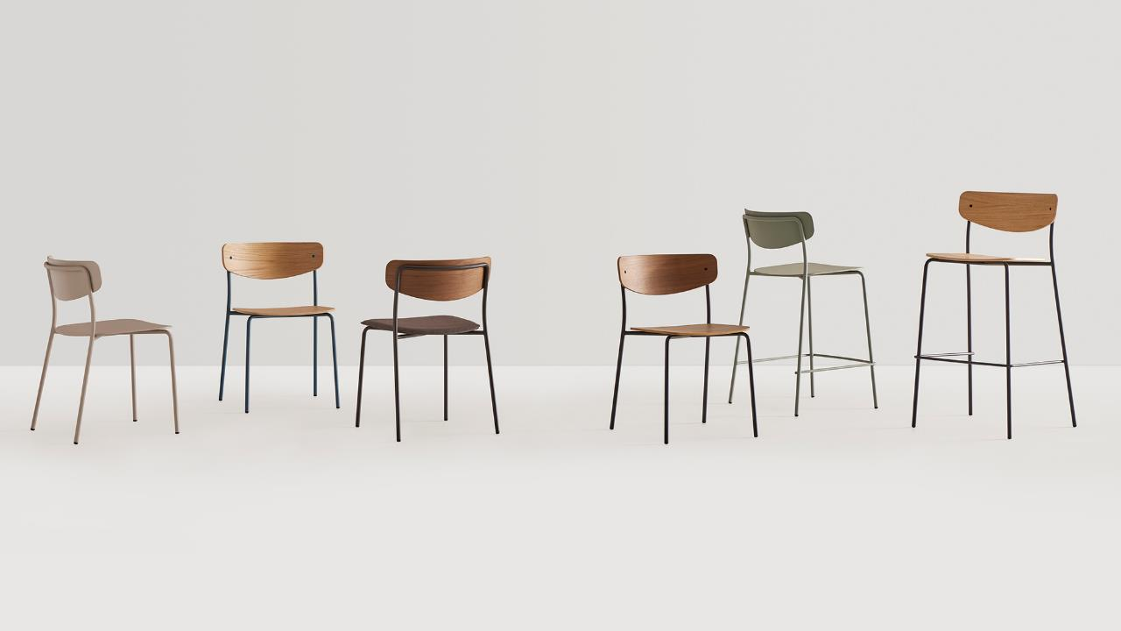
Notes:
Lea 1.1 (all wood) Standard epoxy, walnut, 850 list
1.2 (uphol seat, wood back) – OAK/COM- 1040, WALNUT/COM – 1100 list
3.1 stool – OAK 980, WALNUT 1050
3.2 stool w/ seat UHPL – 1200 OAK COM, 1270 WALNUT COM

Slide 29
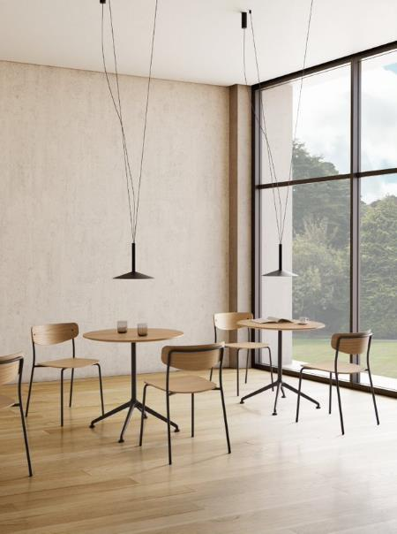
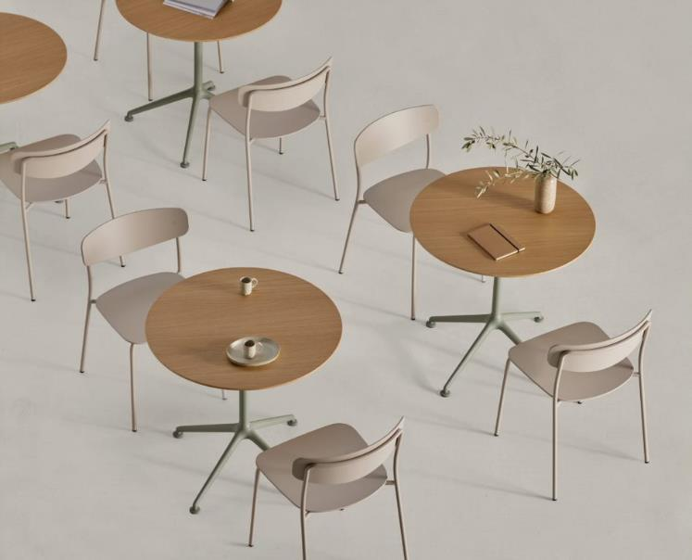

Slide 30
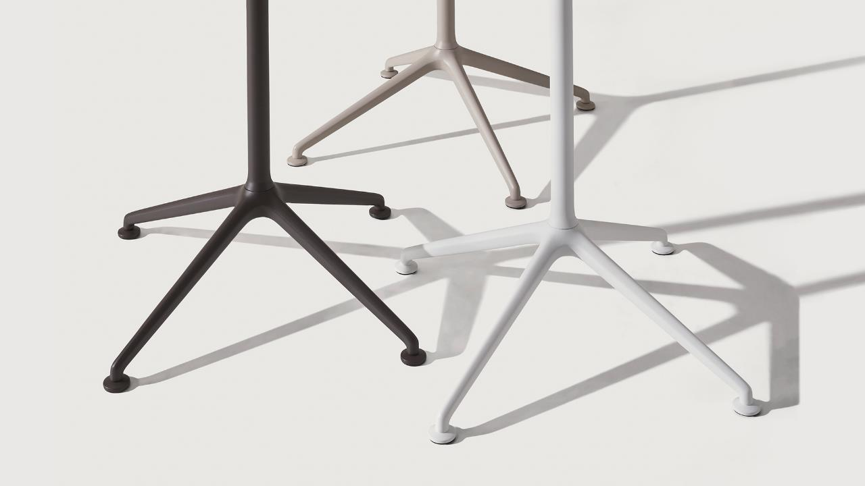
Lex
Notes:
LEX is a collection of versatile tables designed for flexible use in public or domestic spaces. The central frame includes an elegant 4-spoke aluminum base that gives identity to this functional family. The bases are manufactured in a wide range of colours. The tables are available in three heights with tops in different materials and in round or square formats. The collection includes tables with a fix or flip top.
A horizontally stacking/ stowing capable table with indoor, outdoor flexibility. Offering a complete family to fit across multiple environments.
LEX – 32” folding 2550 list
28” coffee table, oak 1500 list

Slide 31
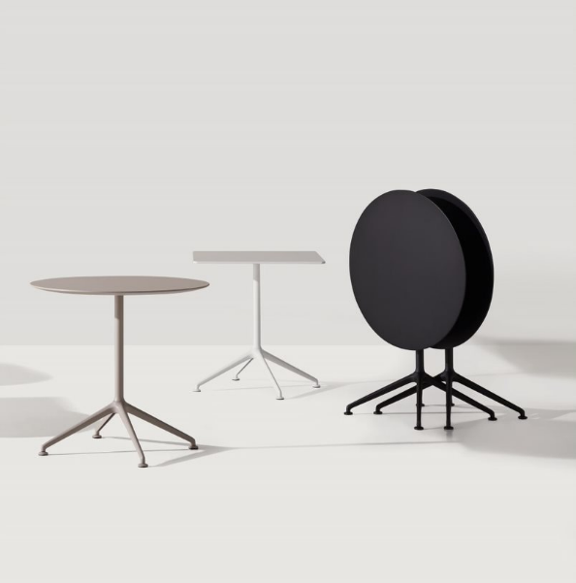
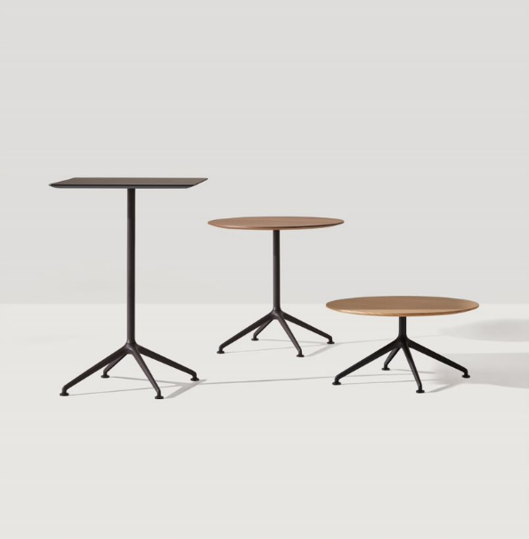

Slide 32
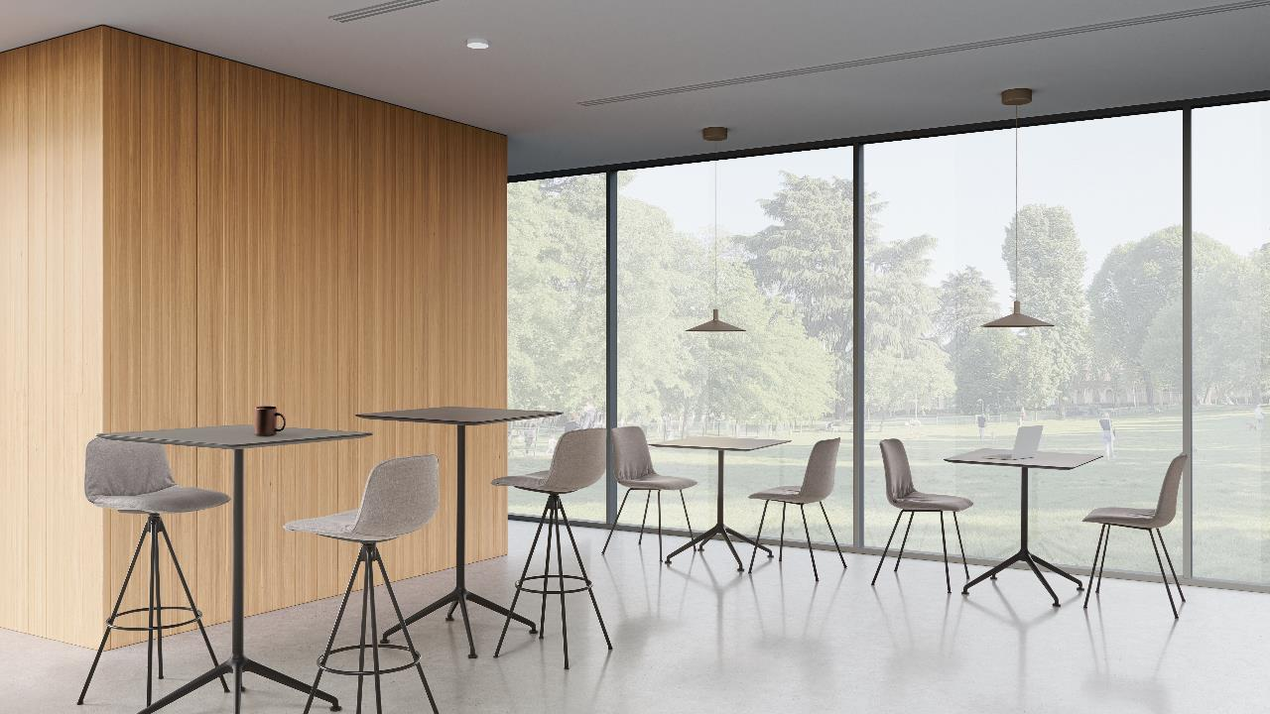

Slide 33
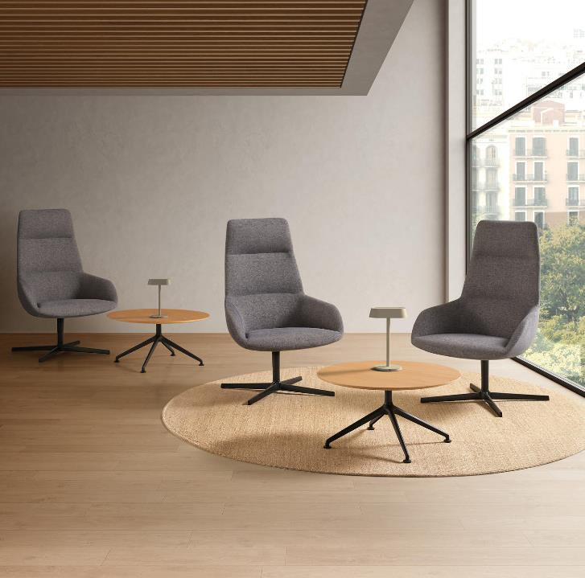
Lex Specs
Three Heights: 40.5”, 28.5”, 14.5”
Available in various sizes in both square and round ranging from 23.5” to 35.5”” depending on base dimensions.
Cast aluminum base
14 powder coat colors, 11 lacquer colors available.
4 standard stains
Top available in: oak veneer, lacquered MDF, melamine, solid HPL (black core, white core), Fenix solid surface.
Flip or fixed top

Slide 34
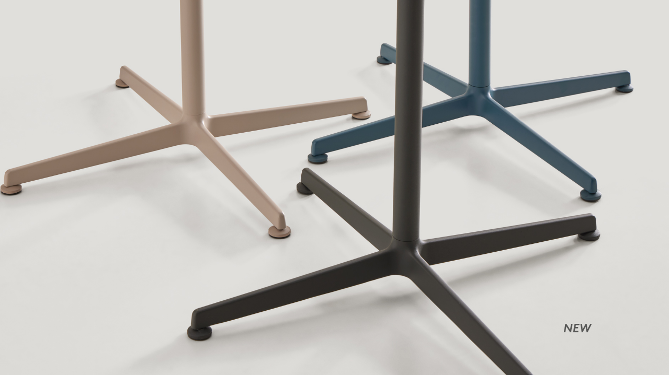
Elix
Notes:
ELIX is a collection of versatile tables that stand out by its timeless and essential design. The collection is characterized by an elegant and functional base with four aluminum spokes that allows multiple tables to be configured. The tables are available in three heights with round or square tops in different sizes and materials. Both the tops and the bases, are available in a wide range of finishes that allow multiple combinations facilitating its integration in multiple meeting, hospitality or domestic spaces.

Slide 35
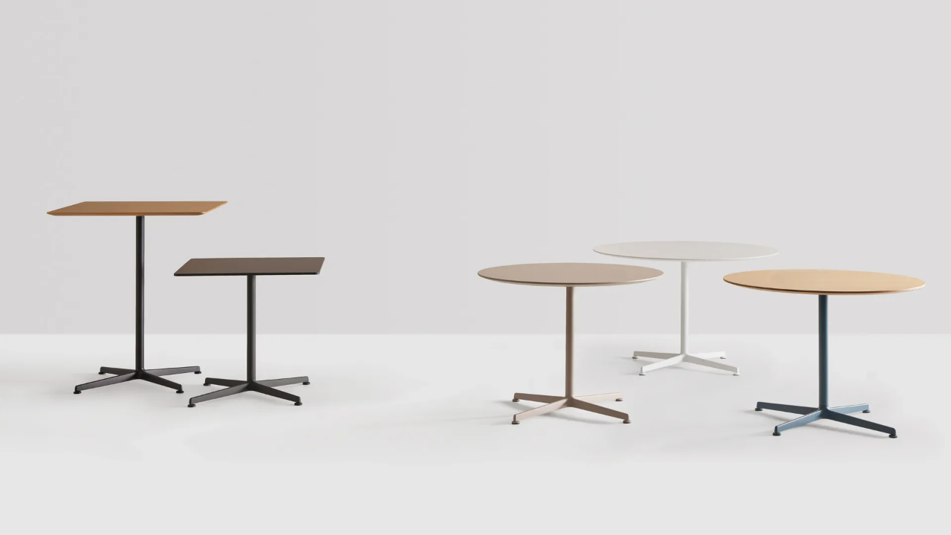

Slide 36
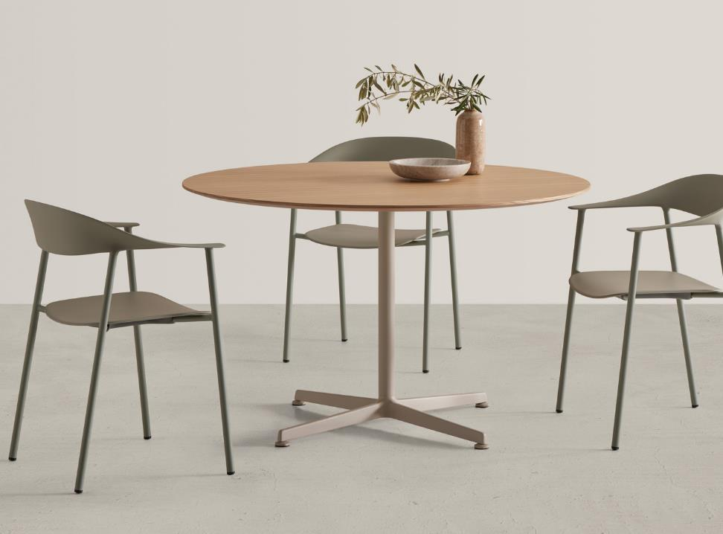

Slide 37
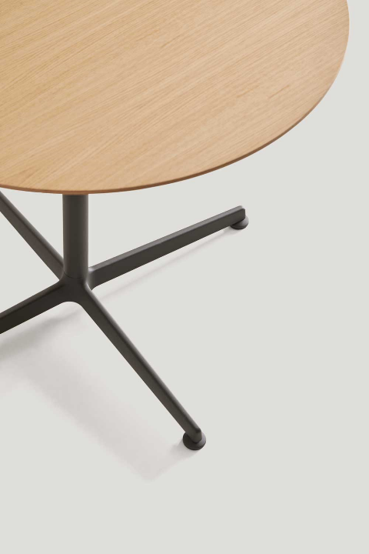
Elix Specs
Three Heights: 40.5”, 29.5”, 12.5”
Available in various sizes in both square and round ranging from 31.5” to 47” depending on base choice.
Welded aluminum, trending blade style base
14 powder coat colors
4 standard stains
Top available in: oak veneer, lacquered MDF, melamine, solid HPL (black core, white core), Fenix solid surface.

Slide 38
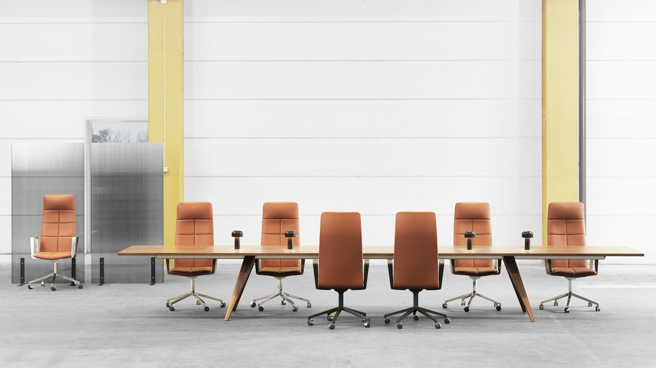
Ponto + Archal
Notes:
Ponto, meaning bridge in Esperanto, is ‘exclusivity and simplicity’ defined, where every detail breathes both designers and Lammhults sense of innovation and quality. Ponto is the table that allows modern technology to meet solid craftsmanship. The legs of Ponto are made of carefully selected solid wood that is milled to fit the aluminum profiles that support the entire table. Nothing on Ponto is unnecessary, with a maximum length of 200”, only four legs and table surfaces are all that is needed, no more no less, together they are whole and that is remarkable in its simplicity. Assembly is quick, by sliding the leg onto the aluminum profile to the desired position.
Legs of solid wood available in the following materials:
natural ash alt. stained ash. Frames made of extruded
recycled aluminum.
Tabletop of 28mm MDF in the following versions:
- Veneer: Natural ash/oak or stained ash with matching wooden edge.
Linoleum: Nero alt Iron with a wooden edge in dark smoked oak. Additional deviating wooden edge in oak, ash, or walnut at an additional cost.
Sizes: all 29”H – Max length 220”
Round – 29”H – in 63” or 71”

Slide 39
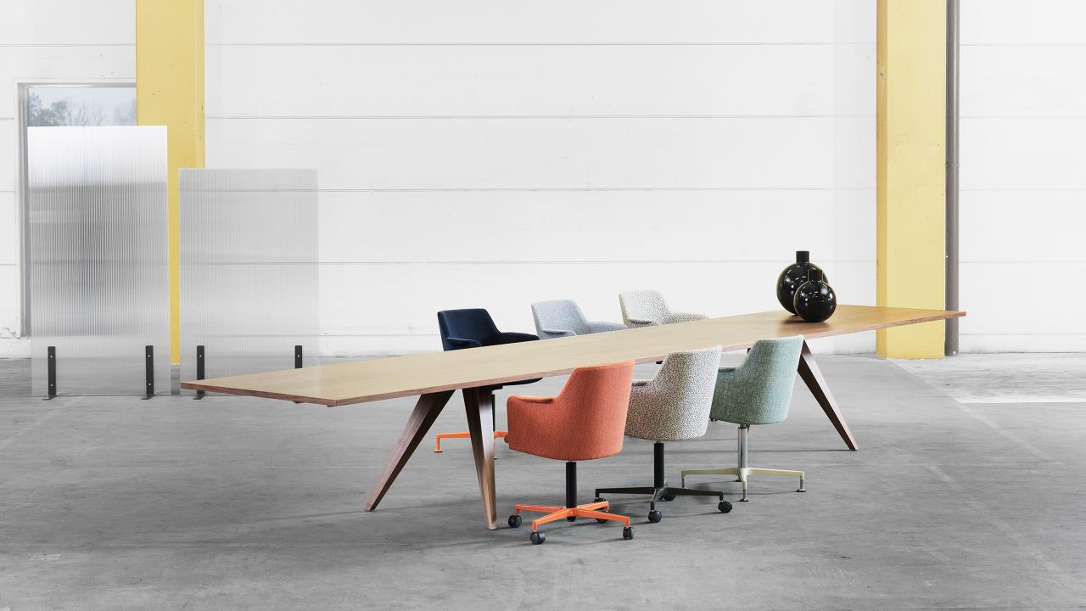

Slide 42
Solid wood legs
MDF tops in Veneer, Laminate, or Linoleum
29”H standard height
Lengths up to 220” standard, with only two sets of legs
Round 29”H in 63” or 71” standard.
Power/ data/ privacy.
Ponto Specs:

Slide 43
Binar
Notes:
Refined design, versatility and comfort are the hallmarks of BINAR 60. A complete family of armchairs designed to be easily integrated into diverse contexts and spaces while keeping a common aesthetic. The armchairs are available with two backrest sizes and can be equipped with a wide range of bases with different functionalities. The collection also offers numerous customization possibilities to adapt to the requirements and style of each project.
Binar 60 – available in multiple base types to accommodate many environments:
1770 list – 5 star
1750 list – wood legs
1490 list – metal legs

Slide 46
Binar Executive
Notes:
Designed to inhabit executive and meeting spaces, BINAR EXECUTIVE armchairs combine elegance, timeless modernity, and ergonomics. The collection stands out for its excellent comfort, enveloping shapes, and exclusive upholstery. The armchairs are available with two backrest heights and can be upholstered in all the leathers and selected fabrics from the INCLASS collection.
Binar executive – range list 2580 – 2700 high back
Mid back – 2240 list

Slide 49
Escalas
Notes:
Designed by the Inclass team, ESCALAS sofas are built combining different elements such as upholstered seats, with or without backrests, arms of different formats, privacy panels and table tops over horizontal platforms of different sizes. For accurate pricing, use the Sandler configurator.

Slide 50
Notes:
Details give a light visual, almost floating. Tables can be specified to add separation and funtionalitity. Power is also available.

Slide 51
Notes:
Two different arm options.

Slide 53
Notes:
For the 1 ½ seat, space division is possible. Two different leg options in wood and metal. Tables can also be specified to create impromptu meeting spaces.

Slide 54
Notes:
Armless with tables adds openness and a lightscale appearance.

Slide 56
Notes:
Add the optional higher back to sections to create space division and privacy. Power is also available.

Slide 57
Entropy

Slide 58
Notes:
Endless options.

Slide 59
Notes:
A whole family of options available to create unique yet functional spaces for engagement.

Slide 60
Notes:
Gorgeous back detail that can be painted in 12 different colors.

Slide 61
Notes:
Modular to fit any space. Use the Sandler configurator to maximize sq footage and components.

Slide 64
Tablet
Notes:
Club chair in COM – 2170 list

Slide 68
Libra
Metal
Notes:
298.13 – ARM chair 3680 list
298.03 – SIDE chair
Available in following paint colors:
47 matt satin
71 brass
76 burnished brown
61 white
59 dark grey
64 black
74 mud
78 bronze

Slide 70
Wings
Notes:
1.1 armless/ guest, dining 1-12 qty 2010 COM list, 13+ qty 1860 list COM
2.1 arms 1-12qty COM – 2330, 13+ COM 2150 list
5.1 lounge 1-12 COM 3290, 13+ COM 3040
3.1 stool- 1-12 COM – 2100, 13+ COM - 1940

Slide 73
Iconica
Notes:
245V – premium leather 5270 list
245S – waterproof suede 4520 list

Slide 76
eco
Notes:
DESIGN BY CARLOS TÍSCAR - Spain
Solid oak or beech wood chair with semi-upholstered back and seat. Eco is a chair designed as a sculptural object with a structure devoid of edges that transmits strength and stability. Its curved shapes create an organic and sensorial element where every detail brings comfort.
500 RT – fully uphol. COM 1850 list
501 RT – fully uphol lounge COM 2570
500 RP – partially uphol 2120 COM – stacks 3
500 RM – full wood/ oak – 1910 stacks 3
500 M – full wood/ beech – 1670 stacks 3

Slide 81
Bloom
Notes:
The designer has created a metal structure that combines support and aesthetic with backrests made of 3D knitted fabric, on which the padded cushions rest. The result is a comfortable and practical sofa that makes it easy to create combinations between the various modules.
3 seater w/ arms – 15,020 list
1 seater w/ arms – 8090 list
Pouf – single – 3950 list

Slide 84
Notes:
Range in COM
Armless w/ side table in white – 7950 list
Arms w/ side table in white – 9340 list
Bench/ pouf with table in white – 5700 list

Slide 85
Notes:
A wide variety of indoor/ outdoor tables with a lightscale aesthetic –
Heights avail: 21, 29, 42, 74 cm
Widths avail: 60, 72, 90, 100, 120 cm
Pricing:
100x240 in Fenix 74 cm h – 9640 list
90x90 in Fenix 21 cm h – 4460 list
120x120 in Fenix 21 cm h – 5800 list

Slide 87
Dunk
Notes:
Dunk is the new armchair by Et al. designed by the young designer Philippe Tabet.
This armchair, although made of polypropylene, takes its inspiration from upholstered seats: in the hypothetical meeting between two seams, there is an invitation for the hole. The polypropylene shell is available in two versions, with and without holes: one makes the chair stackable and more functional; the other non-stackable, more elegant, with a beautiful wooden frame.
Dunk – poly 570 list

Slide 90
Momo
Notes:
MOMO NET 1 is a designer chair made from expanded metal mesh that is e-coated before being painted, making it highly resistant. This makes it an excellent candidate for outdoor use, too, whatever the climate. The holes in the mesh make it particularly ideal outdoors when the temperature climbs.
Light in design and weight, the Momo Net 1 chair can be readily used in bars and restaurants, making it quick to shuffle seating around to accommodate the requirements of patrons.
Armless – 440 list, stacks 12 high
W/ arms – 490 list, stacks 12 high
Stool – bar, counter – 720 list, stacks 6 high

Slide 95
Teasers

Slide 96
Immagine

Slide 99
Cala
Notes:
Stackable, functional, eco-sustainable, highly technological: we are talking about CALA, chair with 3D seat and back, by Martin Ballendat.
CALA best interprets an essential and captivating style, linear but attractive, with an eye to the future and sensitive to the environment, as it is made of recycled materials: metal from sustainable sources and second-life plastic certified by ReMade in Italy.
Range in net pricing – 175 metal base – 400 wood legs.

Slide 103
THANK YOU!

