Slide 2
AN INTRODUCTION pg 04
NEW FOR 2022 pg 06
LAMMHULTS COLLECTION pg 26
RANDERS+RADIUS COLLECTION pg 86 TREVISO COLLECTION pg 102

Slide 3
Inspec, the newest brand from Sandler, manufactures and supplies a wide range of high-quality Scandinavian and European designs, offering a unique new choice for the contract specifying market. Consisting of our Swedish collection of impeccably crafted meeting tables, dining options, and lounge, guest, and modular seating, to the Danish simplicity and ingenuity of our line of seating, folding and fixed tables, to our range of site furniture and public and passenger seating, Inspec is a fresh offering in the marketplace.
An Introduction
Featuring both timeless pieces as well as new and innovative ones that point to the future of the workplace, Inspec offers products that are characterized by aesthetic awareness, environmental stewardship, innovation, and functionality. Quality, comfort and craftsmanship leads directly to user satisfaction and in turn, increased productivity.
Just as luxury goods are prized for their design and longevity, so too will Inspec products provide a timeless aesthetic and years of service.
The craftsmanship of Inspec will always be modern and the design will always be essential.

Slide 4
New for 2022

Slide 5
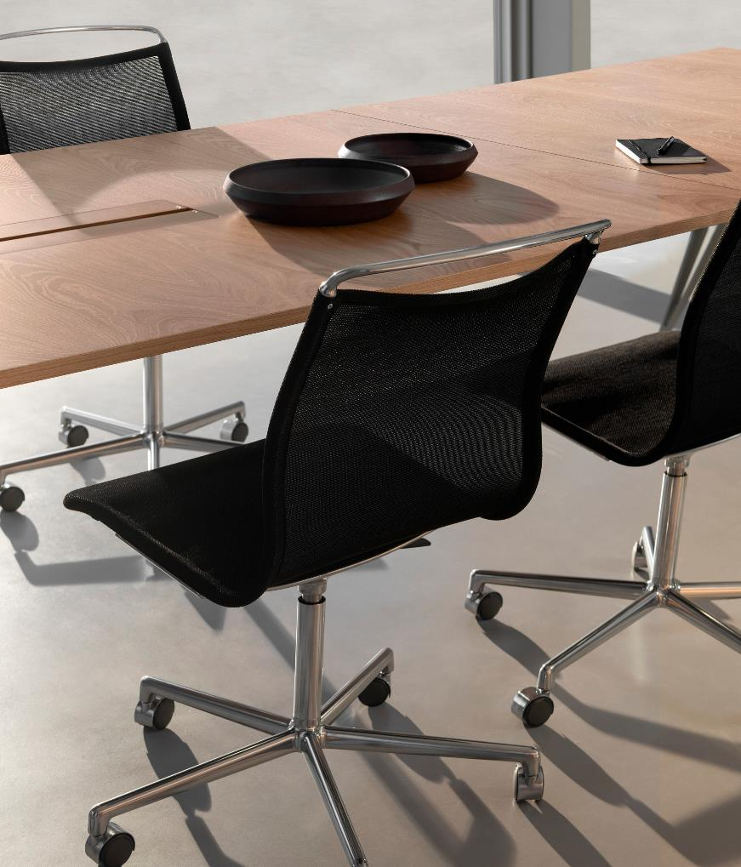
Atlas Air
Design: Johannes Foersom & Peter Hiort-Lorenzen
Atlas Air combines qualities such as sustainability, elegant form, thin lines, lightness, and exceptional comfort. It is an office chair that lets you work
in comfort and peace — by supporting your body properly and allowing you to move it freely. Atlas Air’s lightness is not only rooted in design but material composition. The cast, recycled aluminium frame, armrest and back arch reduce the chair’s weight and environmental footprint. The seat is made of wear-resistant mesh, which contributes to the chair’s slender, lightweight appearance. The mesh seat is available in four colours. There is also a version of Atlas Air with a quilted cushion in fabric or leather. Both a 4-feet swivel base with glides and a height adjustable 5-feet swivel base with casters or glides are available.
LAMMHULTS COLLECTION 8
LAMMHULTS COLLECTION
9

Slide 6
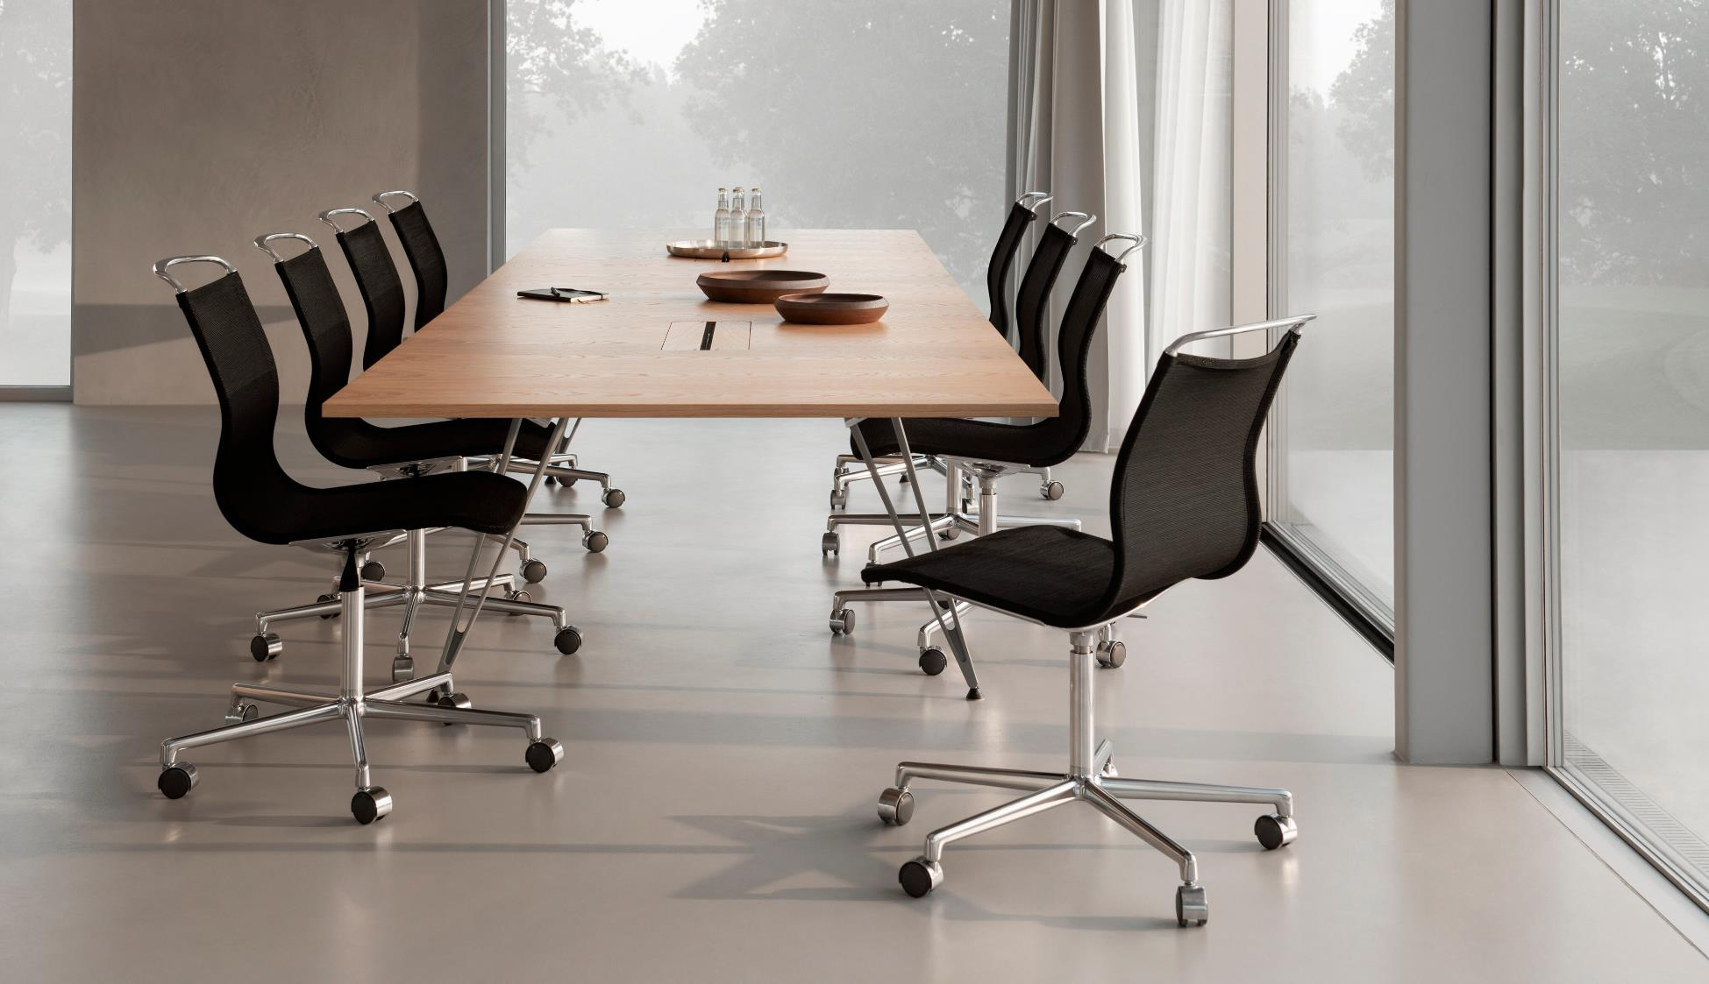

Slide 7
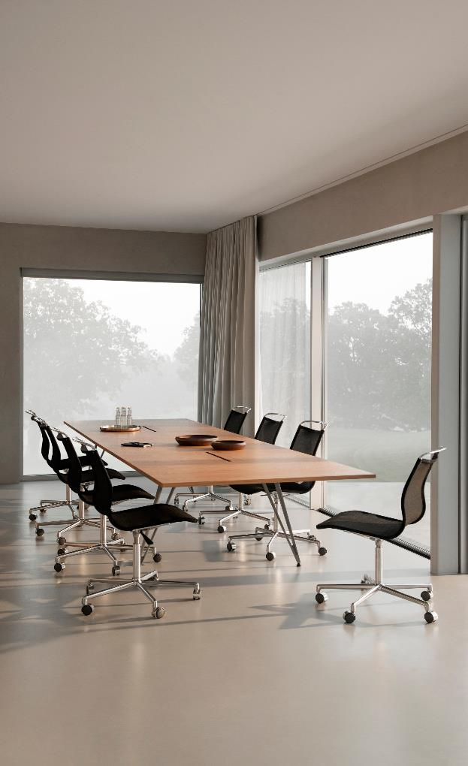
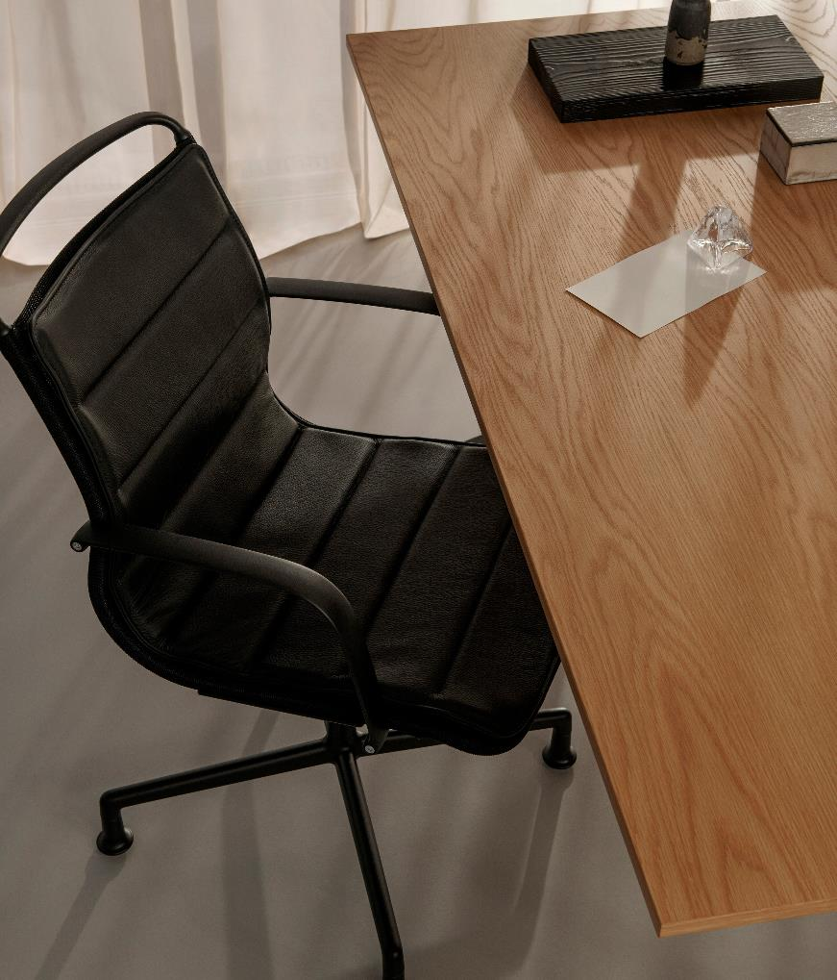
LAMMHULTS COLLECTION
12

Slide 8
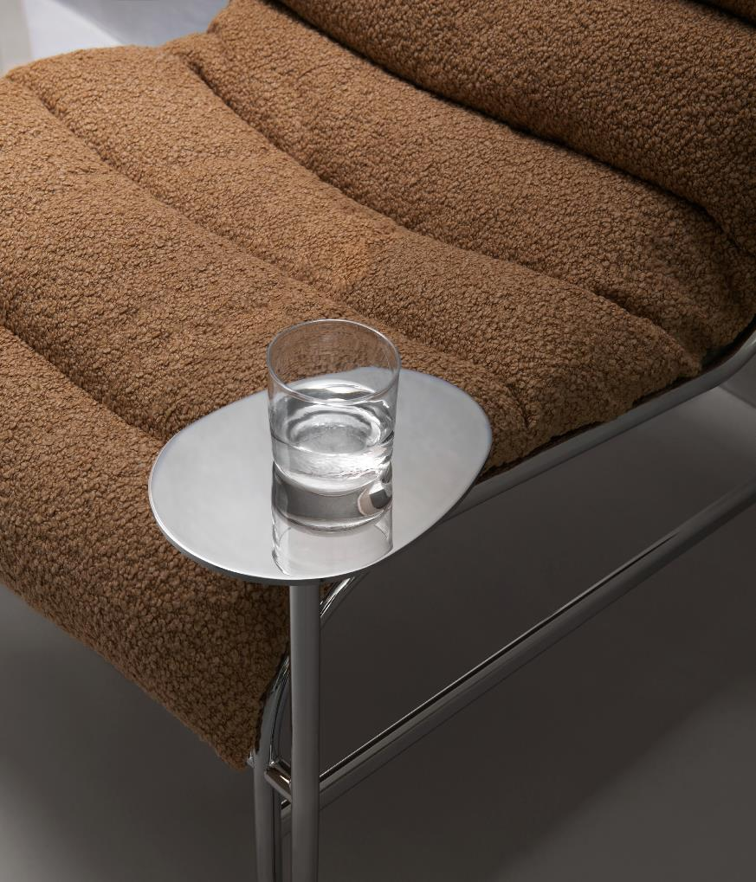
Sunny
Design: Gunilla Allard & Note Design Studio
This year, the designers have complemented Sunny with an oval-shaped metal side table for one’s coffee cup or laptop. “We got the idea from the shape of puddles and ice patches,” explains Allard. “The chromed version gives the impression of a mirrored sheet of water. There’s also a version of the table made of recycled plastic.”
The new side table underscores an essential detail that is key to the Sunny concept: a u-shaped foot that, in this case, connects the table’s single leg to the seat’s leg frame. This ingenious feature allows functions to be added and seat modules to be combined to create larger furniture pieces and shapes for different types of rooms and ways of using space. Sunny
is suitable for both home and office; for general public settings, as well as thoughtfully designed retail environments. The seat can be employed as a solitary lounge chair or as a modular component in a variety of seating configurations. Sunny is also available with armrests, and on casters.
LAMMHULTS COLLECTION
14
LAMMHULTS COLLECTION
15

Slide 9
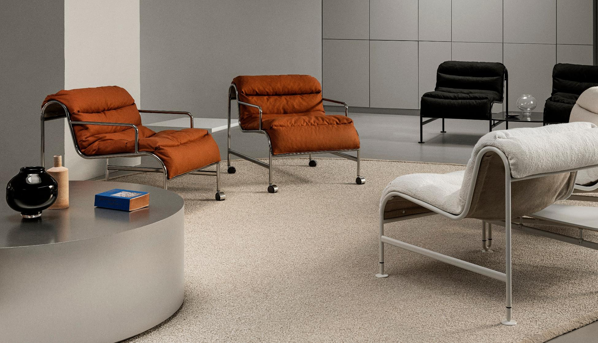

Slide 10
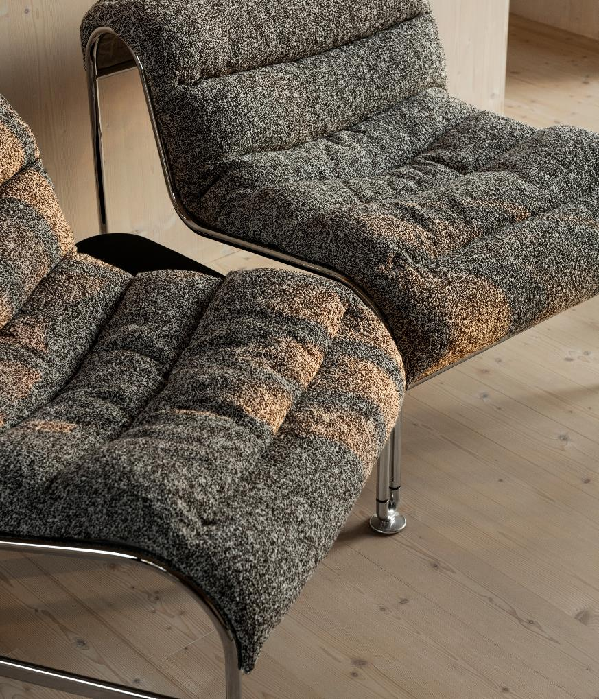
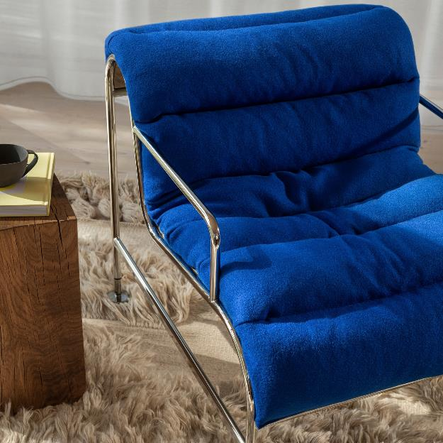
LAMMHULTS COLLECTION
19

Slide 11
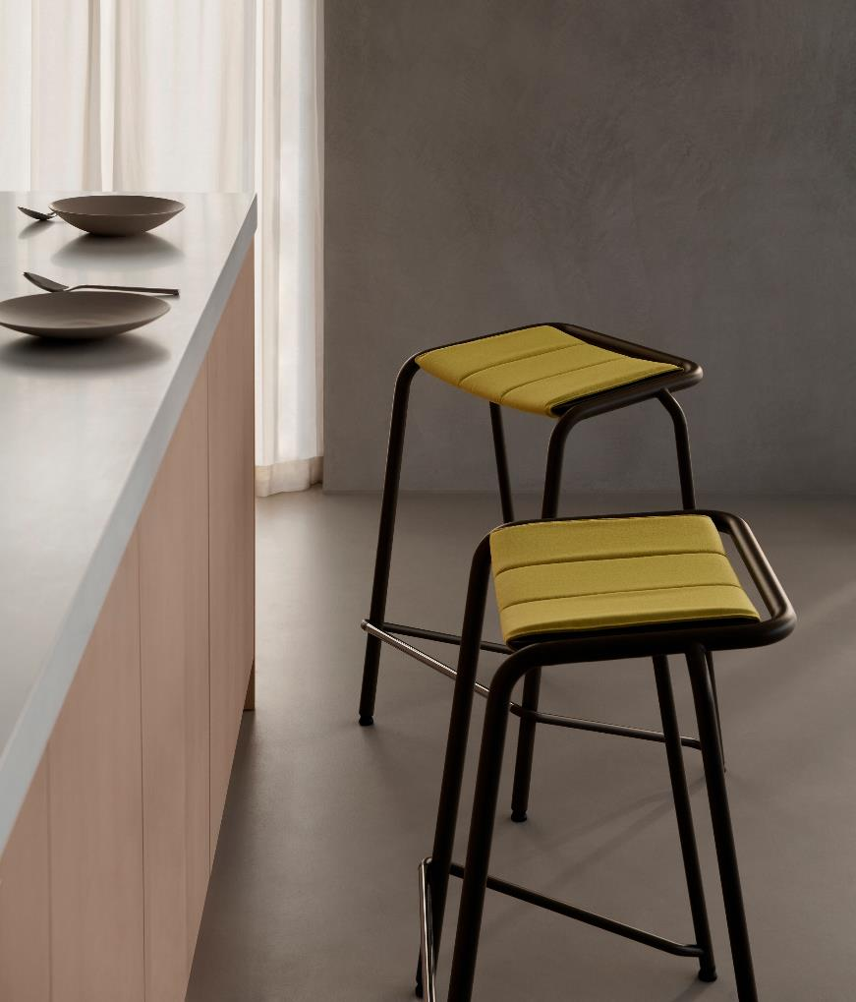
Design: Anya Sebton
A22
A22 is a stackable, highly versatile stool designed for impromptu meetings and quick breaks in dynamic environments. Its comfortable seat is angled slightly forward to encourage occupants to stand occasionally and do their bodies a favour. The leg frame consists of curved steel tubes in three different diameters. This interplay of thinner and thicker lines gives A22
its striking graphic character, which is accentuated by the seat surface’s laser-cut pattern. It is also designed for movement and change. A gap between its tubular frame and the back edge of the seat creates an integrated handle for easy moving and lifting. An add-on cushion simply wraps over the seat surface like a scarf. A22 is available in three different heights.
LAMMHULTS COLLECTION
21

Slide 12
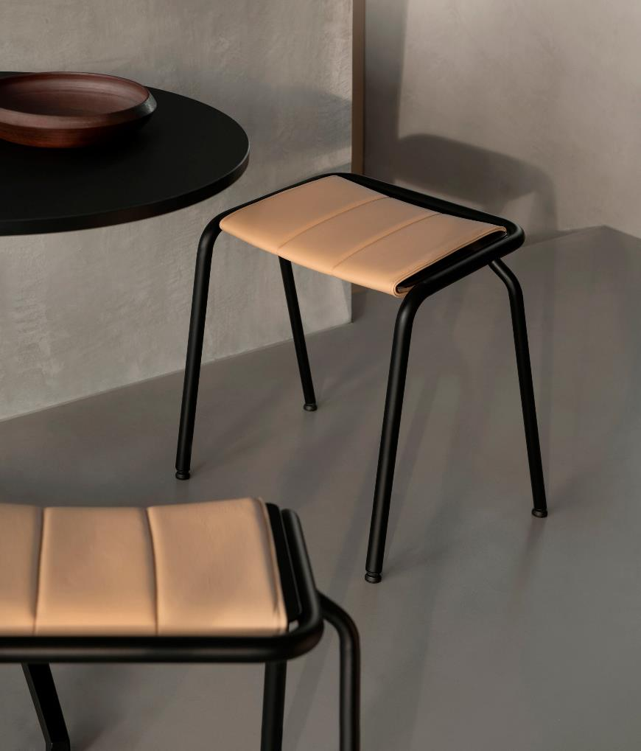
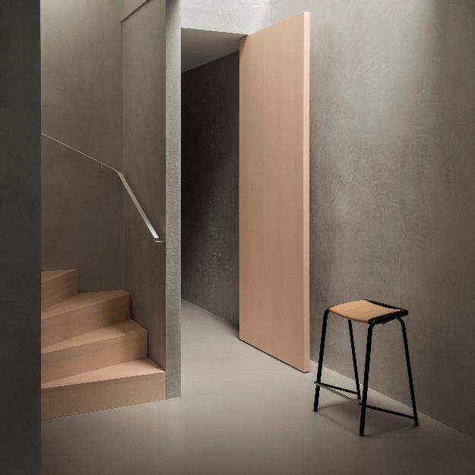
Design: Anya Sebton
A22
A22 is a stackable, highly versatile stool designed for impromp-
tu meetings and quick breaks in dynamic environments — wheth- er indoors or out.Its comfortable seat is angled slightly forward to encourage occupants to stand occasionally and do their bodies a favour. The leg frame consists of curved steel tubes in three dif- ferent diameters. This interplay of thinner and thicker lines gives
A22 its striking graphic character, which is accentuated by the seat surface’s laser-cut pattern. It is also designed for movement and
change. A gap between its tubular frame and the back edge of the seat creates an integrated handle for easy moving and lifting. And it works just as well indoors as it does in a garden or on a terrace. An add-on cushion simply wraps over the seat surface like a scarf.
A22 is available in three different heights.
22

Slide 13
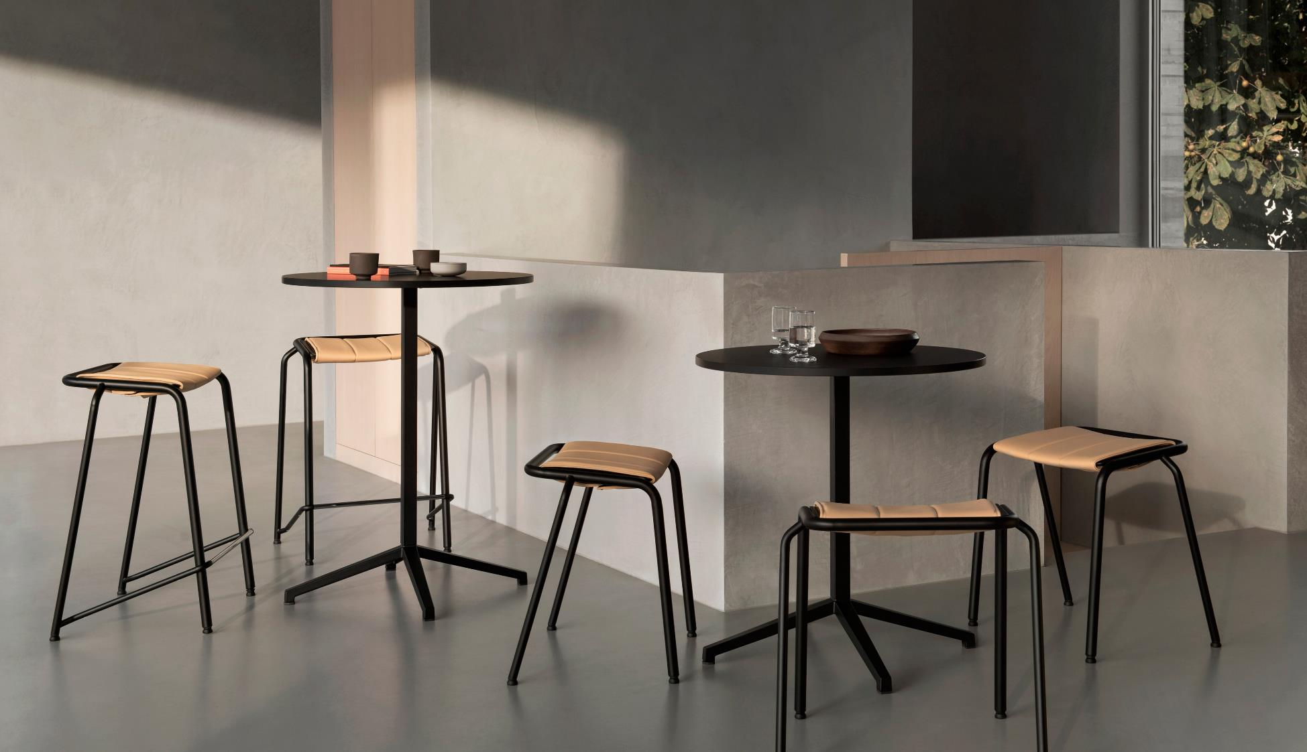

Slide 14
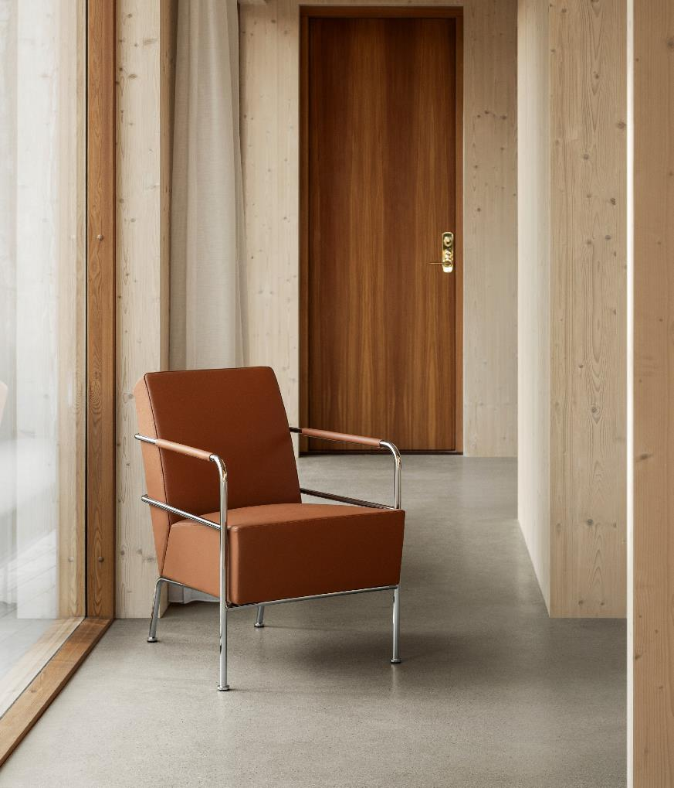
Lammhults Collection
A22 is available in three different heights.
Cinema easy chair

Slide 15
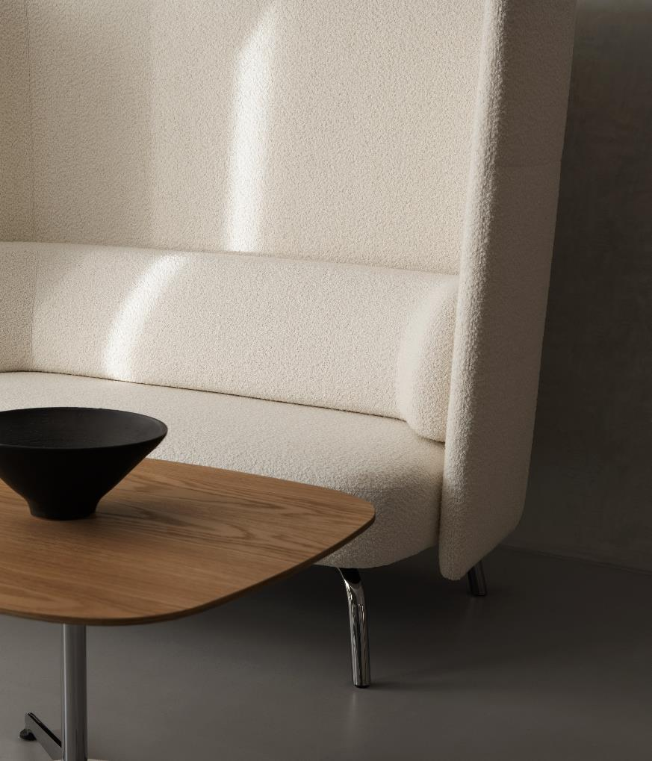
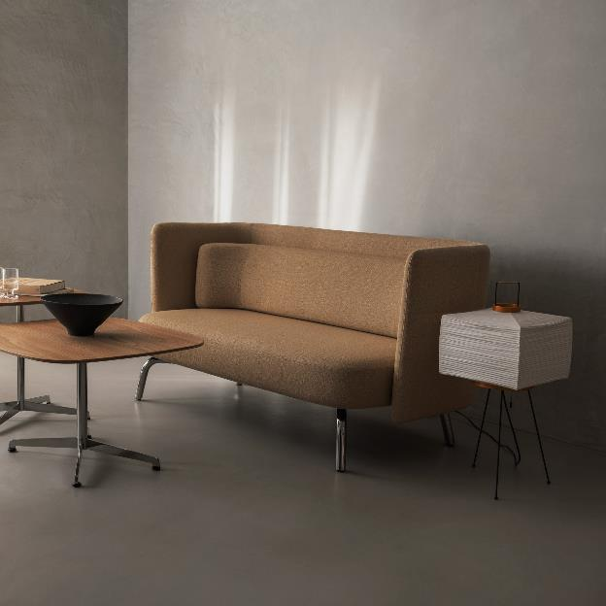
28
Portus sofa and Cooper table

Slide 16
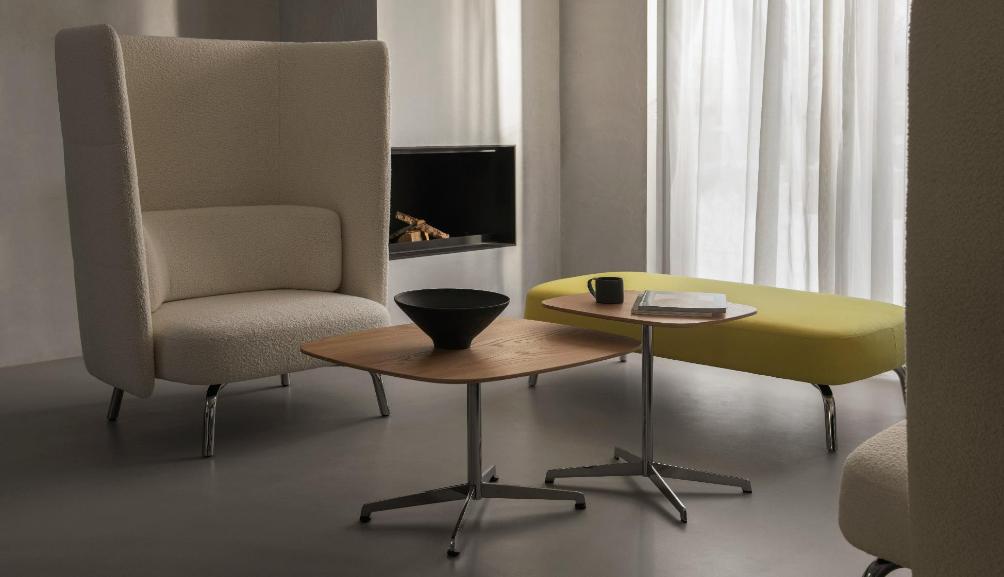
A22 is available in three different heights.

Slide 17
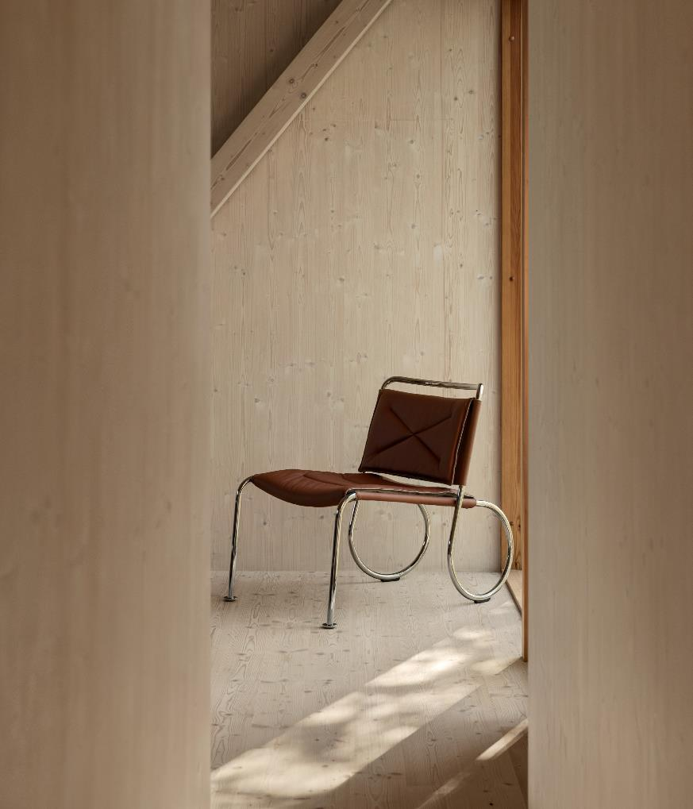
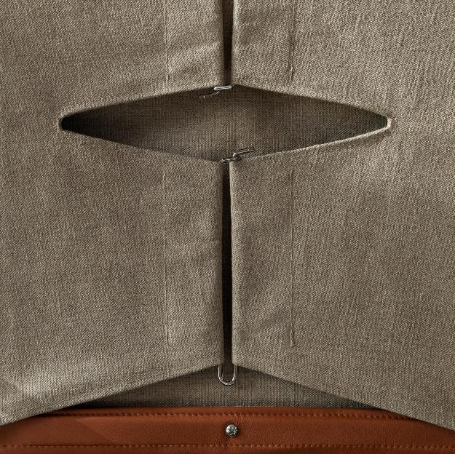
32
Corso easy chair (detail)

Slide 18
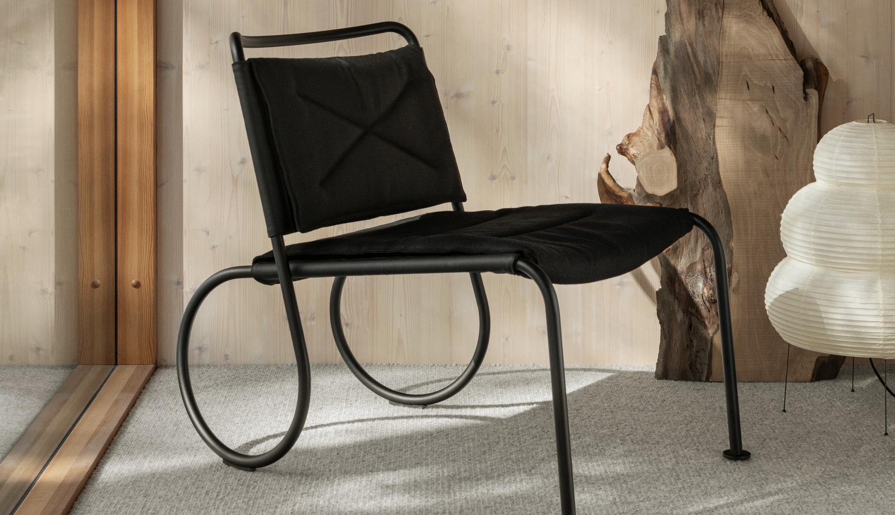
Corso easy chair

Slide 19
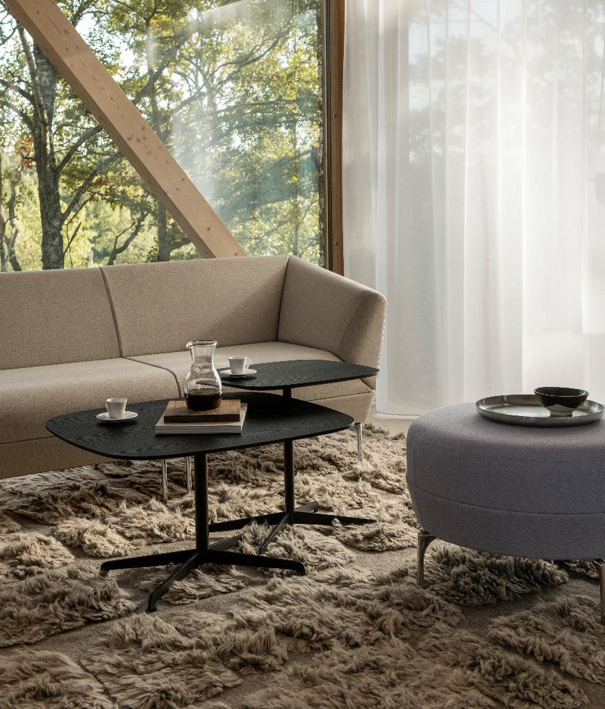
36
Addit sofa, Addit ottoman and Cooper table

Slide 20
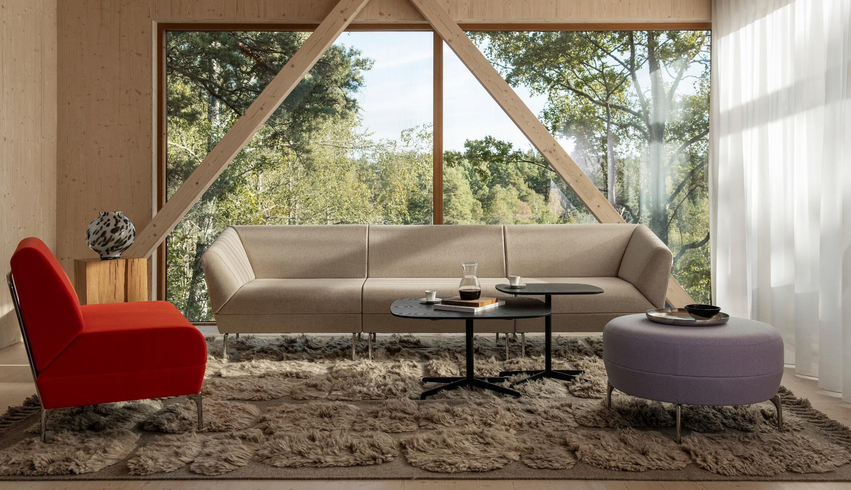

Slide 21
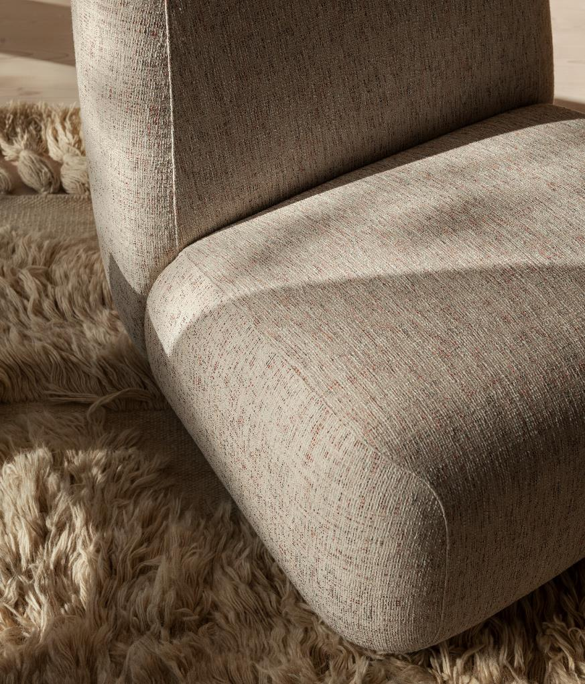
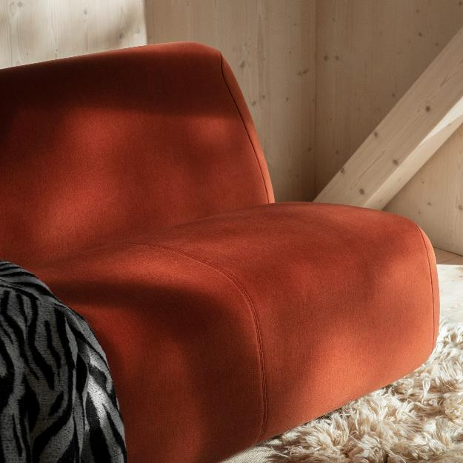
40

Slide 22
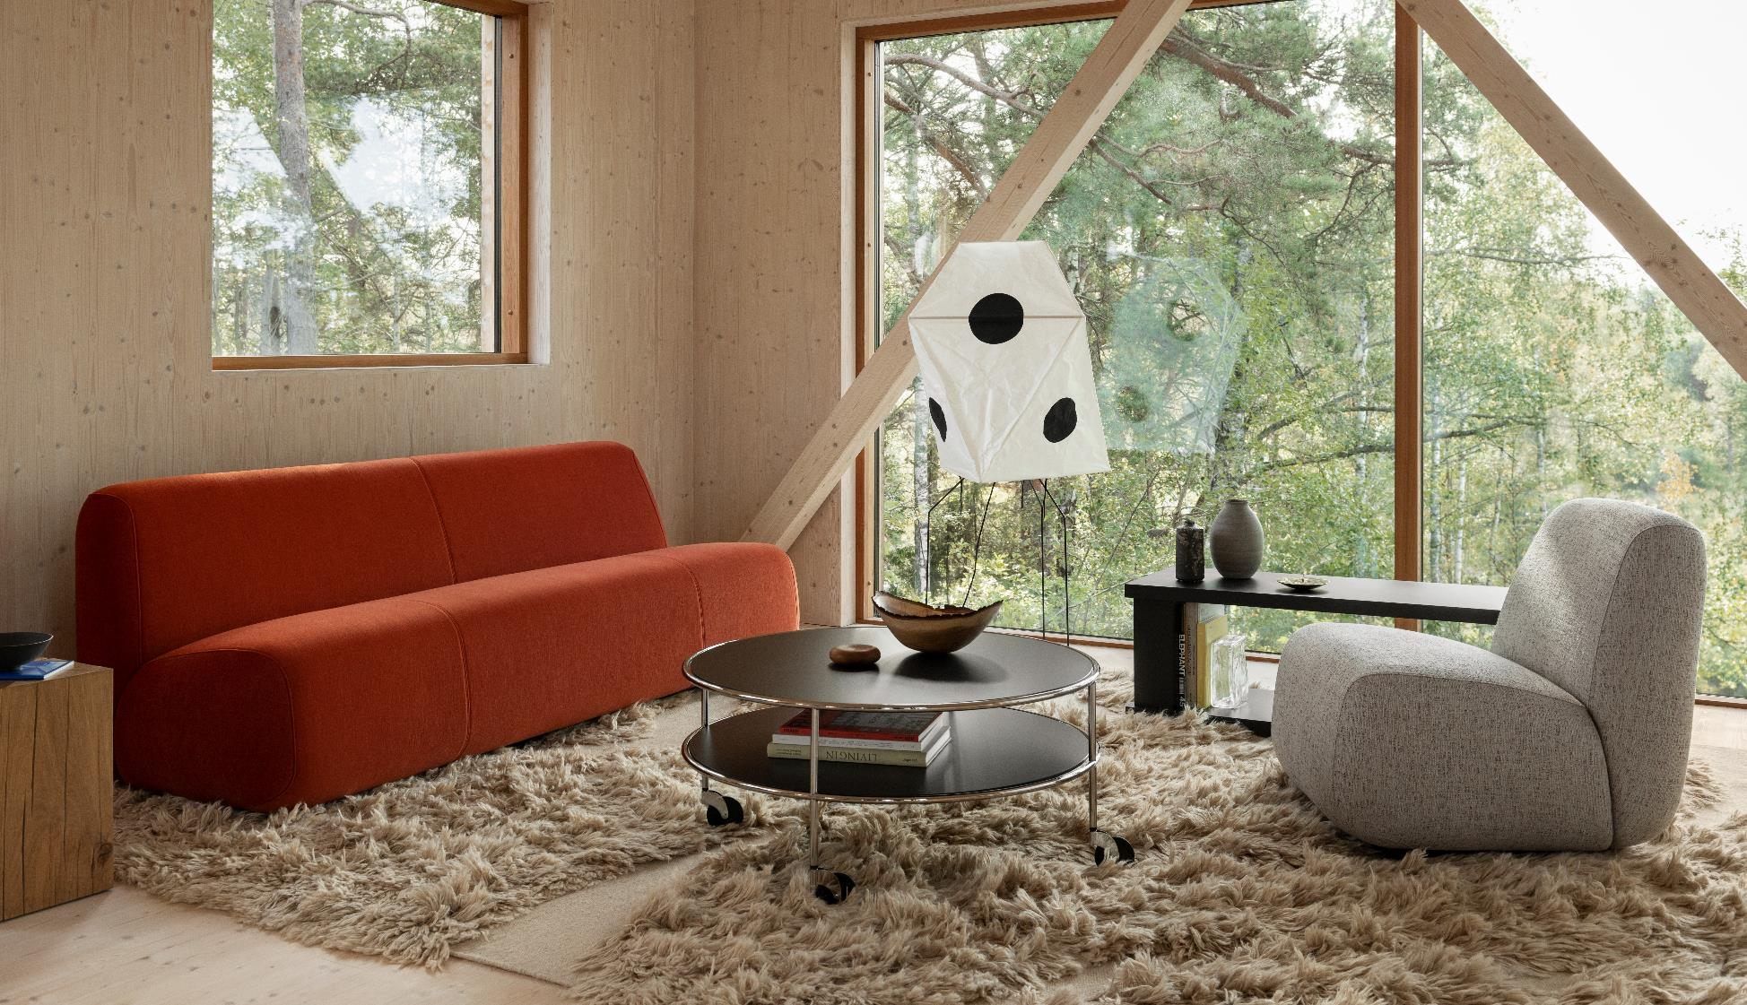
A22 is available in three different heights.
Aperi sofa and easy chair with Chicago table

Slide 23
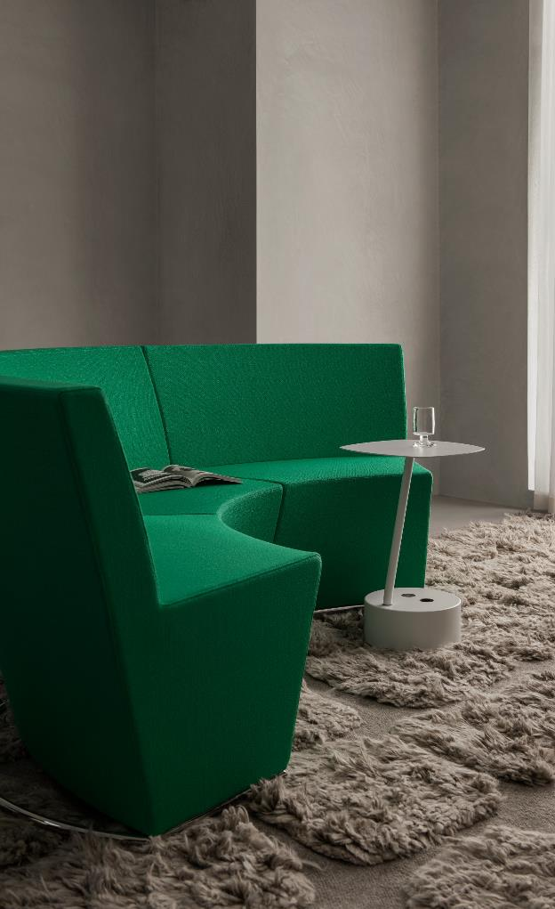
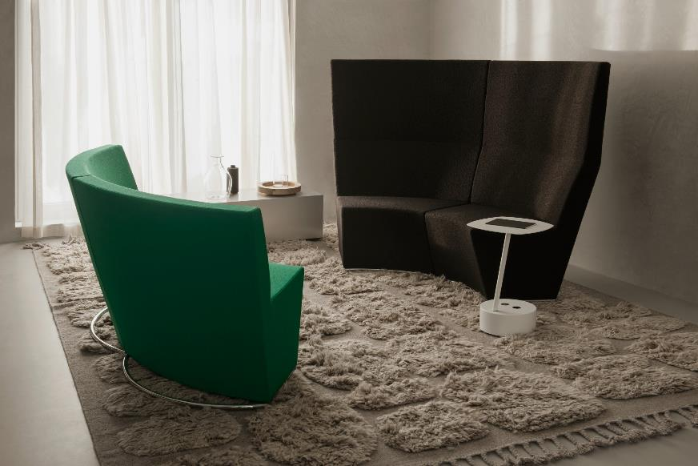
44
Area Radius sofa and Add Cable table
LAMMHULTS COLLECTION
45

Slide 24
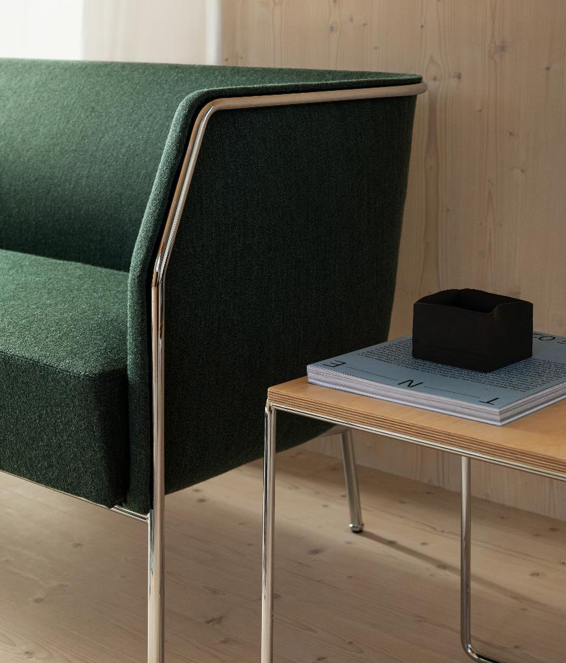
46
Cajal sofa and table

Slide 25
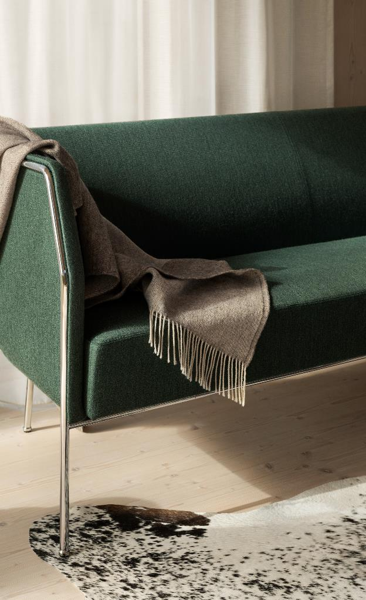
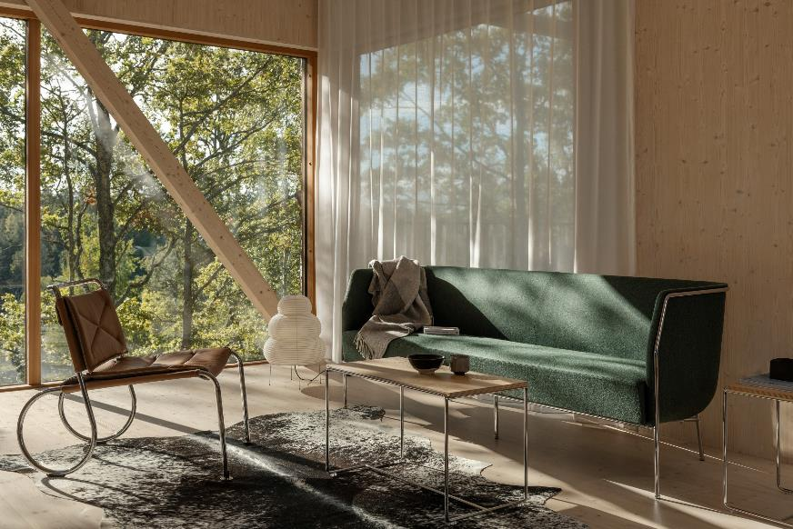
LAMMHULTS COLLECTION 48
Cajal sofa and table with Corso easy chair
LAMMHULTS COLLECTION
49

Slide 26
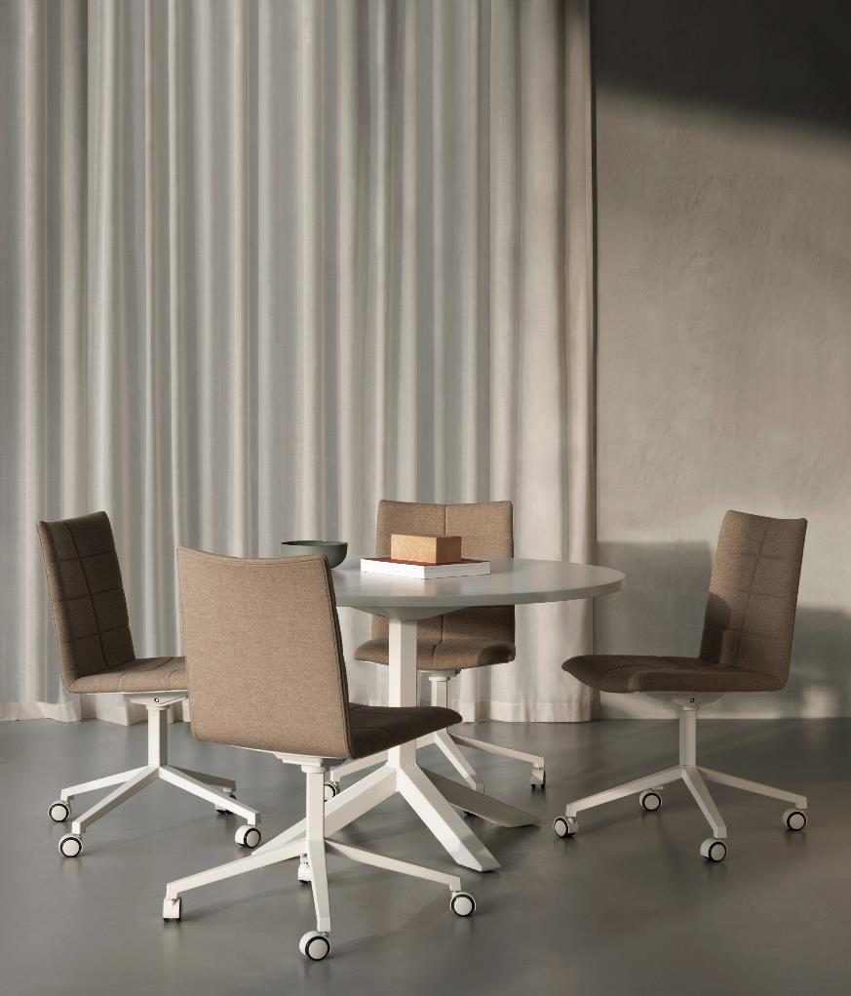
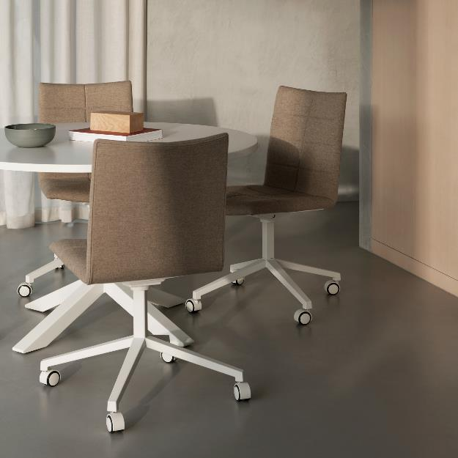
50
Archal chair and Funk table

Slide 27
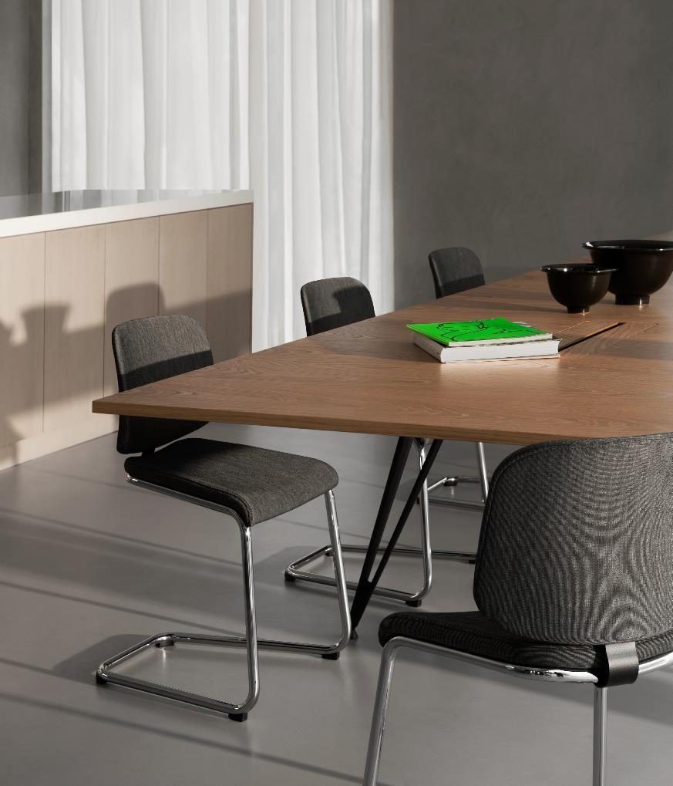
52
Add chair and Attach table

Slide 28
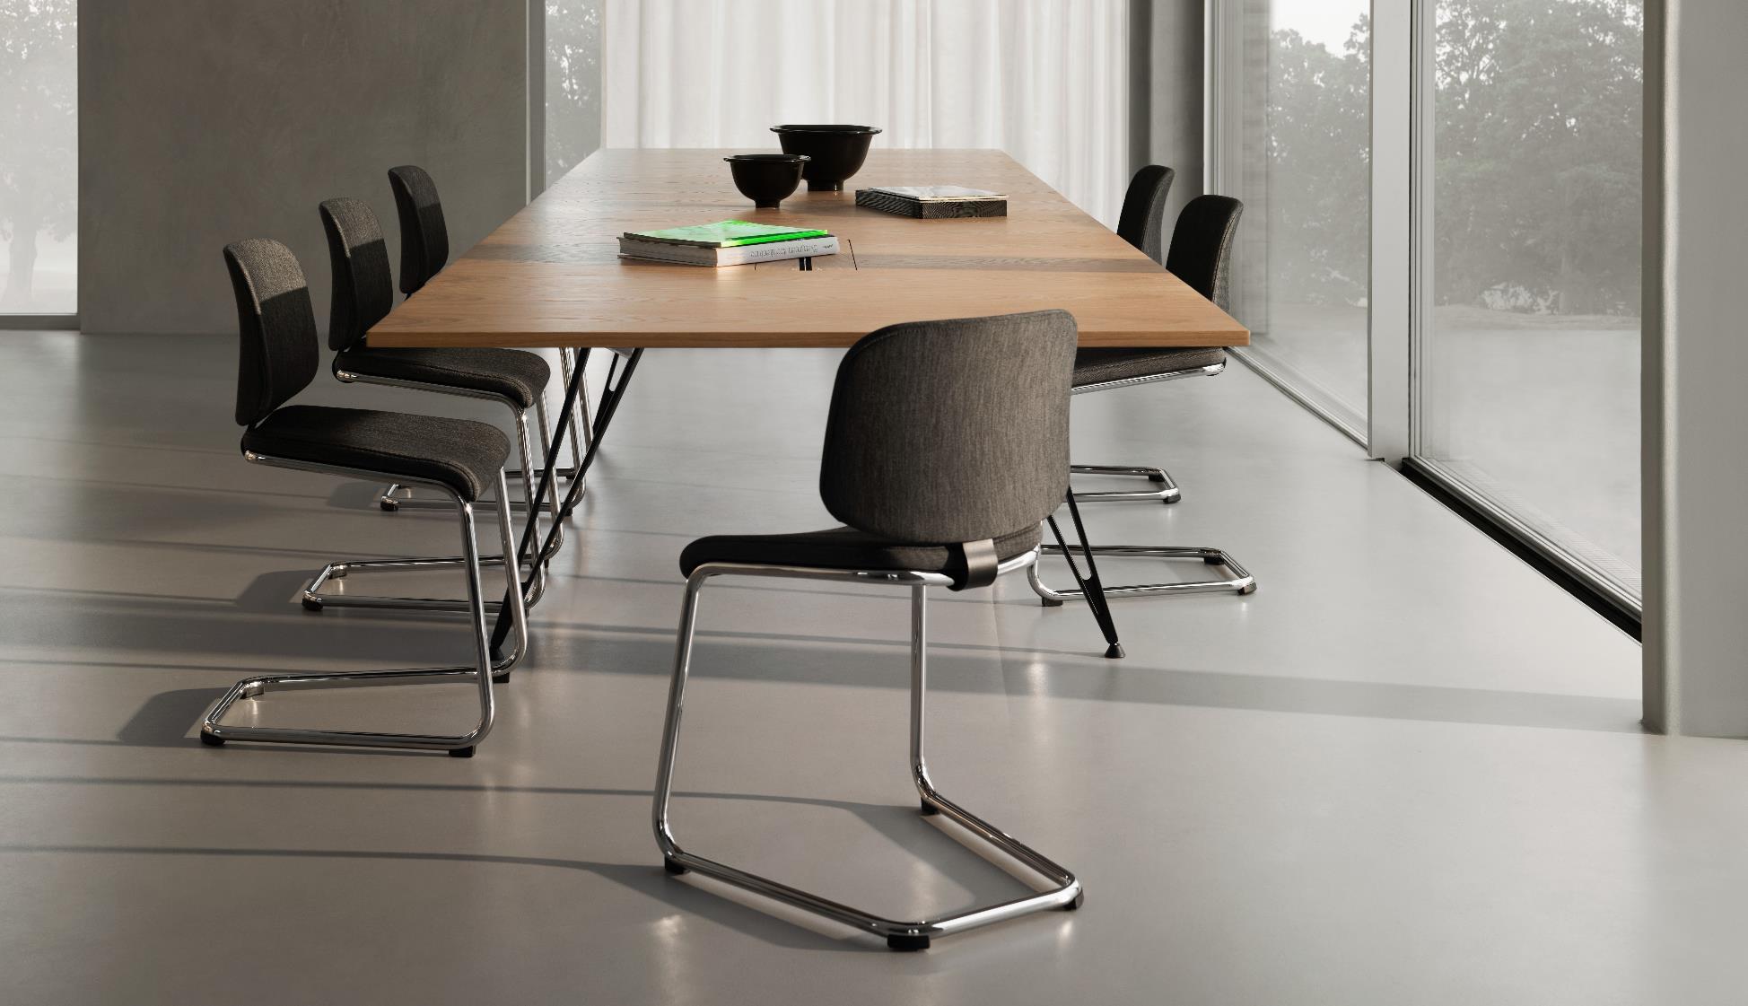

Slide 29
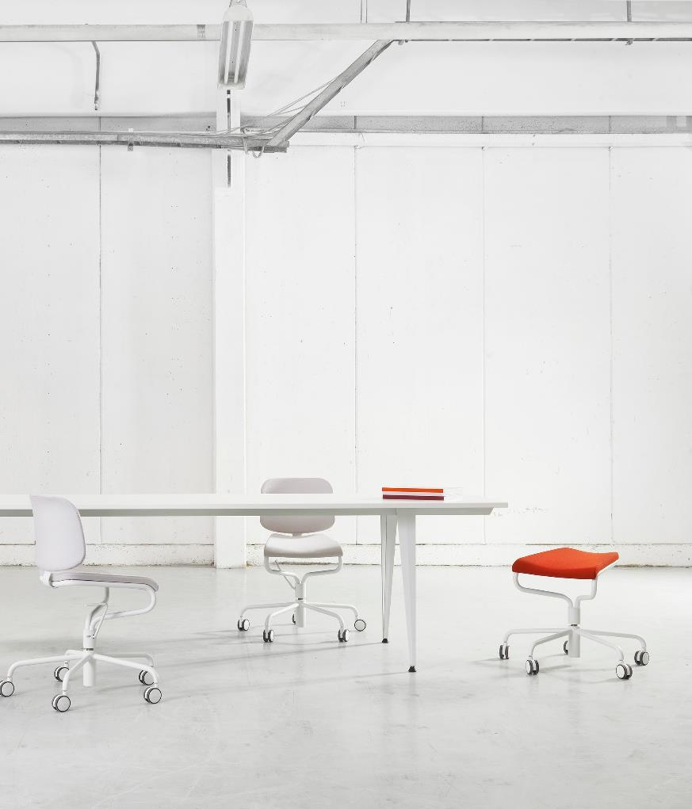
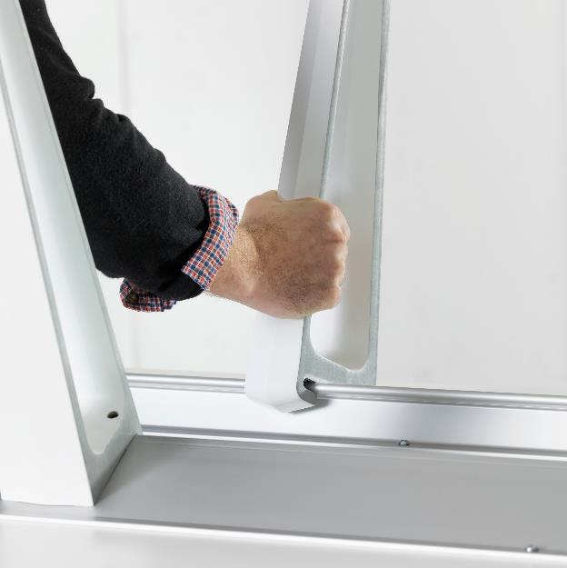
56
Attach table

Slide 30
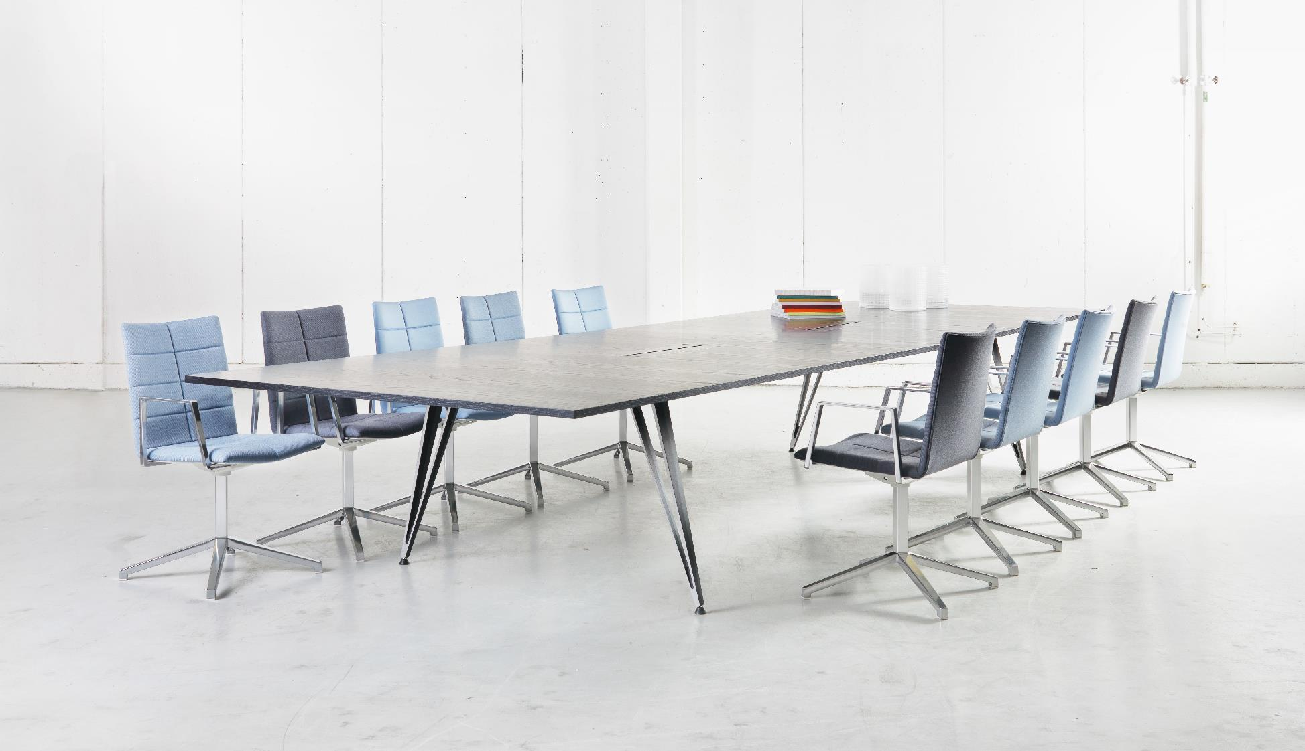
Attach table

Slide 31
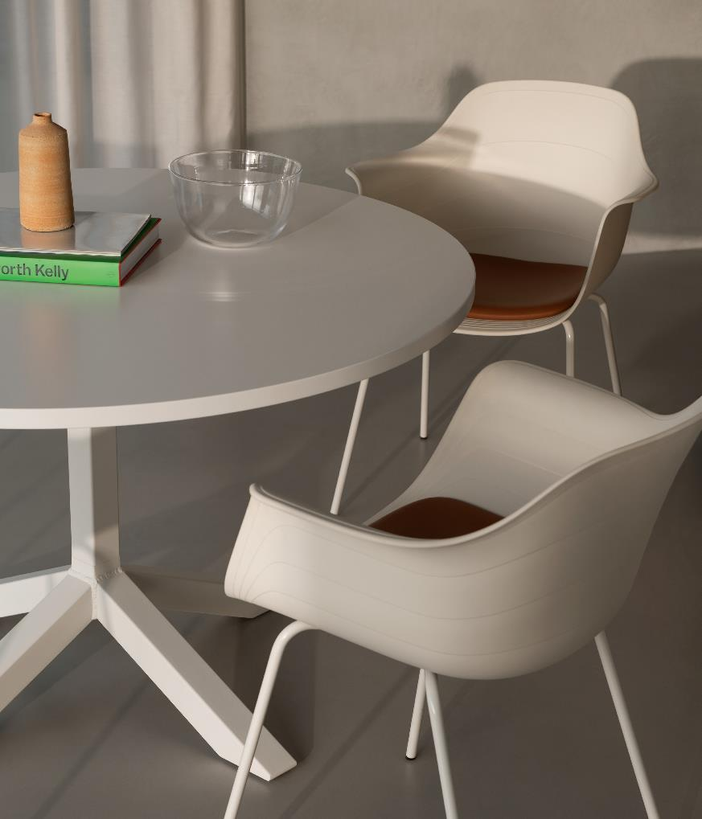
60
Grade Plus armchair and Funk table

Slide 32
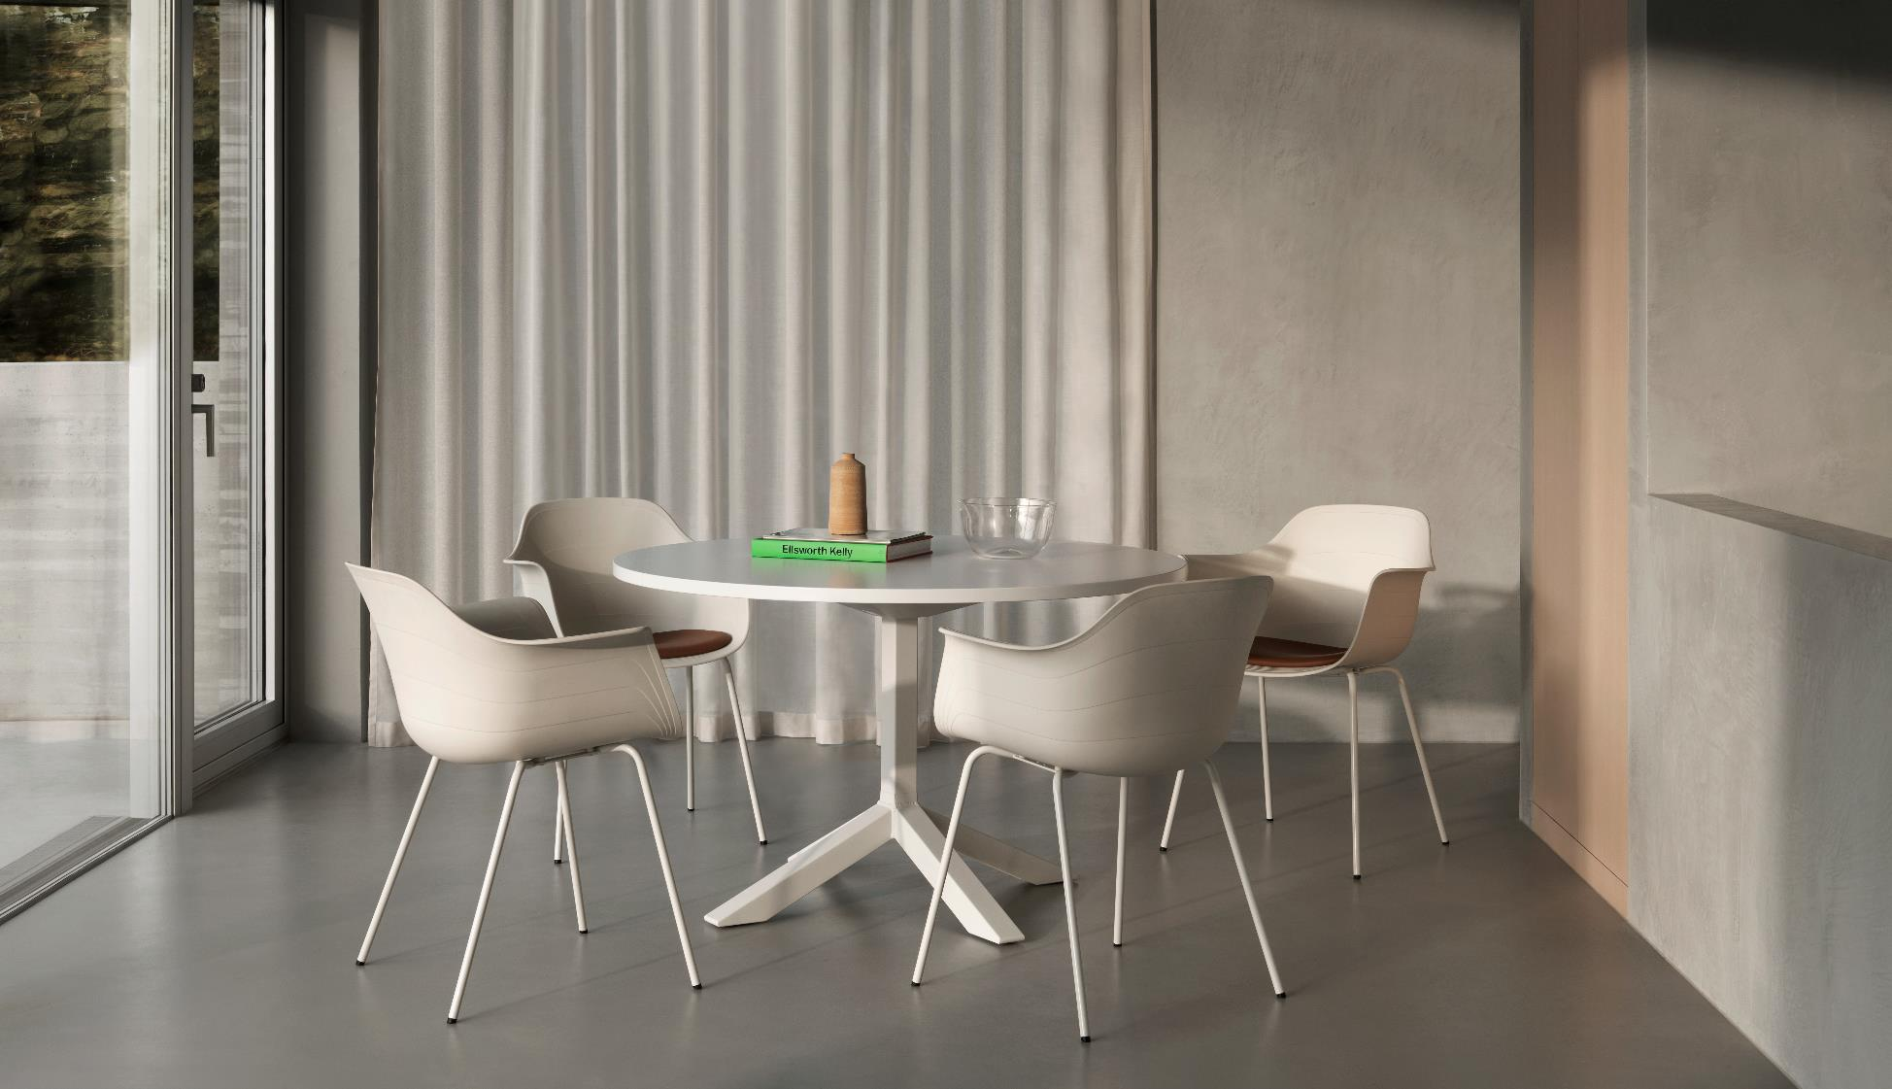
A22 is available in three different heights.

Slide 33
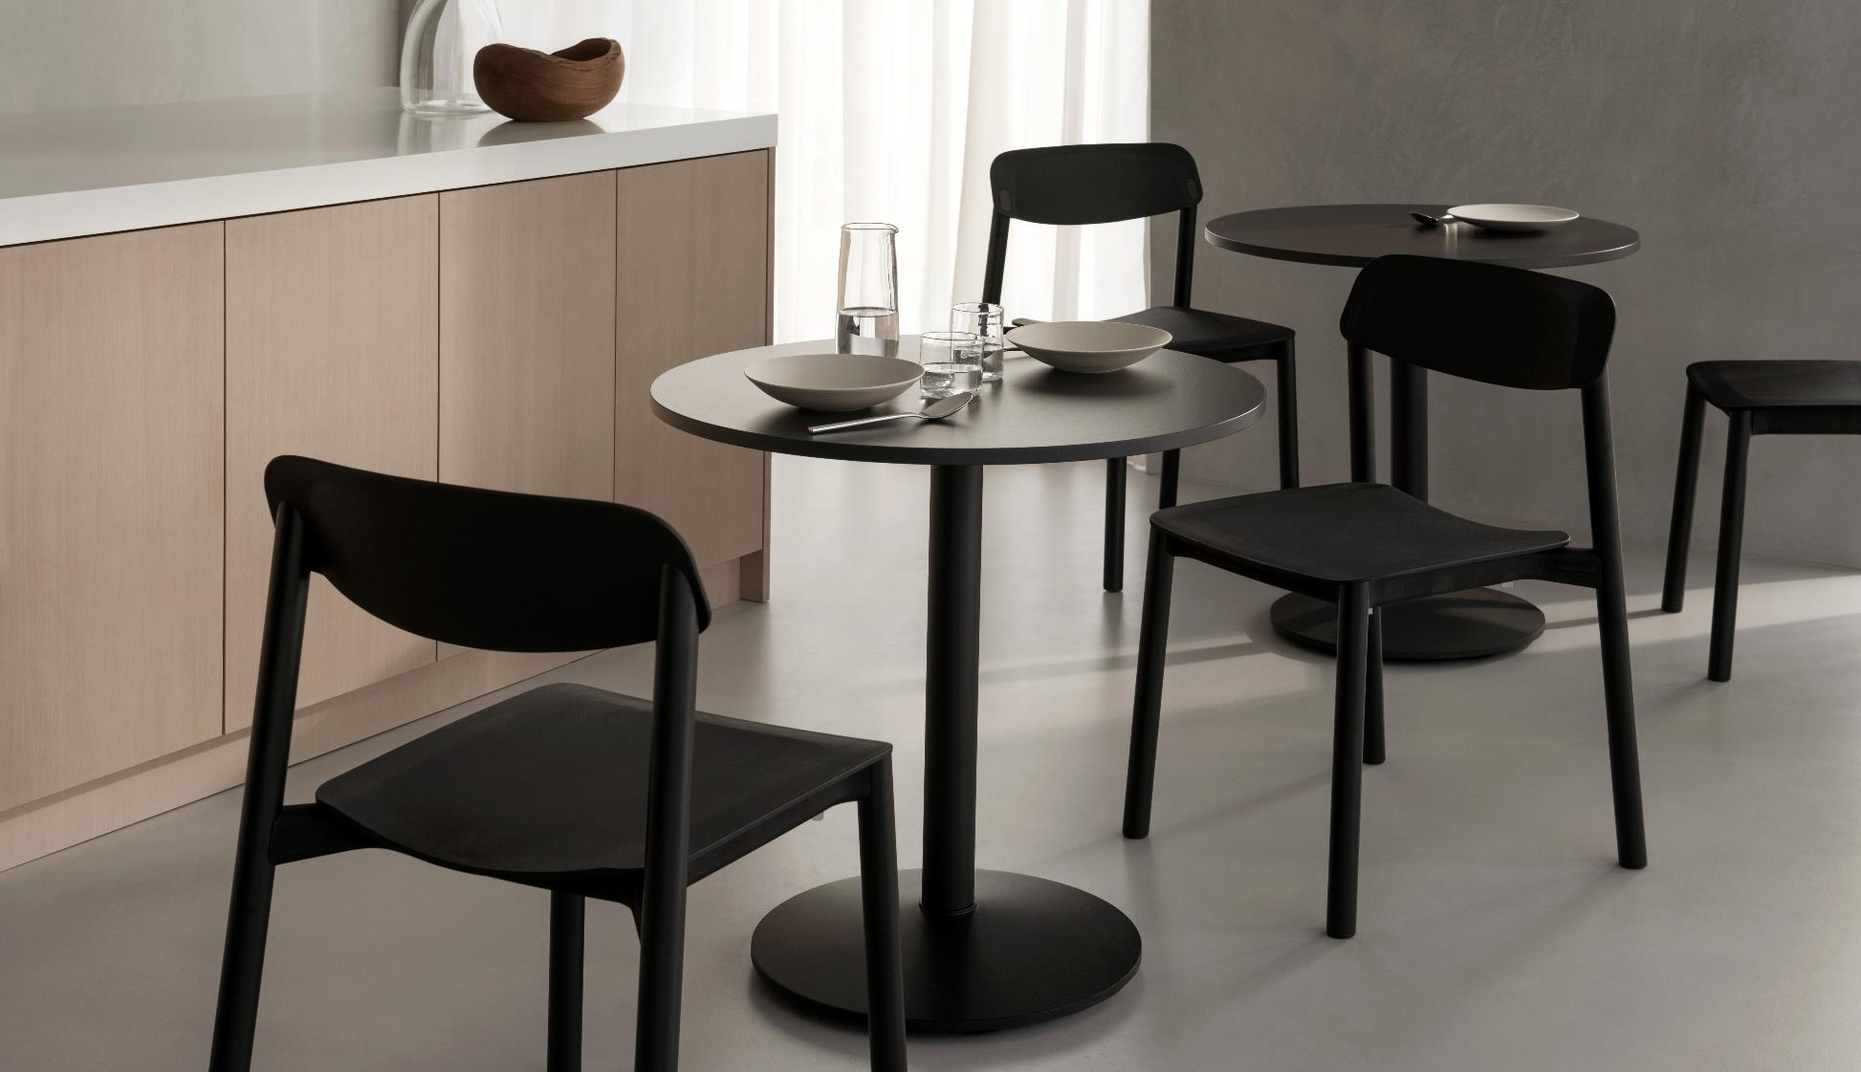
A22 is available in three different heights.
Penne chair and Campus Café table

Slide 34
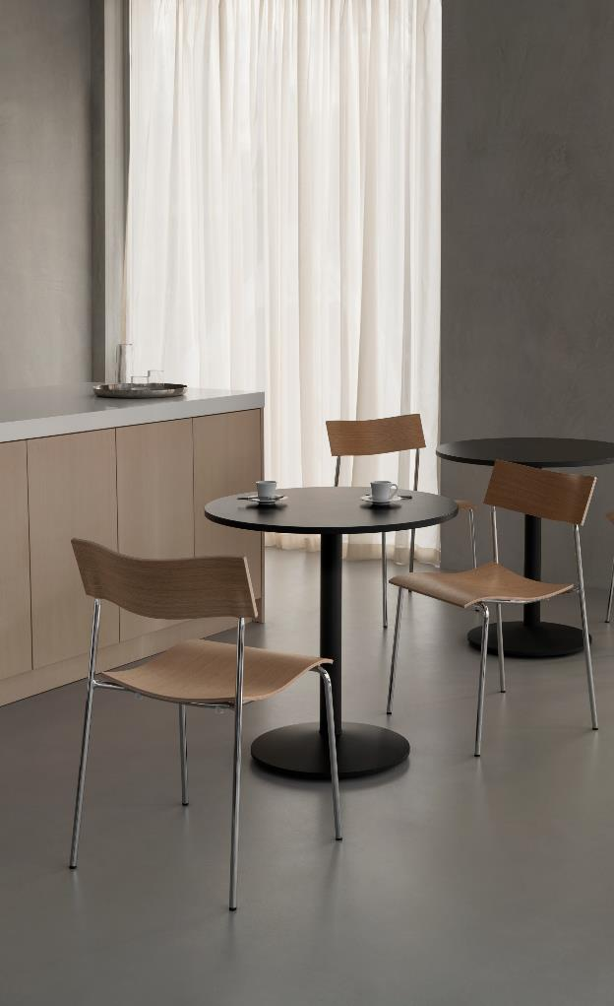
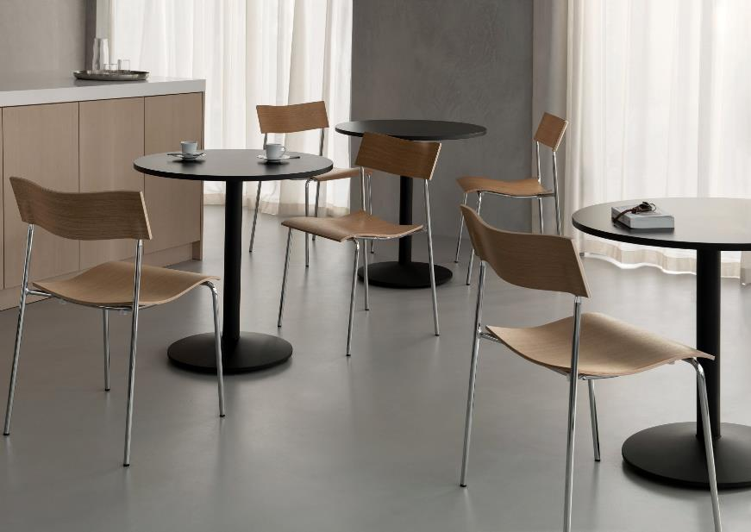
LAMMHULTS COLLECTION 66
Campus chair and Campus Café table
LAMMHULTS COLLECTION
67

Slide 35
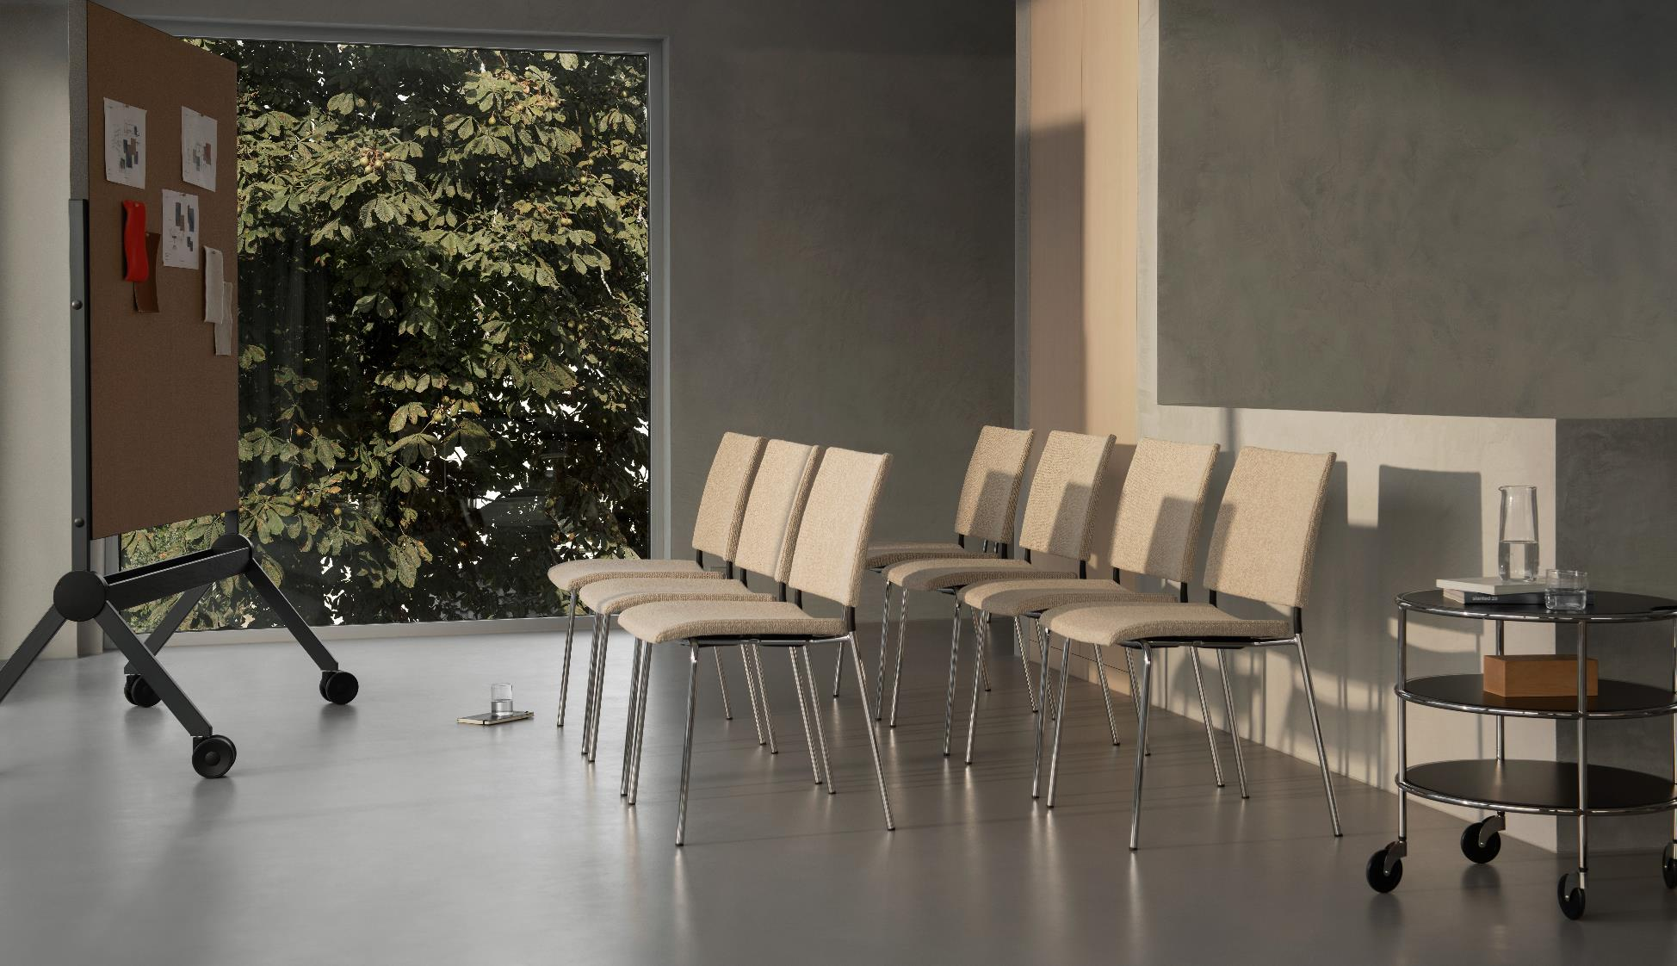
A22 is available in three different heights.
Spira chair and Chicago trolley

Slide 36
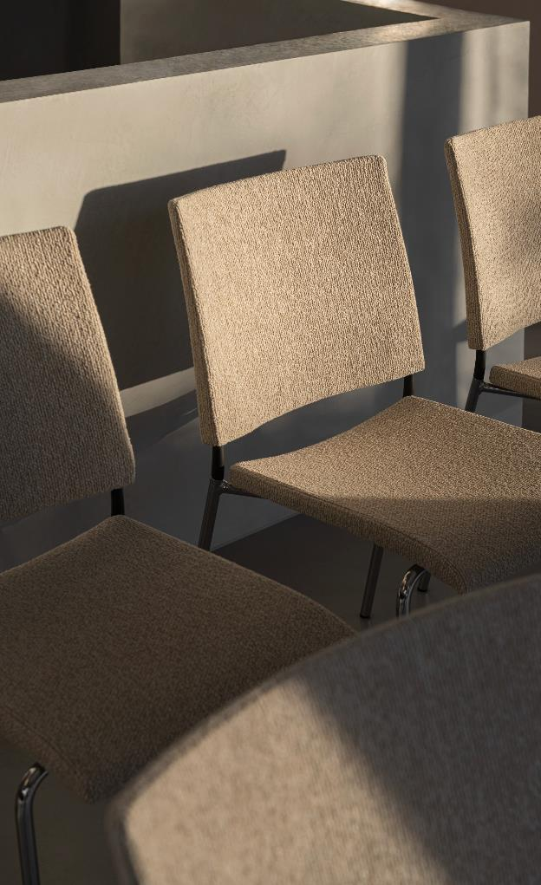
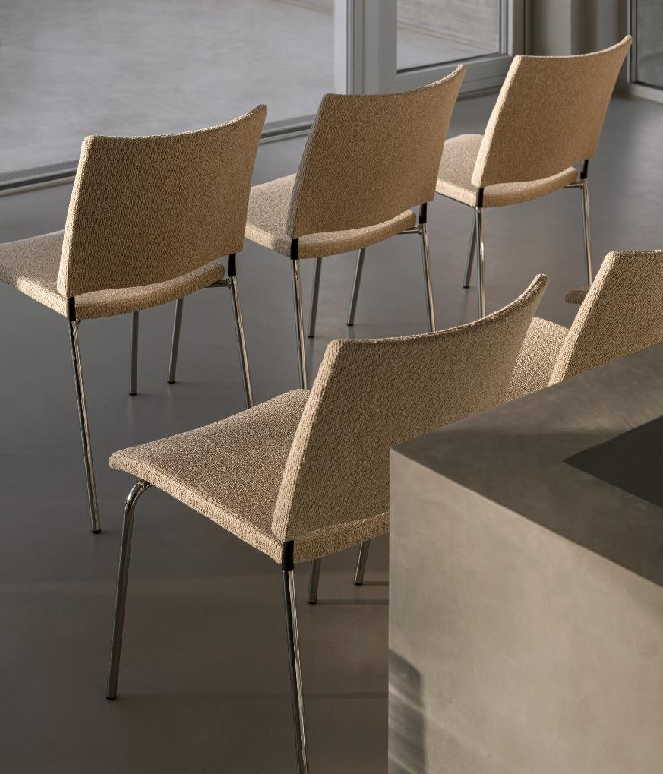
70

Slide 37
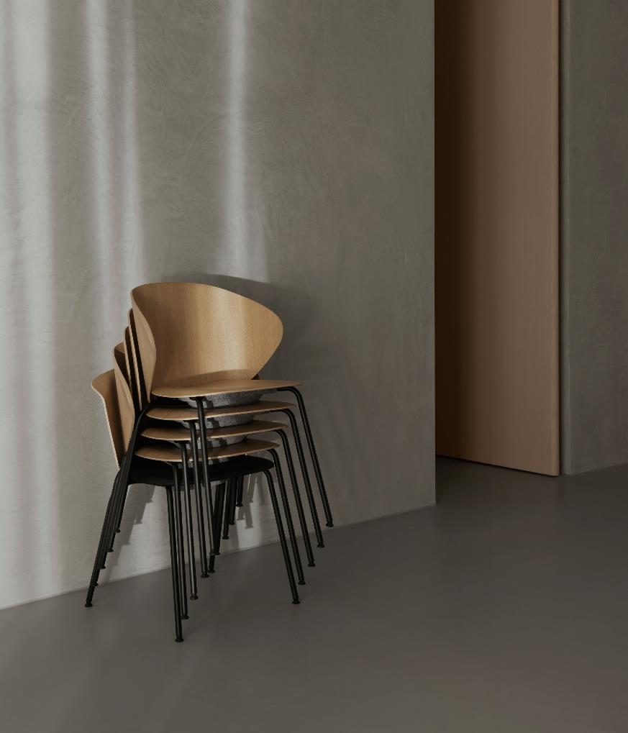
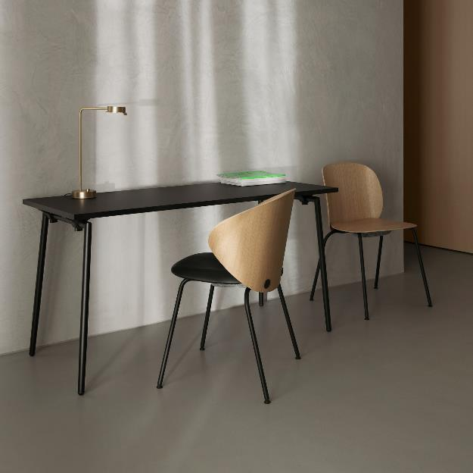
72
Trioo chair and Quickly table

Slide 38
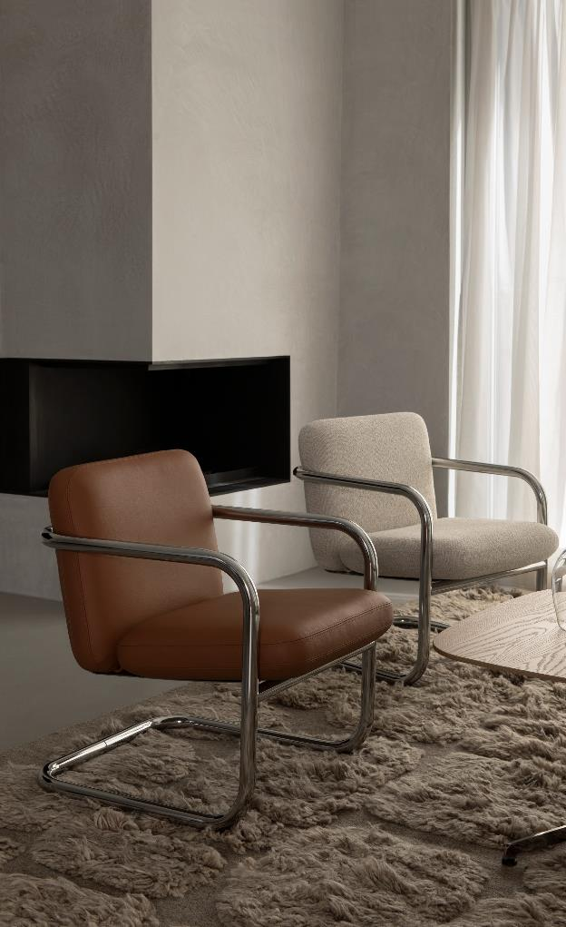
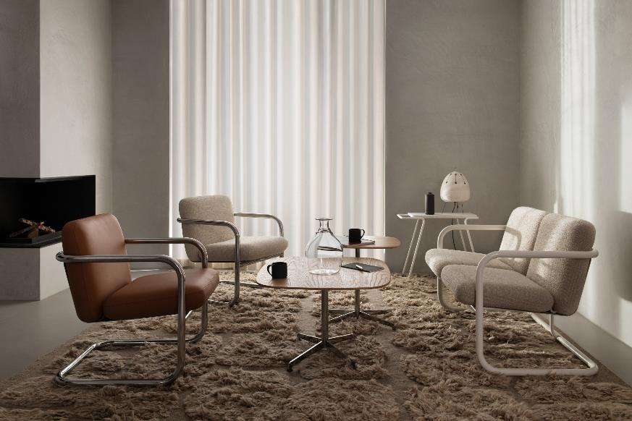
LAMMHULTS COLLECTION 74
S70-4 easy chair and S70-5 sofa with Cooper table
LAMMHULTS COLLECTION
75

Slide 39
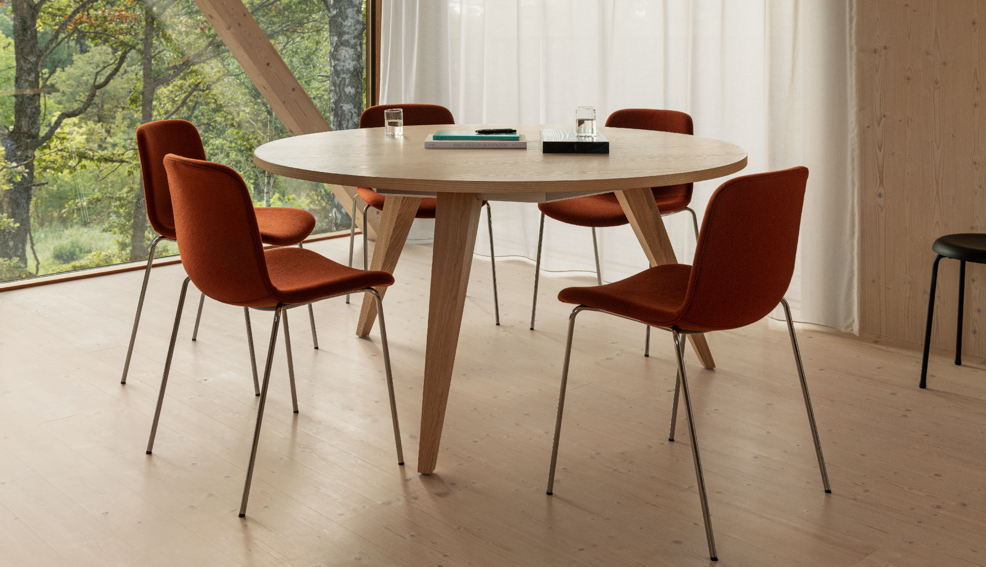
Grade chair and Ponto table

Slide 40
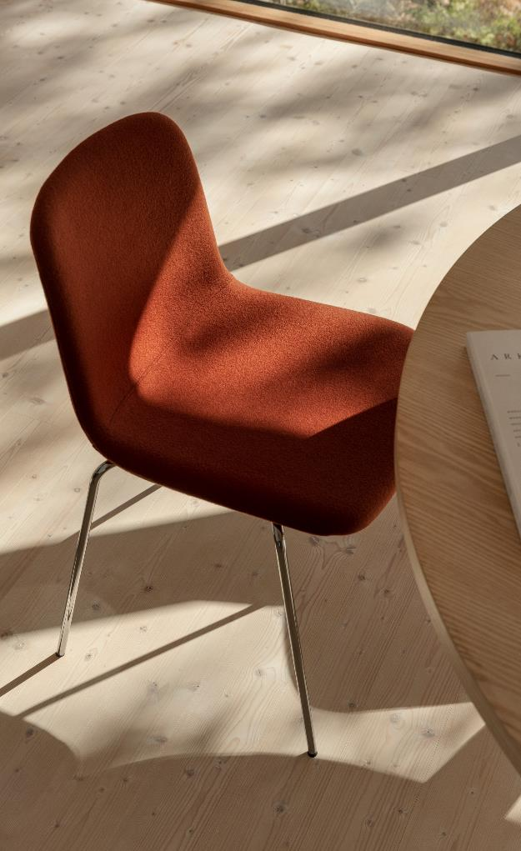
78

Slide 41
X75-2 armchair

Slide 42
82
Cargo Trolley with Carousel armchair and Ponto table

Slide 43
A22 is available in three different heights.
Carousel armchair and Ponto Table

Slide 44
ENVIRONMENTAL STATEMENT
Sandler Seating is committed to achieving good environmental practice and operating in a sustainable manner.
We wholly support and comply with or exceed the requirements of current
environmental legislation and codes of practice.
We seek to minimise our waste and then reuse or recycle as much of it as possible. We minimise energy and water usage in our buildings, vehicles and processes in order to conserve supplies, and minimise our consumption of natural resources,
especially where they are non-renewable.
We operate and maintain company vehicles (where appropriate) with due regard to en-
vironmental issues as far as reasonably practical and encourage the use of
alternative means of transport and car sharing as appropriate.
We hope to continuously improve in respect of air, water, noise and light pollution from our premises and reduce any impacts from our operations on the environment and local community.
We purchase products and services that are the least damaging to the environment and encourage others to do the same where possible.
We assess the environmental impact of any new processes or products we intend to in- troduce in advance.
All our aluminum and steel frames can be melted down and recycled. Both our rubber glides and standard fabric ranges are also recyclable.
*
Please note that colors shown in this catalog are within the limitations of the
printing process and can vary from our actual finish colors. Whenever the exact shade of a color is critical please request a finish sample prior to placing an order.
We aim to reduce our environmental impact and improve our environmental
performance as an integral part of our business strategy.
It is our priority to encourage our customers, suppliers and all business associates to do the same.

