Slide 1


2025 Preview

Slide 2
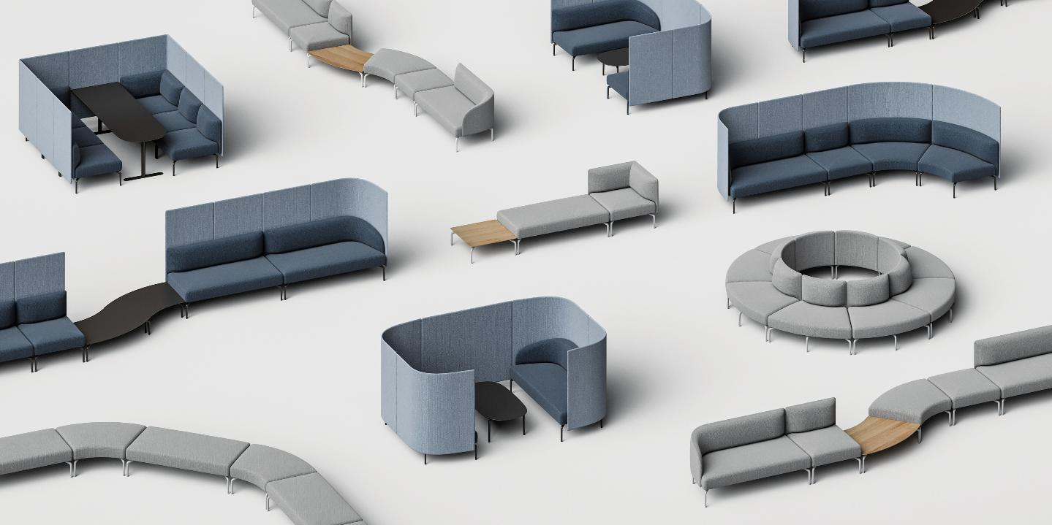

Slide 3
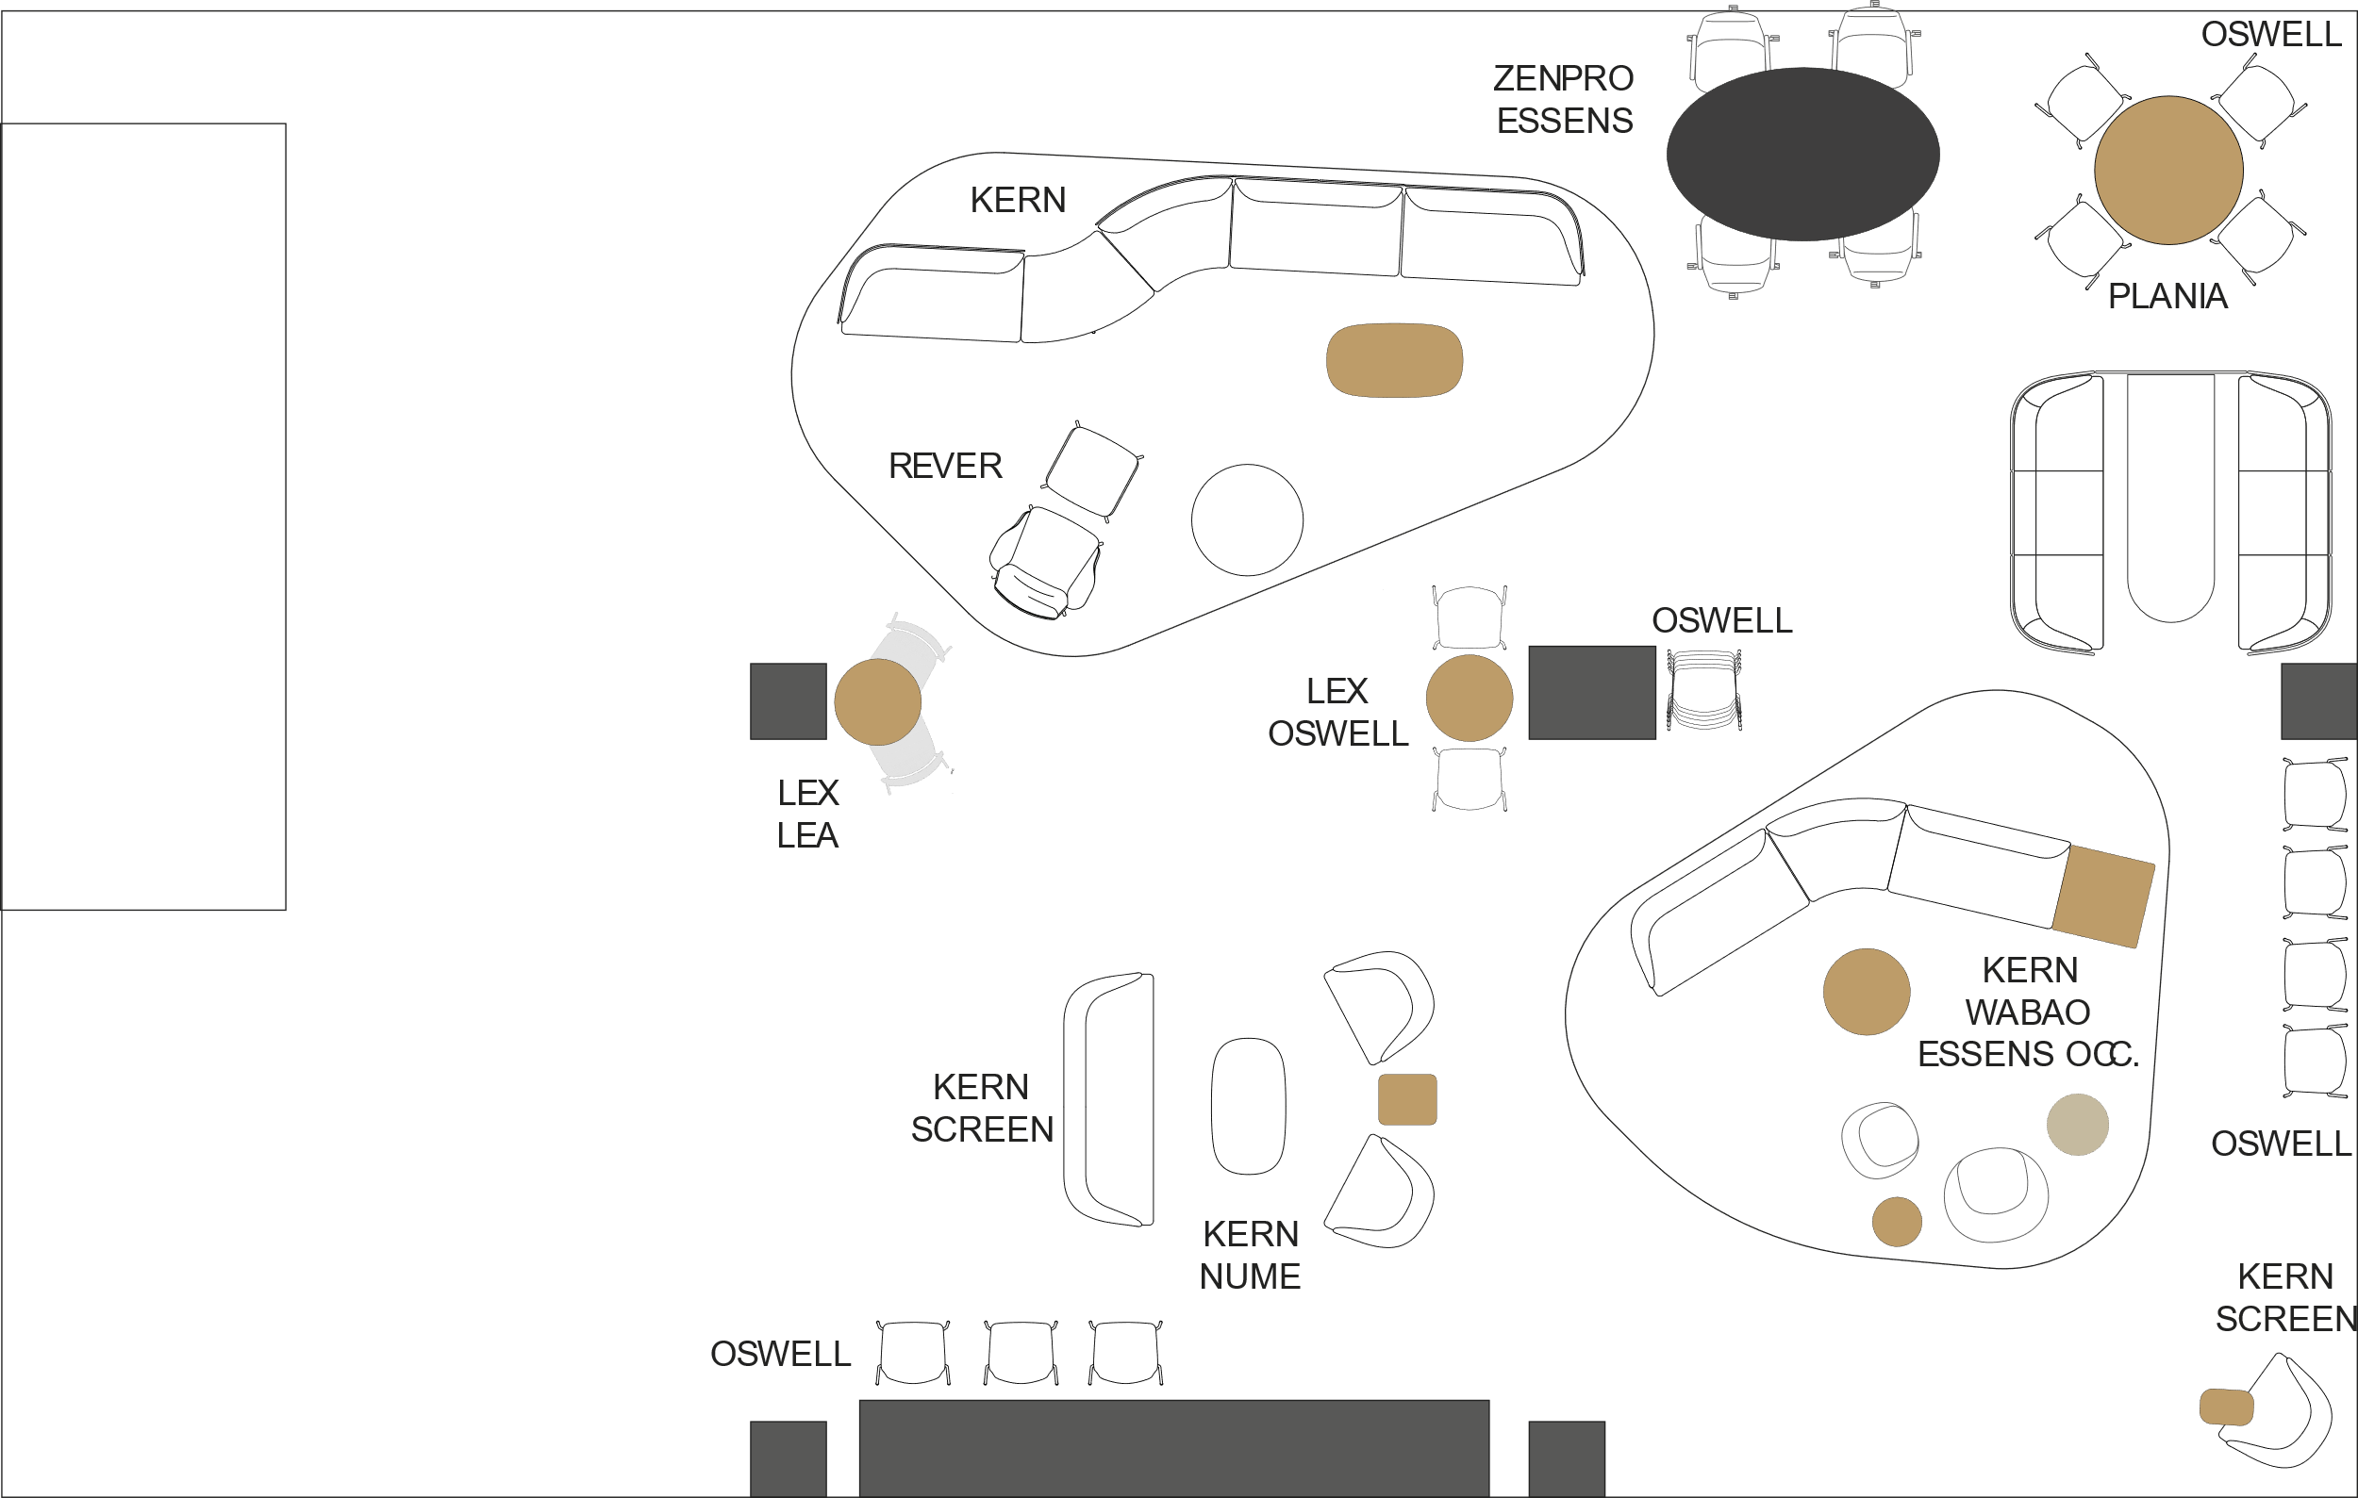
Collections
Oswell
Kern
Zenpro
Rever
Wabao
Essens
Essens occ
Lea
Plania
Nume

Slide 4
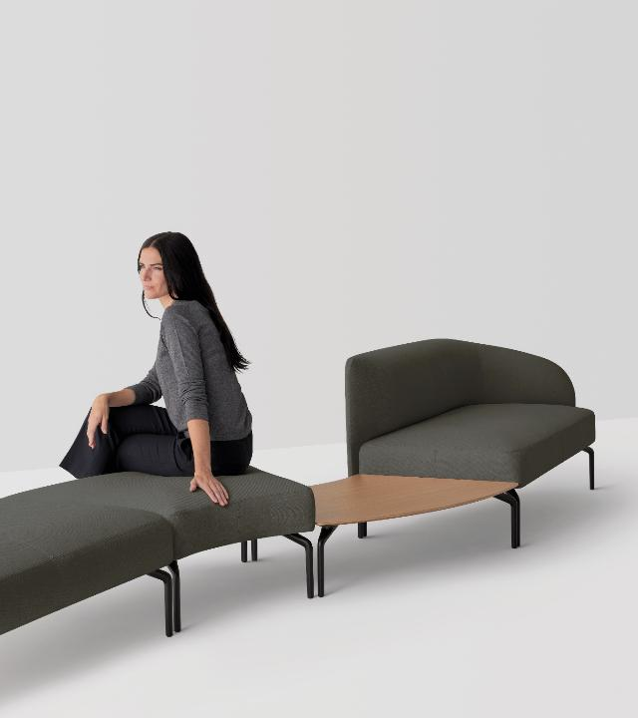
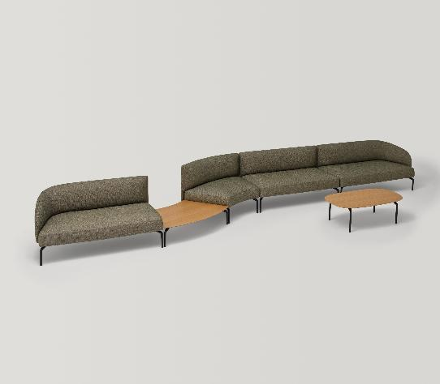
Kern
Designed by Pearson Lloyd

Slide 5
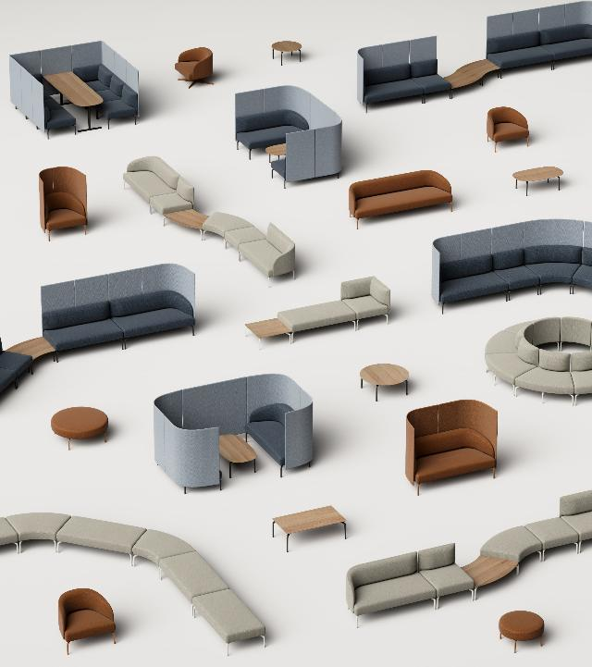
KERN is a broad system of modular seating elements designed for gathering and waiting. A fully modular family of elements that can be used independently or be freely combined to create functional and unique compositions suitable for any interaction or waiting space.
KERN modules can be easily rearranged to create modern and flexible spaces to wait, meet, work or simply relax.
Its full modular spirit and the wide variety of modules available, make it a truly adaptable and transversal system suitable for every interaction space or context.
KERN is composed by four collections: sofas, modular seats, meeting booths and occasional tables. The combination of these four collections creates a complete universe of versatile elements able to solve the needs of today´s interaction and waiting spaces.

Slide 6
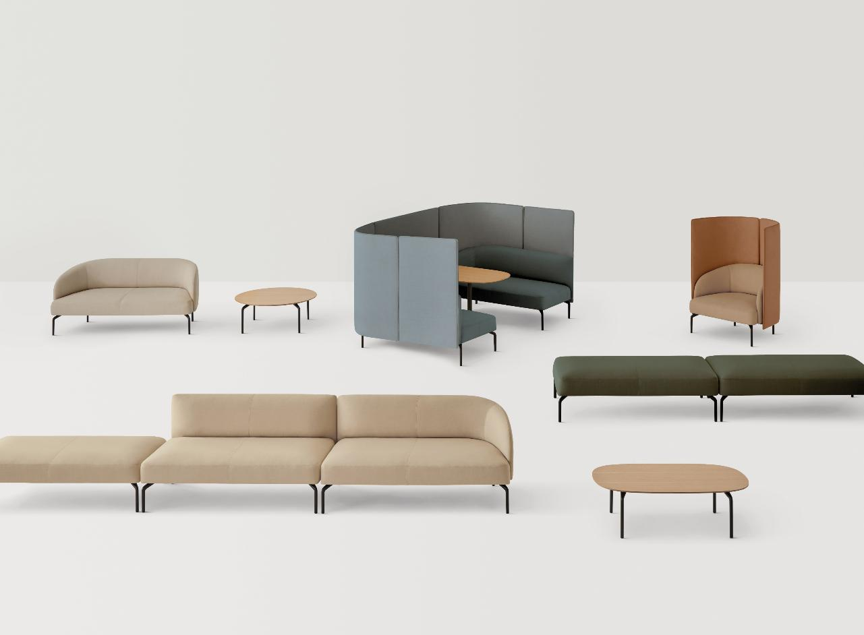
Subcollections
Sofas
Modules
Rooms
Low tables
The versatile Kern sofas can be used individually or be combined with elements from the Modules collection. Elegant and essential, the sofa collection stands out for its organic beauty and timeless design.
The Kern Modules collection offers a wide range of fully modular elements that can be used on their own or connected to form endless configurations and shapes. Designed for flexibility, these pieces effortlessly adapt to any space with fluid elegance.
In open-plan offices or halls, Kern can be configured to create rooms within a room. Intimate spaces that are ideal for casual meetings or focused work..
The collection also includes a wide range of coffee and side tables, available in various formats. These tables can stand alone or be seamlessly combined to enhance the collaborative possibilities of Kern.

Slide 7
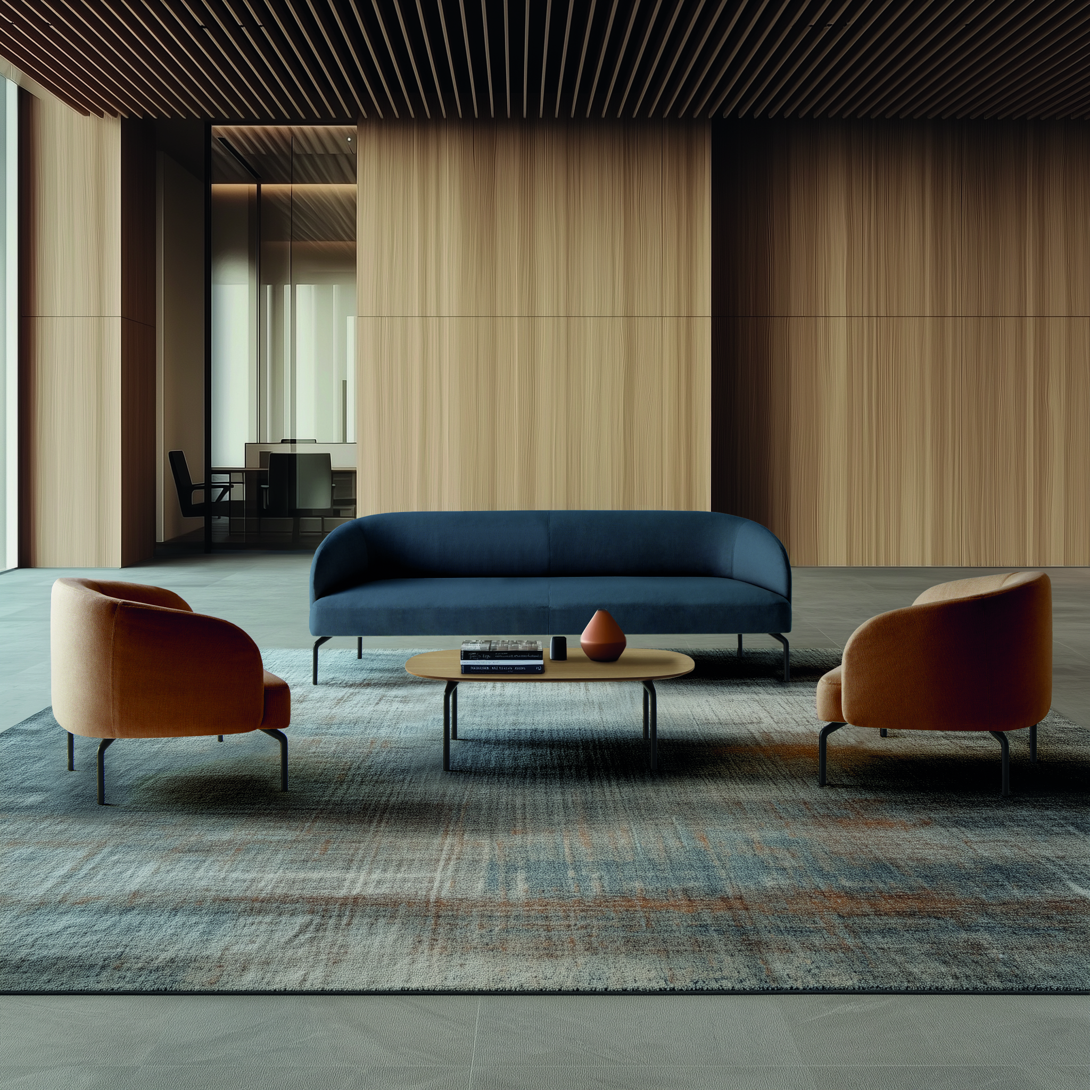
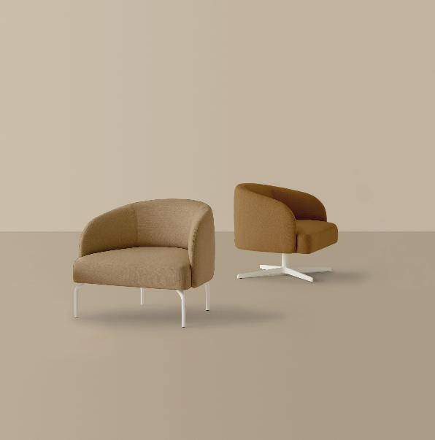

Slide 8
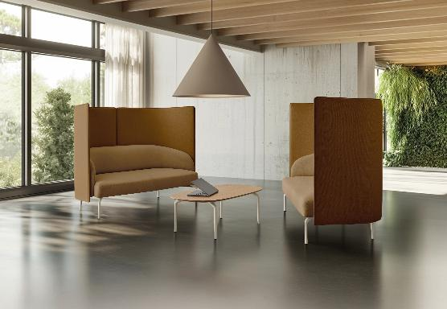
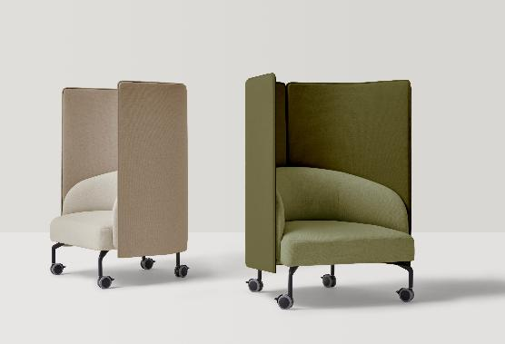

Slide 9
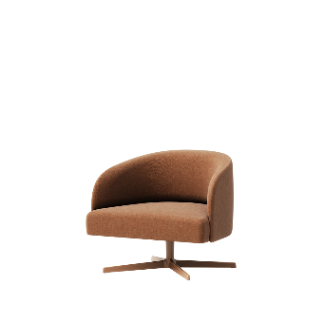
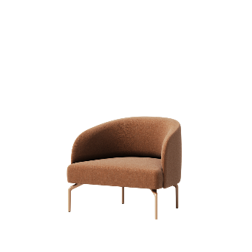
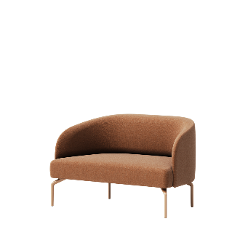
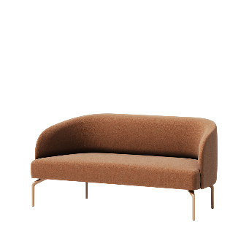
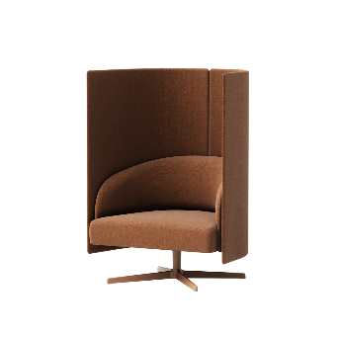
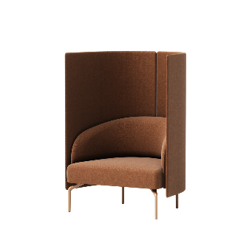
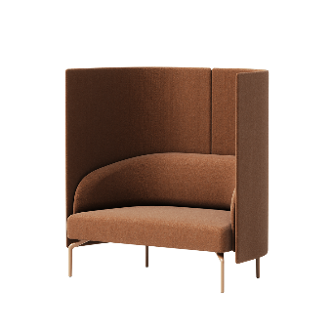
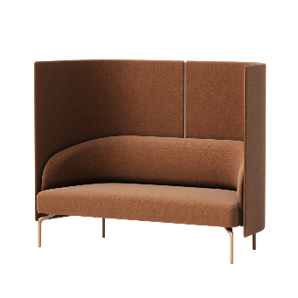
OVERVIEW
^{Armchair with swivel base}
^{28,1 x 34,6 x 29,1 h}
^{Armchair with 4 legs}
^{28,1 x 34,6 x 29,1 h}
^{Two seater sofa}
^{28,1 x 61,6 x 29,1 h}
^{Three seater sofa}
^{28,1 x 88,2 x 29,1 h}
^{Armchair with swivel base}
^{and privacy screen}
^{27 x 36,8 x 49,6 h}
^{Armchair with 4 legs}
^{and privacy screen}
^{27 x 36,8 x 49,6 h}
^{Two seater sofa}
^{and privacy screen}
^{27 x 63,8 x 49,6 h}
^{Three seater sofa}
^{and privacy screen}
^{27 x 90,4 x 49,6 h}
Notes:
Kern sofa 3 seater 7230 list. Swivel arm chair 4100 list

Slide 10
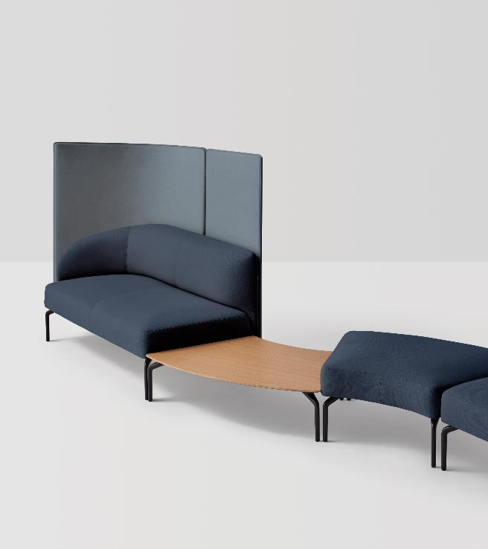
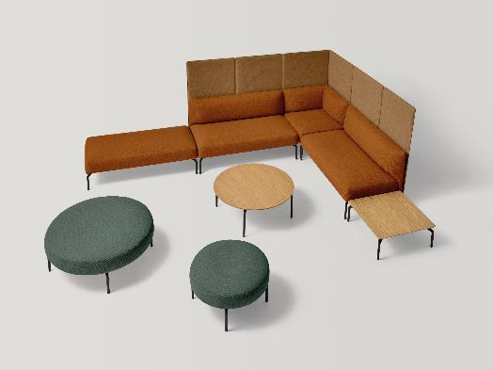
Modules

Slide 11
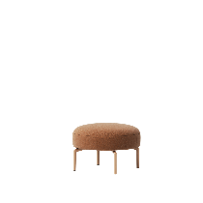
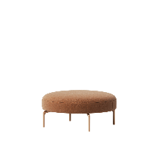
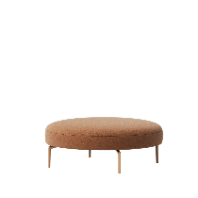
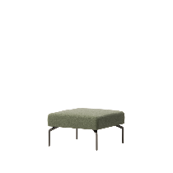
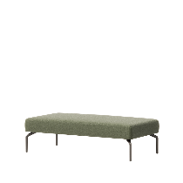
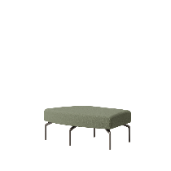
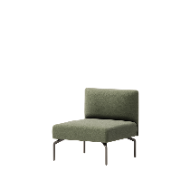
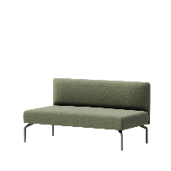
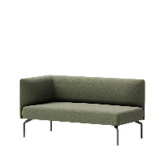
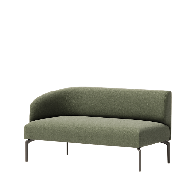
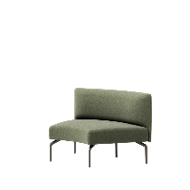
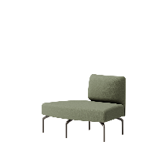
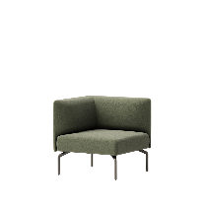
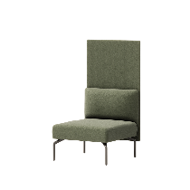
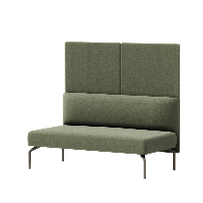
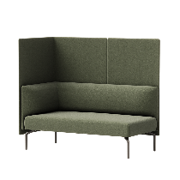
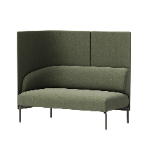
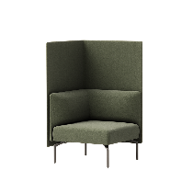
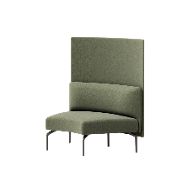
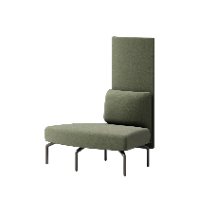
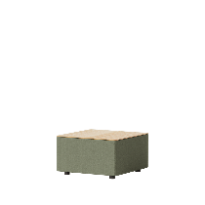
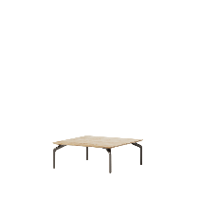
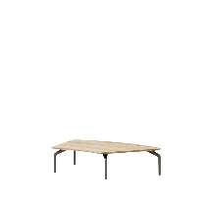
^{Round ottoman Ø70cm}
^{27,6 x 16,9 h}
^{Round ottoman Ø100cm}
^{39,4 x 16,9 h}
^{Round ottoman Ø120cm}
^{47,2 x 16,9 h}
^{One seater module}
^{28 x 28 x 16,9 h}
^{Two seater module}
^{16,9 x 53,5 x 16,9 h}
^{One seater}
^{29,7 x 44,7 x 16,9 h}
^{One seater module}
^{with backrest}
^{28,1 x 28 x 29,1 h}
^{Two seater module}
^{with backrest}
^{28,1 x 53,5 x 29,1 h}
^{Two seater module}
^{with corner backrest}
^{28,1 x 53,7 x 29,1 h}
^{Two seater module}
^{with end arm backrest}
^{28,1 x 57,9 x 29,1 h}
^{One seater concave module}
^{45º with backrest}
^{31,5 x 45,7 x 29,1 h}
^{One seater convex module}
^{45º with backrest}
^{31,5 x 44,7 x 29,1 h}
^{One seater module}
^{with corner backrest}
^{28,1 x 28,1 x 29,1}
^{One seater module}
^{with backrest}
^{and privacy screens}
^{25,8 x 25,8 x 49,6 h}
^{Two seater module}
^{with backrest}
^{and privacy screens}
^{25,8 x 54,7 x 49,6 h}
^{Two seater module}
^{with corner backrest}
^{and privacy screens}
^{29,7 x 55,7 x 49,6 h}
^{Two seater module}
^{with end arm backrest}
^{and privacy screens}
^{27 x 55,7 x 49,6 h}
^{One seater module}
^{with corner backrest}
^{and privacy screens}
^{29,7 x 29,1 x 49,6 h}
^{One seater concave module 45º}
^{with backrest}
^{and privacy screens}
^{45,3 x 49,6 h}
^{One seater convex module 45º}
^{with backrest}
^{and privacy screens}
^{45,3 x 49,6 h}
^{Electrificable table}
^{27,6 x 27,6 x 16,9 h}
^{Connecting side table 70x70}
^{27,6 x 27,6 x 10,2 h}
^{Concave/convex side table 45º}
^{28,7 x 43,7 x 10,2 h}

Slide 12
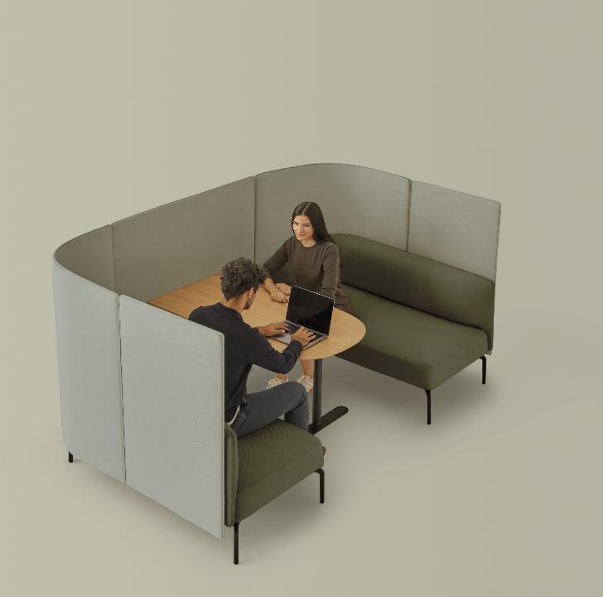
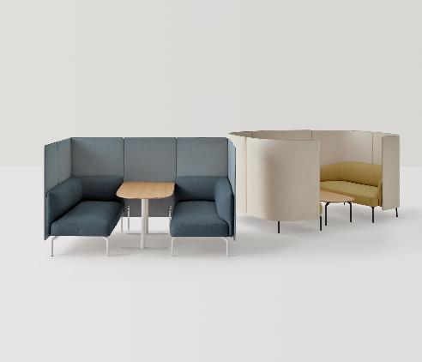
Rooms

Slide 13
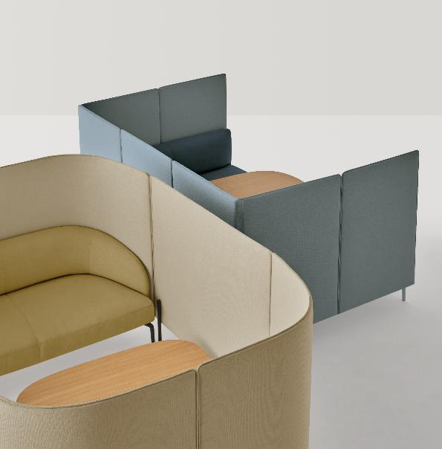
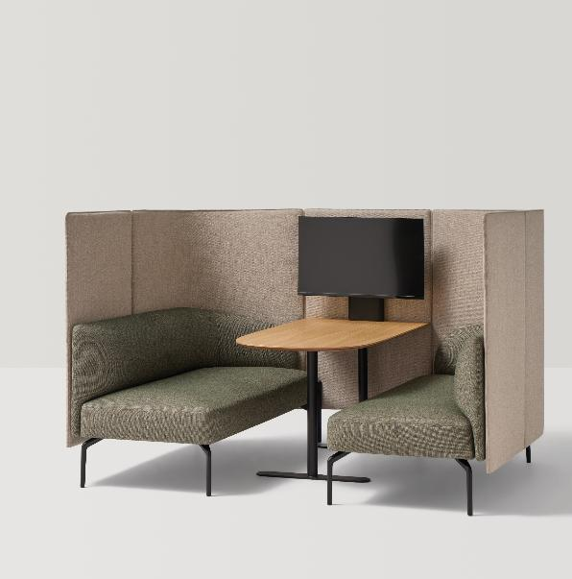

Slide 14
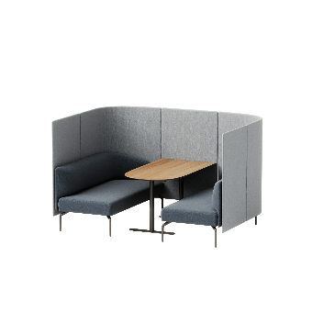
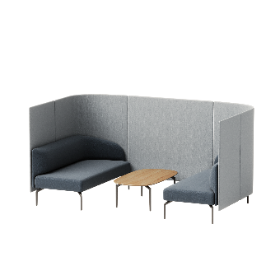
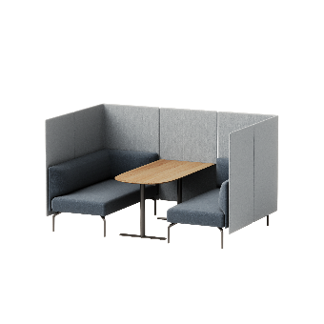



COMPOSITION EXAMPLES
^{Configuration 1}
^{82,6 x 62,9 x 49,6 h}
^{Configuration 2}
^{102,3 x 58,2 x 49,6 h}
^{Configuration 3}
^{87,4 x 55,9 x 49,6 h}
^{Configuration 4}
^{107 x 55,9 x 49,6 h}
^{Configuration 5}
^{82,6 x 62,9 x 49,6 h}
^{Configuration 6}
^{102,3 x 89,7 x 49,6 h}

Slide 15








ELECTRIFICATION
ACCESORIES
^{Meeting table L.130cm}
^{for 4 position room}
^{27,5 x 51,1 x 25,5 h}
^{Meeting table L.130cm}
^{for 4 position room}
^{27,5 x 51,1 x 25,5 h}
^{Meeting table L.200cm}
^{for 6 position room}
^{27,5 x 78,7 x 25,5 h}
^{Meeting table L.200cm}
^{for 6 position room}
^{27,5 x 78,7 x 25,5 h}

Slide 16


Low tables
Notes:
Oval in veneer – 1570 list

Slide 17






OVERVIEW
^{Round side table}
^{Ø23,6 x 13,7 h}
^{Round coffe table}
^{Ø35,4 x 13,7 h}
^{Oval coffe table}
^{43,3 x 23,6 x 13,7 h}
^{Squad side table}
^{27,5 x 27,5 x 13,7 h}
^{Squad coffe table}
^{35,4 x 35,4 x 13,7 h}
^{Rectangular coffe table}
^{43,3 x 23,6 x 13,7 h}

Slide 18


Notes:
Poly/ 4 leg Steel approx 500list. Sled poly approx 600 list

Slide 19



Slide 20


Notes:
Wood legs poly approx 900. fully upholstered 1500 list.

Slide 21



Slide 22




Slide 23


Floe
Notes:
TBD on pricing

Slide 24



Slide 25


Slide 26



Slide 27


Zenpro
Designed by Mario Ruiz

Slide 28


Notes:
Highback chrome 3590 list midback 3160 list

Slide 29



Slide 30



Slide 31



Slide 32



Slide 33








OVERVIEW
VERTICAL STITCHING UPHOLSTERY
^{Swivel high back armchair}
^{with 5 spoke base on casters}
^{Ø28,7 x 50,7 h}
^{Swivel medium back armchair}
^{with 5 spoke base on casters}
^{Ø28,7 x 43,7 h}
^{Swivel low back armchair}
^{with 5 spoke base on casters}
^{Ø28,7 x 38,1 h}
^{Swivel low back armchair}
^{with 4 spoke base}
^{Ø29,1 x 34,4 h}
HORIZONTAL STITCHING UPHOLSTERY
^{Swivel high back armchair}
^{with 5 spoke base on casters}
^{Ø28,7 x 50,7 h}
^{Swivel medium back armchair}
^{with 5 spoke base on casters}
^{Ø28,7 x 43,7 h}
^{Swivel low back armchair}
^{with 5 spoke base on casters}
^{Ø28,7 x 38,1 h}
^{Swivel low back armchair}
^{with 4 spoke base}
^{Ø29,1 x 34,4 h}

Slide 34







MOVEMENT OPTIONS
ARM FINISHES
^{Black}
Swivel with gas lift. Swivel base on casters.
Seat height adjustment with gas lift.
Synchronized mechanism. Swivel base on casters.
Seat height adjustment with gas lift. Synchronized tilt
movement of the seat and back. Four locking positions.
Tension adjustment to user weight.
UPHOLSTERY OPTIONS
^{White}
^{Vertical stitching upholstery}
Horizontal stitching upholstery
^{Polished}

Slide 35

Notes:
ODDA armchair – 2150 list. 2 seater 3270 list

Slide 36

Notes:
Armchair 2410 list. 3 seater 4820. 2 seater 3490 list

Slide 37

Notes:
2.1 – 1640 list. 2.2XL 2820 list

Slide 38

Notes:
Zelda starts 600 list

Slide 39



Notes:
Stools 1250 list

Slide 40


Slide 41


Slide 42


Slide 43




Slide 44



Notes:
Albany (left), Soho (top right), Hadley (bottom right) range 300 – 400 list

Slide 45


Notes:
Horizontal slats – Soho w/ Step nesting tables tables range 980 list – up.

Slide 46

Notes:
Plus 360 indoor/ outdoor tables, cross base.

Slide 47

Notes:
Vertical slats – Saratoga outdoor w/ plus 360 tables

Slide 48



Slide 49


Notes:
Danielle high back lounge starts 4430 list – 5100 list w/ Chanel

Slide 50


Notes:
Nala from Montbel – pricing TBD

Slide 51

Notes:
Daisy + ottoman

Slide 52



Notes:
Daisy from Montbel – less than tablet by approx 15-20%

Slide 53



Notes:
Airy

Slide 54


Notes:
Rose lounge approx 5000 list wood legs, metal 5700 list w/ Kona table

Slide 55


Slide 56


Notes:
Luma air

Slide 57

Notes:
Benchi pricing not avail. Built to spec.

Slide 58


Slide 59



Slide 60


Slide 61


Notes:
Tender lounge, sofa

Slide 62



Notes:
Tender – 3 configurations. Lounge – 7890 list, ottoman 3320 list, and side table w/ lounge 9160 list

Slide 63


Notes:
Sabre 4650 list

Slide 64

Notes:
Bright chair 2580 list

Slide 65


Slide 66


Notes:
Alpha table 12270 list w/ Eli wood back. 1890 list

Slide 67


Notes:
Eli total wood dining 1890 list

Slide 68



Notes:
Little K

Slide 69


